Slide 1
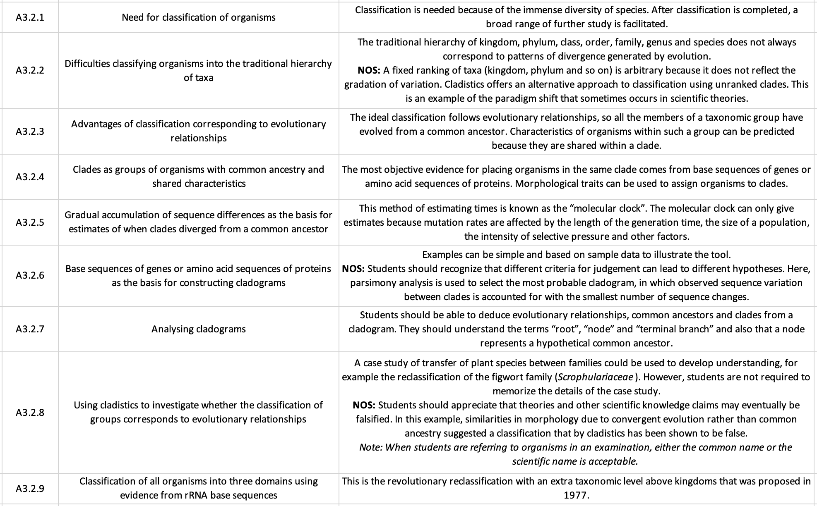
AHL Learning Outcomes
iPad notes will replace these at a later date

Slide 2

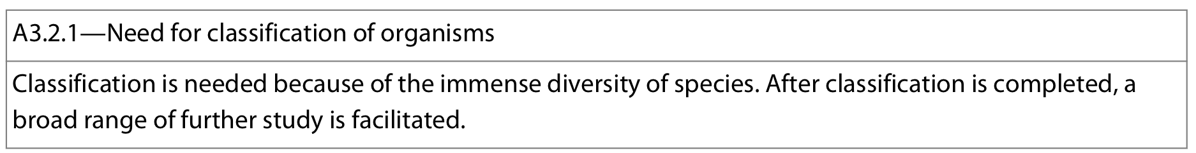
Earth has immense biodiversity, where estimates are placed anywhere from several million to over a trillion different species!
Classification: the arrangement of organisms in taxonomic groups according to similarities. Classification necessity and use:
Identify unknown organism: greatly facilitates the process of deducing the identity of an unknown organism by using hierarchy of traits to pinpoint the appropriate taxa
Information storage and retrieval: classification facilitates how information regarding different species are stored and then retrieved for use. Also, classification prevents recording the same species more than once or incorrect grouping
Research into evolutionary origins: Accurate classification allows scientists to determine the evolutionary relationships between species, i.e. shared ancestry and estimated time of divergence
Allows conservation to take place when needed: It is not possible to conserve a species if we don't know that it exists
ex: if several species are incorrectly classified as one species, then the extinction of what might be thought of as one local population could actually result in the extinction of an entire species
Facilitates medical research and disease treatment: classification allows scientists to identify properties within groups which can be used in medicine development or disease prevention/treatment
ex: if one plant species is known to have medicinal properties, then it is possible to quickly identify others by looking at its close relatives; this is much faster than just selecting plants at random for research
ex: SARS-CoV-2 was quickly classified as being a coronavirus, providing medics with information about how it might affect the body, and how to go about developing a vaccine
Predictive value: species in a taxon share traits, so the characteristics of a species can be predicted based on its taxon

Slide 3
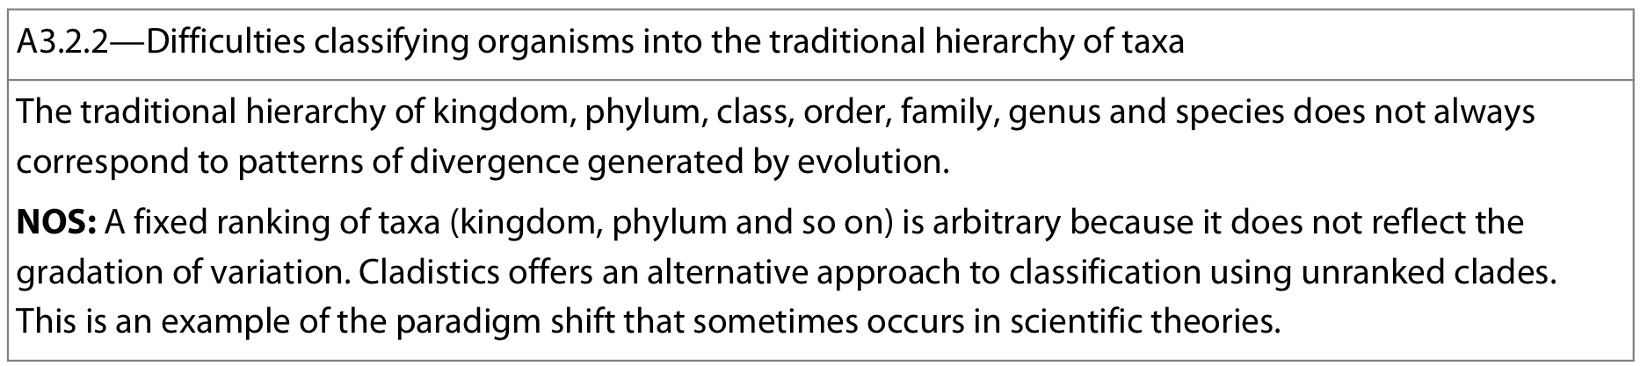
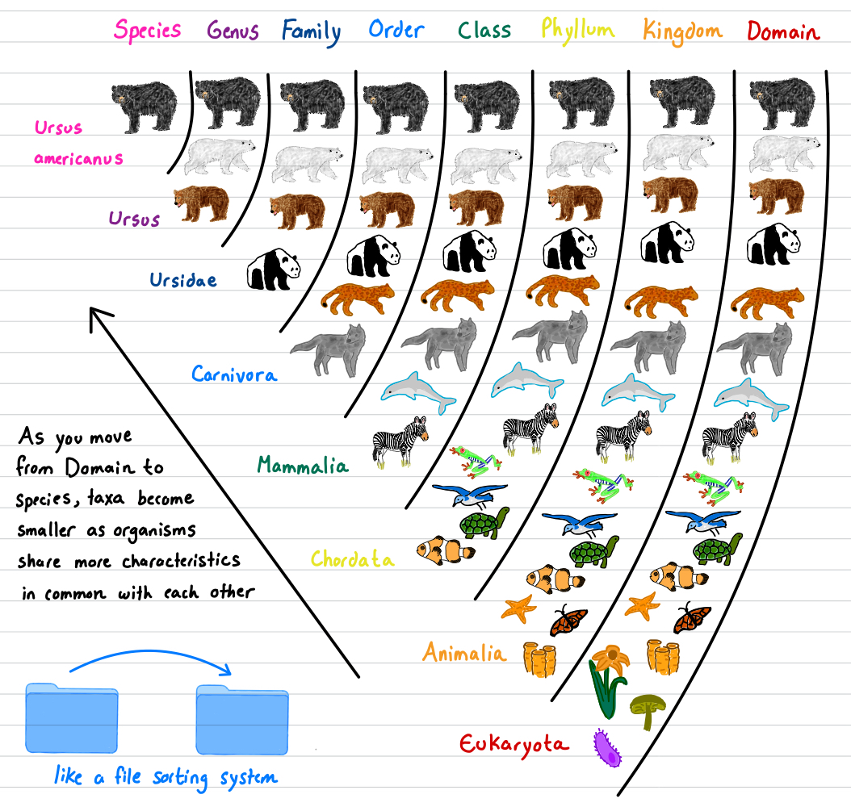
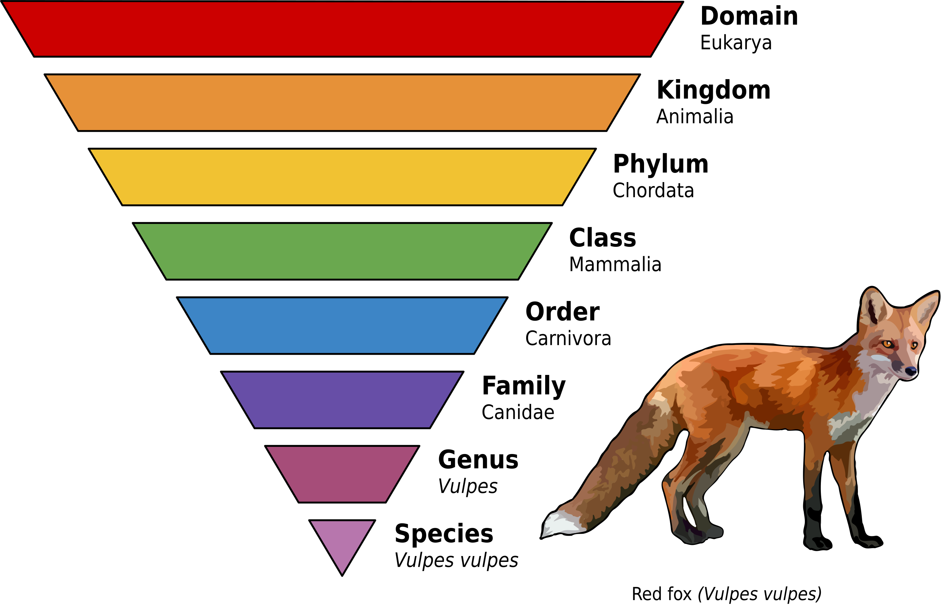
Organisms are classified into these traditional taxa (singular, taxon):
Notes:
Do
King
Penguins
Congregate
On
Frozen
Ground
Sometimes

Slide 4
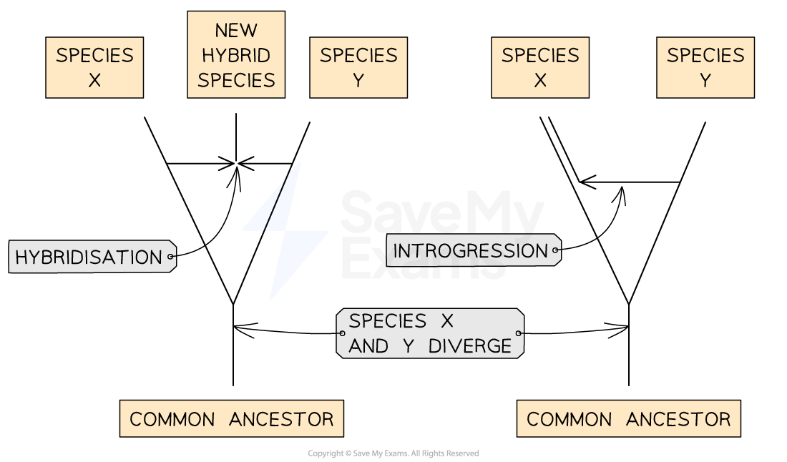
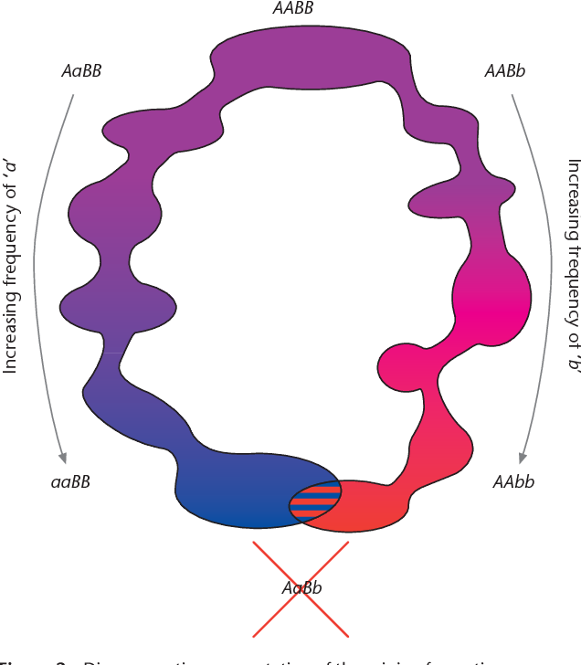
However this system has some problems:
Unclear and subjective when two populations should be grouped as separate species (A3.1). Ultimately contrived and does not always reflect evolutionary history and divergence
Introgression: transfer of genetic material between species following hybridization and backcrossing to the parental species. Demonstrates difficulty in species classification as the resulting offspring after several generations do not fit completely into either species, but neither does it seem to make sense to classify them as a new species
A fixed ranking of taxa is arbitrary – one taxonomist might argue traits in a group of species are similar enough to form a genus; another may think them different enough to form a family
Distinct taxa does not reflect gradation of variation and gradual divergence of species and larger groups over time. As species in a genus diverge from each other, there will eventally be sufficient diversity for the genus to split into two or more separate ones. The instant in time when these separations occurred cannot be determined objectively
Hirearchy poses issues in re-classification: if an organism is moved from one taxon to another, does this mean all other members of that taxon should be moved as well?
Notes:
Introgression in easier words: .when the offspring of a cross between two species goes on to breed only with members of one of its parent species.

Slide 5
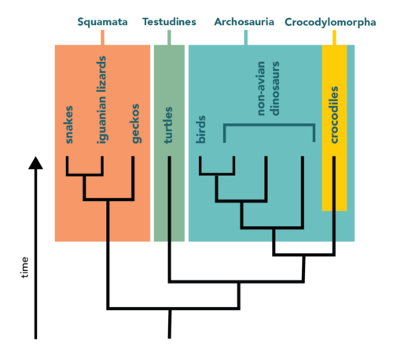
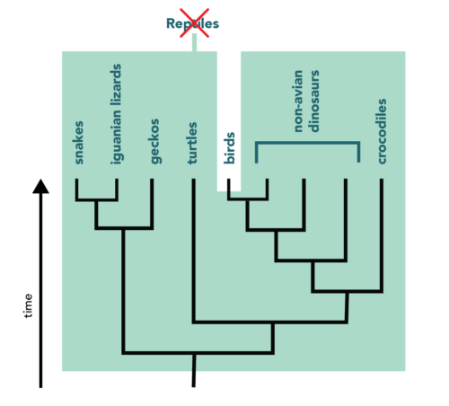
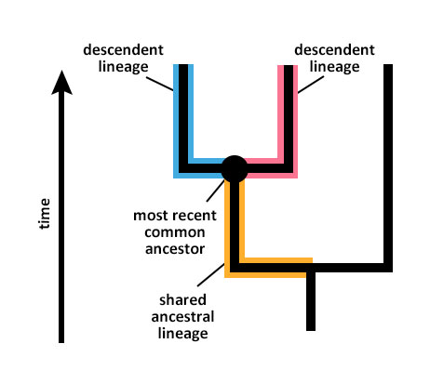
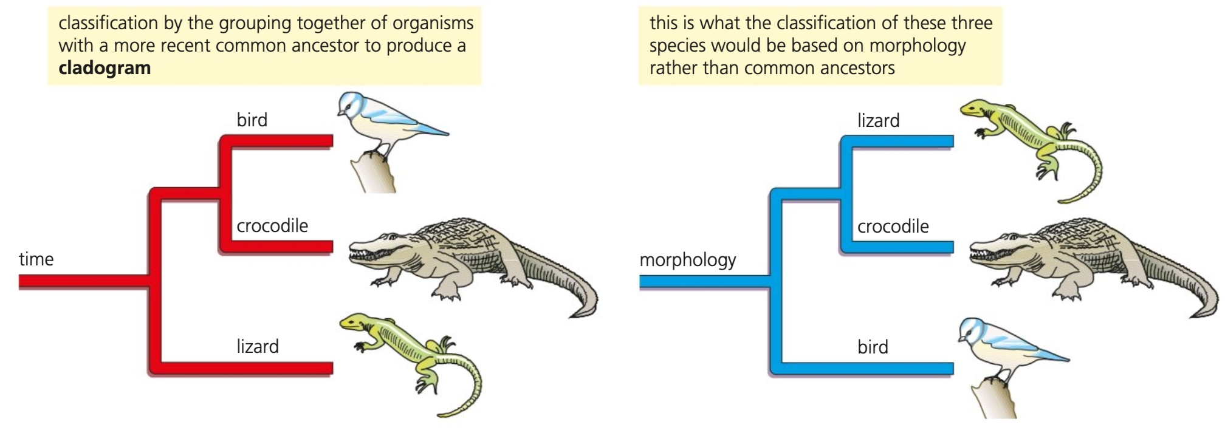
Ideally, classification should follow evolutionary relationships, so all members of a taxonomic group have evolved from a common ancester, showing unbroken lines of evolutionary descent → clade
Two criteria to achieve this:
Every organism that has evolved from a common ancestor is included in the same taxonomic group
In each taxonomic group, all the species are evolved from the same common ancestor
Reptiles do not form a clade under this system. That means that either “reptile” is not a valid phylogenetic grouping or we have to start thinking of birds as reptiles
Classification which correspond to evolutionary relationships is advantageous:
All members of a clade will share characteristics inherited from a common ancestor → synapomorphies
Can be used to predict characteristics:
Ex: new species of bat is discovered. As a mammal, we can make predictions with reasonable certainty: four chambered heart, hair, mammary glands, placenta, etc.
Notes:
Syn = shared
Apo = derived
Morphy = form or trait
Shared newly evolved trait
Ex:
hair in mammals
Four limbs with digits in tetrapods

Slide 6
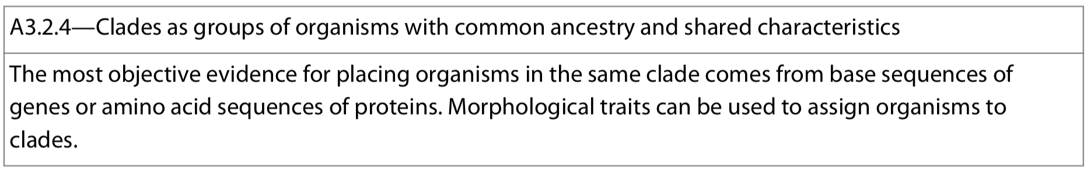
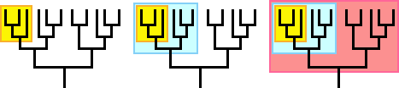
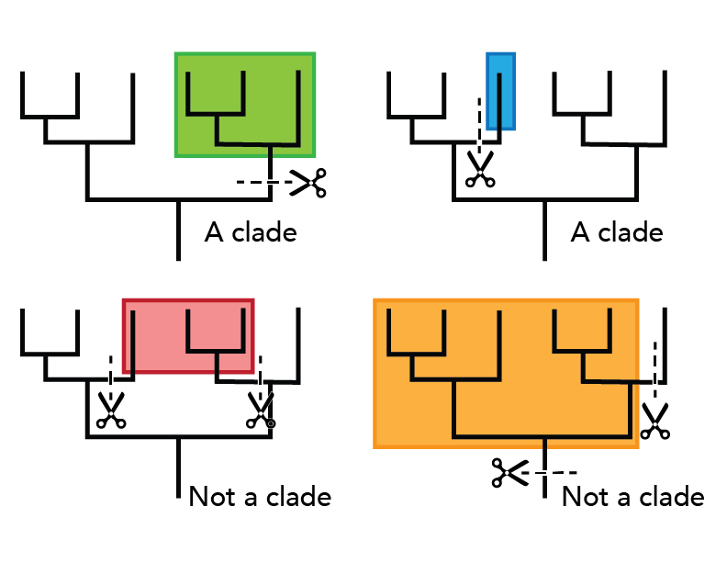
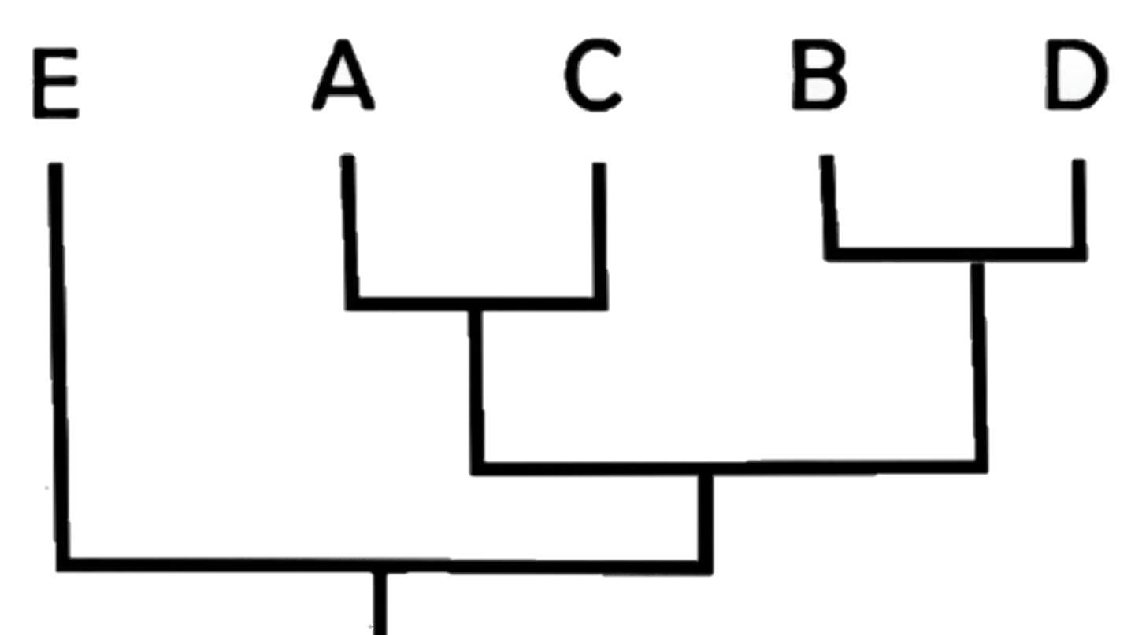
Clade: group of organisms with common ancestry and shared charcateristics.
Each clade consists of an ancestral organism and all of its evolutionary descendants
members of a clade will possess common characteristics as a result of their shared evolutionary lineage
Clades are nested within one another — they form a nested hierarchy.
Cladistics is about identifying evolutionary relationships between organisms
The most objective method for grouping species into clades is the use of sequence data from:
Gene DNA sequences
RNA sequences (mRNA, rRNA)
Amino acids sequence in polypeptide
Mitochondrial DNA (mtDNA)

Slide 7
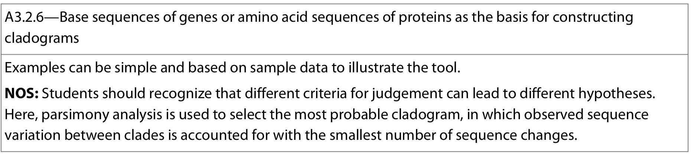
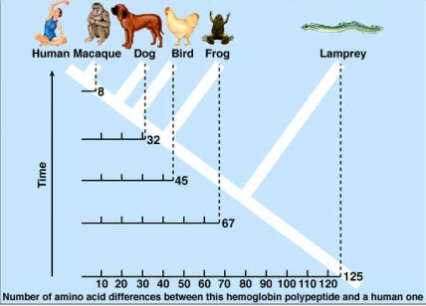
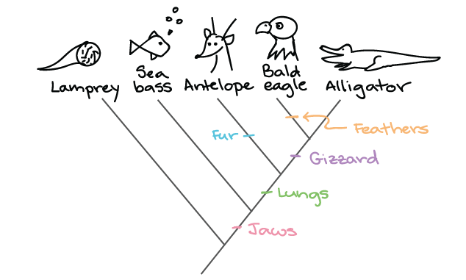
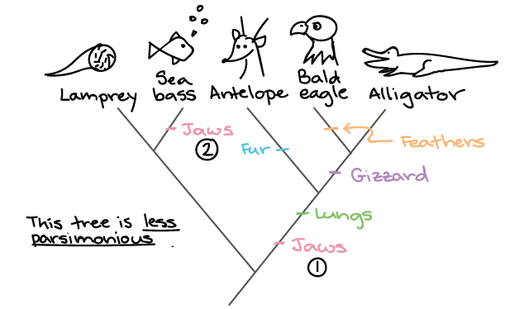
For all types of sequence data → more similar the sequences, the more closely related the species
Two groups of organisms with very similar sequences have separated into separate species more recently than two groups with less similarity in their sequences
Species that have been separated for longer have had a greater amount of time to accumulate mutations and changes to their DNA and potentially amino acid sequences
If sequence data not available, morphological traits can be used (ex: extinct organisms)
Note: phylogentic trees are hypotheses
Principle of Parsimony: a particular sequence variation/trait will (likely) occur/evolve once rather than independently
→ provides the criteria for the construction of cladograms
we choose the simplest explanation that can account for our observations. i.e. choose the tree that requires the fewest independent genetic events (appearances or disappearances of traits) to take place.
Ideally compare several versions that were produced independently and used different genes
Notes:
https://www.khanacademy.org/science/ap-biology/natural-selection/phylogeny/a/building-an-evolutionary-tree

Slide 8
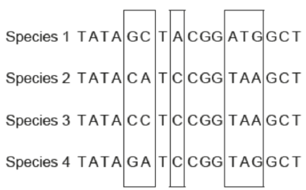
Question 1
The DNA base sequences in a gene coding for a particular protein in four different species are shown. Locations where mutations have occurred resulting in changes to the base sequences are outlined in boxes.
Based on the data provided, construct a cladogram showing the most likely phylogenetic relationship
Question 2
The amino acid sequences for protein X was deduced for 5 species. Differences between the amino acid sequence is provided in the table on the right.
Based on the data provided, construct a cladogram showing the most likely phylogenetic relationship
 | Species A | Species B | Species C | Species D | Species E
Species A |  | 4 | 2 | 6 | 10
Species B |  |  | 6 | 1 | 11
Species C |  |  |  | 5 | 9
Species D |  |  |  |  | 12

Slide 9
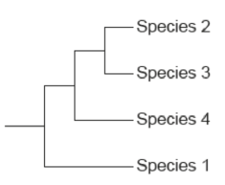
Question 1 - solution
Question 2 - solution
Species 1 has the most mutations, it is the most dissimilar (outgroup_. Species 2 and 3 have the fewest differences, most closely related to each other
Species E has the most differences and is the outgroup. Species A has the fewest differences with C and likewise with B and D

Slide 10
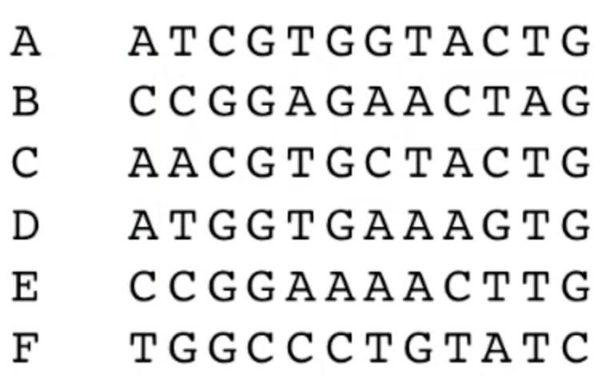
CHALLENGE Question – use the sequences to create a probable cladogram for sepcies A - F

Slide 11
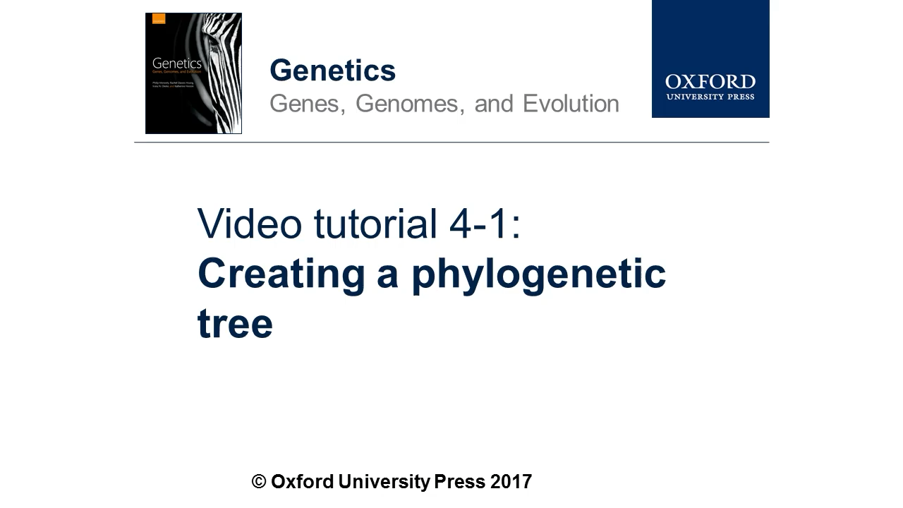
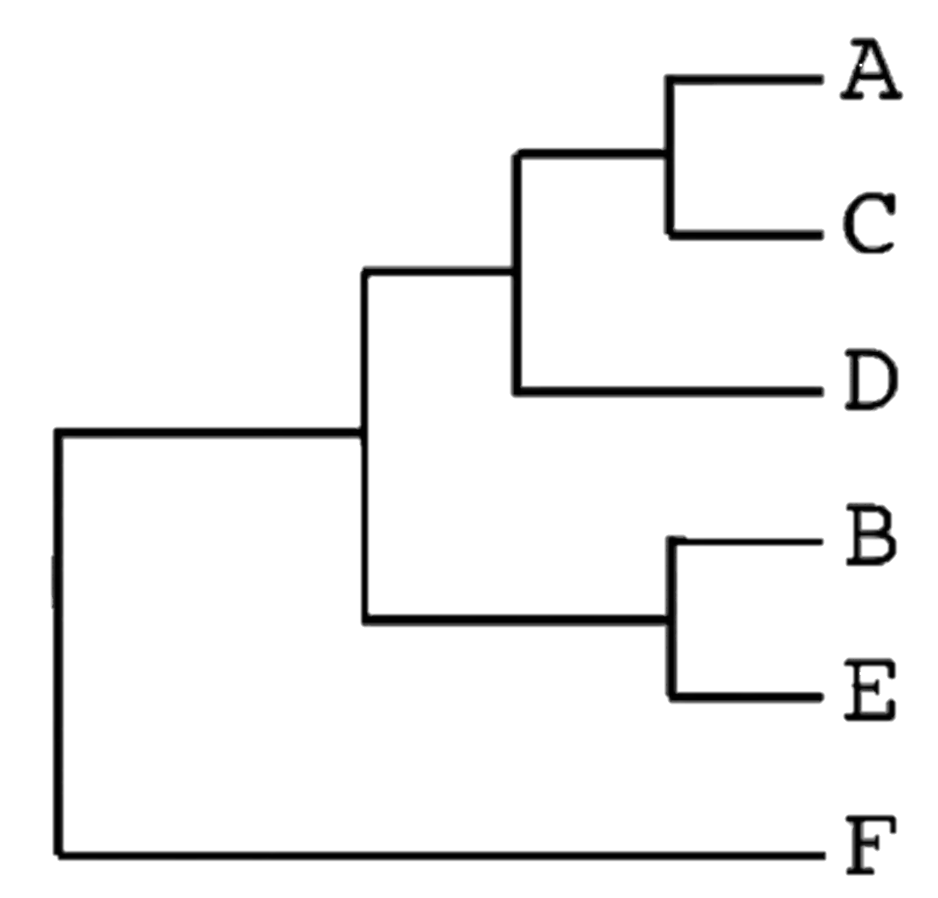
CHALLENGE Question - solution

Slide 12
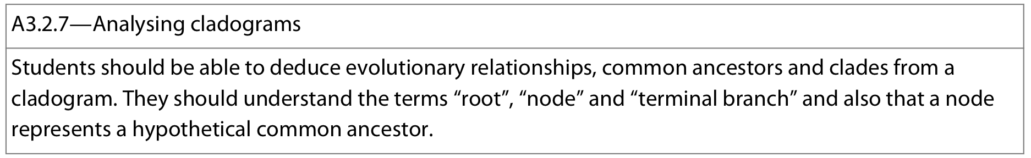
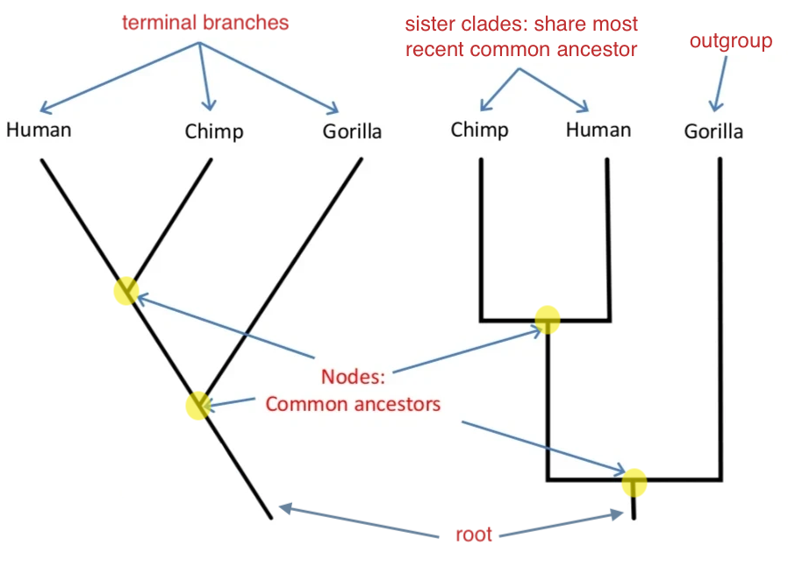
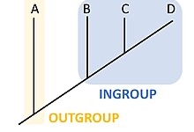
Root: central base of a cladogram. The hypothetical common ancestor to all clades in the cladogram
Node: Represents a hypothetical common ancestor for the clades split from it. The point at which the common ancestor split to form two or more clades (speciation event)
Terminal branches: represent individual clades (can be any taxonomic group: species, genus, etc.) Data exists for these organisms
Outgroup: more distantly related group of organisms that serves as a reference group when determining the evolutionary relationships of the ingroup. The outgroup is used as a
point of comparison for the
ingroup and specifically allows
for the phylogeny to be rooted.

Slide 13
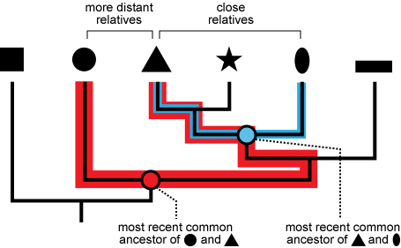
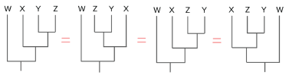
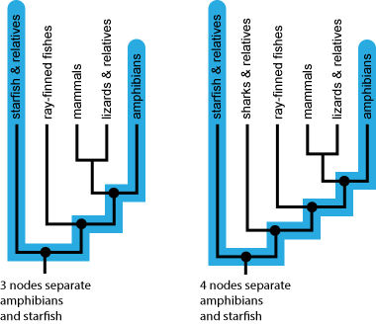
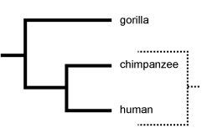
Tips in reading cladograms
the proximity to taxon to each other doesn't matter
→ true indicator of evolutionary relatedness is the age off a common ancestor. Taxa that share a MRCAA are more closely related than taxa whose MRCA is older
the order of taxon doesn't matter
→ focus only on branching pattern
number of nodes separating two taxa doesn't indicate relatedness
→ only the age of the MRCAA
number of nodes depends on how many taxa are included in the cladogram
terminal taxa are not descendents of each other
→ Each terminal taxon has a separate evolutionary lineage that can be traced back to ancestors shared with the other taxa in the tree at some point the past, making them the equivalent of evolutionary cousins
Cousins, not ancestors/descendents

Slide 14
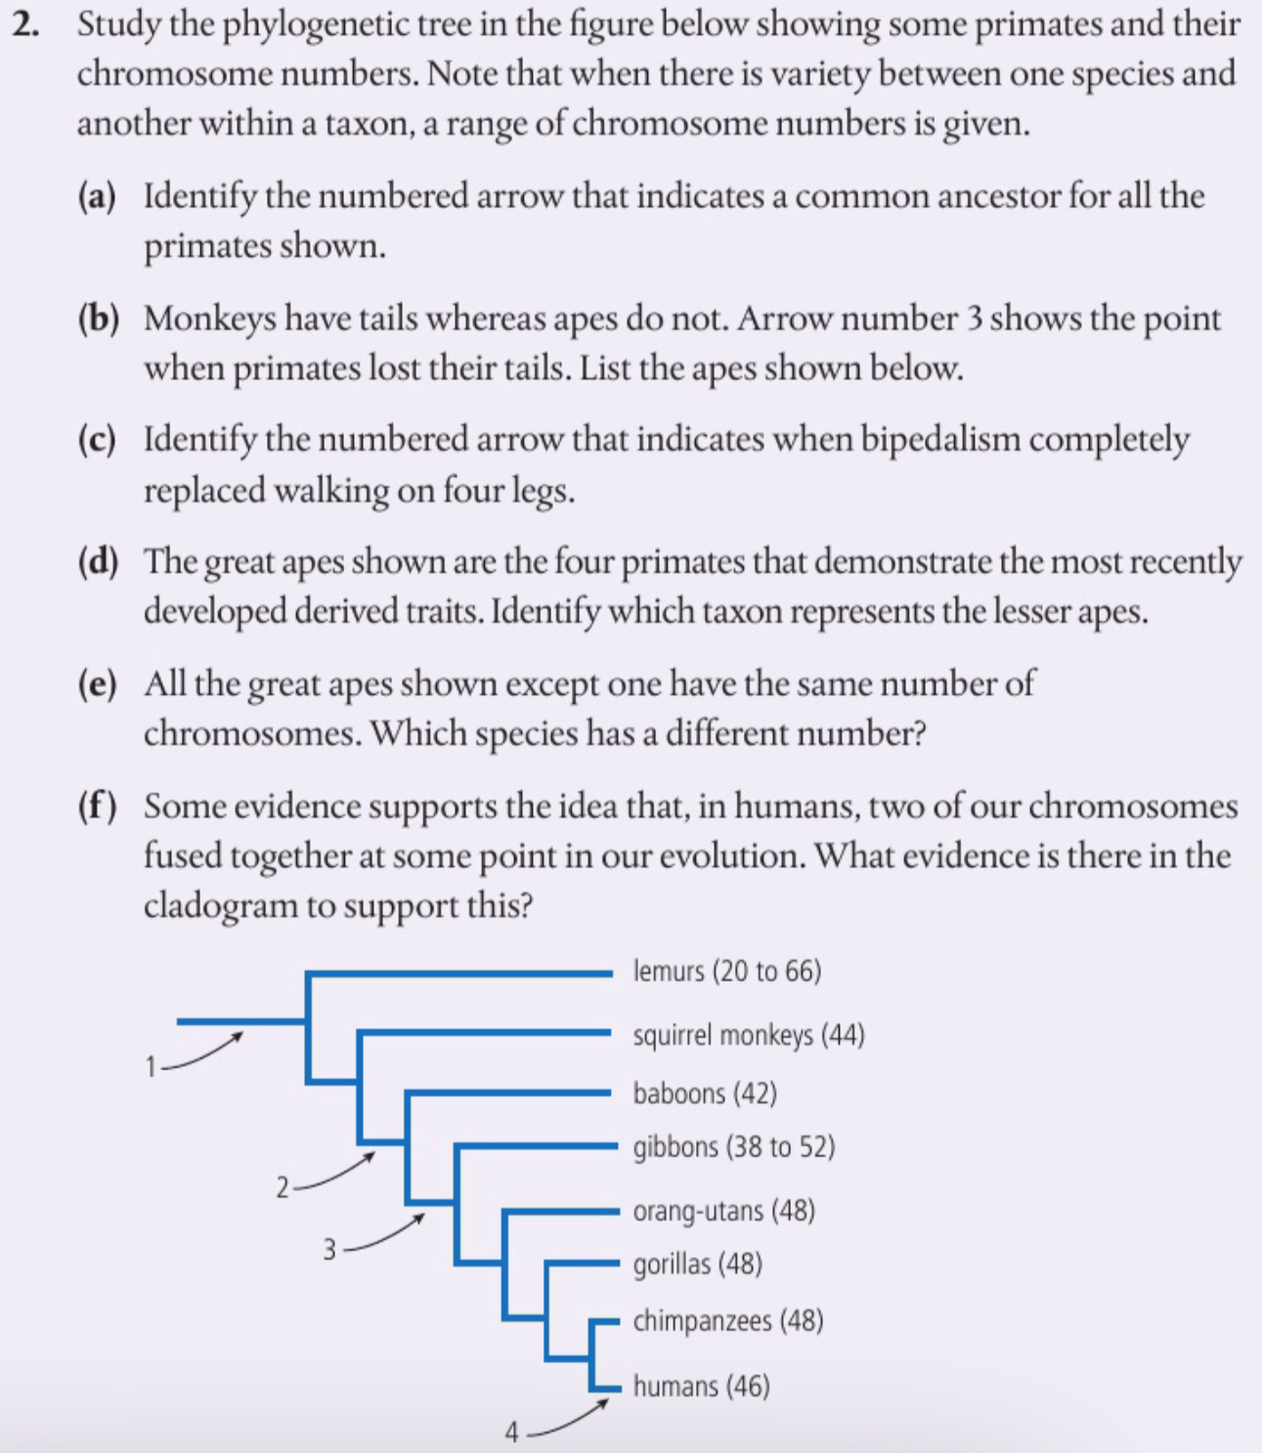
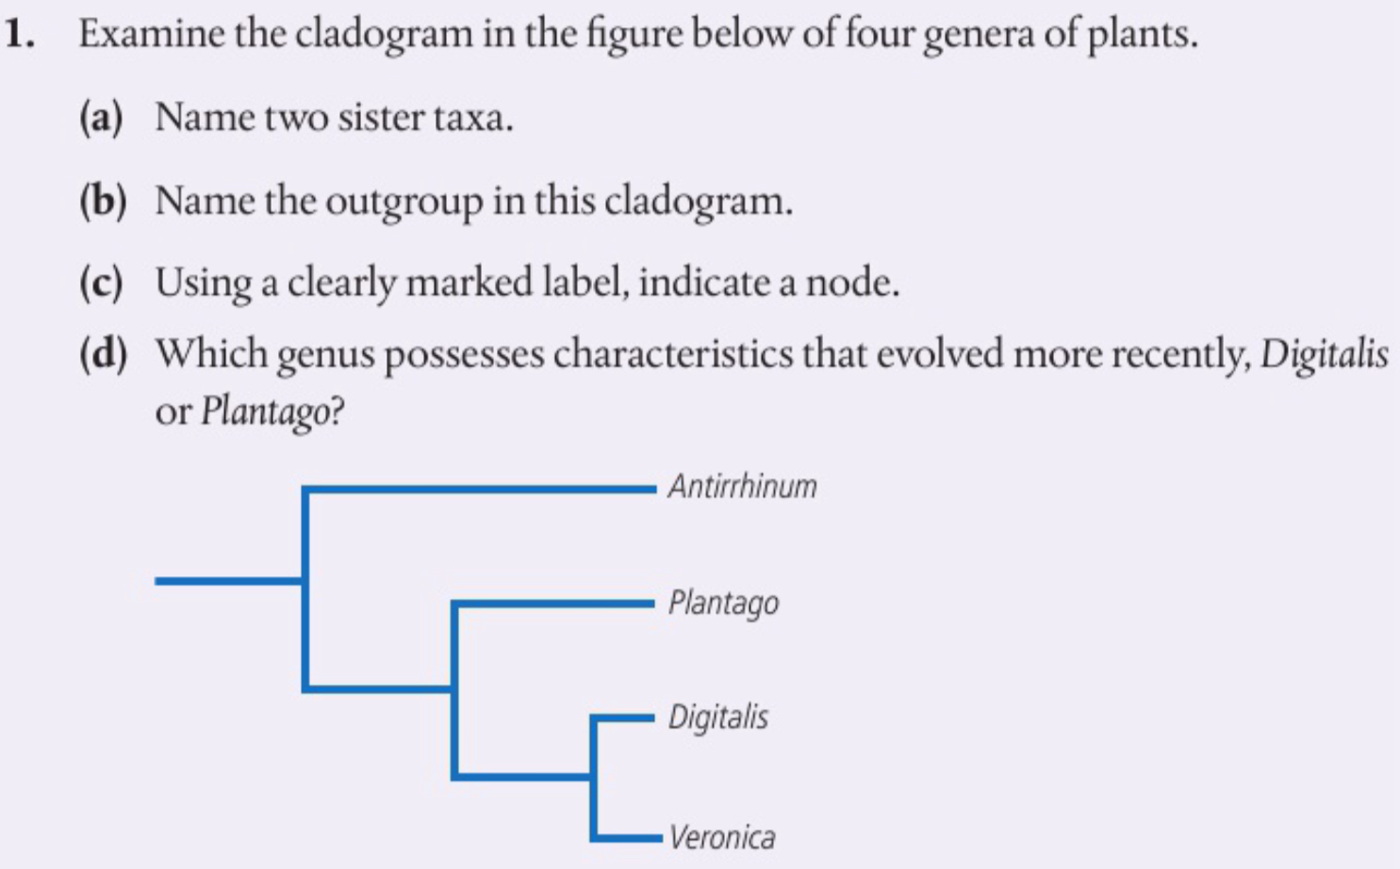

Slide 15
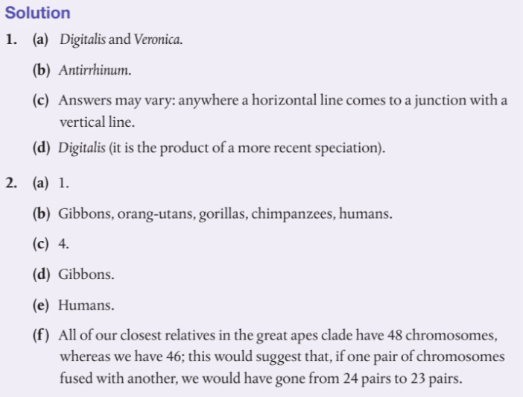

Slide 16
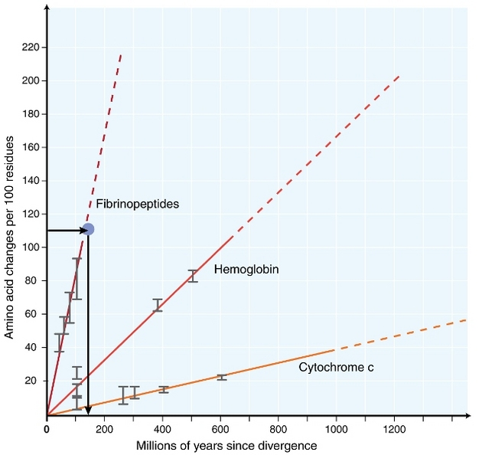
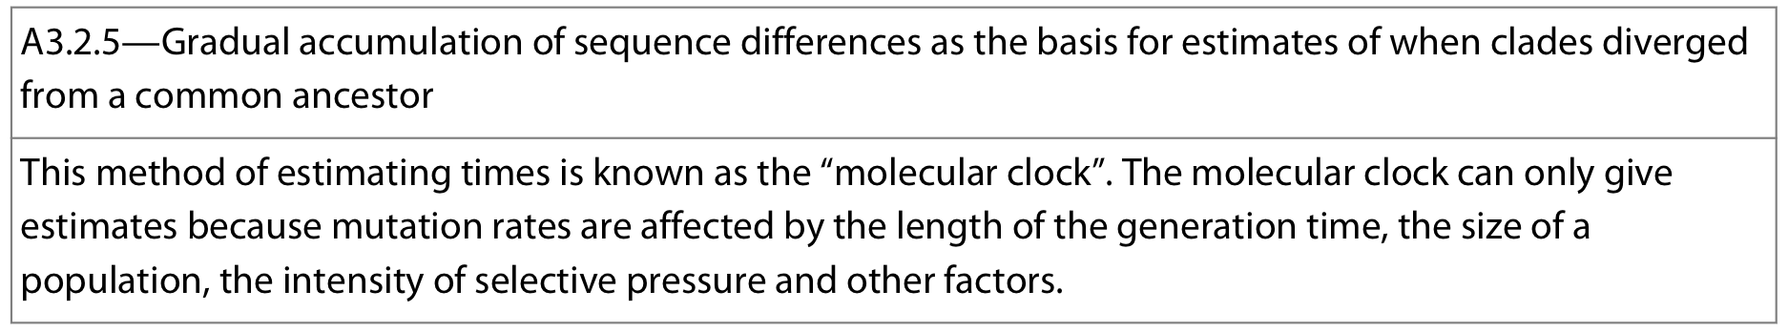

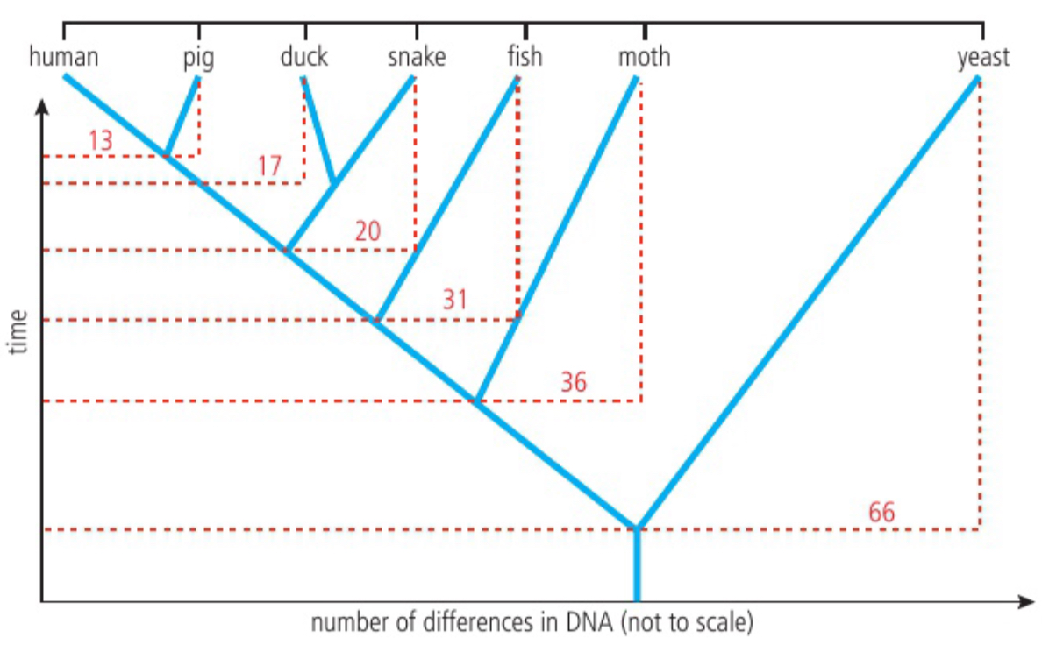
DNA and amino acid sequence differences among species are a result of mutations
These mutations gradually accumulate over long periods of time
Mutations in DNA that persist and are inherited* occur at a predictable rate**
Molecular clock: the number of differences between homologous DNA sequences/amino acid sequences can be used to estimate a probable time of divergence from a common ancestor, i.e. the more differences = the longer since the point of divergence
Note: mutation rate can vary and is not always constant:
  Generation time hypothesis: Mutations are transmitted from generation to generation in the germ cell line of sexually reproducing organisms. Since DNA in germ cells replicates during meiosis → expect short-lived species to have higher mutation rates
  Metabolic rate hypothesis: species with high metabolic rates have increased mutation rates due to mutagenic elements resulting from mitochondrial respiration
Timing can be calibrated using morphological fossil evidence and radiometric dating
Notes:
* In species that reproduce sexually for mutations to be inherited they must occur duration the creation of sex cells.
**When considering multiple changes in the base sequence of DNA. The sample size is large enough to estimate a mean rate of mutation.

Slide 17
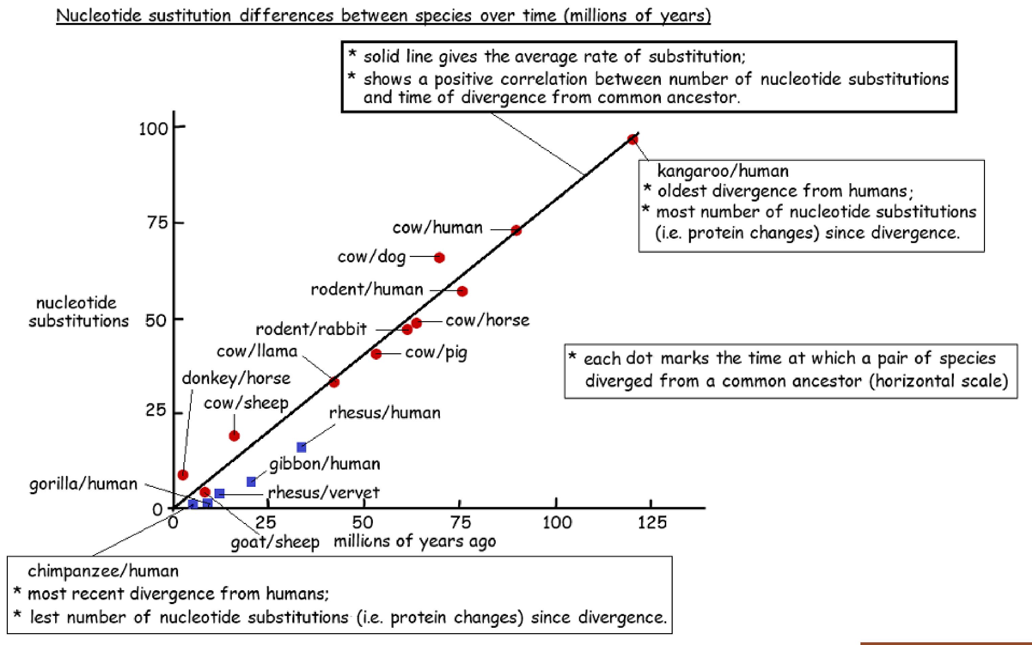

Slide 18
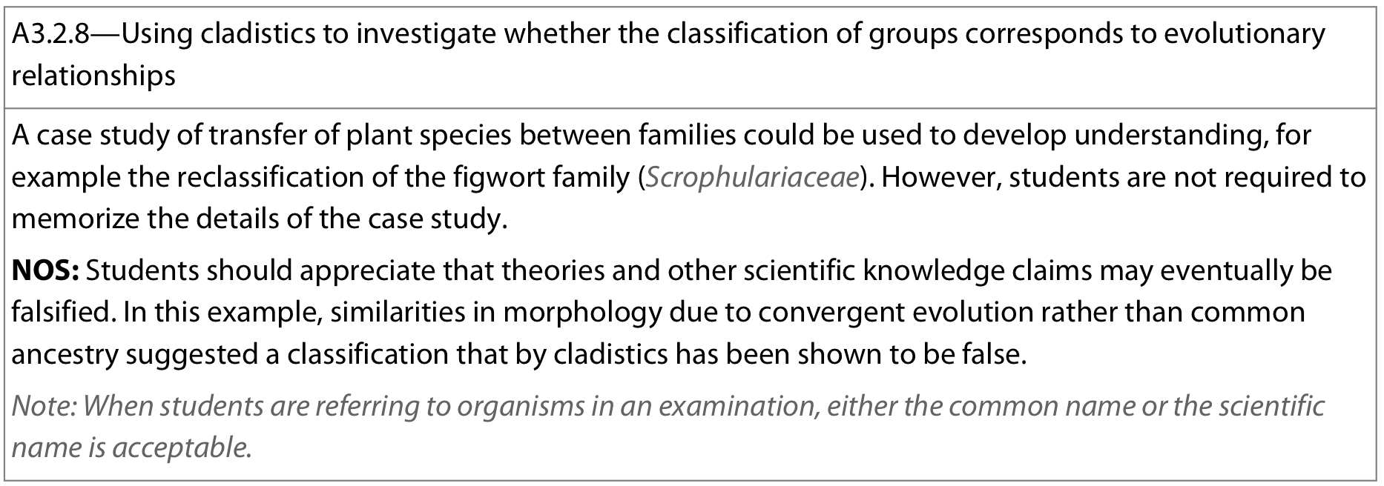
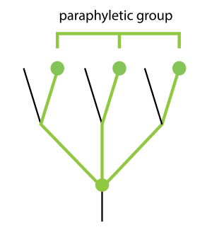
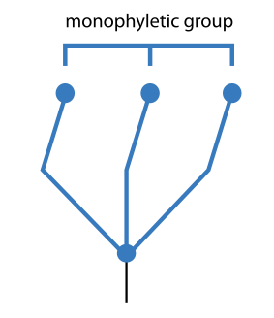
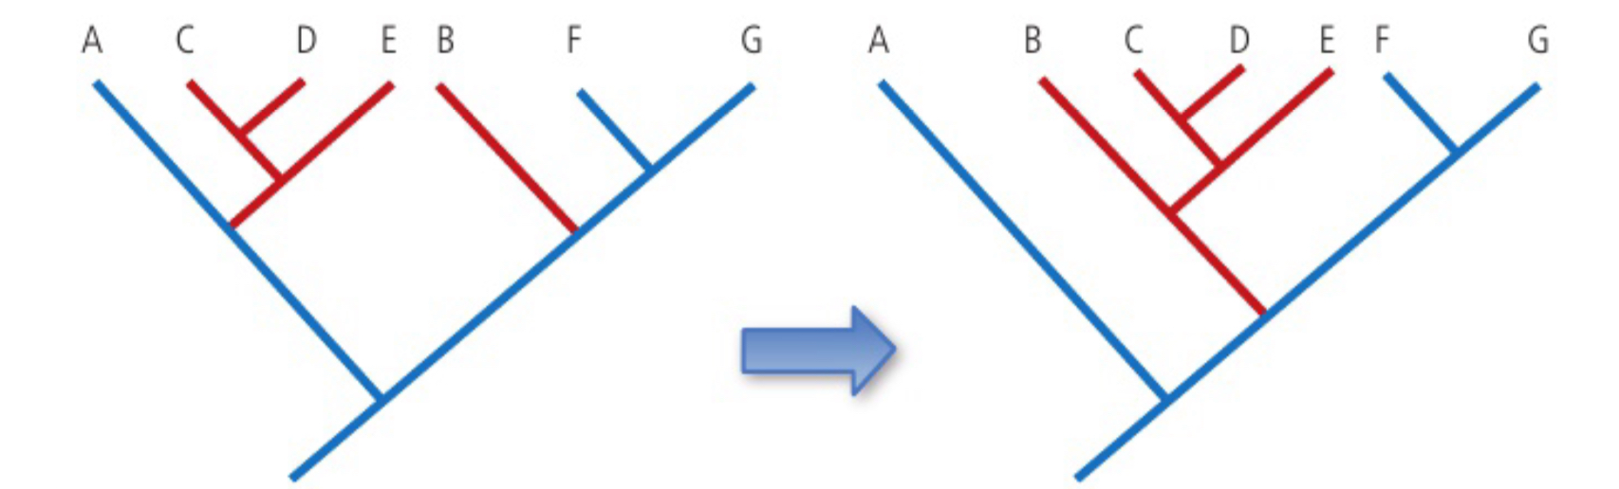
Previously, figworts (Scrophulariaceae) were the 8th largest family of angiosperms, containing 275 different genera and >5000 species!
→ Originally classified using morphological traits such as petal arrangement and nectary morphology
Why re-classify the Figwort family?
lack of uniquely defining traits raises the possibility that the figwort family are not part of the same family
Analysis of ribosomal internal transcribed spacer (ITS) regions DNA sequencing of three chloroplast genes revealed taxa did not share recent common ancestor →previous classification was paraphyletic and not monophyletic
Many species did not share common ancestry and observable similarities are instead due to convergent evolution
→ re-classified into 5 separate families

Slide 19
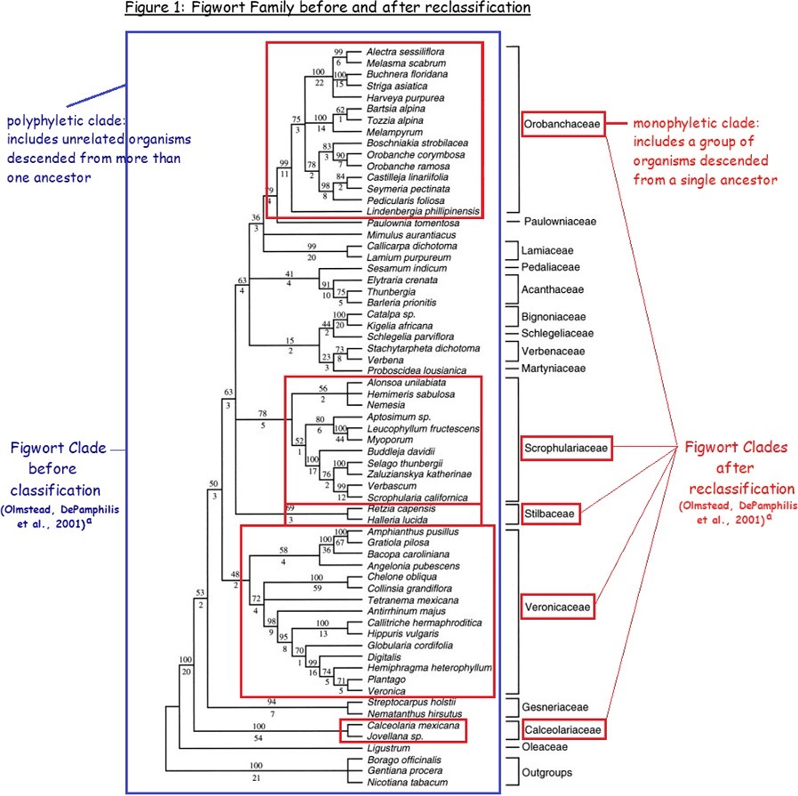
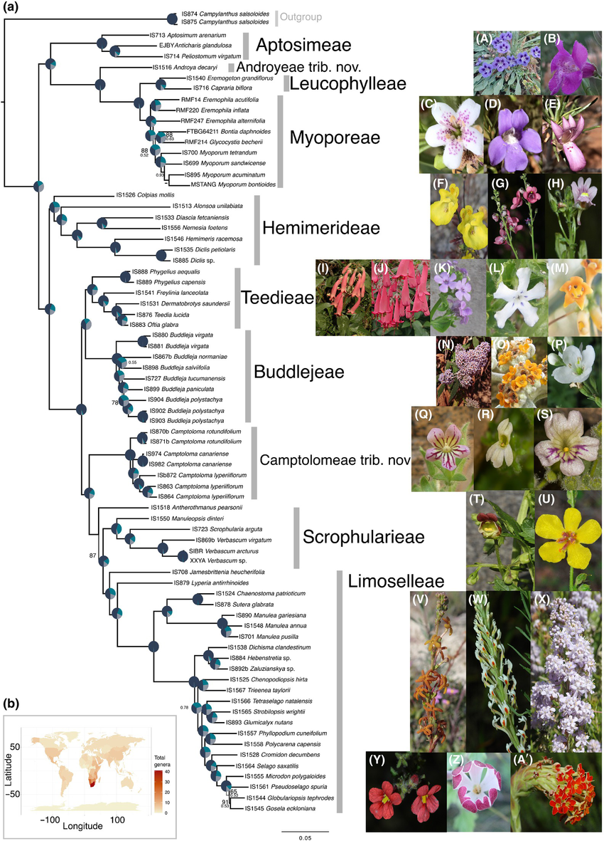

Slide 20
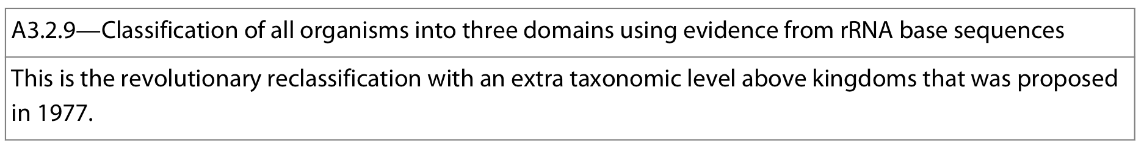
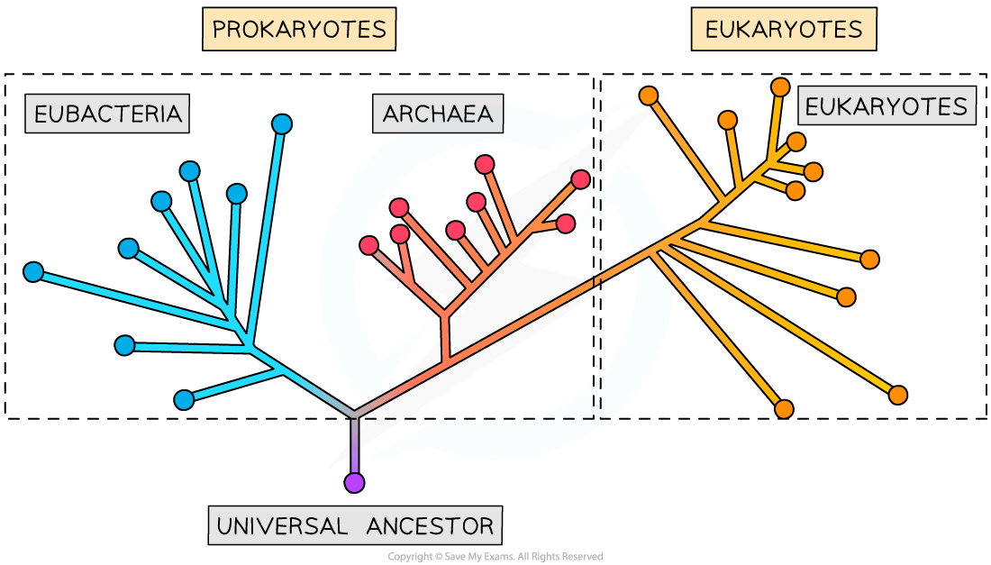
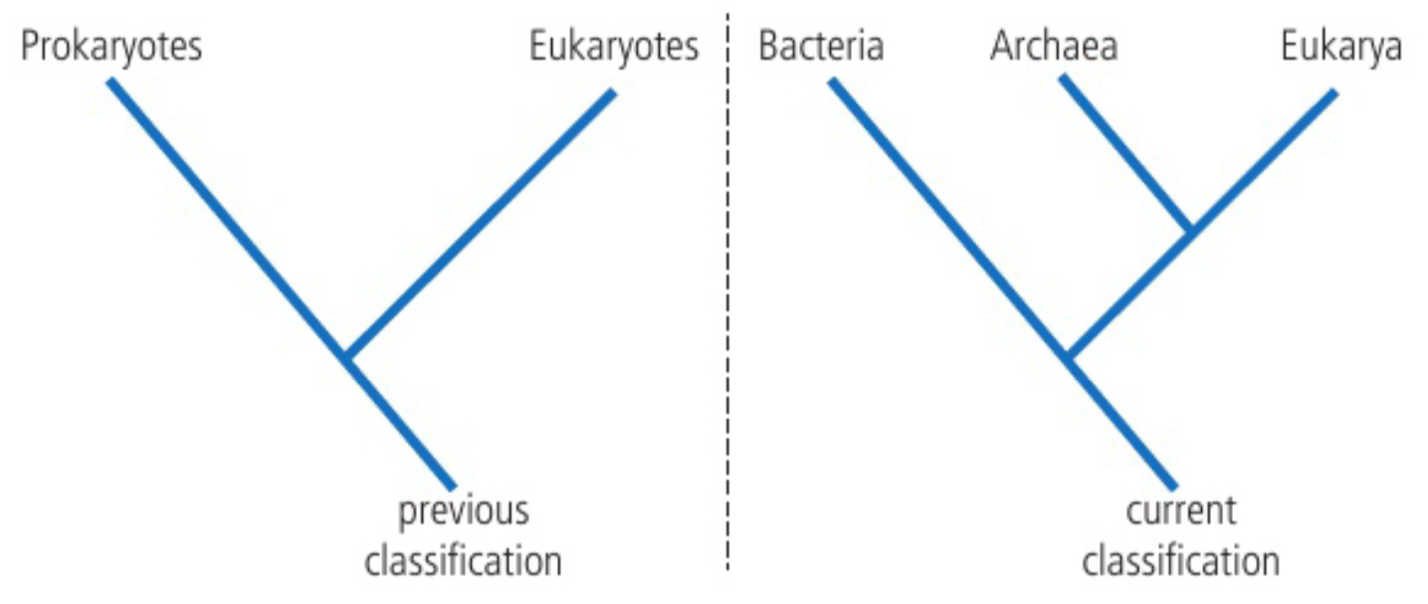
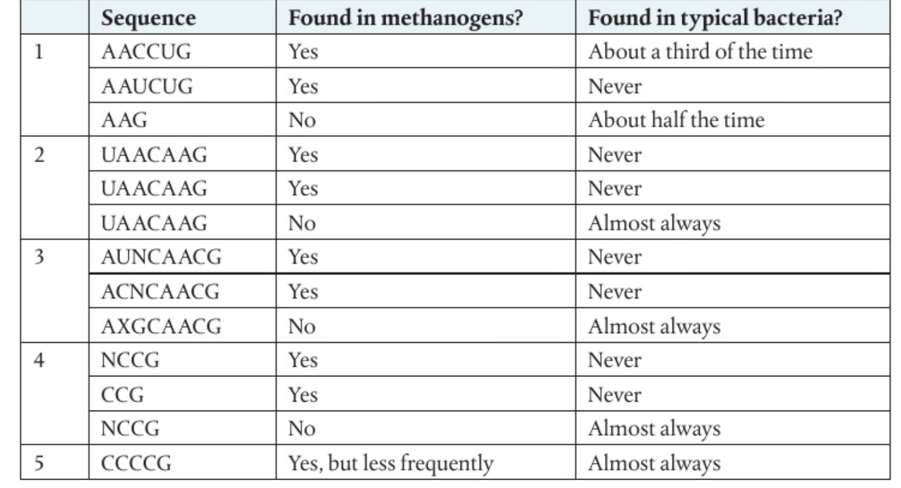
Traditional classification classified all life into two large groups based on cell type: prokayotes and eukaroytes.
In 1977, rRNA base sequences were determined in a wide variety of organismsand the differences were analyzed → paper
Analysis suggested there are actually two major groups of prokaryotes: Archaea and Eubacteria.
Why?
Differences in the subunit of their small ribosomal subunit
Metabolic reactions are carried out by archaea that no eubacteria can perform. Ex: methanogenesis
Transcription and translation in archaea is more similar in to eukaryota than in eubacteria
Some strcutural features in archaea are more similar with eukaryota than in eubacteria
Notes:
table (from Pearson) is a summary of the results from Woese 1977 paper.
Researchers were surprised that so many sequences that are present in typical bacteria and which should be present in methanogens (if they are considered bacteria) are absent
X and N represent variables indicating that more than one nucleotide can be found at that position

Slide 21
