Slide 1
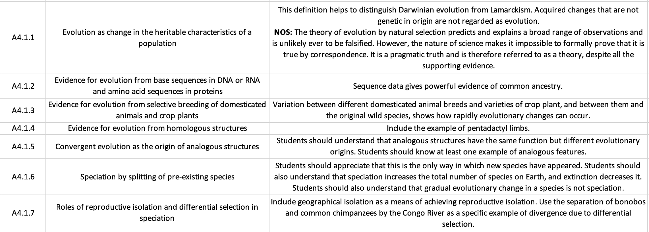
SL Learning Outcomes
ipad notes will replace these at a later date

Slide 2
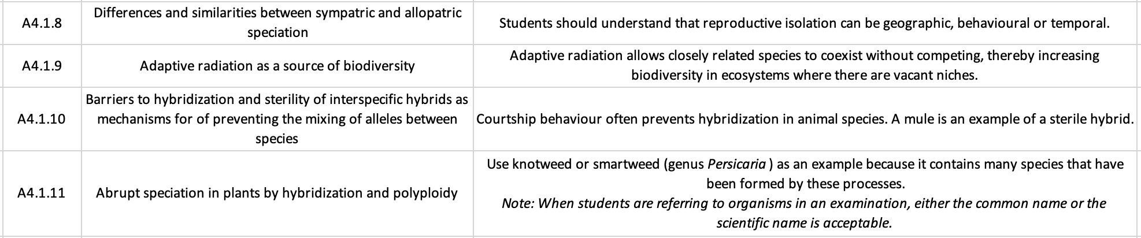
AHL Learning Outcomes

Slide 3
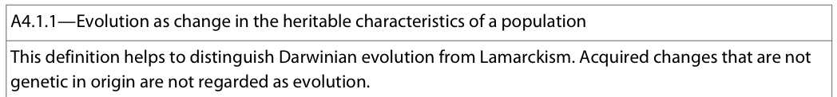
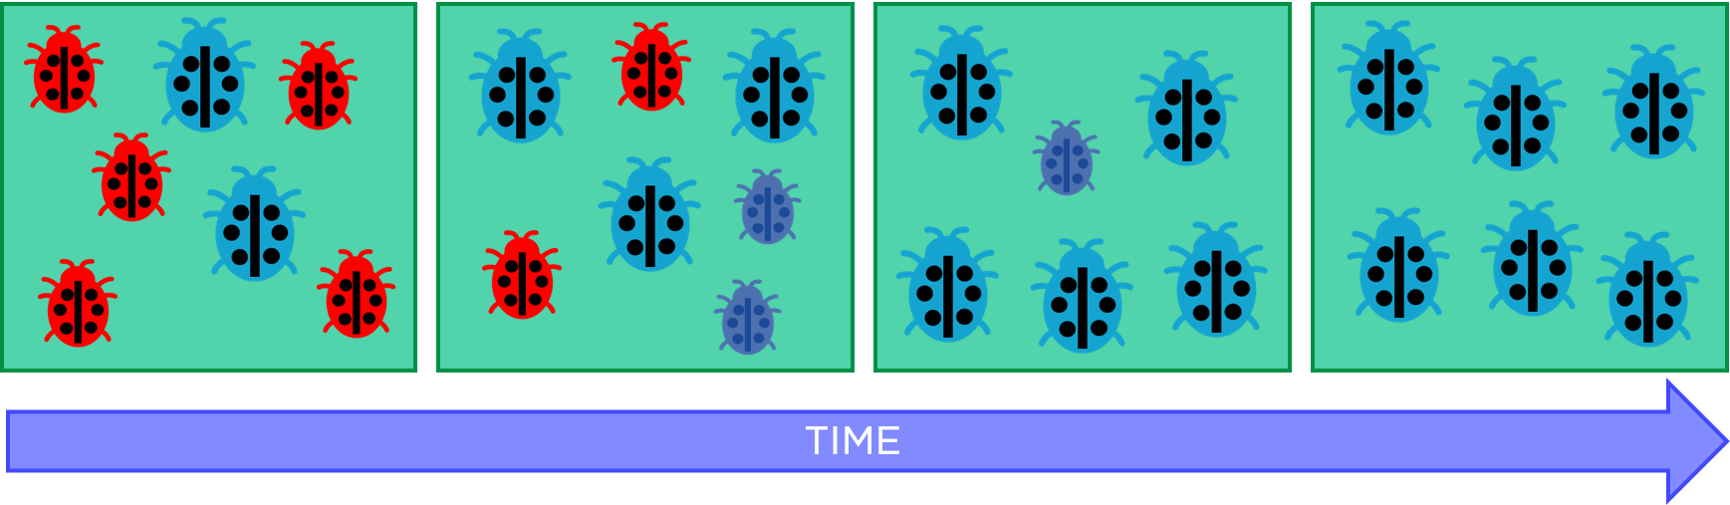
Evolution: (cumulative) change in the heritable characteristics of a population
Heritable = traits that can be passed down from parent to offpring. i.e. genetic (encoded in DNA)
Only traits encoded by DNA can be transferred from one generation to the next – acquired traits cannot be passed on
Population = group of organisms of the same species living in the same area at the same time
The frequency of the trait is recorded across successive generations – therefore, evolution is measured at a population level not at the individual level

Slide 4
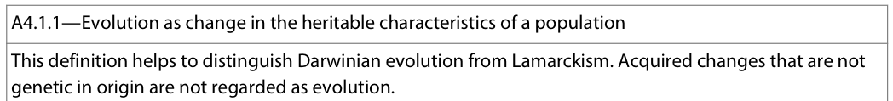
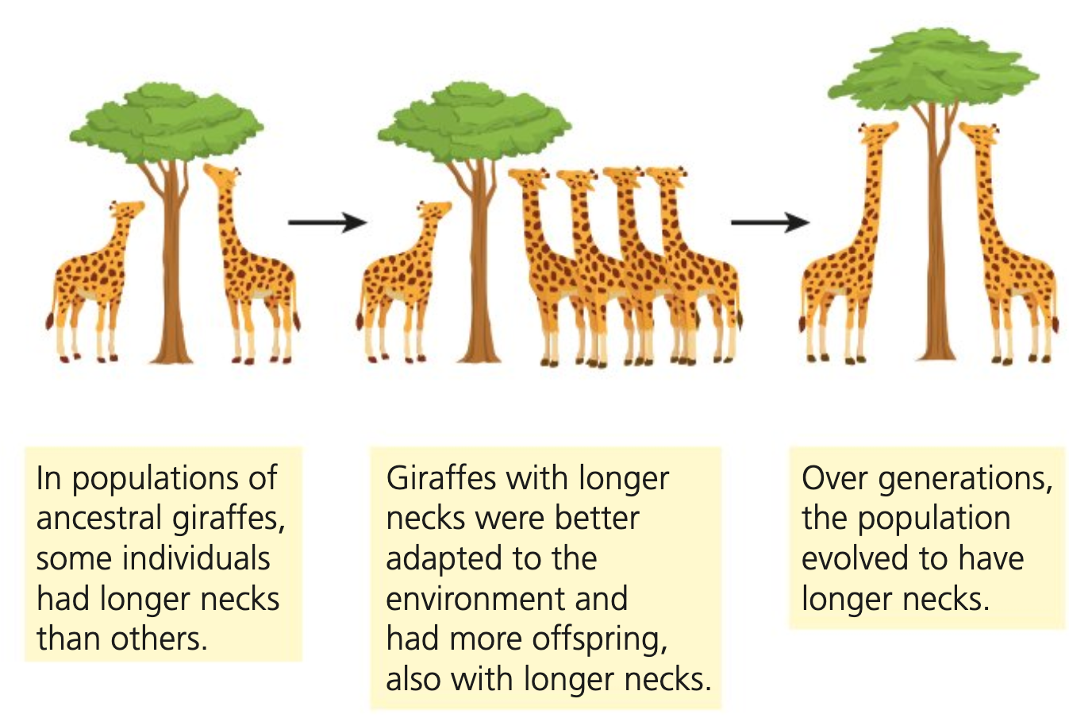
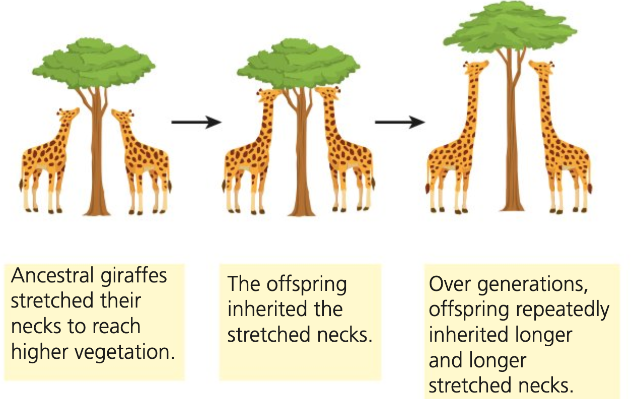
Lamarckism (Jean-Babptiste Lamarck)
Darwanism (Charles Darwin)
New organs are result of need: formation of new body parts is a result of a new need which has arisen due to a selection pressure
Use and disuse: structures that are used frequently and continuously will strengthen and develop while structures that are not used will weaken and deteriorate. This determines the stength, form and function of organs
Inheritancee of acquired characteristics: physical changes to the structures of an organism that result from use/disuse during their lifetime are inherited by offspring
Change in enviroment → change in needs → change in behaviour → change in organ useage and development → change in form over time → gradual transmutation of the species
Evolution via natural selection:
Variation exists among individuals of a species and this is heritable
Over-reproduction: more individuals are produced each generation than can survive – leads to compeition
Individuals with heritable traits allowing them to better-compete (adaptive features) will be more likely to survive and leave more offspring
Adaptation: over time, selected traits become more common in the population and the population changes and is better-adapted
Long necked giraffes evolved as generations of giraffes stretched their necks to reach higher leaves
Long necked giraffes are randomly born and have more offspring due to their competitive advantage

Slide 5
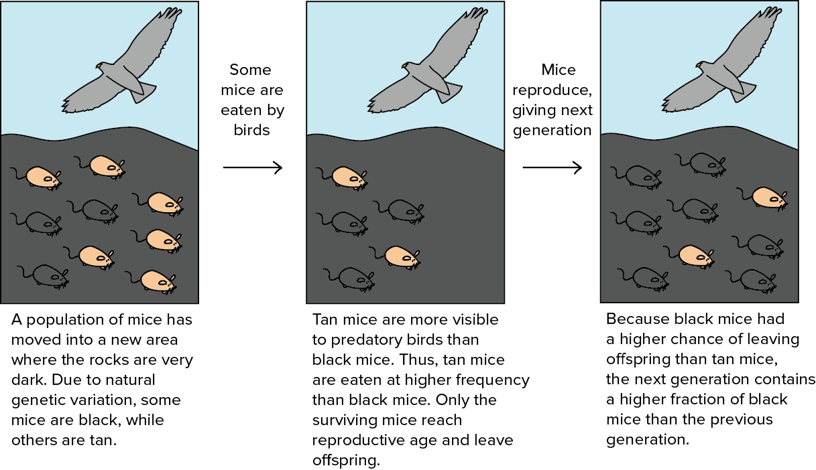

Slide 6
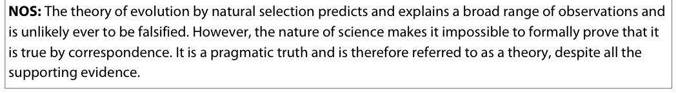
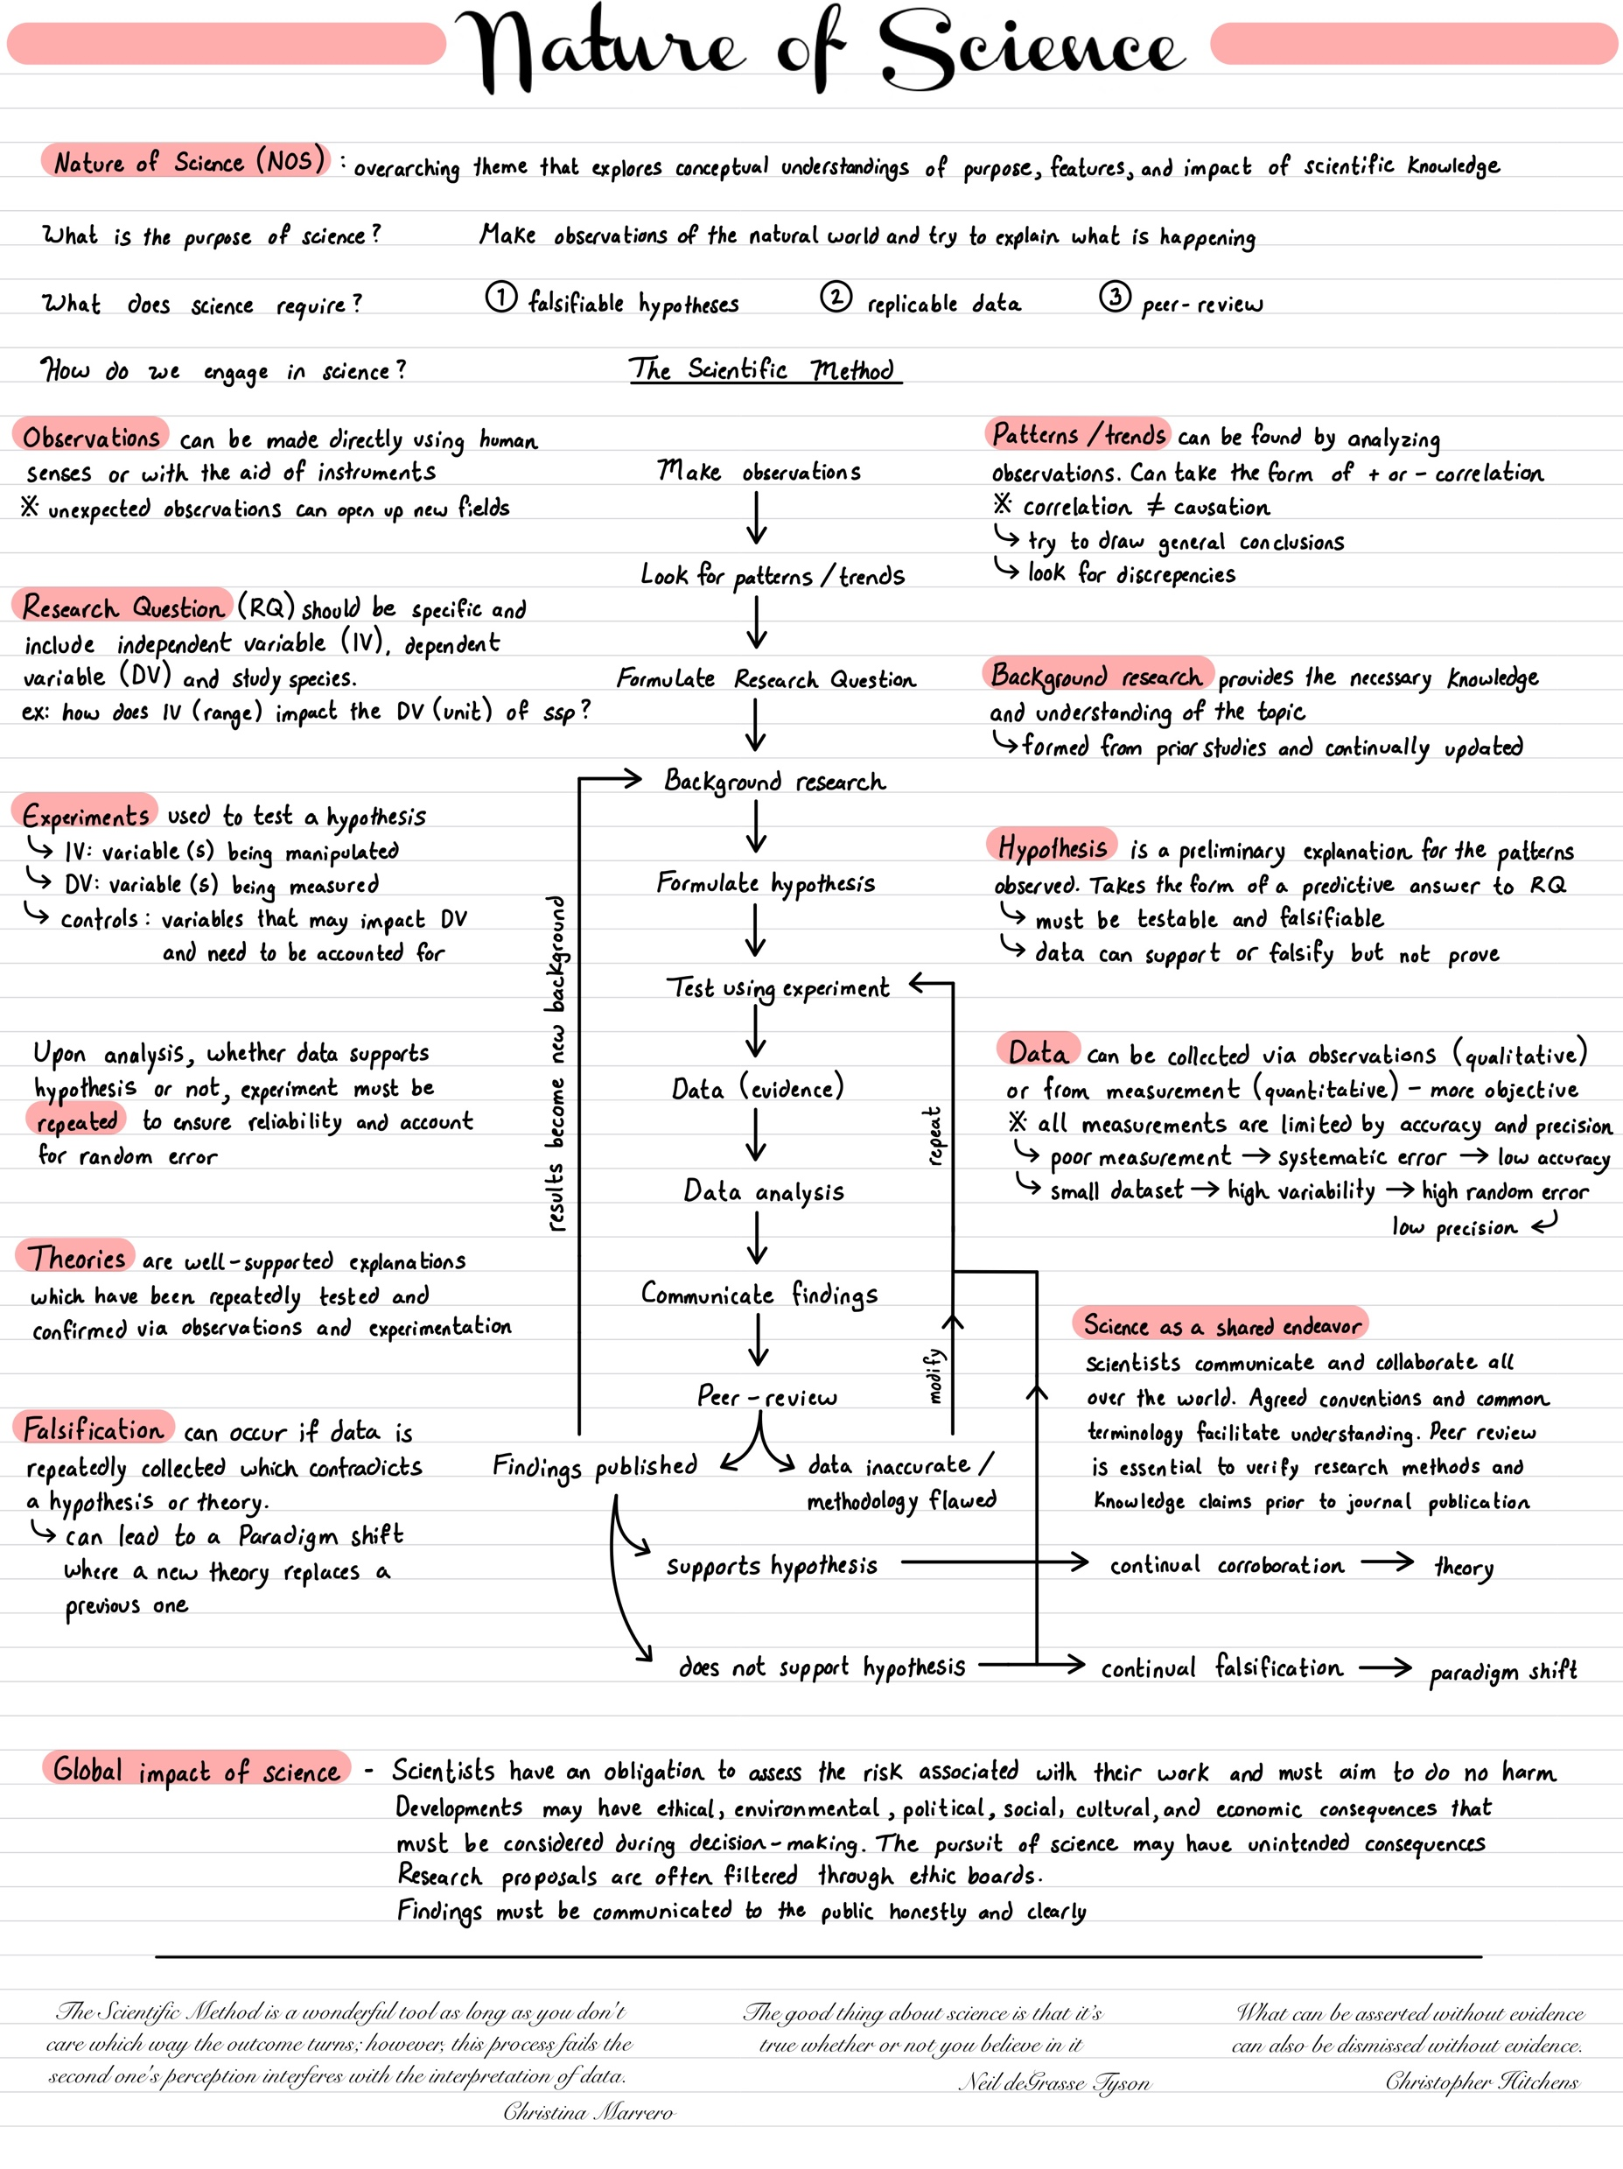
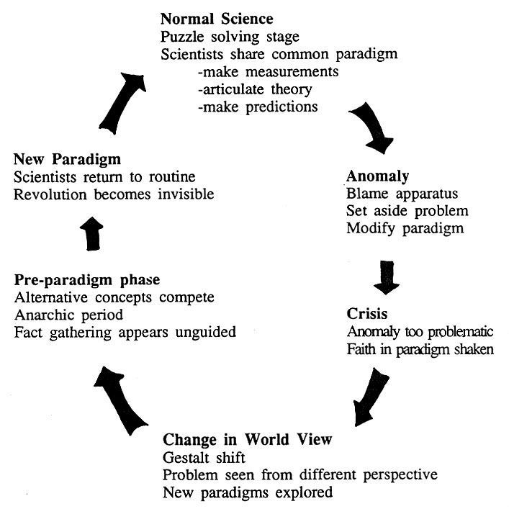
Kuhn cycle of paradigm shifts:
Knowledge claims in science are based on observations of a fraction of possible cases. Observations are used to form generalizations that are then tested. If the generalizations are supported, a theory begins to emerge. If theory can explain and predict future observations → pragmatic truth
Theory of evelotion via natural selection predicts and explains a borad range of observations thus is unlikely to be falsified. However it is impossible to prove formally that it is true. It is a pragmatic truth and referred to as a theory.

Slide 7
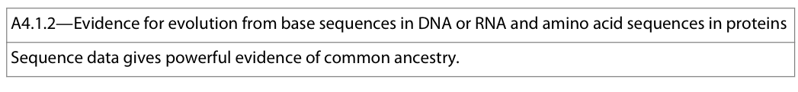
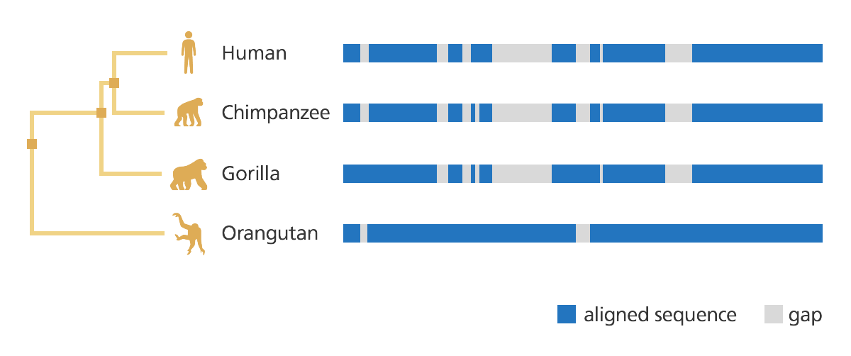
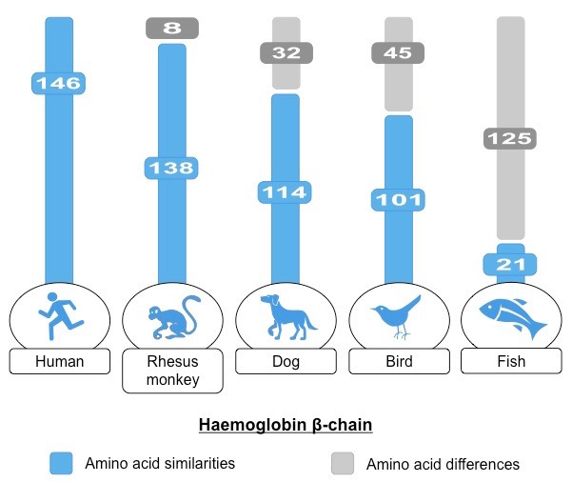
As evolution is a change in heritable characteristics in a population over time, and all living organisms (and viruses) use the same genetic code to create proteins, changes within base sequences of DNA or RNA and the corresponding amino acid sequences of proteins are expected and can be compared.
Evidence for evolution: Over the course of millions of years, mutations will accumulate within any given segment of DNA. Compare base/amino acid sequences of the same gene in different species.
Fewer differences = more closely related → divergered from common ancester more recently
The sequences for comparison must come from the same part of the DNA, and are often taken from regions of DNA that are highly conserved, meaning that they have changed very little over time (ex: haemoglobin); this is important for several reasons:
  Like needs to be compared with like; comparing two completely different regions of DNA will not yield useful information
  There are likely to be relatively few differences, so similarities and differences can be easily identified
  Conserved sequences are also more likely to exist in a wide range of species
Notes:
Also explored in:
A3.2 – Classification and cladistics
D1.3 (HL) – Mutations and Gene editing

Slide 8
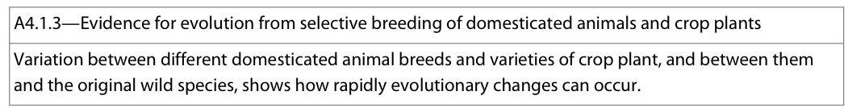
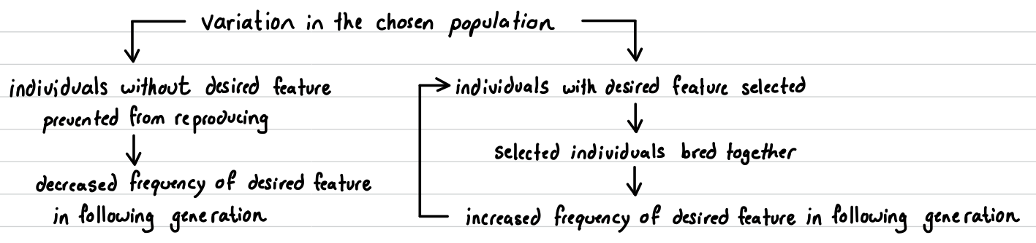
Selective Breeding / Artificial Selection is a process whereby humans act as the selection pressure and determine which individuals in a population reproduce in the hopes of increasing or decreasing the prevalence of a particular trait
Evidence for evolution: shows how populations can change rapidly given selection pressures, leading to evolution
Selective breeding provides evidence that selection can cause evolution, on short geologic time scale. It does not prove that evolution of species is occurring naturally but gives evidence that species can evolve rapidly.

Slide 9
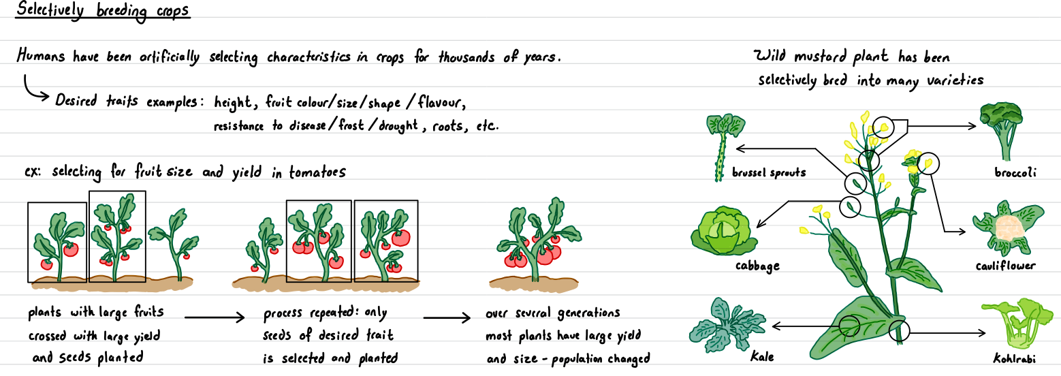

Slide 10
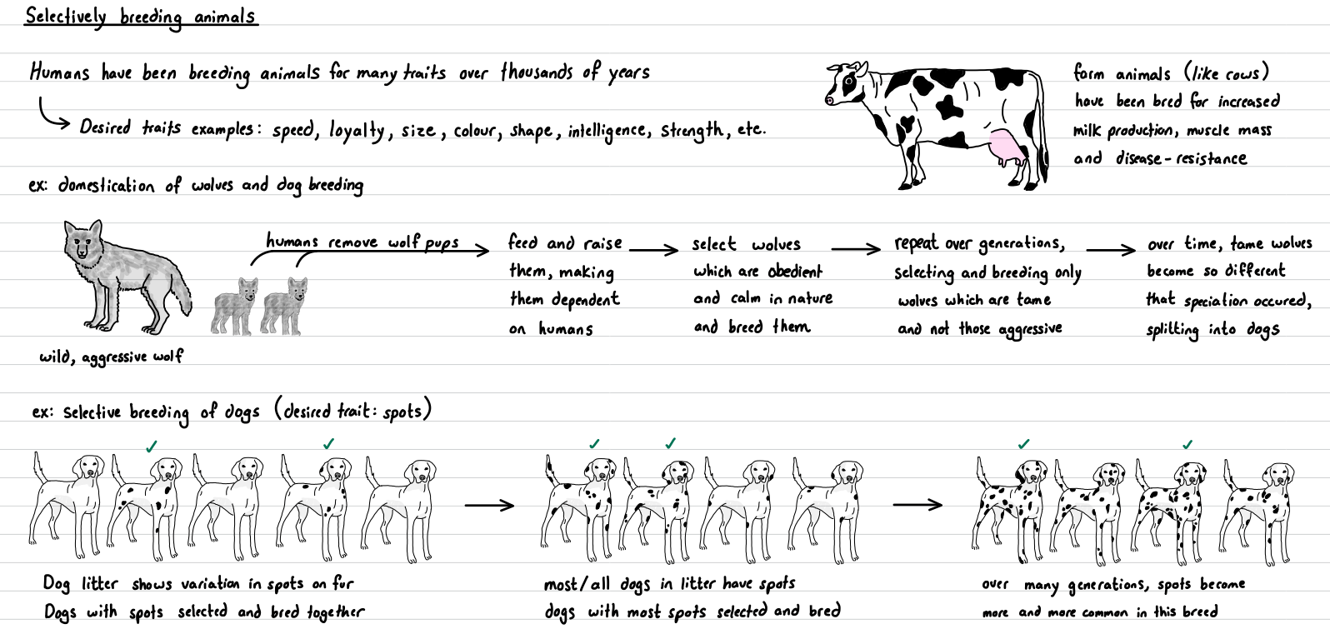

Slide 11
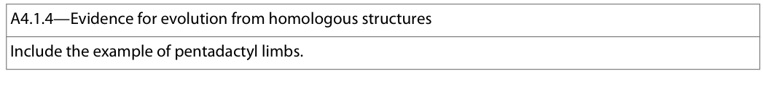
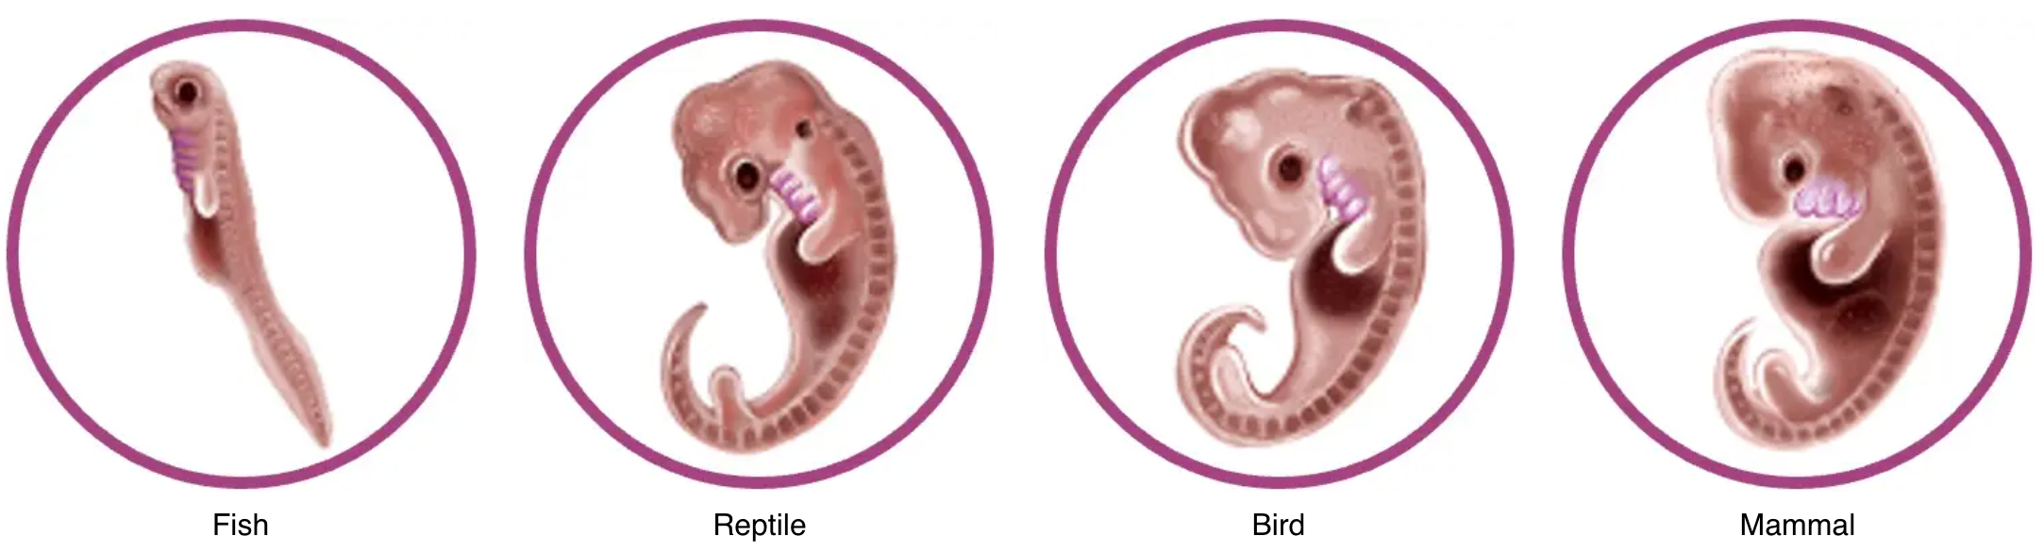
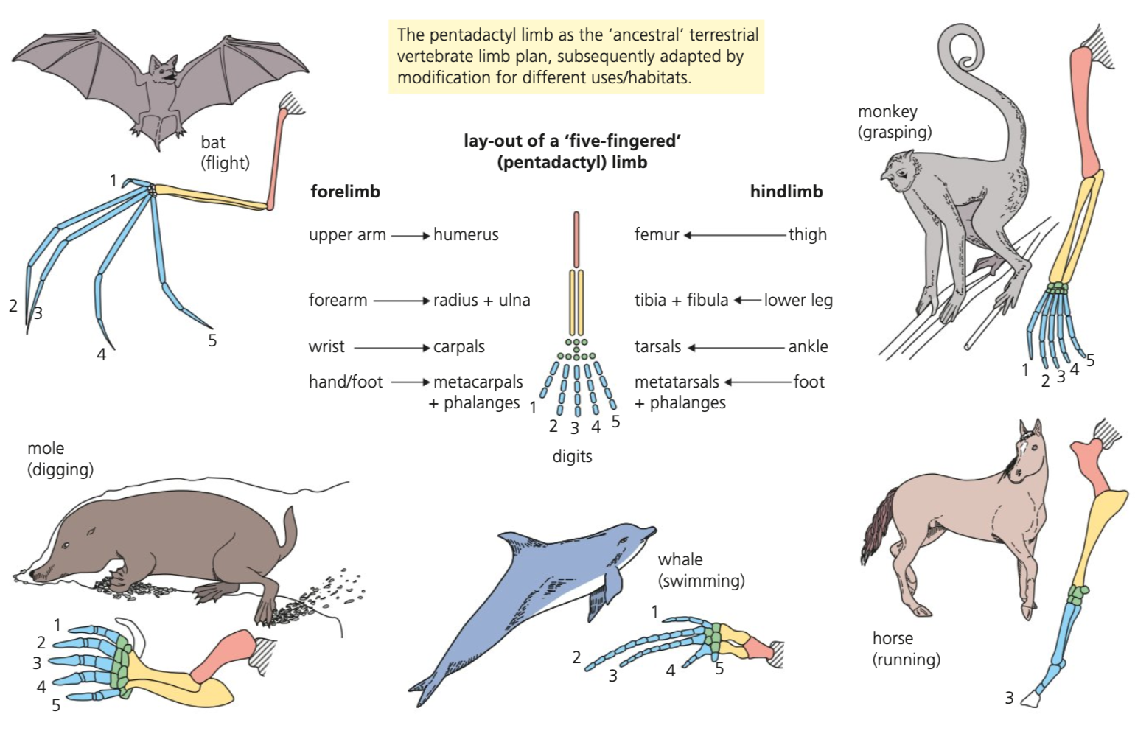
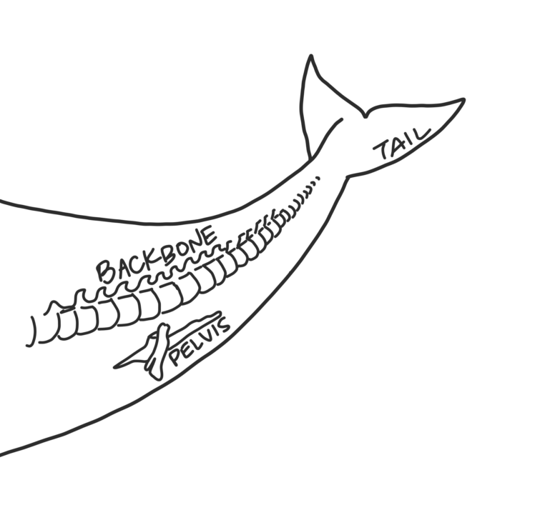
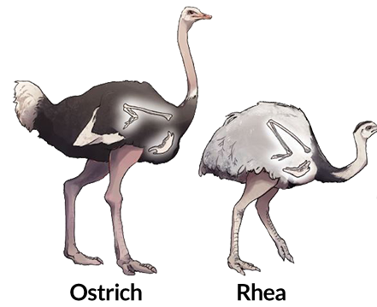
Homologous structures: structures which have similar anatomy but different functions (often making them appear very different)
Results from Divergent evolution / Adaptive Radiation where common ancestor subject to different selection pressures
Homologous structures in different species suggests more recent common ancestry and relatedness
can include anatomical features, embryological patterns of development or vestigial structures
Notes:
Presence of homologous structures is difficult to explain without evolution

Slide 12
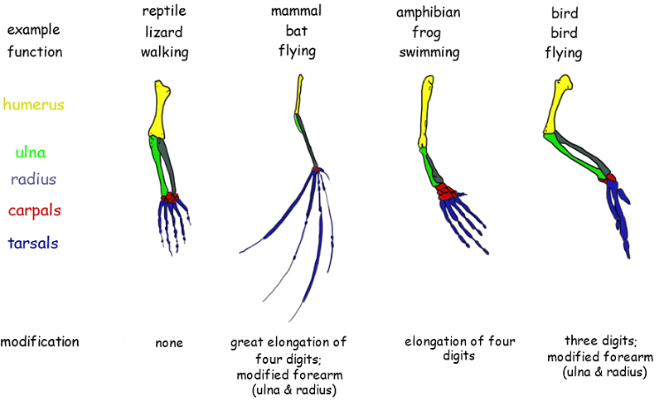
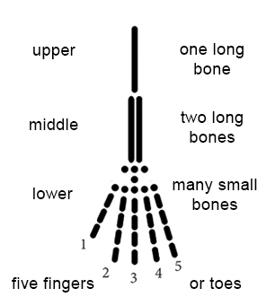
Pentadactyl Limb has been adapted to serve specialized locomotor functions related to the niche of the animal
Notes:
Presence of homologous structures is difficult to explain without evolution

Slide 13
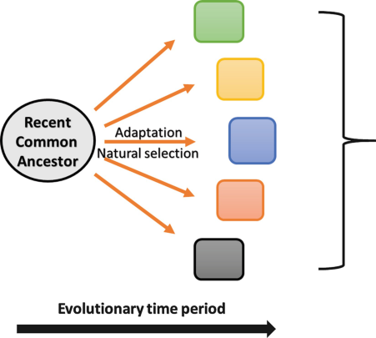
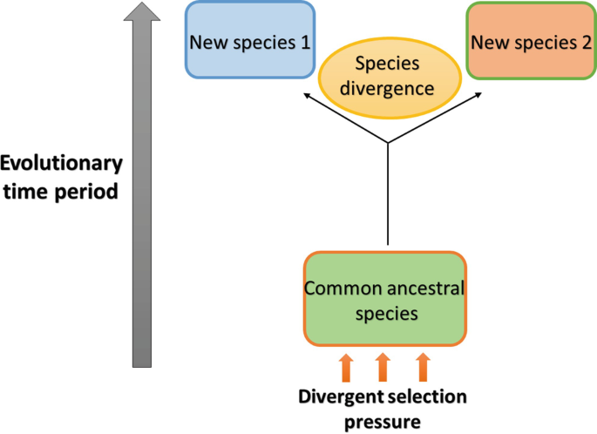
Divergent Evolution:
process in which two or more closely related species become more dissimilar over time due to different selective pressures in their environments.
→ Results in homologous structures
Descendent species with homologous structures, specialized to specific environmental conditions
Ex: pentadactyl limb
Common ancestor had general pentadactyl limb. Population is separated and isolated and subject to different selection pressures for different modes of locomotion. One population is subject to selection pressures for flight (limb → wings, ex: bats) and another is subject to selection pressure for swimming (limb → fins, ex: dolphins).

Slide 14
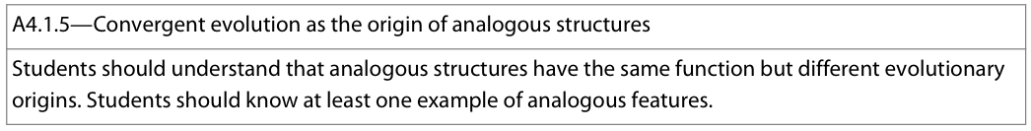
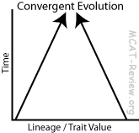
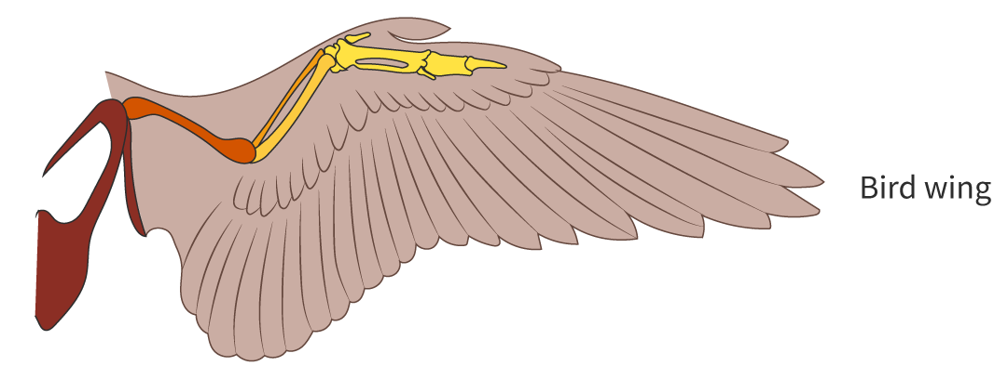
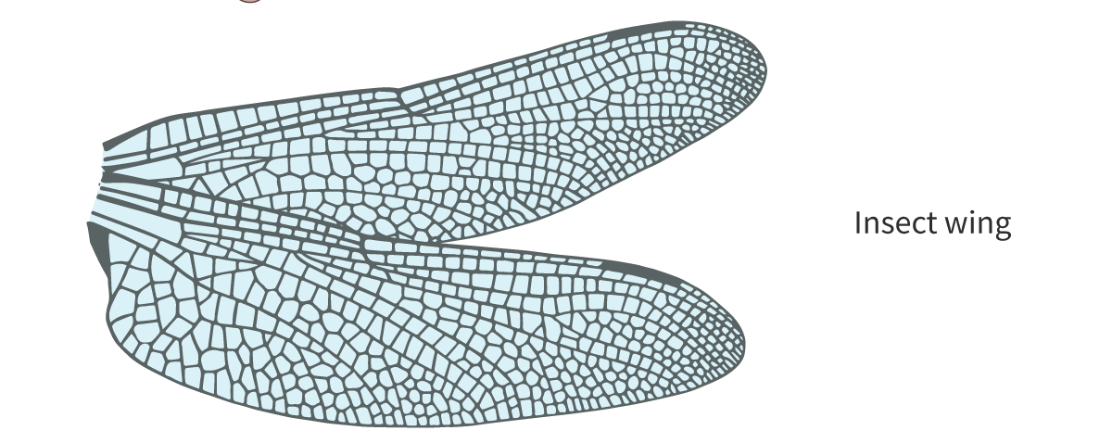
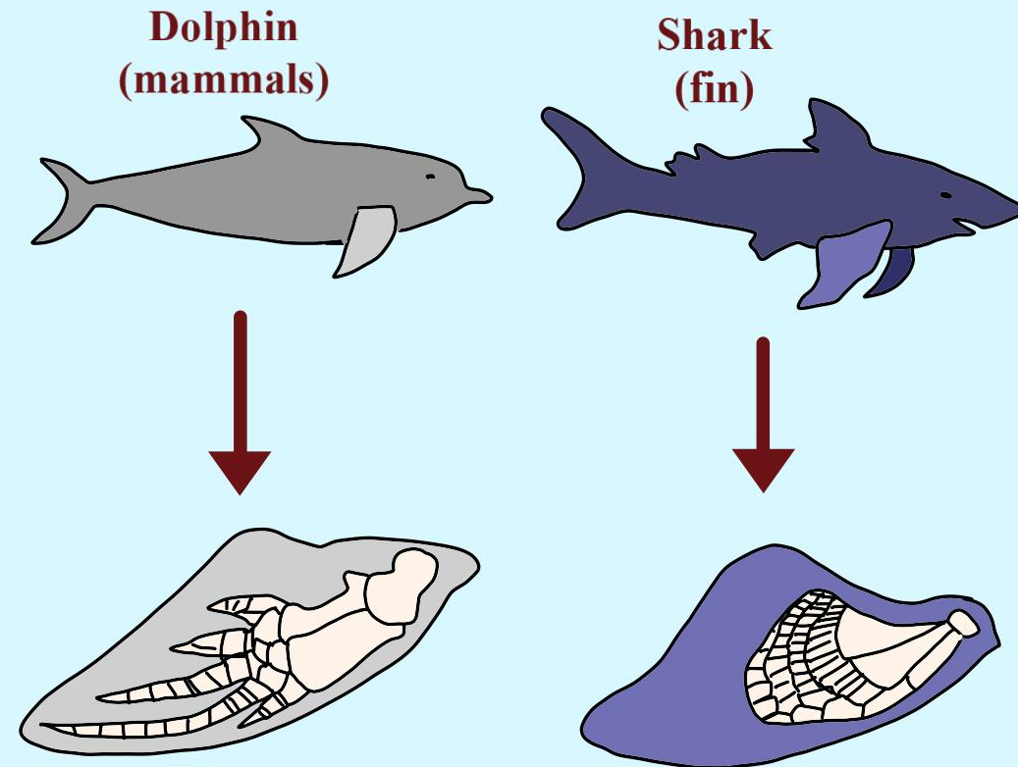
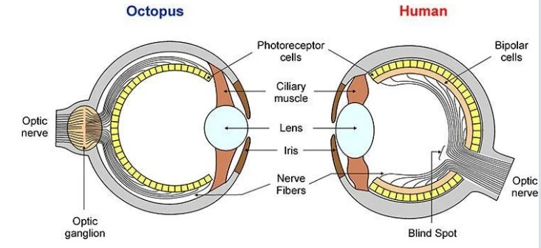
Analogous structures: structures which have different anatomy and evolutionary origins but similar functions
Results from Convergent evolution where distantly related species live in similar habitats and are subject to similar selection pressures (where similar traits provide an adaptive advantage)
Analogous structures in different species does not suggest recent common ancestry and relatedness as they have evolved separately
Notes:
Classification based on analogoous structures is Artificial classification and can lead to misclassification of evolutionary relationships and ancestry

Slide 15
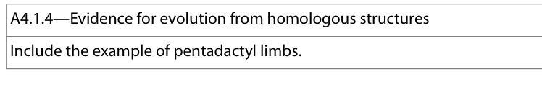
 | Homologous | Analogous
Anatomy | Similar pattern | Very different
Evolutionary origin | Similar (more recent common ancestor) | Different (distant common ancestor)
Function | Different (typically) | Same
Causal selection pressure | different | similar
Type of evolution | Divergent evolution | Convergent evolution
Example | Pentadactyl limbs in mammals | Eye of octopus and human Wings of insects and birds

Slide 16
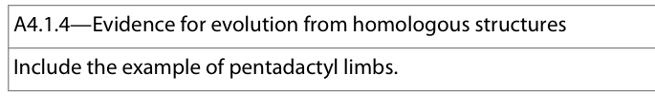
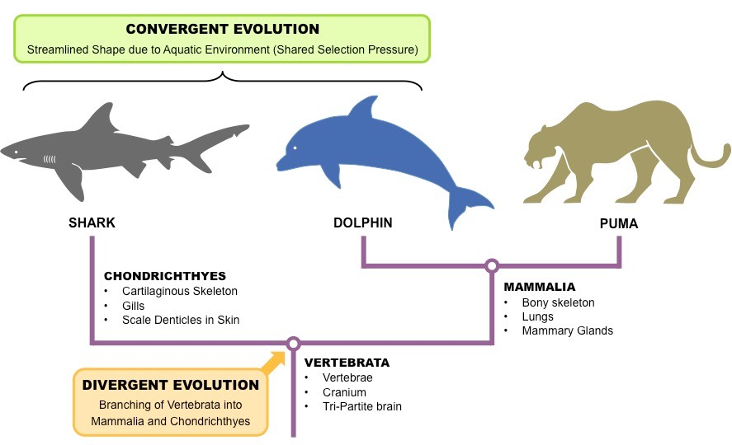
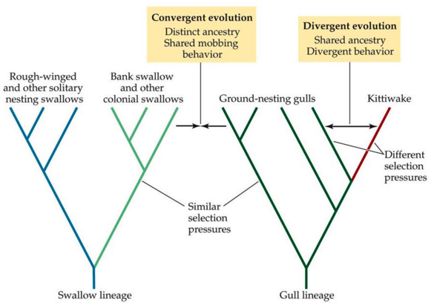
Analogous
Structures
Homologous
Structures

Slide 17
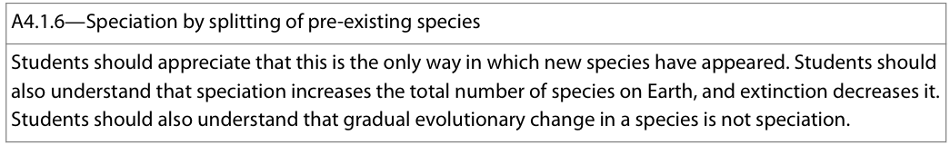
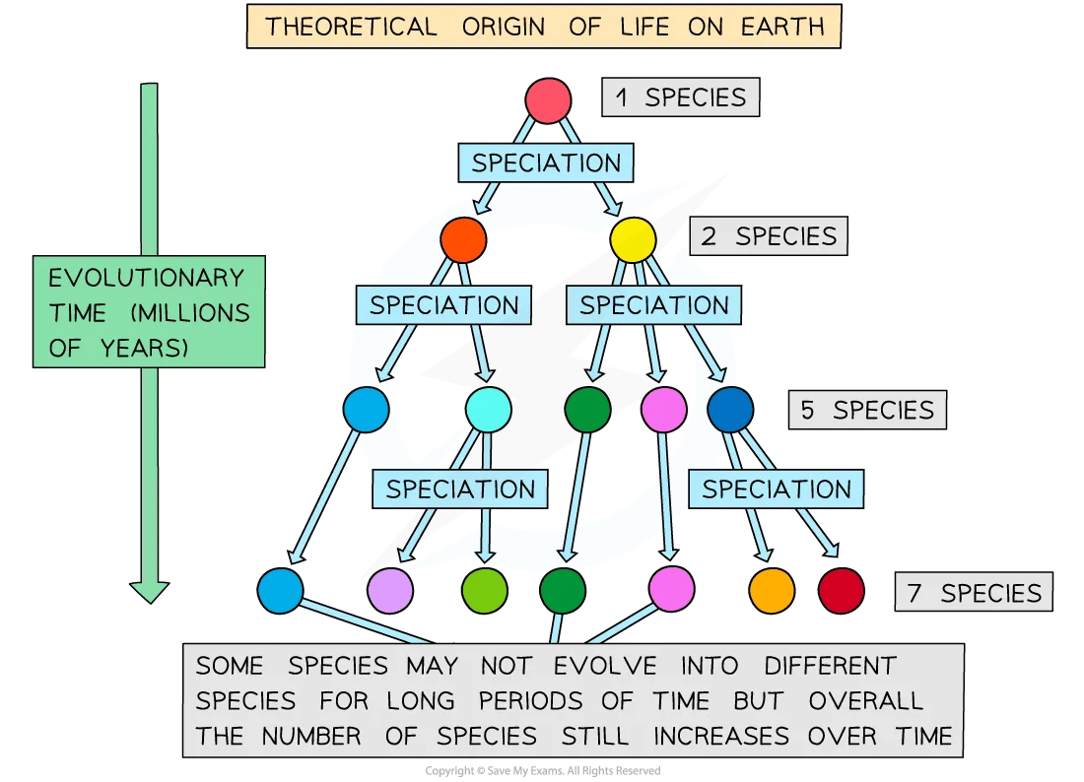
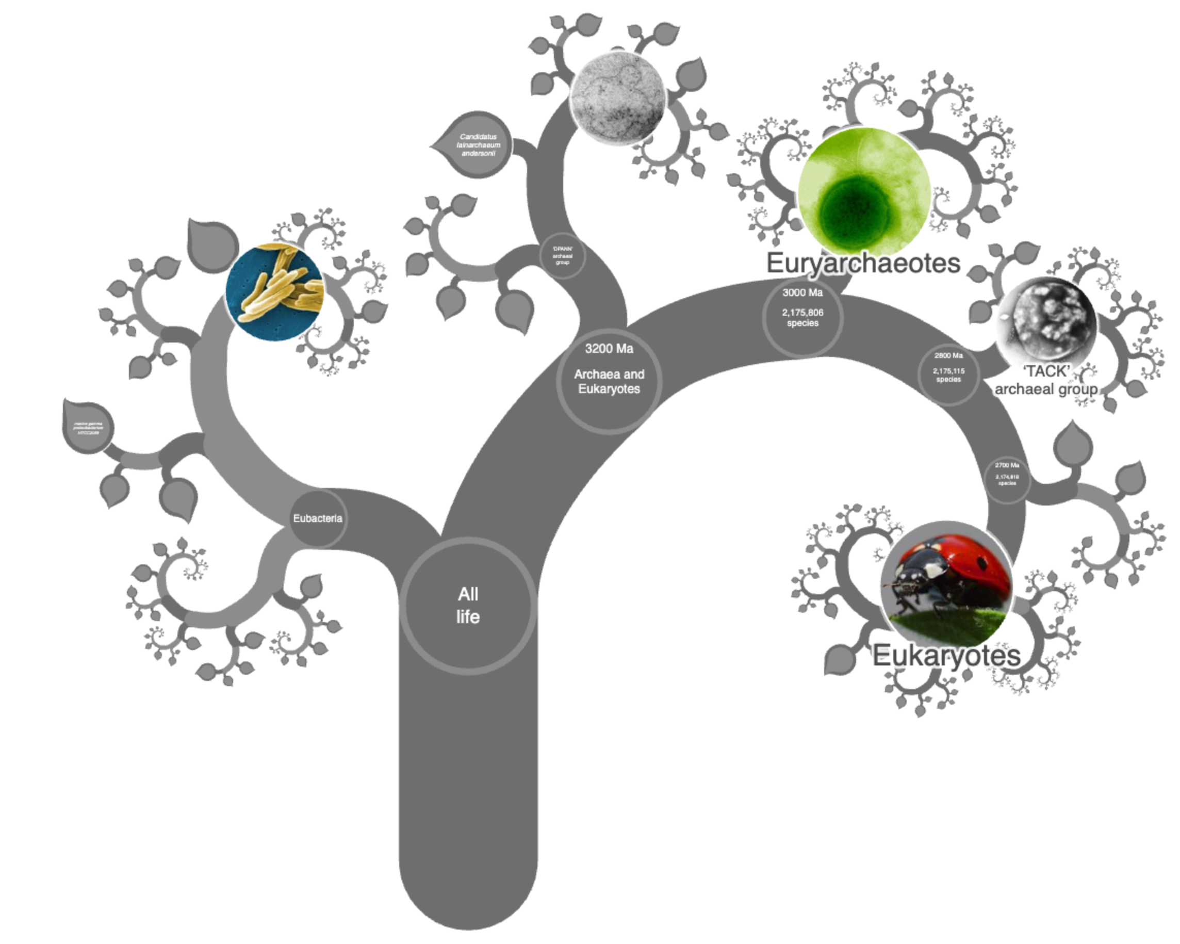

Speciation: evolutionary process by which populations evolve to become distinct species, i.e. the splitting of a pre-existing species into two
According to biological species concept, species: group of organisms that can breed and produce fertile offspring
Speciation occurs when a part of a population becomes isolated from the other, preventing their interaction and reproduction. Over enough time, these isolated population diverge so much they become new species
Speciation is the only natural mechanism from which new species have appeared and it increases the total number of species on Earth whereas Extinction decreases the total number of species on Earth
Gradual evolutionary change in a species is NOT speciation. Only once separate populations have diverged so much that they cannot naturally produce fertile offspring (reproductive isolation) do we say speciation has occurred.
Notes:
Note: over 99.999% of all species that have ever lived on Earth are extinct

Slide 18
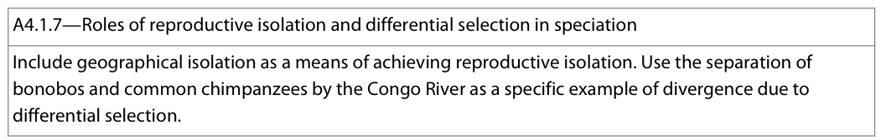
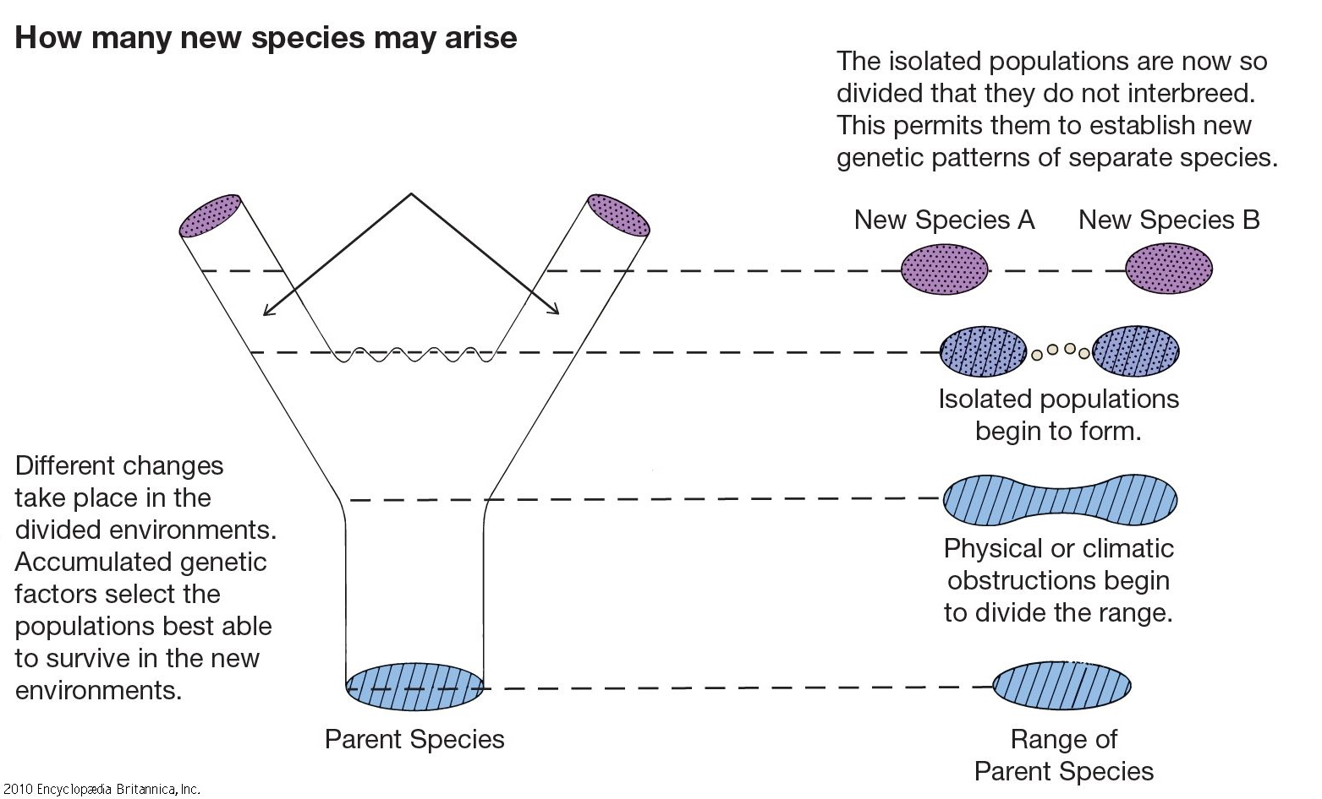
Speciation can occur when the exchange of genes, or gene flow, between populations of a species is prevented, (ex: due to them being separated on different islands)
  When gene flow stops, genetic differences can accumulate between the two populations
  This may happen faster if different selection pressures are acting on the two populations
A speciation split has occurred when the two populations can no longer interbreed to produce fertile offspring; at this point the two populations are said to be reproductively isolated from each other
Reproductive isolation: lack of interbreeding and geneflow between populations. Can occur due to:
Geographical isolation
Temporal isolation (HL)
Behavioural isolation (HL)
Notes:
Without a barrier and reproductive isolation, populations would continue to mix and exchange alleles – mainitaining the variety present in the initial population but not allow new species to emerge

Slide 19
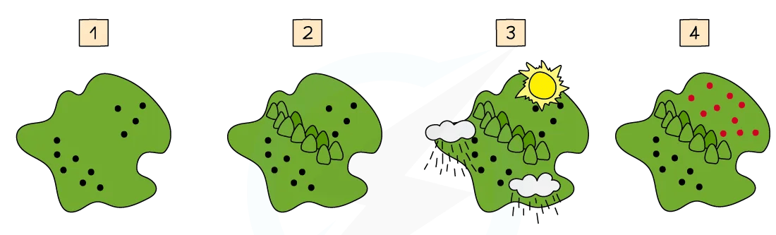
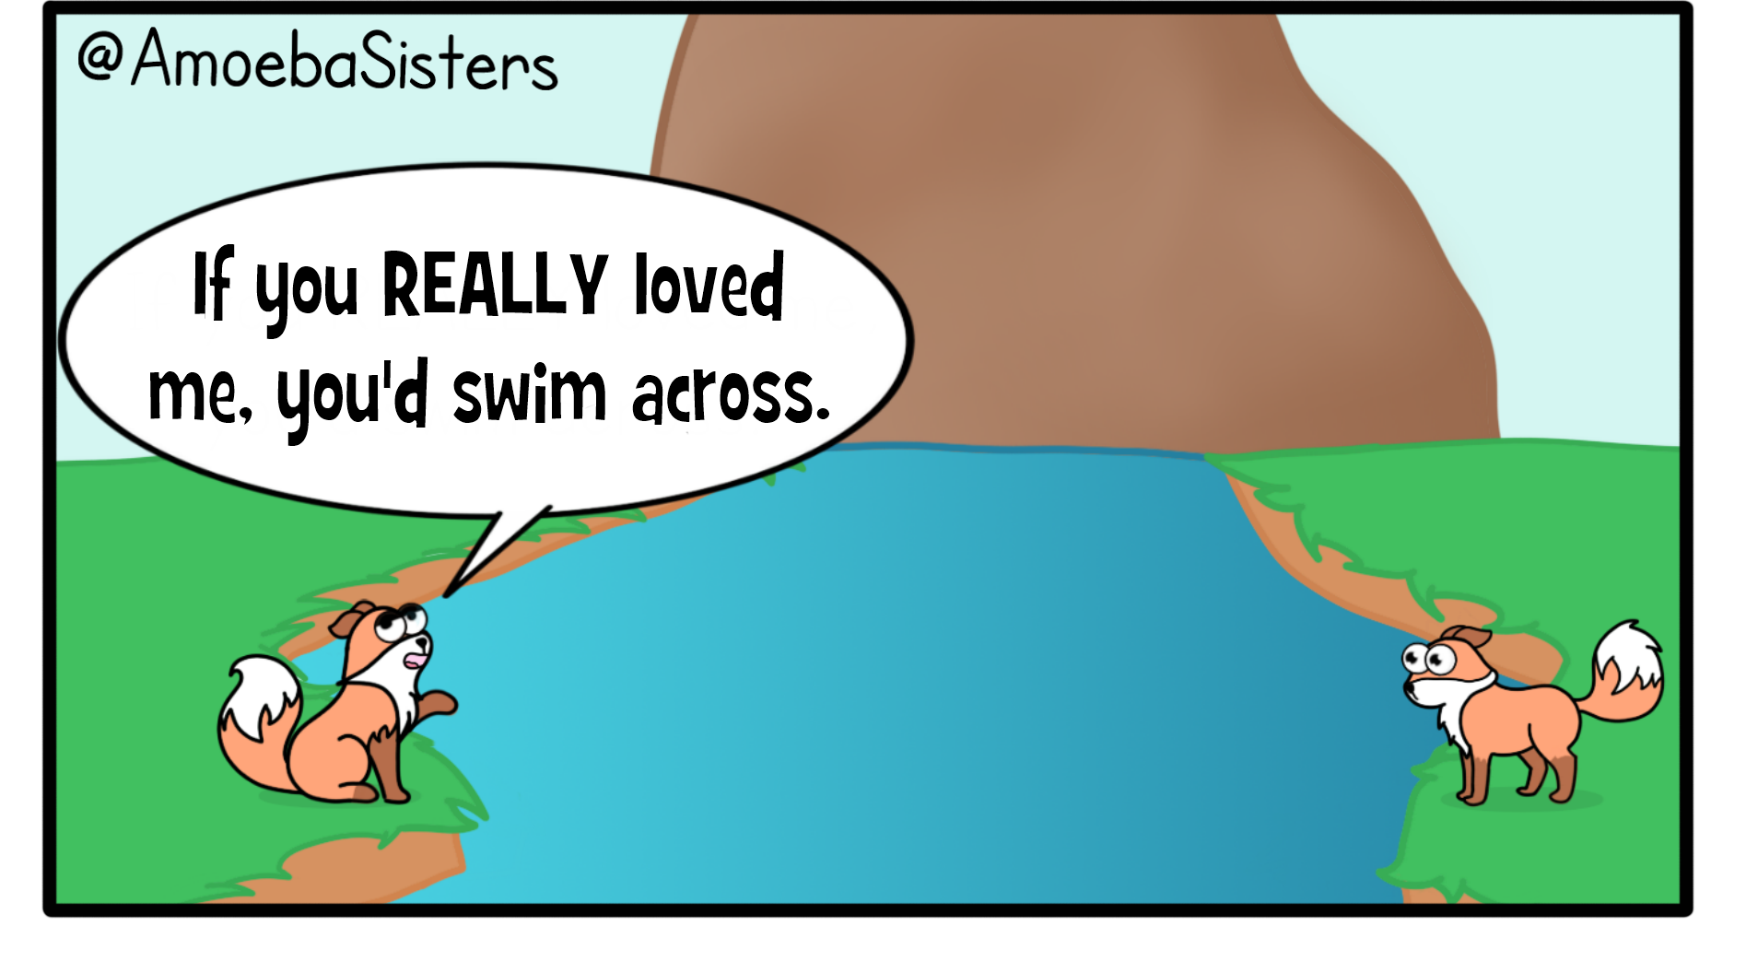
Geographical isolation: physical barrier that leads to populations becoming isolated, leading to speciation
→ can be due to plate activity, formation of mountains, bodies of water, deserts, clearing in forest etc.
Original population. Unobstructed gene flow
Geographical barrier divides population into 2 separate groups, physically preventing interbreeding and geneflow between populations
After many generations, populations become adapted to different local conditions (due to differential selection) and become genetically different from each other
Reproductive isolation occurs and the species cannot interbreed to produce fertile offspring if they meet → speciation has occurred

Slide 20
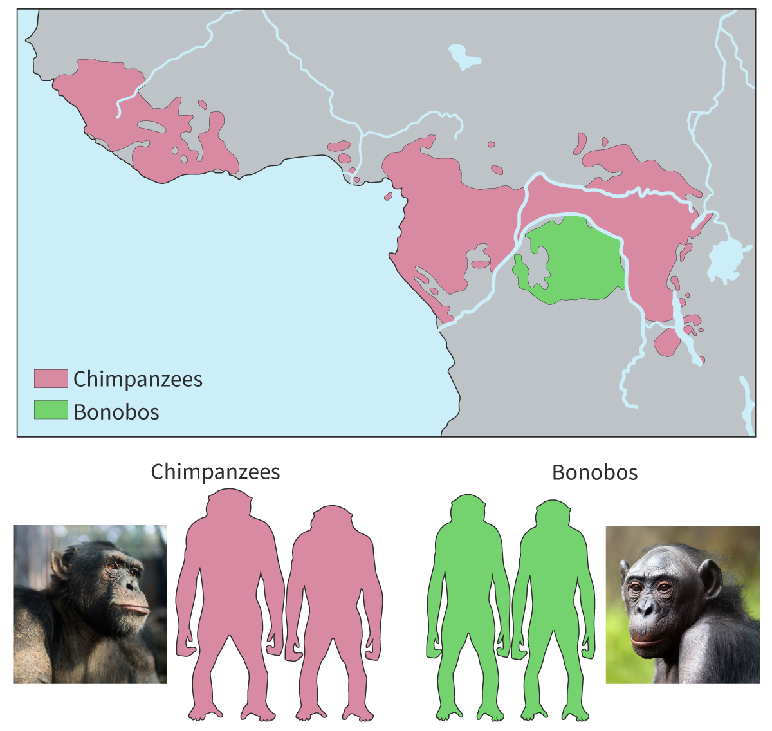
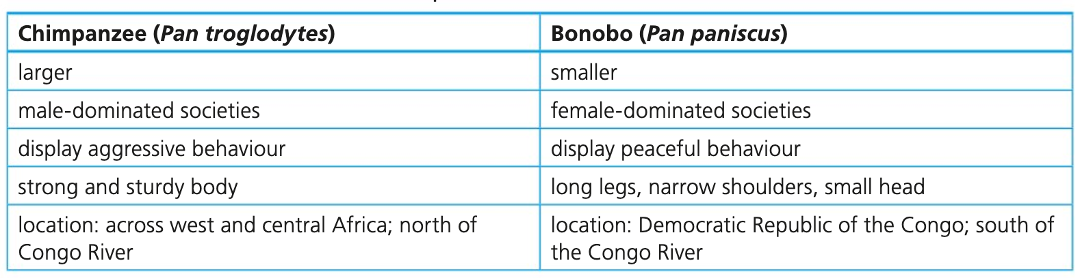
Example of geographical isolation as a means of reproductive isolation: Bonobos and Chimpanzees
Bonobo (Pan paniscus) and Common Chimpanzee (Pan troglodytes) are different species of great ape, belonging to the same genus – Pan. Their ranges do not overlap. These species emerged as a result of geographical isolation due to the Congo River.
A population of the common ancestor or bonobos and chimpanzees resided in Africa around and North of the Congo River
At some point, the level of the Congo River decreased, allowing a portion of the population to migrate South (as they cannot swim)
The Congo River water level increased, isolating the southern population
The environmental conditions north and south of the river were different, leading to the isolated populations to diverge due to differential selection
Overtime, the isolated populations became reproductively isolated, leading to two separate species
Notes:
https://www.bonobos.org/post/bonoboschimpsandthecongoriver

Slide 21

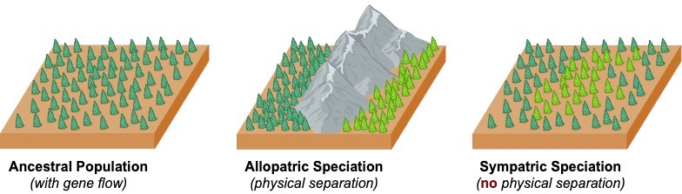
Allopatric speciation: Evolution of one or more new species from an ancestral species due to a geographical (physical) barrier. The barrier leads to geographic isolation, preventing geneflow and leads to reproductive isolation and speciation.
Sympatric speciation: Evolution of one or more new species from an ancestral species while living in the same geographical area. Behavioural or temporal isolation prevents geneflow and leads to reproductive isolation and speciation

Slide 22
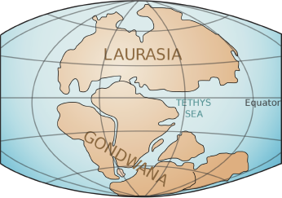
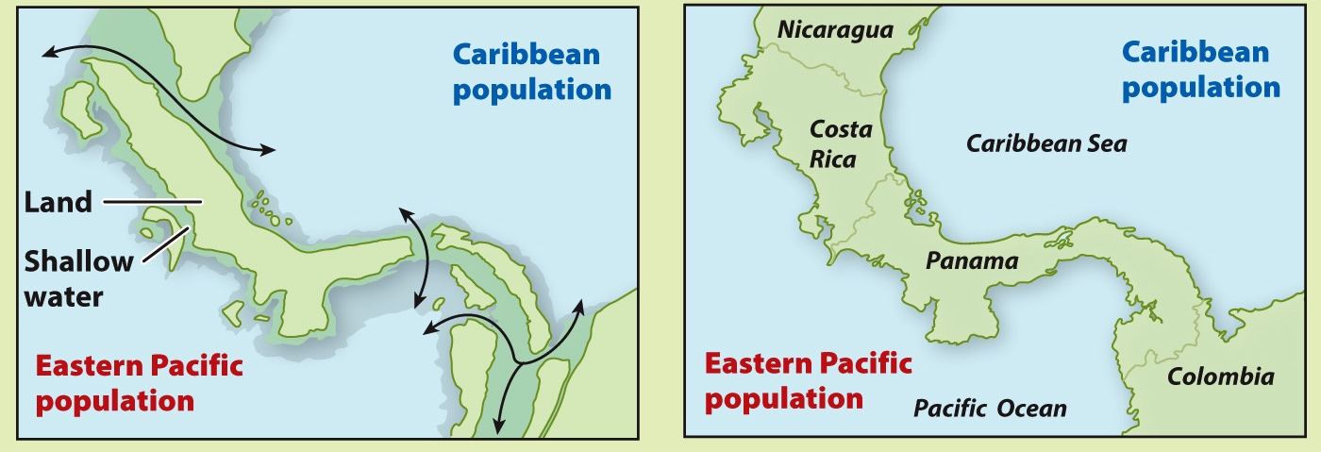
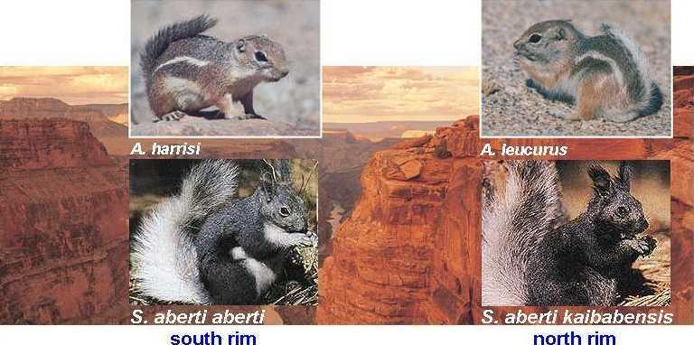


Geographic isolation examples:
Flightless birds
At one time Africa, Australia, New Zealand, South America were all connected (Gondwana)
When it split up, large flightless birds each began to evolve separately and became their own species
Evidence: these large flightless birds only appear on Gondwana continents
Isthmus of Panama
a land bridge formed between North and South America and this divided the waters on either side
the closure of the Isthmus led to speciation events of marine organisms isolated on each side (blue and green).
Examples are shrimp (Alpheus)
Arizona squirrels
When Arizona's Grand Canyon formed, squirrels that had once been part of a single population could no longer contact and reproduce with each other across this new geographic barrier.
They could no longer interbreed. The squirrel population underwent speciation. Today, separate squirrel species inhabit the north and south rims of the canyon

Slide 23




Behavioural isolation: prevents species from interbreeding due to differences in reproductive behaviour such as courtship rituals and mate preference
Behavioural isolation examples:
Meadowlark birds
While the ranges overlap, the Western and eastern meadowlark will not mate due to differences in songs to attract mates
Courtship rituals in birds of paradise
Many species of birds of paradise have complex mating rituals unique to their species. Despite being nearby, different species will not interbreed due to specificity in mate selection
Fireflies
Many different species of fireflies produce different light patterns of flashes to attract members of the opposite sex of their own species
Notes:
https://besjournals.onlinelibrary.wiley.com/doi/full/10.1111/1365-2656.12824

Slide 24




Temporal isolation: prevents species from interbreeding due to differences in the timing of mating or fertility, such as having different mating seasons.
Temporal isolation examples:
Skunks
Eastern and Western spotted skunks ranged overlap
Eastern spotted skunk (S. putorius) reproduces in late winter but Western spotted skunk (S. gracilius) reproduces in late summer
Magicicada Cicadas
Some cicadas, such as M. seotendecim only breeds every 17th year
At some point, a switch to breeding ever 13th year occurred in some individuals, causing reproductive isolation, leading to a new species such as M. neotredecim
Rana Frogs
Wood frog (R. sylvatica) mates in late March or early April when water temperature is ~7.2°C
Leopard frog (R. pipens) mates in mid April when water temperature is ~12.8°C
Pine trees
Monterey pine (P. radiata) and Knobcone pine (P. attenuate) cannot hybridize as they have different pollination times

Slide 25


Natural selection can result in the rapid evolution of multiple species from a common ancestor → adaptive radiation
These new species are likely to have some similar features due to their shared ancestry (homologous structures)
Differences that arise between the new species often enable them to live together in one habitat because they are able to fill different ecological niches
  Ecological niche: The position of a species within an ecosystem or community and its interrelationships with both biotic and abiotic factors. I.e. An organism's role within its ecosystem, e.g. the food that it eats, the environmental conditions that it requires, the predators that it provides food for, etc.
Adaptive radiation allows closely related species to coexist without competing, increasing biodiversity in ecosystems where there are vacant or new niches available

Slide 26


Interspecific hybrids: produced from cross-breeding members of different species. Can be done deliberately by plant or animal breeders or can occur naturally if the ranges of closely related species overlap.
→ Interspecific hybrids are often sterile thus in evolutionary terms, resources expended to produce these are not favourable and ‘wasted’. Therefore, barriers have evolved to prevent hybrid development and keep gene pools separate.
Prezygotic barrier –prevent members of different species from mating to produce a zygote. Occurs before fertilization.
Postzygotic barrier – keep hybrid zygotes from developing into healthy, fertile adults. Occurs after fertilization.

Slide 27

Two species have different courtship behaviors or mate preferences
Ex:
Females of a species are only attracted to key songs or courtship displays of males of their species (birds of paradise, blue-footed booby)
Two species have bodies or reproductive structures that simply don't fit together
Ex:
The male reproductive organs of related species of damselfly, have distinctive shapes. Each enables the male to mate only with females of its own species.
Snails (right-handed and left-handed spirals)
Two species prefer different habitats and thus be unlikely to encounter one another.
Ex:
tigers and lions live in different areas and habitats and unlikely to meet.
Two species reproduce at different times of the day or year and thus be unlikely to meet up when seeking mates
Ex:
Frog species may live in same pond but reproduce at different times of the year
Two species produce egg and sperm cells that can't combine in fertilization, even if they meet up through mating
Ex:
Sea urchin species release eggs and sperm into the water for fertilization, but gamete incompatibility prevents certain cross-species hybrids from forming
Hybrids fail to produce functional gametes (sterility)
Ex:
Mules from horses and donkeys are sterile
Hybrids are produced but fail to develop to reproductive maturity
Ex:
The hybrid embryos of sheep and goats, for example, die in the early developmental stages before birth

Slide 28




Normally, speciation is a gradual, slow process taking many generations.
Abrupt speciation is when a new species is created in a single generation due to sudden different in chromosome number in offspring, leading to reproductive isolation
Polyploidy: process that results in more than 2 sets of homologous chromosomes.
Autopolyploidy occurs when a polyploid offspring is derived from a single parental species (usually via self fertilisation). New species emerges by chromosome doubling of the same species.
Allopolyploidy occurs when a polyploid offspring is derived from two distinct parental species. Allopolyploid species originates through merging the the entire chromosomal sets of both parental species.

Slide 29


Autopolyploidy mechanism
  During meiosis of a diploid species (2n) the separation of homologous pairs does not occur correctly (total nondisjunction) or a gamete fails to undergo cytokinesis → daughter cell may contain two sets of chromosomes (2n instead of n)
  → resulting diploid (2n) gamete can then fuse with a normal gamete to produce a 3n zygote (sterile hybrid), or with another diploid gamete to produce a 4n zygote, forming a new species. In plants polyploid plants are often larger and more vigorous than their diploid parents

Slide 30


Allopolyploidy mechanism
  Merging of gametes from different species (hybridization) can result in allopolyploidy via several pathways:
  One-step: two unreduced gametes merge, resulting in a polyploid species
  Triploid bridge: reduced gamete merges with an unreduced gamete, forming a triploid hybrid that then merges with a reduced gamete in a subsequent generation
  Two-step: two reduced gametes merge, forming a homoploid hybrid, which doubles resulting in unreduced gametes which fuse forming a polyploid

Slide 31

Example of speciation via polyploidy: Persicaria (knotweed)
The plant genus Persicaria (commonly known as knotweeds) includes over 130 species many of whom have been formed via polyploidy.
Some examples:
Persicaria foliosa is diploid (2n)
Persicaria japonica is tetraploid (4n)
Persicaria puritanorum is hexaploid (6n)
It is hypothesized that tetraploid species could have arisen by allopolyploidy between two diploid species, and that hexaploid species could have arisen by a hybridisation event between a diploid and a tetraploid species
Notes:
https://www.pnas.org/doi/10.1073/pnas.0805141105

