Slide 1
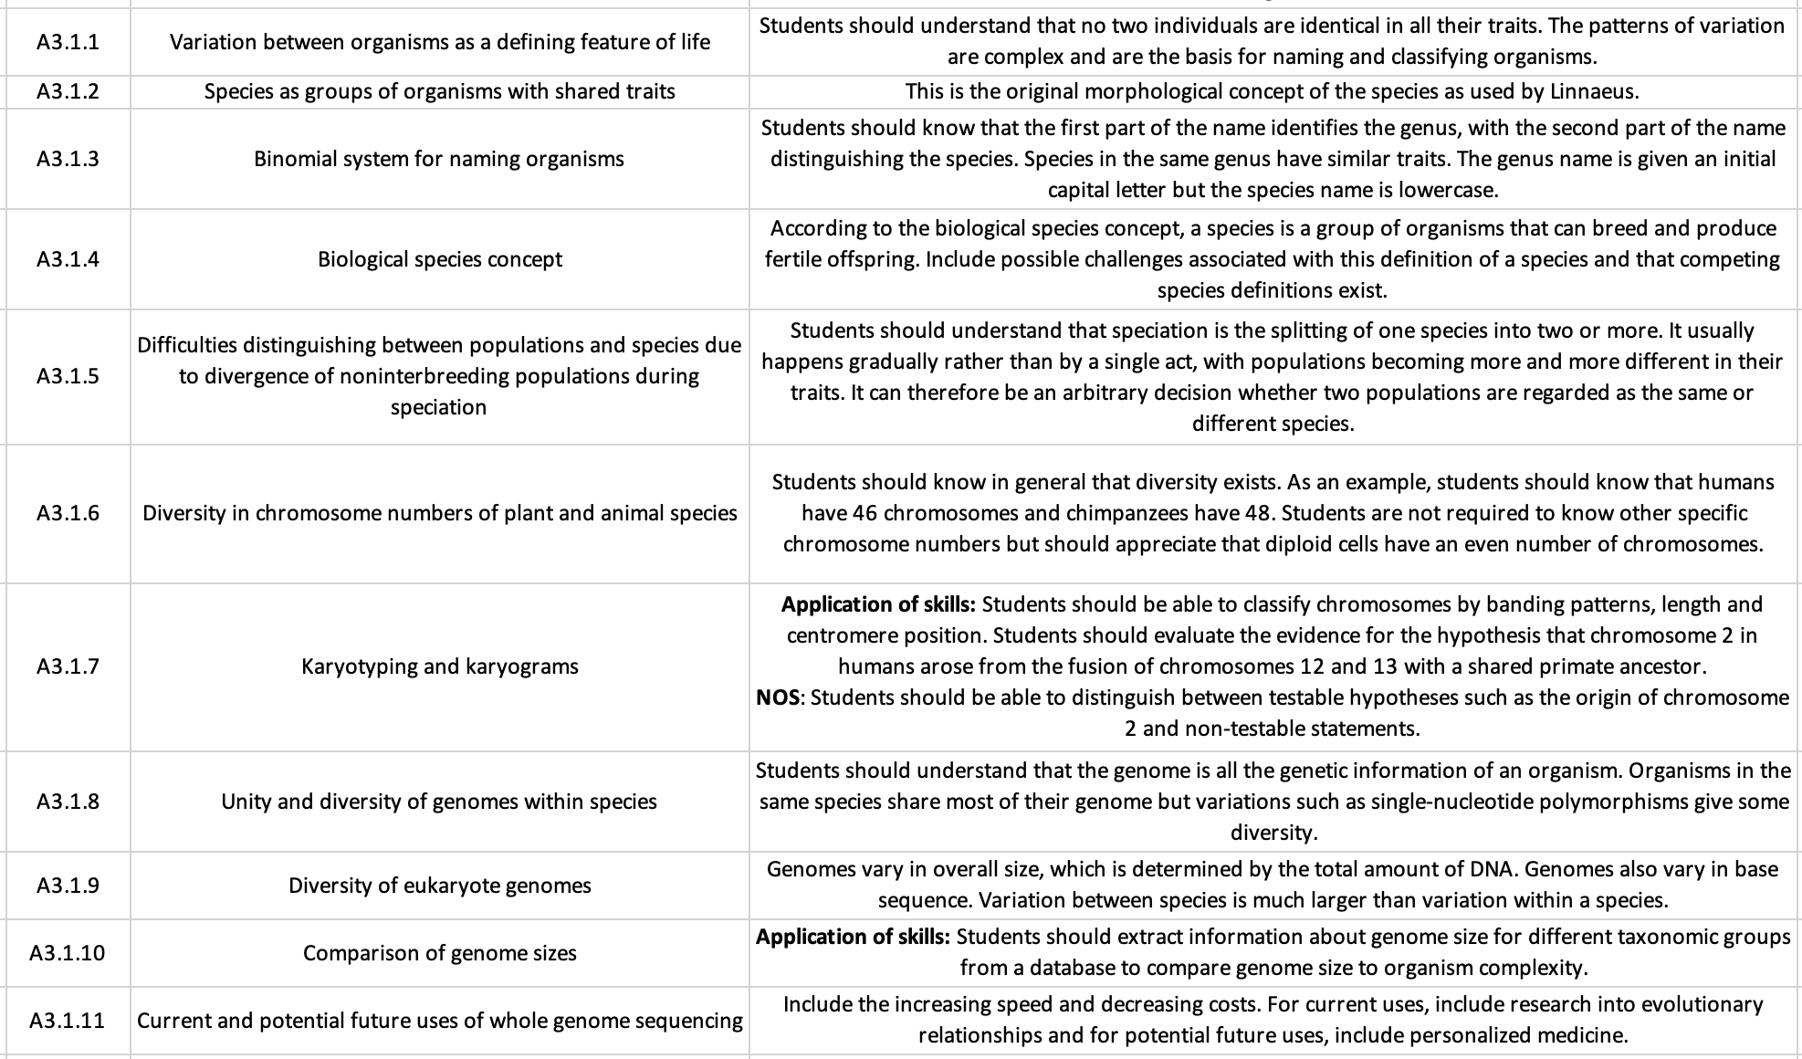
SL Learning Outcomes
ipad notes will replace these at a later date

Slide 2
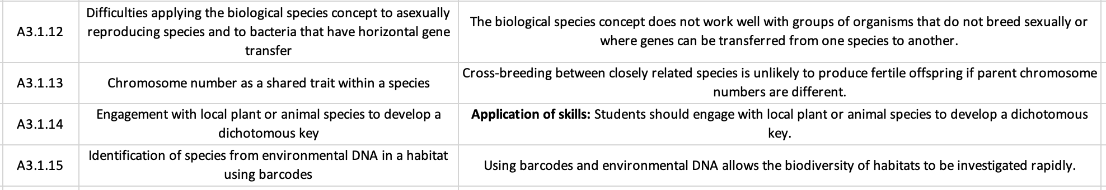
AHL Learning Outcomes

Slide 3
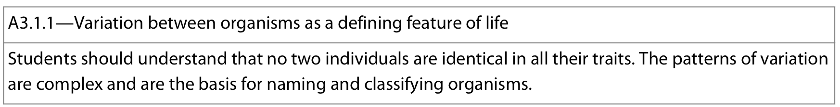
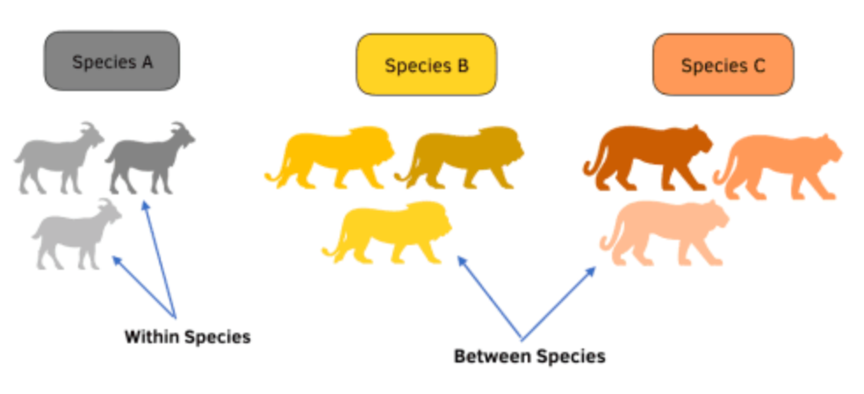
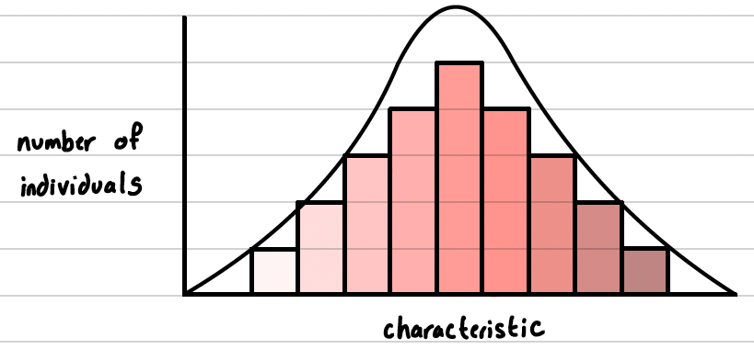
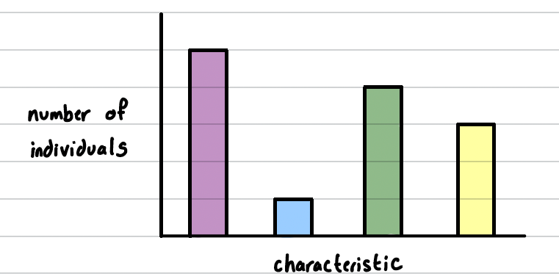
All organisms display variation – no two individual organisms are identical in all traits (ex: morphology, behaviour, metabolism)
This variation is a defining feature of life
Interspecific variation: variation across different species
Intraspecific variation: variation across individuals of the same species
Intraspecific variation will be less than interspecific variation
Complex patterns: caused by both genes and interaction with environment
Patterns of variation form the basis of naming and classifying organisms
More similarity between organisms implies closer evolutionary relationship (more recent common ancestor) and relatedness
Different types of variation:
Continuous variation
Discontinuous/discrete variation
Ex: height, weight, surface area
Ex: blood groups
Notes:
*even monozygotic twins display variation due to gene expression differenes with the environment

Slide 4
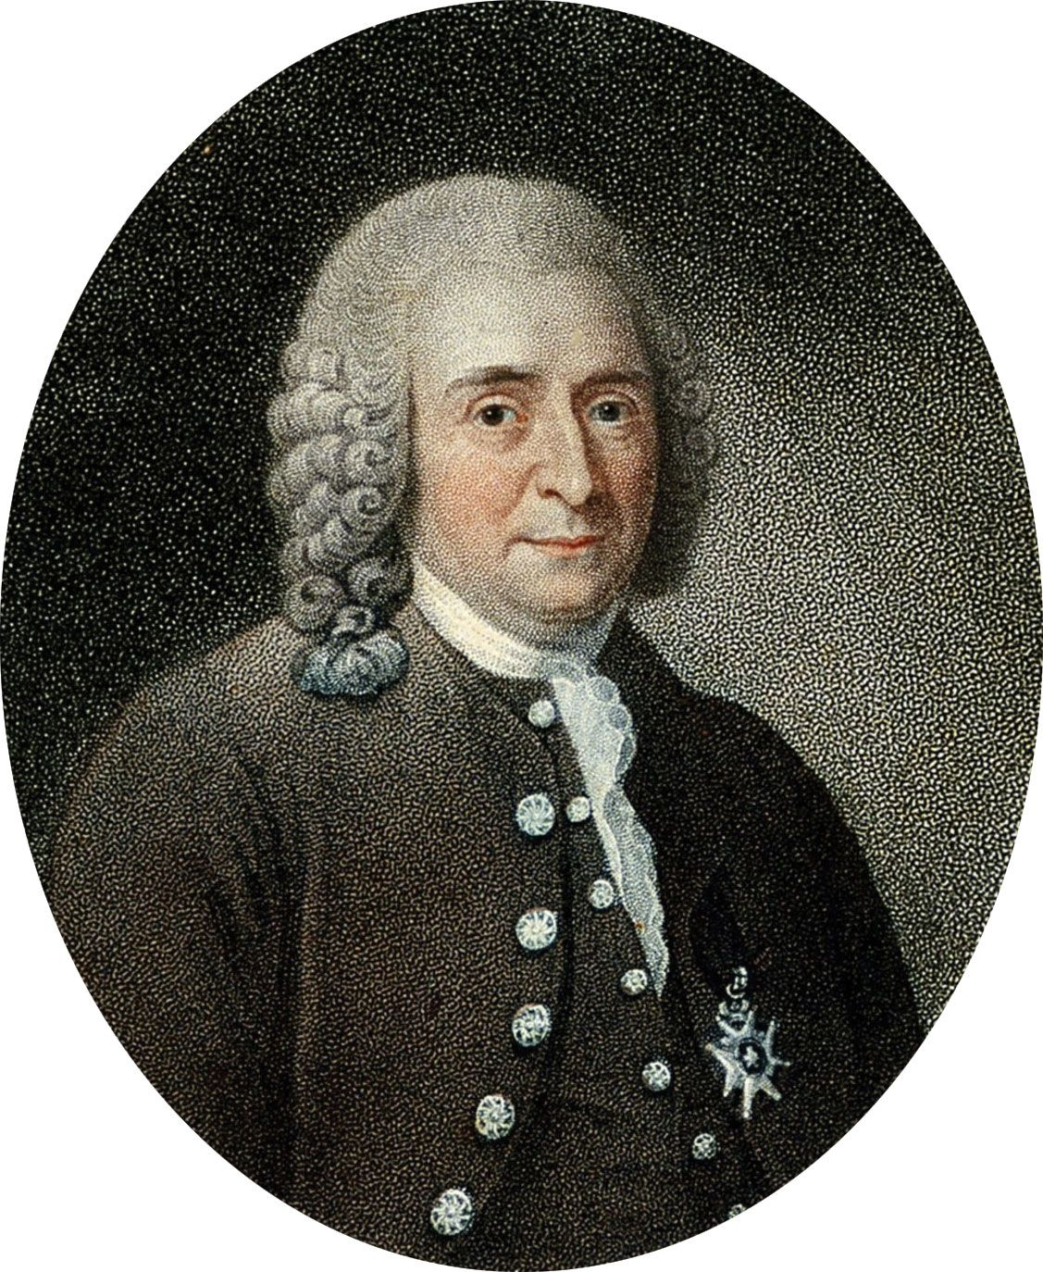
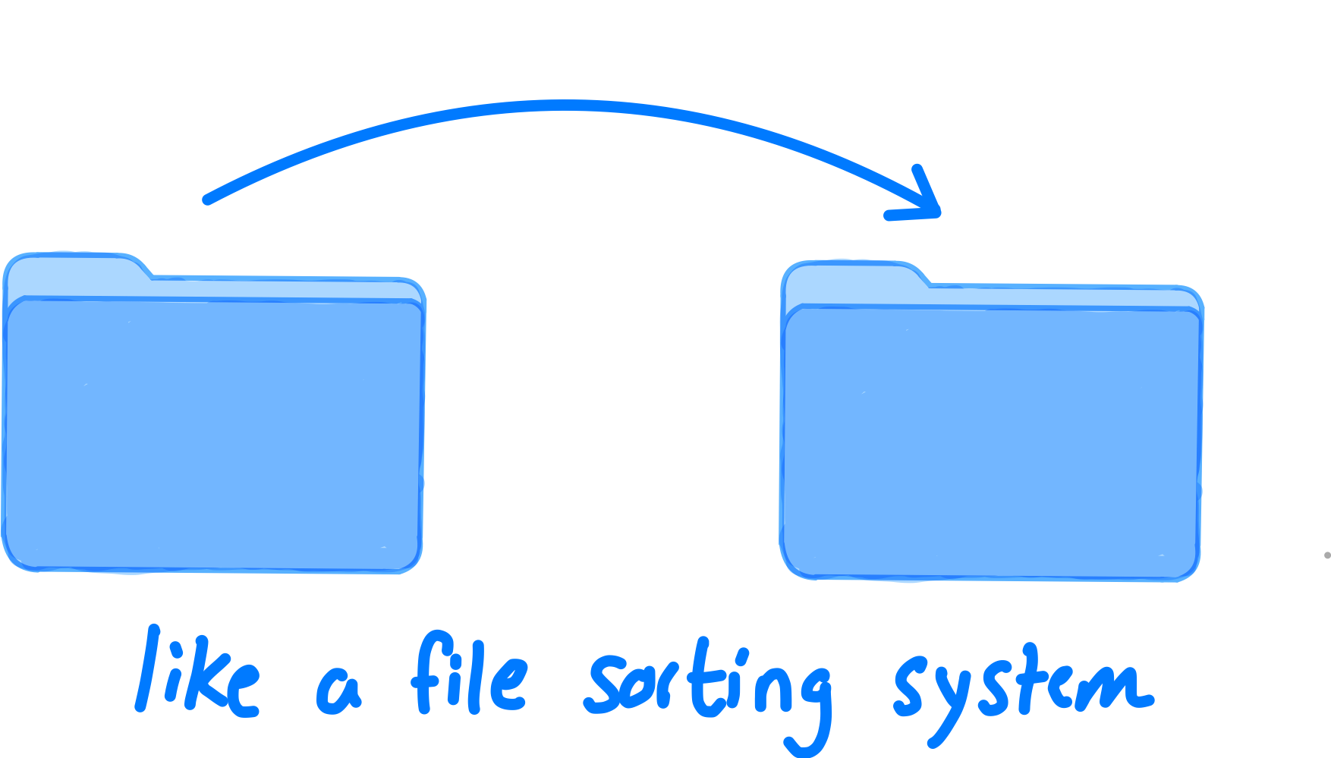
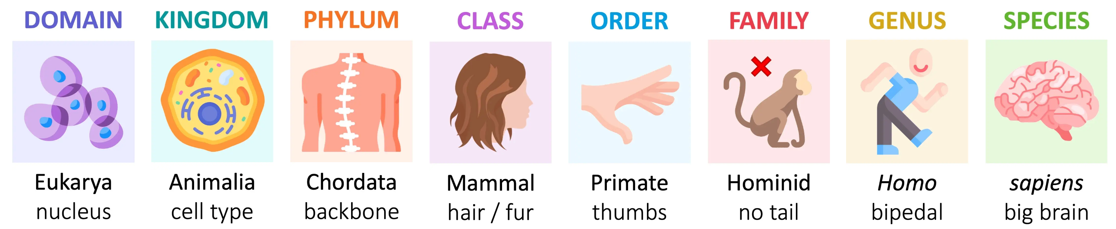
Morphological species concept defines “species” as a group of organisms with shared traits
Morphology: the form and structure of an organism or any of its parts
Carl Linnaeus originally classified organisms into species based on morphological characteristics
The Linnaean system of classification (taxonomy) consists of a hierarchy of groupings (taxa), where each taxon shares common characteristics. As you move from Domain to Species, taxa contain fewer organisms and share more characteristics in common with each other
Grouping organisms on morphology alone has limitations:
Genetically diverging populations may be hard to distinguish as separate species
Morphologically similar groups may be the result of convergent evolution and not closely related/same grouping

Slide 5
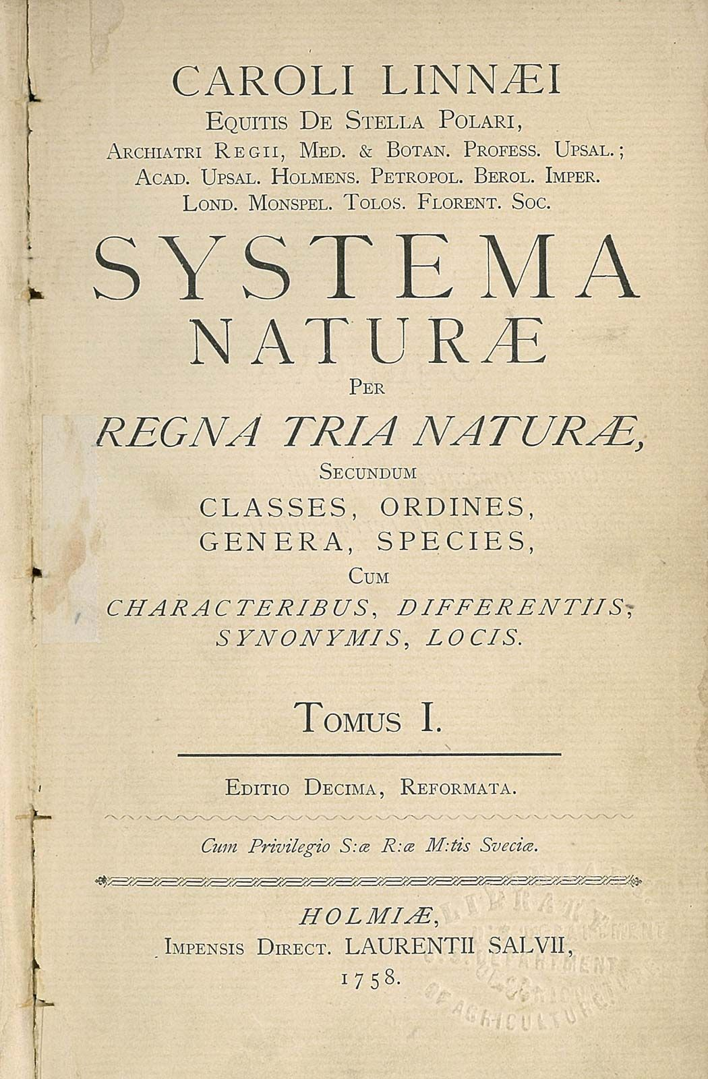
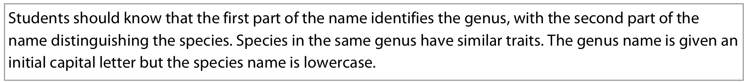
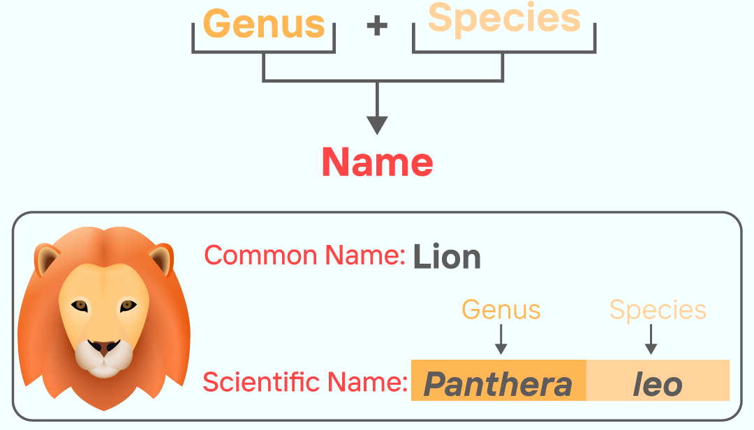

“two name”
Binomial system of nomenclature is the formal system by which all living species are classified
→ Developed by Linnaeus in 1700s and is updated periodically at a series of international congresses.
→ every species is designated a scientific name with two parts:
→ Genus is written first and is Capitalized, followed by species in lower case
When typed it is written in italics Homo sapiens
When handwritten it is underlined
If full name previously mentioned can be appreciated H. sapiens
The binomial system of nomenclature is advantageous:
Every organism has a unique name – no confusion/duplicates/ambiguity
Allows for the identification and comparison of organisms based on recognized characteristics
Allows all organisms to be named according to a globally recognized scheme → international collaboration/cooperation
Can show how closely related organisms are, allowing for the prediction of evolutionary links
Facilitates collection, sorting and grouping information about organisms
Notes:
Some awesome species names:
Agra schwarzenegger – beetle with large legs
Dracula vampire – orchid named after famous vampire
B. articuno, B. moltres, and B. zapdos – Australian beetles named after pokemon

Slide 6
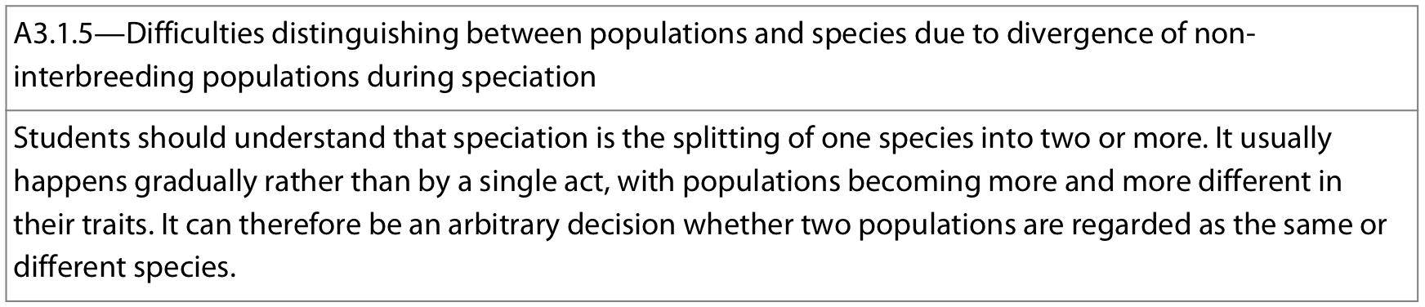
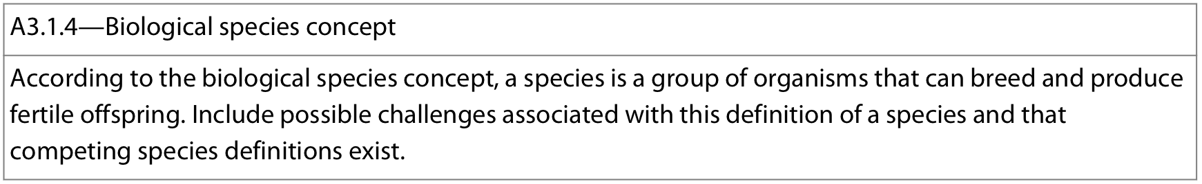
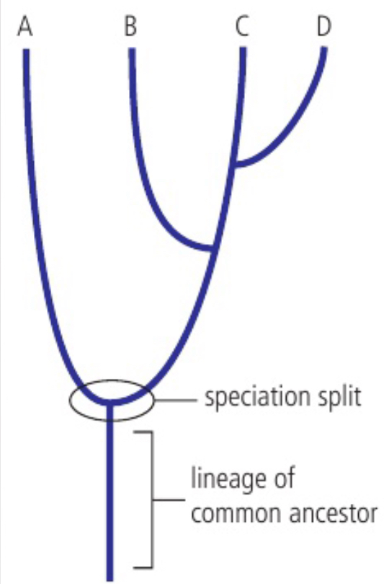
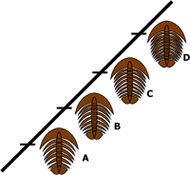
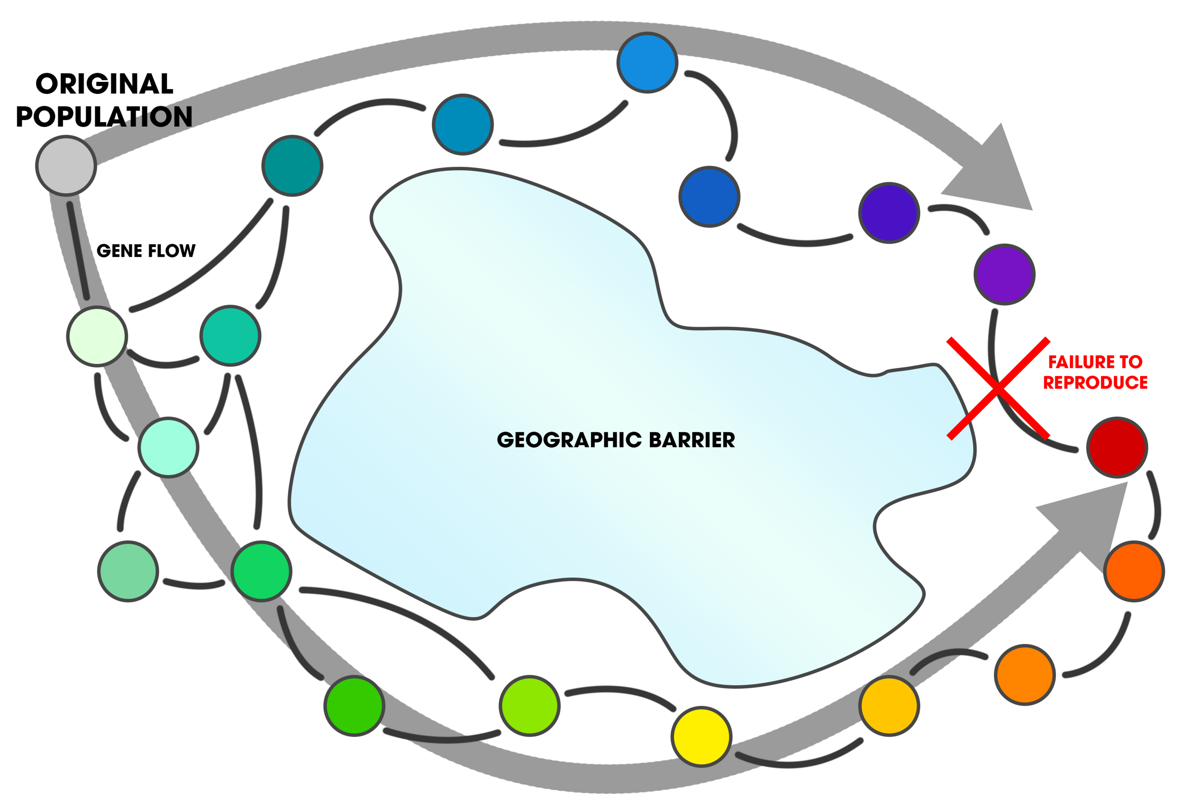
Biological species concept defines “species” as a group of organisms that can interbreed and produce fertile offspring
fertile: able to conceive young/produce seed
→ if organism A can breed with organism B and produce fertile offspring → A and B same species
→ if organism A cannot breed with organism B / cannot produce fertile offspring → A and B different species
There are challenges with this definition:
Asexual reproduction - asexual reproducing organisms cannot be classified using this method
Fertile hybrids - On rare occasions, animals of different species breed together and produce fertile offspring – should these be considered different or the same species?
Extinct organisms - Some species are extinct, so it is not possible to breed them together with members of an existing species to determine the fertility of their offspring and determine if separate species
Chronospecies - a single lineage whose morphology changes with time.
Decision on where to divide lineage into separate species can arbitrary
as definition considers species at only a single point in time
(the present) and ignores the evolutionary and ecological
processes that shaped reproductive isolation between groups
Ring species - species with multiple populations in a geographic distribution that
forms a ring and overlaps at the ends → where do we mark the point of speciation?
**speciation involves the splitting of one species into 2 or more. On cladograms they may
appear sudden but they are typically gradual events, where reproductively isolated populations
become more and more dissimilar → difficult to determine when they are separate “species”
Notes:
While hybridisation can lead to new species, it needs to be a frequent event

Slide 7
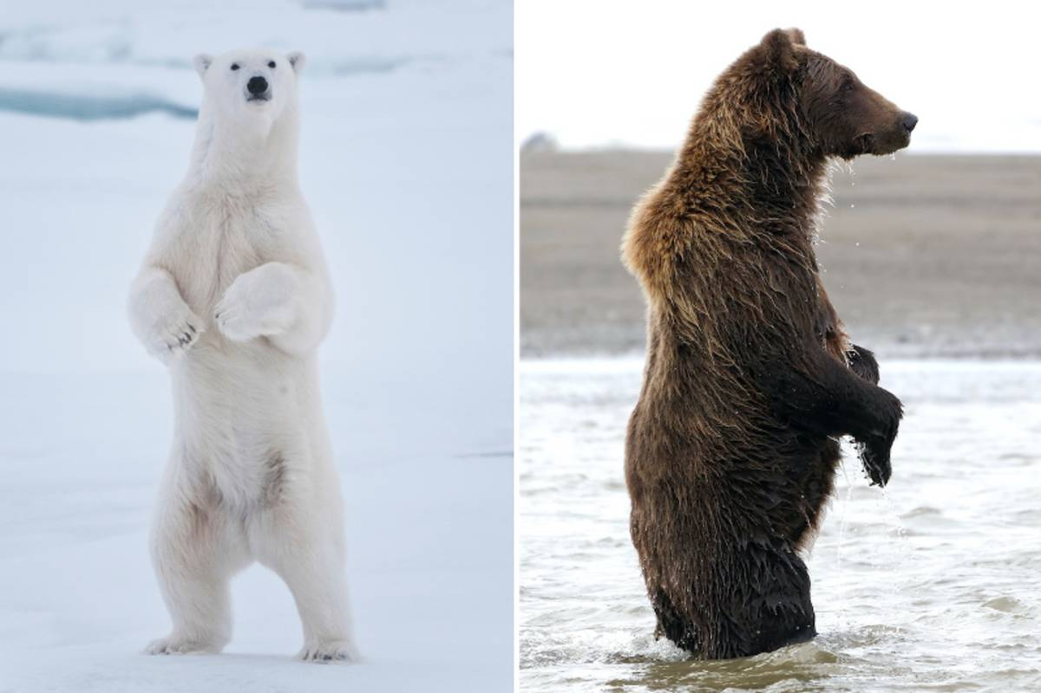
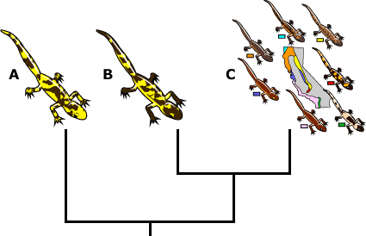
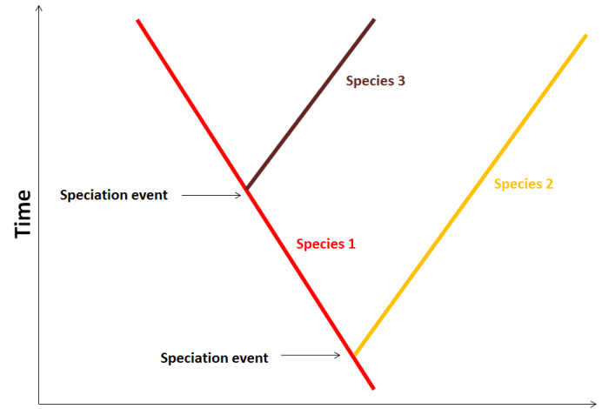
Alternative definitions for “species” other than biological species concept:
→ useful video → useful articles: Article A - part 1 Article A - part 2 Article B article C
Ecological species concept - An ecological species is a set of organisms belonging to a single or closely related lineages that basically occupy the same niche in an ecosystem
Recognition species concept: a species is a set of organisms that can recognize each other as potential mates.
Phenetic species concept - a species is a set of organisms that are phenotypically similar and that look different from other sets of organisms
Cladistic/Phylogenetic species concept - a species is a “tip” on a phylogeny, that is, the smallest set of organisms that share an ancestor and can be distinguished from other such sets
Evolutionary species concept - a set of organisms from a single lineage that has its own evolutionary tendencies and historical fate. The evolutionary species does not necessarily become extinct when another lineage split from it, so being able to be paraphyletic, i.e., if a population is divided in two, the one that continues to have the same general features and the same evolutionary path is considered the same species as the ancestral one.
And many many more…
These lines of evidence are not mutually exclusive and so multiple species concepts may be used together to define species boundaries.

Slide 8
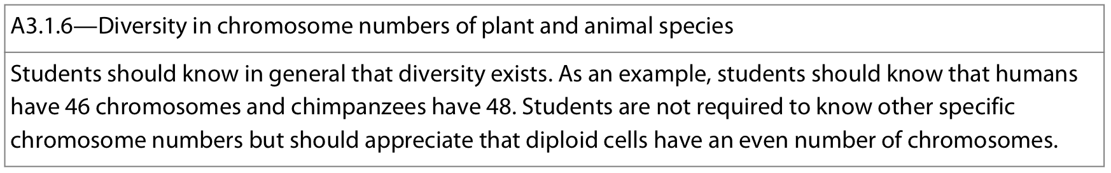

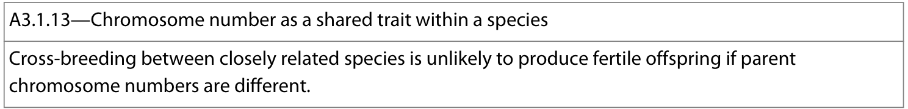
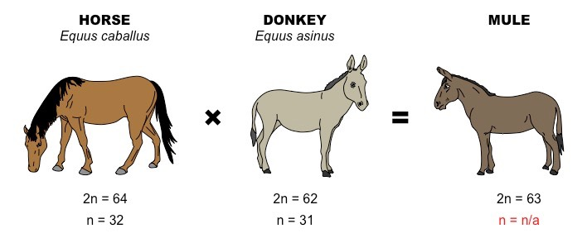
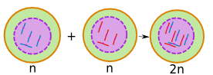
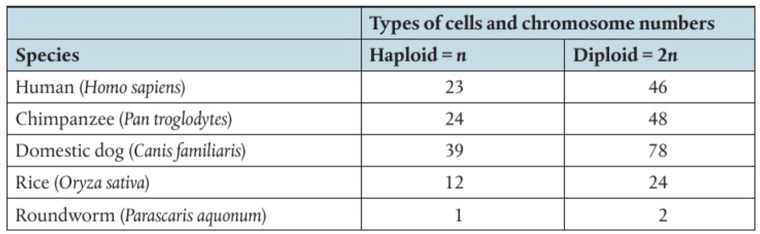
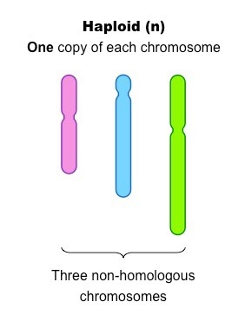
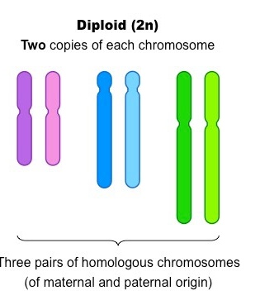
There is significant diversity in the number of chromosomes in animal and plant species → good list
The number of chromosomes is a characteristic feature of a members of a species as in order to interbreed, there must be comparable genetic profiles (genetic information of each parent must be organized onto the same number of chromosomes, with comparable sizes and gene loci positions).
Therefore, organisms with different diploid numbers are unlikely to be able to interbreed as the chromosomes cannot form homologous pairs
The chromosome number that is given for each species is the number of chromosomes in a somatic (body cell)
If diploid (2n), then the number will be even (n+n = 2n)

Slide 9
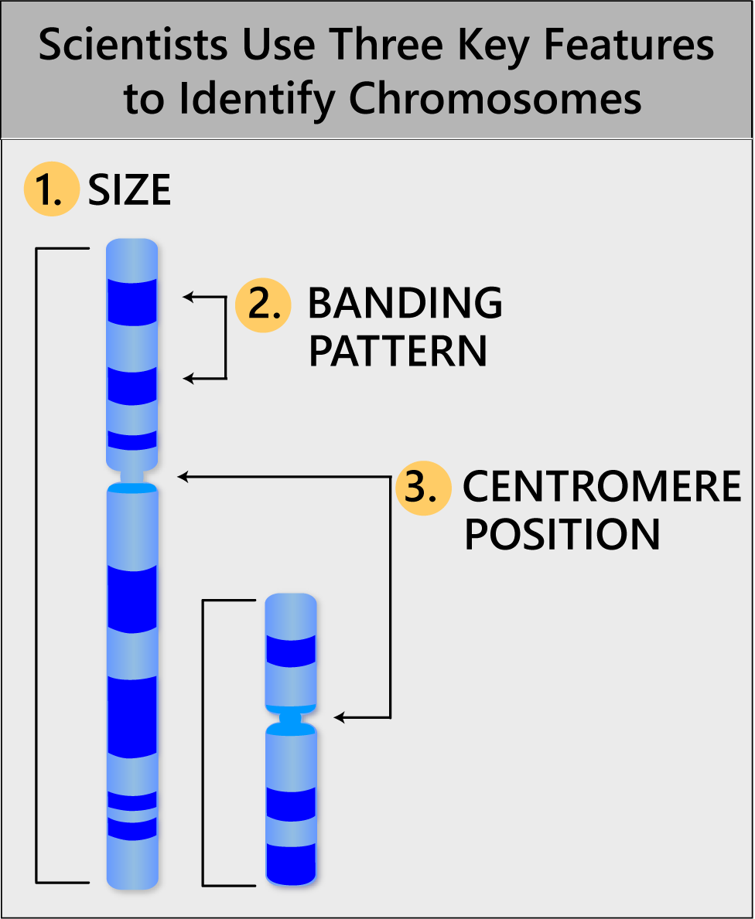
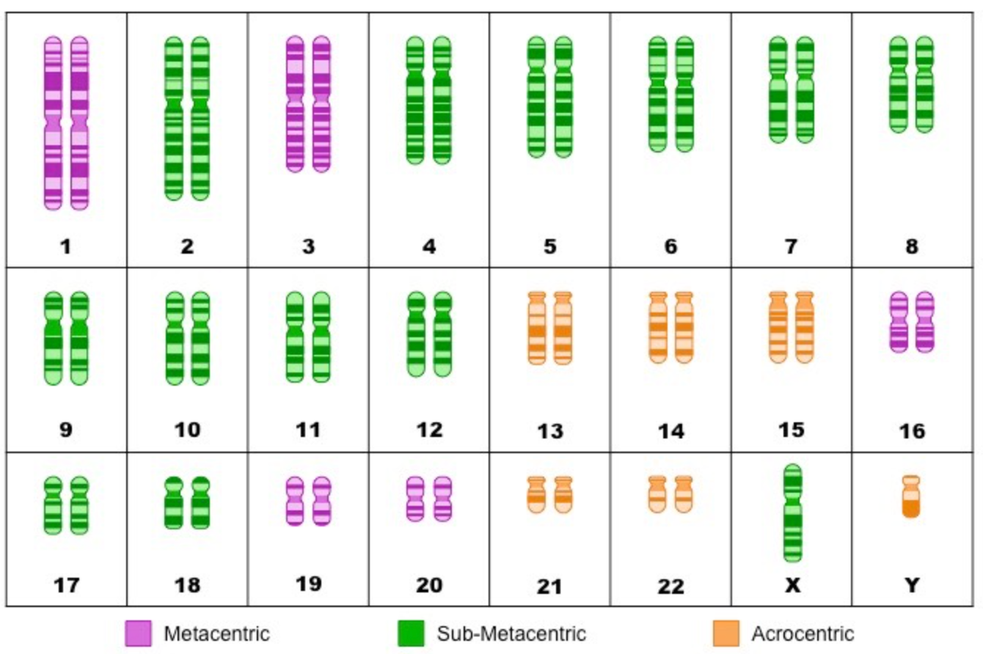
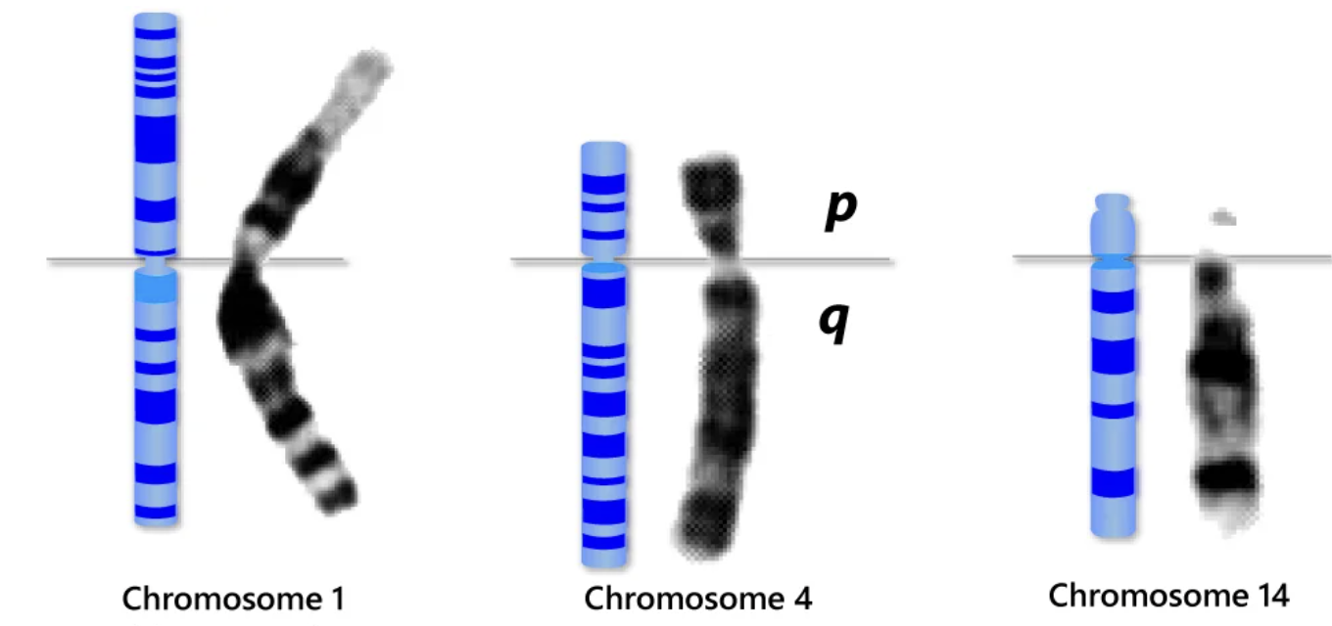
Karyotype: number and type of chromosome present in a cell or organism
→ Karyotyping: process of pairing and ordering the complete set of chromosomes within a cell to provide a snapshot of an organism’s genetic profile. The chromosomes can then be photographed to generate a visual representation called a karyogram
Karyogram: photographs/diagrams in which the chromosomes of an organism are shown in in homologous pairs of decreasing length
Preparation: (1) cells are cultured + allowed to divide. (2) Chemicals used to arrest cells in metaphase (organized and condensed) (3) stained (4) observed/photographed using a microscope (5) organized in decreasing size

Slide 10
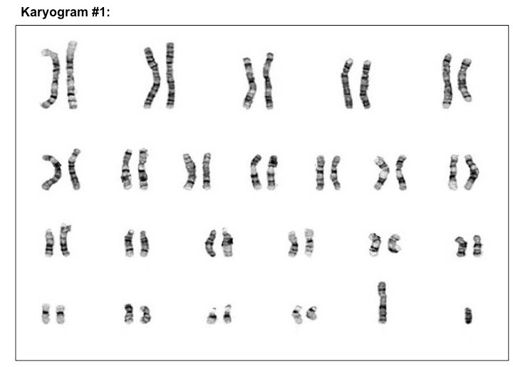
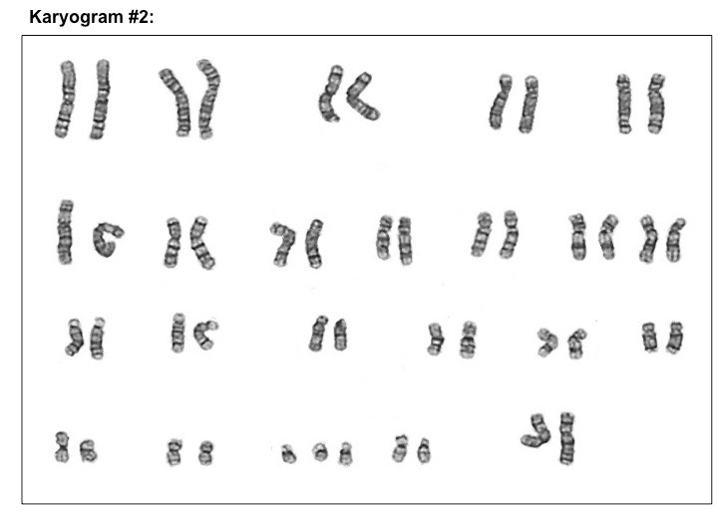
Applications of karyograms:
Determine type of species (chromosome number is a characteristic feature of a species)
Determine sex of the organisms (in humans, males are XY and females are XX)
Identify any chromosomal abnormalities (e.g. translocations or aneuploidies)
→ Practice here and here

Slide 11
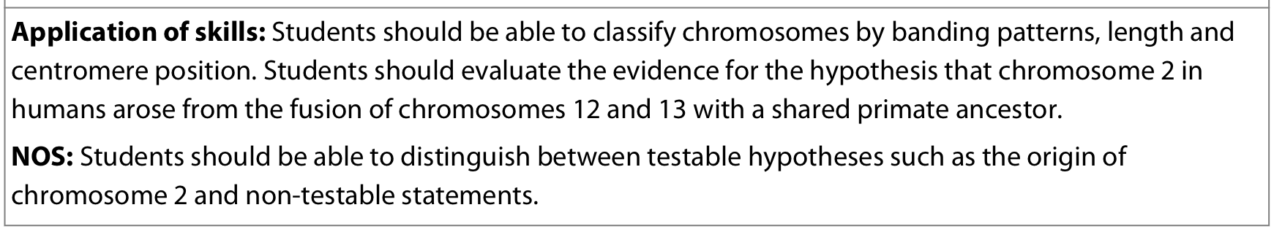
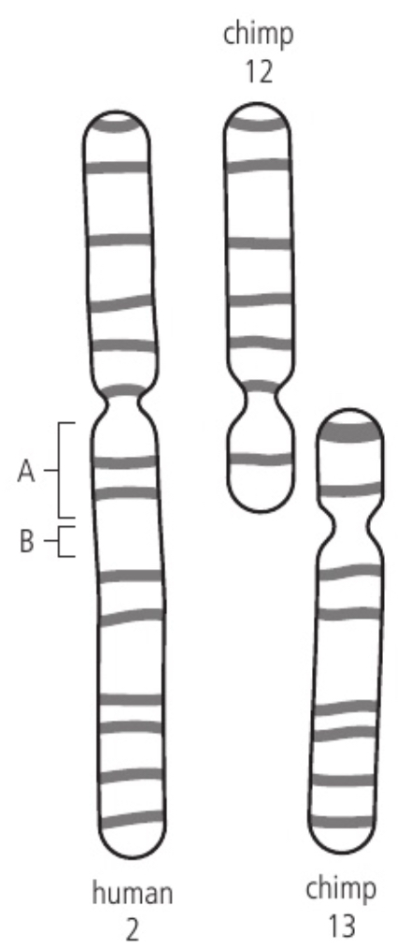
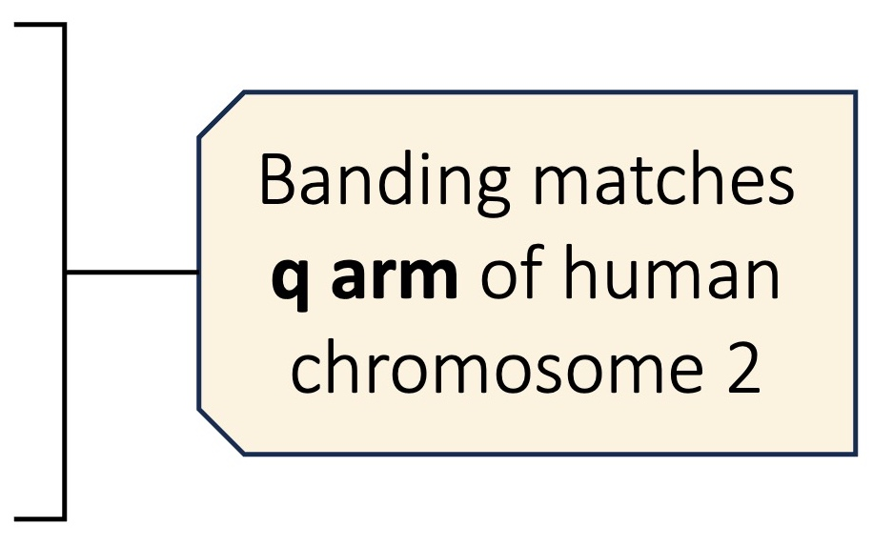
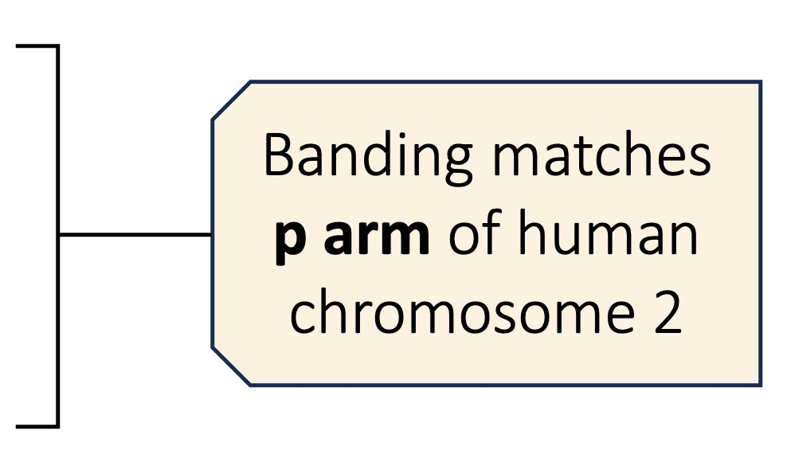
Chromosome number is a characteristic feature of members of a particular species and can be used to deduce evolutionary relationships. For example: Humans have 46 chromosomes while chimpanzees have 48 chromosomes
→ Humans and chimps share a recent common ancestor and it is hypothesized that chromosome 2 in humans arose from the fusion of chromosomes 12 and 13 in the primate ancestor → article
Comparing chromosomes in humans and modern chimpanzees provides strong evidence that supports the hypothesis of a past chromosomal fusion event:
The combined length of chromosomes 12 and 13 in chimpanzees match the length of human chromosome 2
The centromere location of human chromosome 2 matches that of chimpanzee chromosome 12
Part of human chromosomes 2 (site B) contains satellite DNA (normally in centromeres) which correspond to centromere in chimp chromosome 13
The banding of the arms of human chromosome 2 matches the long arms of chimpanzee chromosomes 12 and 13
Human chromosome 2 contains telomeric DNA (normally in telomere on tips of chromosomes) in position (site A) where fusion of chromosomes 12 and 13 would have occurred
this does not show that humans descended from chimpanzees, this would have occurred in a common ancestor after the speciation split
Centromeres align
→ Video
Notes:
NOS:
hypothesis of chromsome 2 from fusion cannot be proved but this is not expected (or required)
Evidence for hypothesis is strong and sufficient for agreement
For it to be scientific it must be testable either experimentally or via observations and falsifiable
This is hypothesis is testable and falsifiable

Slide 12
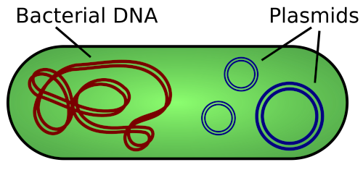
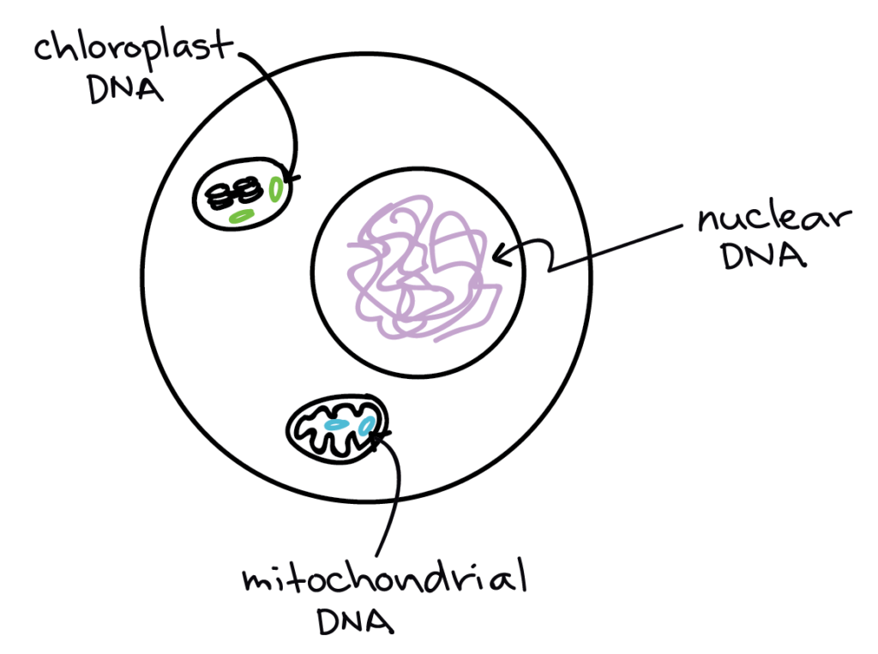
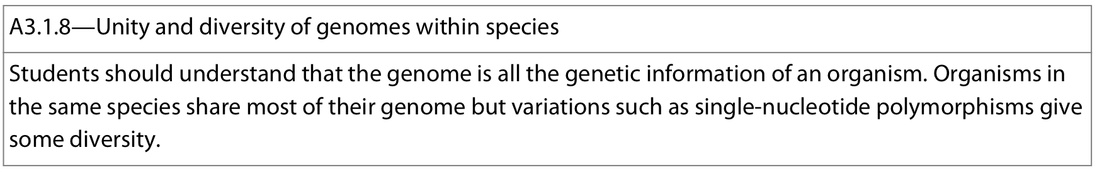
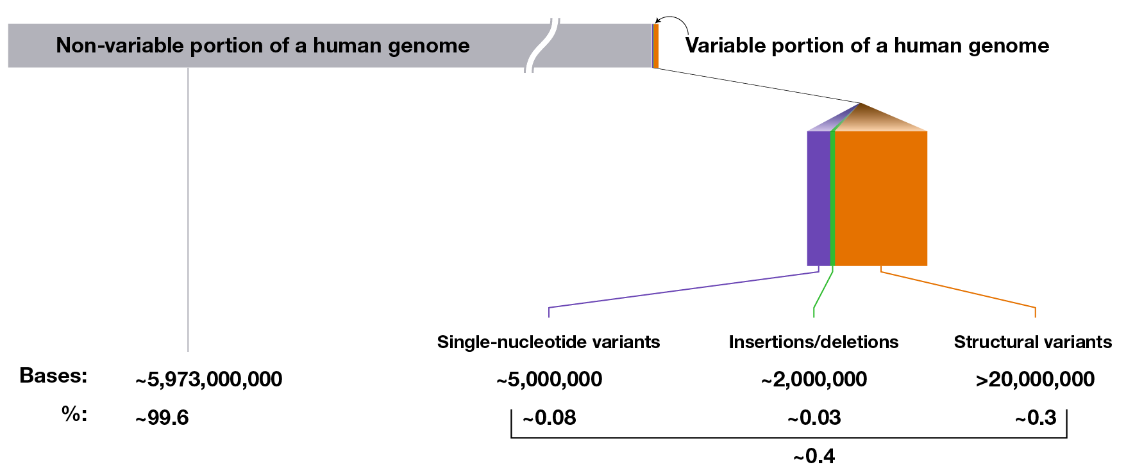

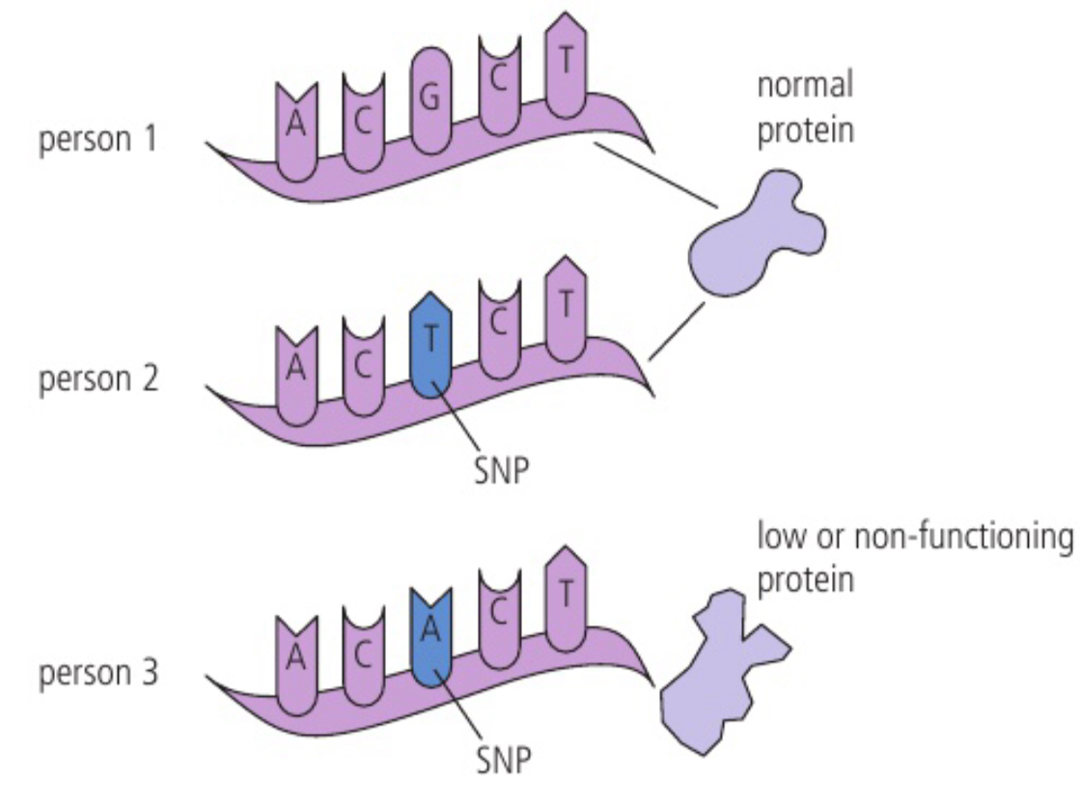
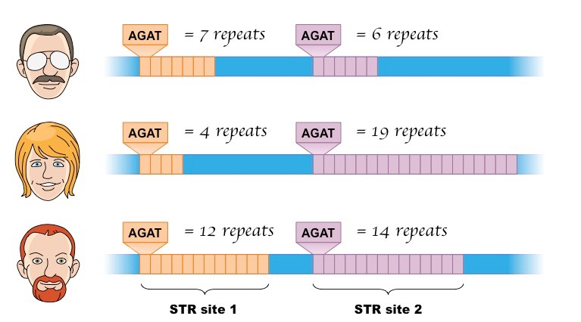
Genome: all of the genetic information (DNA base sequence) present in an organism
Includes: all genes as well as non-coding DNA sequences (introns, promoters, STRs, etc.)
Include: all non-nuclear sequences – such as plasmid DNA (in prokaryotes) and organelle DNA (mitochondria and chloroplasts)
Organisms in the same species share most of their genome (ex: >99% shared in humans) where members share:
  approx. same genome size
  same number of chromosomes
  same genes at the same loci on same chromosomes
Members of a species still display variation:
Variation within coding sequences (genes) → alleles
Variation within non-coding sequences
  Single Nucleotide Polymorphisms (SNP): single base changes which occurs at a frequency of 1% or more in the population. Most are neutral.
  Mutations: base sequence alterations (substitution/deletion/insertion) which occurs less frequently than SNP (<1% of population)
  Short Tandem Repeats (STRs) which are repeated sequences within non-coding regions unique among individuals

Slide 13
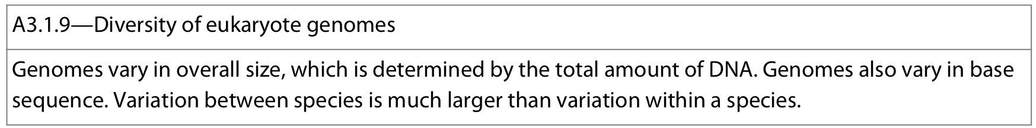
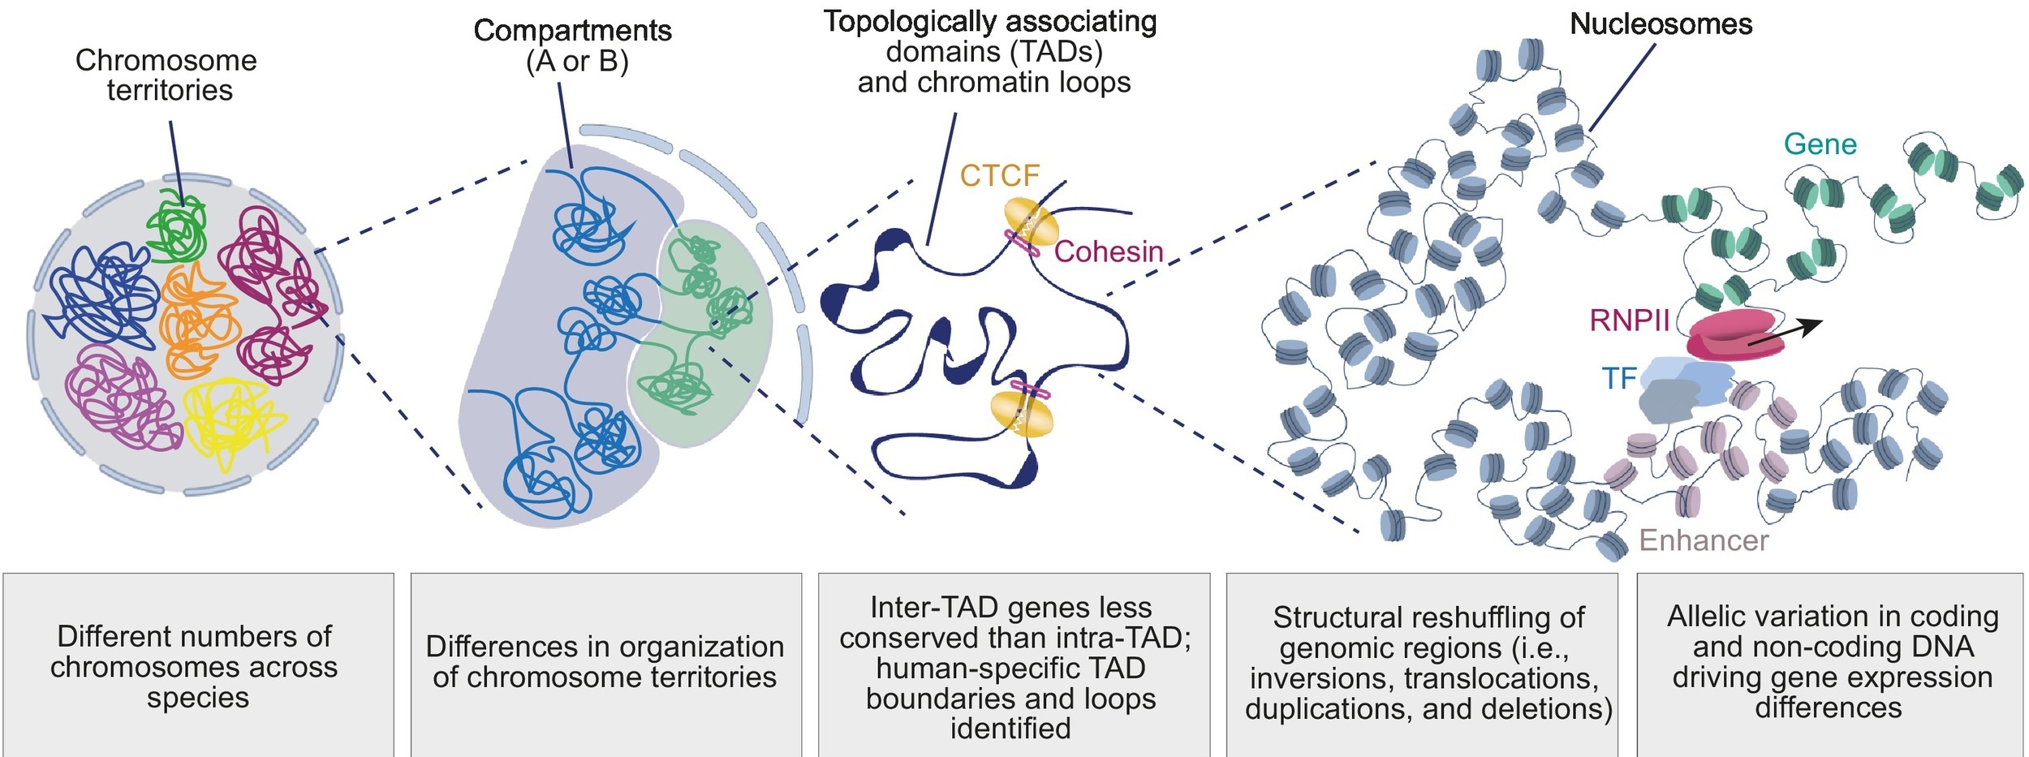
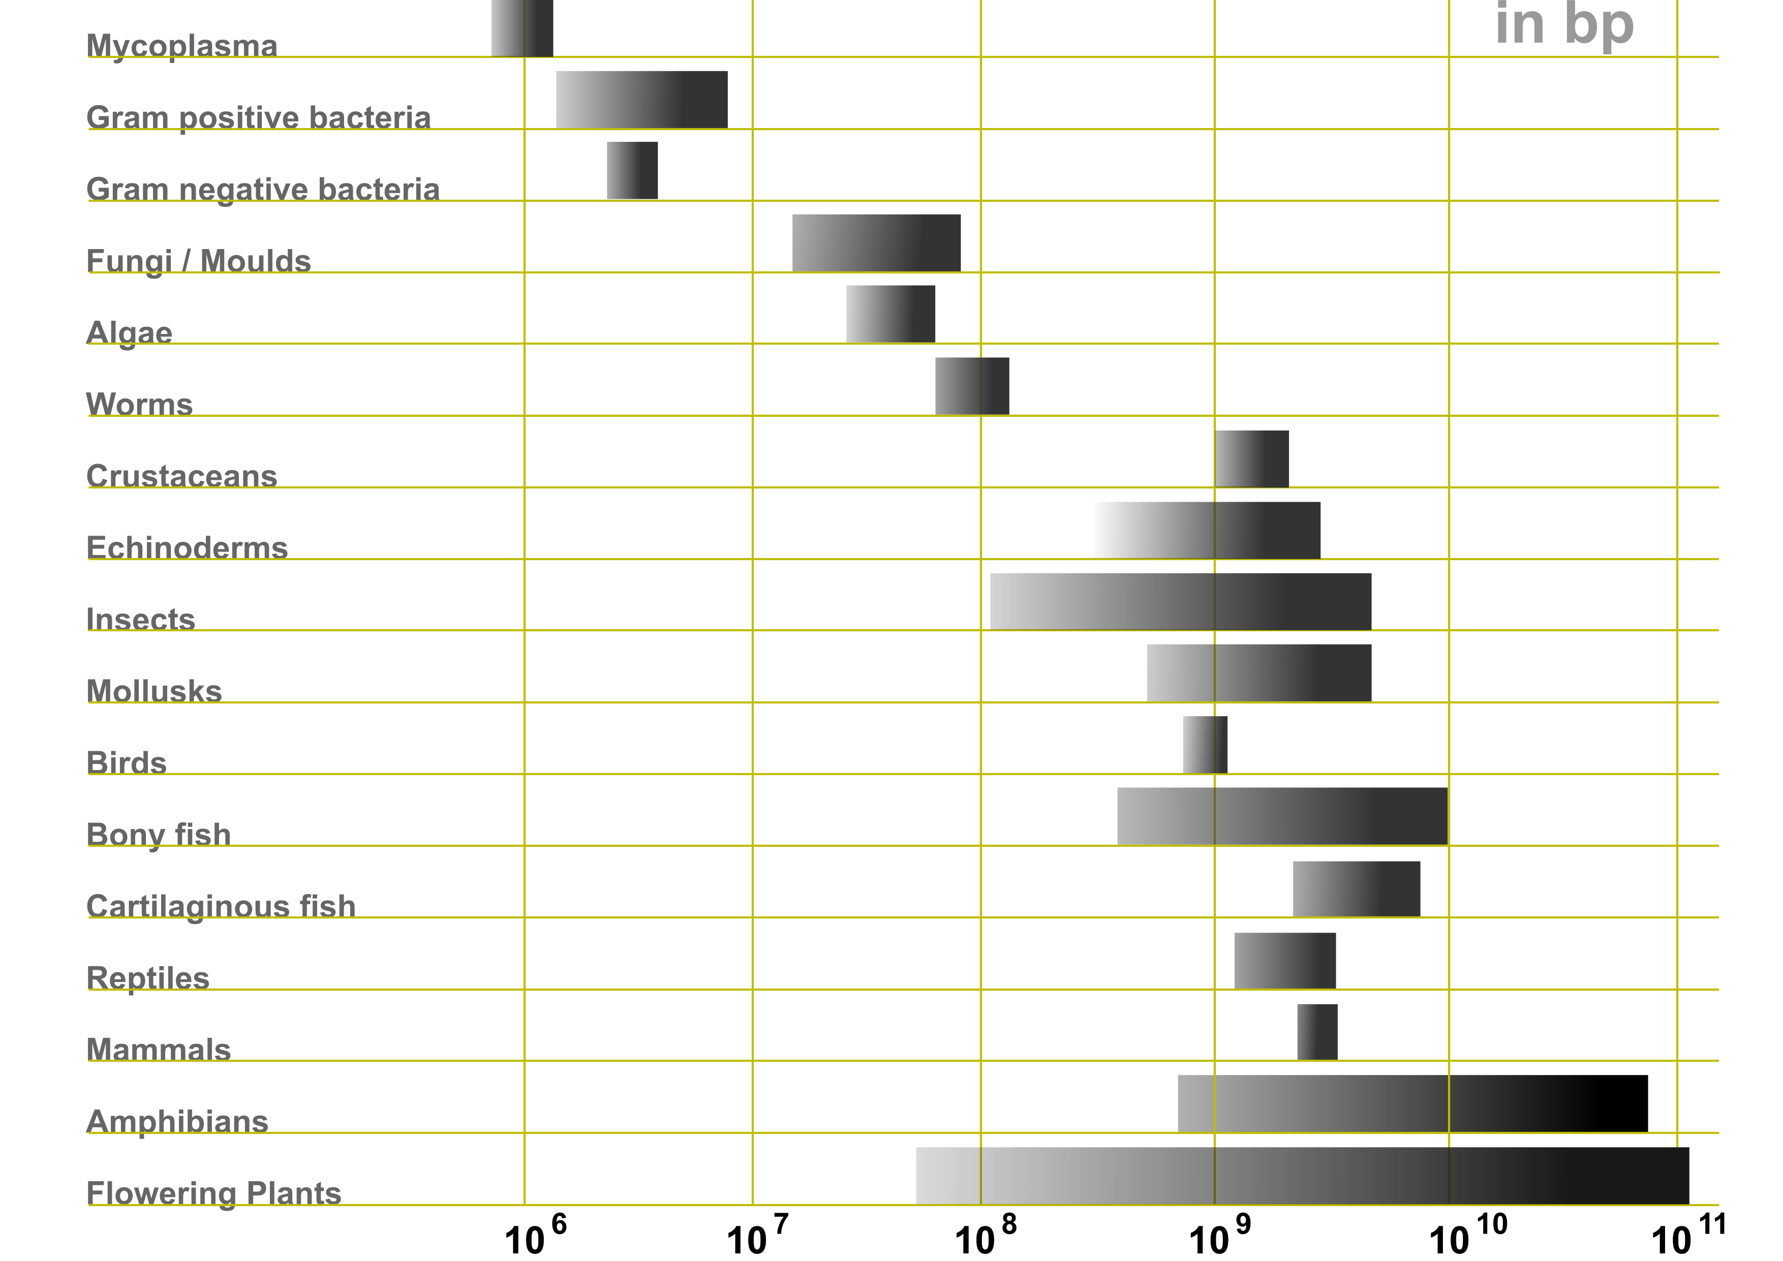
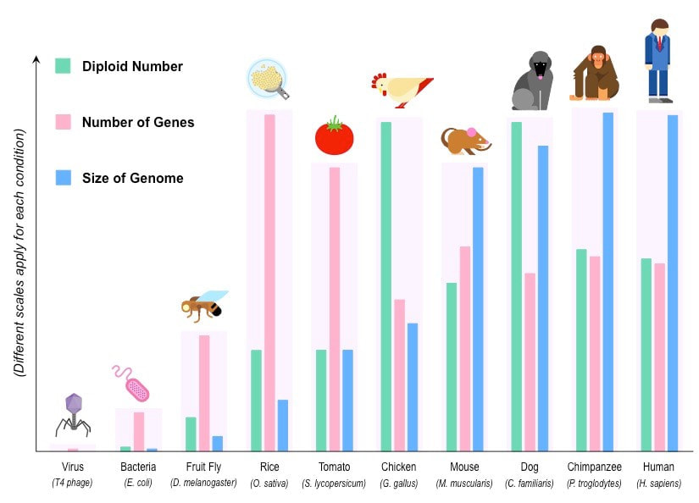
Variation between members of different species >>>> variation within members of the same species
Across different eukaryotic species, genomes vary:
  in size (total amount of DNA)
  in organization (total number and sizes of chromosomes)
  In size and number of coding and non-coding sequences
Genome size is NOT an accurate measure of organism complexity

Slide 14
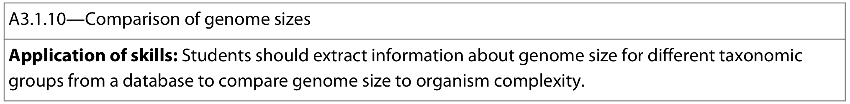
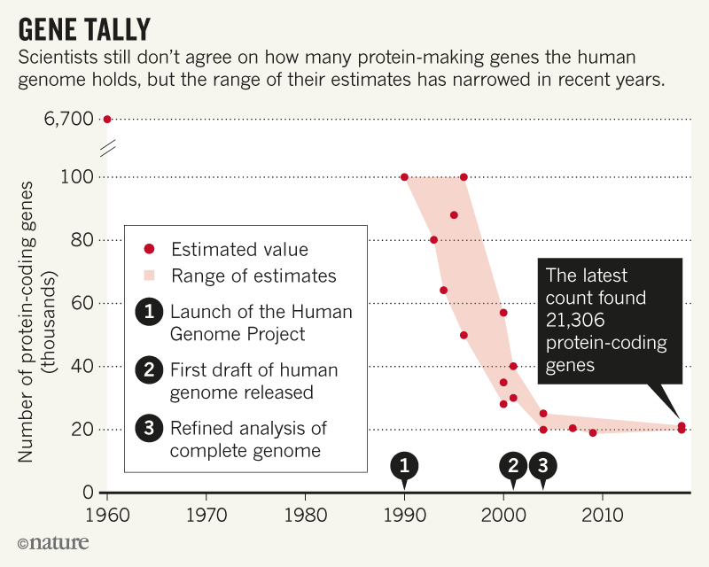
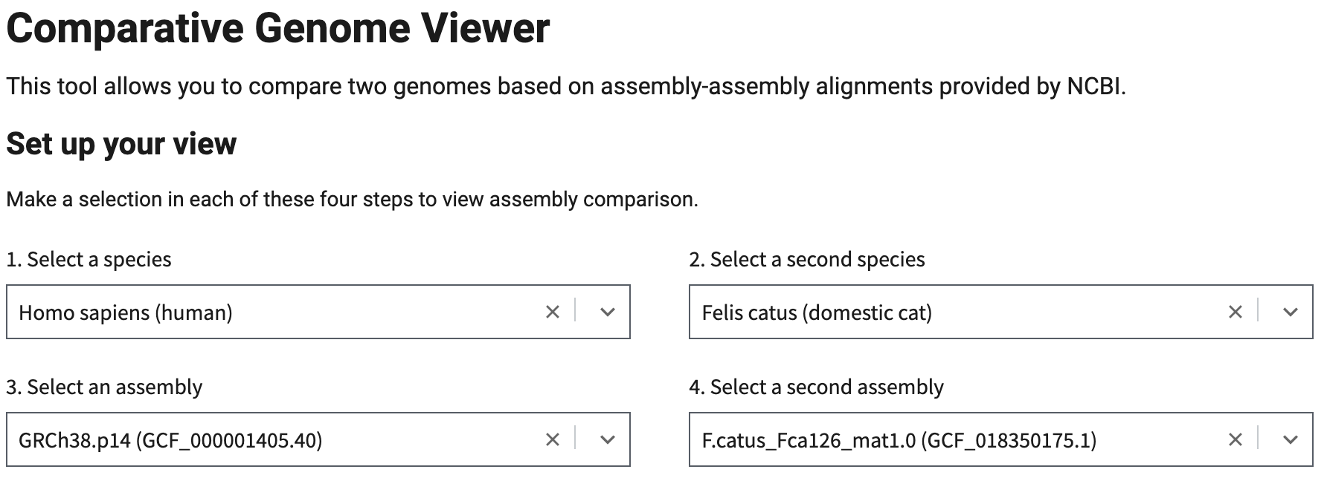
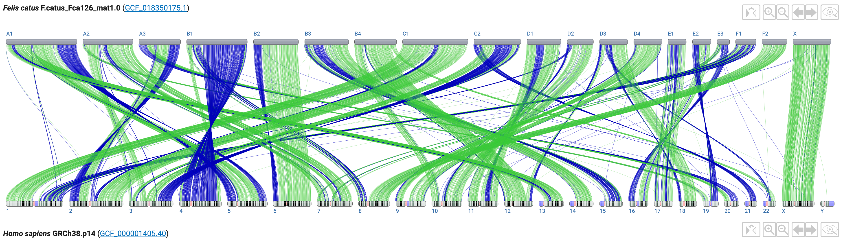
Genome databases
Genbank - comparative genome viewer
Genbank
Ensembl – vertebrate genome browser
UniProt – protein database
Online Medelian Inheritance in Man (OMIM) gene database
Wiki - list of human genes
genomesize
Kew - plant cvalue database

Slide 15



Genome sequencing is becoming faster and cheaper to carry out, making its use more convenient and practical to use
Currently, it is used to deduce evolutionary relationships:
DNA, mRNA, and Amino acids sequences are compared between different taxa → more similar, the more closely related the taxa
Two groups of organisms with very similar sequences will have separated into separate species more recently than two groups with less similarity
Species that have been separated for longer have had a greater amount of time to accumulate mutations and changes to their sequences
Phylogenetics: sequence analysis and comparison can be used to create phylogenetic trees that show evolutionary relationships between species
In the future, there is potential for personalized medicine:
The sequence and structure of proteins involved in disease allows the development of drugs that target these specific proteins
Genetic screening allows:
  Identification of individuals with high risk factor(s)/predisposition of developing specific diseases → allowing preventative measures can be taken
  Determination of treatment efficacy for certain individuals
  allowing treatments to be selected on the basis of an individual’s
  genotype, increasing efficacy and reducing side-effects
Notes:
Another potential use of human sequencing is the production of new medicines:
Find beneficial proteins that are produced naturally in people
Determine which gene(s) controls the synthesis of these proteins
Copy the gene and use genetic modiciation to create more of the desired molecule in a lab
Distribute the beneficial theraputic protein as a new medical treatment

Slide 16





Biological species concept defines “species” as a group of organisms that can interbreed and produce fertile offspring
Difficult to apply this to organisms that do not breed sexually but rather asexualy:
The concept of “interbreeding” does not apply to these organisms and genes are still transferred from parent to offspring
All offspring are clones of their parents and if these do not ‘interbreed’ with each other than technically according to the concept they are different species
Notes:
Interesting review paper on various horizontal gene transfer mechanisms: https://sci-hub.se/https://www.nature.com/articles/s41579-021-00534-7

Slide 17




Difficult to apply this to organisms that can transfer gene between species
Horizontal Gene Transfer: movement of genetic material between organisms other than by the "vertical" transmission of DNA from parent to offspring (reproduction)
Transduction
Conjugation
Transformation
As genes can be transferred between populations, they cannot be reproductively isolated preventing typical ‘speciation’
Mixing lineages by trading genes among different species challenges the notion of common ancestry and the “tree of life”
Notes:
Interesting review paper on various horizontal gene transfer mechanisms: https://sci-hub.se/https://www.nature.com/articles/s41579-021-00534-7

Slide 18



Slide 19




Examples:

Slide 20



Environmental DNA (eDNA): genetic material from organisms that can be found in the environment. Can be sampled from the abiotic environment such as water or soil.
DNA barcodes: short sections of DNA from gene(s) that are distinctive enough to identify a species from others.
*Often taken from mDNA in eukaryotes, and rRNA in prokaryotes
Creating a DNA barcode:
Collect sample
Extract DNA/eDNA
PCR
Gel electrophoresis
Sequence analysis
Comparison to database
Advantages/Application of DNA barcodes and rapid species identification:
Identification of similar looking species without relying on morphology or capture
Determine ecosystem biodiversity rapidly for many species
Identifying indicator species for pollution monitoring
Identify presence of rare/endangered species
Notes:
Disadvantages:
Only provides presence/absence and not population size
Does not indicate whether living or dead

