Slide 1
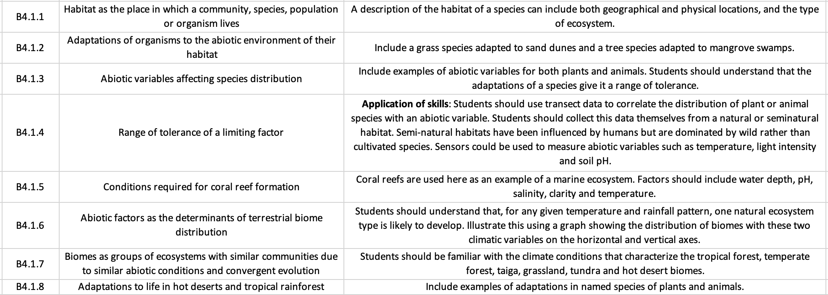
SL Learning Outcomes
ipad notes will replace these at a later date

Slide 2
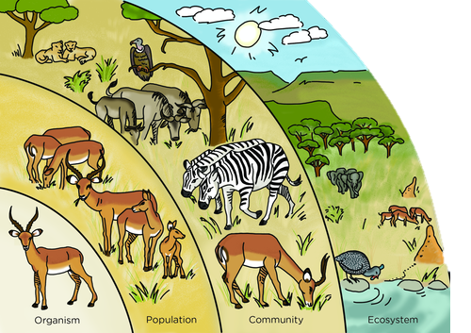
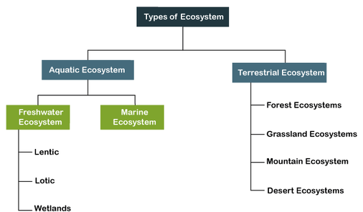
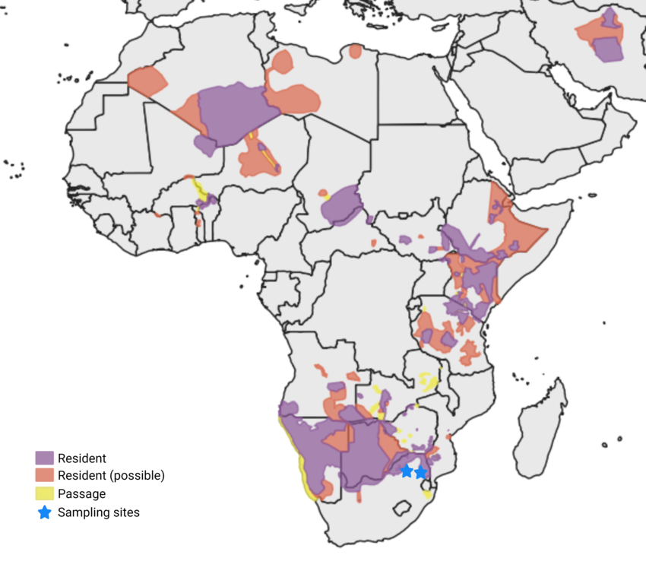
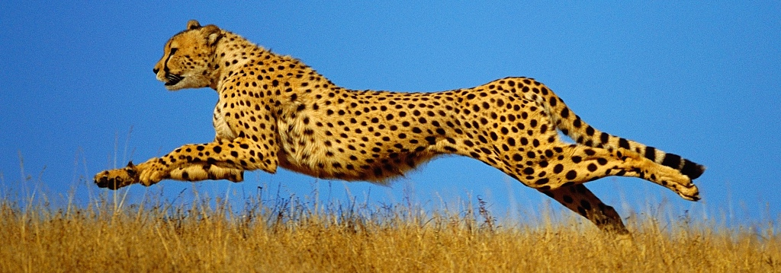
Habitat: the place in which a community, species, population or oganism lives.
Includes:
Geographical location: where on the planet
Physical location: where in the environment
Type of ecosystem
Example: Cheetah (Acinonyx jubatus)
Many parts of Africa, currently most prevalent in Kenya and Tanzania in east Africa, and Namibia and Botswana in southern Africa
typically stay on the ground but are known to climb trees on occasion
Occupy terrestrial ecosystems: shrublands, grasslands, savannahs, and temperate to hot deserts
Organism: any living thing that functions as an individual
Species: group of organisms that can interbreed and produce fertile offspring
Population: group of organisms of the same species living in the same area at the same time
Community: Group of populations (of different species) living and interacting with each other in the same area
Ecosystem: community and its abiotic environment
Notes:
Habitat etymology = “it lives”

Slide 3
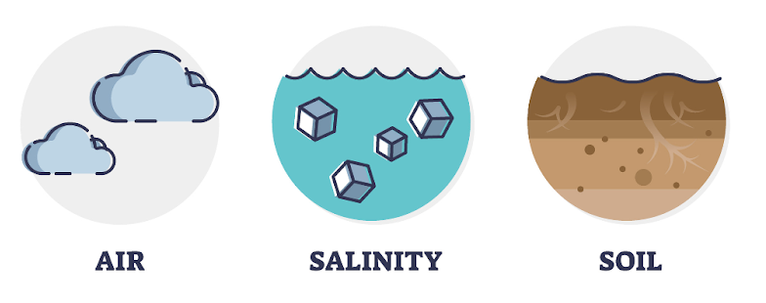
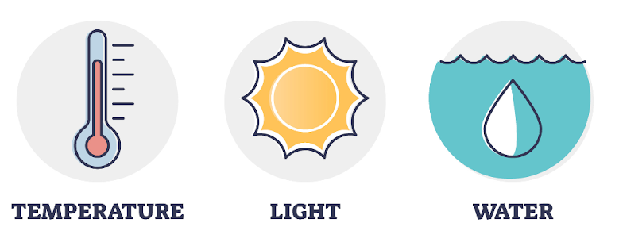
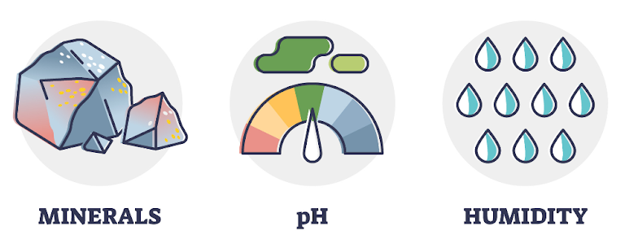
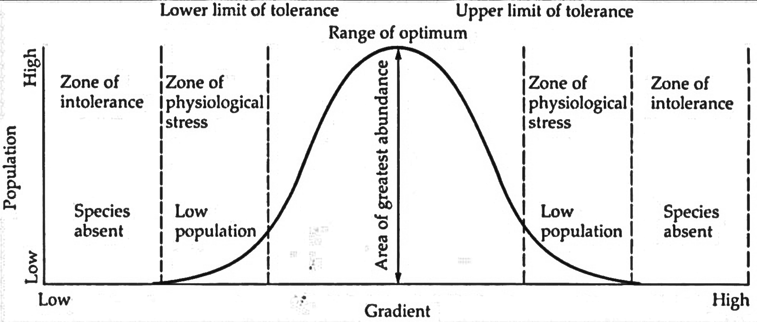
The distribution of a given species (where it lives/found in the world) is affected and limited by abiotic variables (nonliving factors).
[O₂/CO₂/pollutant/wind speed]
(water or soil)
(composition/texture)
(air/soil/water)
(wavelength/intensity)
(turbitidy)
(water/soil)
(water or soil)
Range of tolerance: the critical maximum and minimum limits of an abiotic variable that the organism can withstand
populations have optimal survival conditions within critical minimal and maximal thresholds
As a population is exposed to the extremes of a particular limiting factor, the rates of survival begin to drop
The distribution of a species in response to a limiting factor can be represented as a bell-shaped curve with 3 distinct regions:
Optimal zone – Central portion of curve which has conditions that favour maximal reproductive success and survivability
Zones of stress – Regions flanking the optimal zone, where organisms can survive but with reduced reproductive success
Zones of intolerance – Outermost regions in which organisms cannot survive (represents extremes of the limiting factor)
Gradient can be any environmental abiotic factor
Notes:
Species will not be found in areas with abiotic conditions that are outside their range of tolerance
Species which are adapted to live in extreme conditions may have an especially wide range of tolerance, allowing them to live in areas where other species cannot survive
Such species will often have an environmental optimum that is higher or lower than average
These extreme species will do well in these extreme environments where competition from other species is low
Such extreme species may do less well in more moderate environments due to competition from species with an average environmental optimum
Species will have a range of tolerance for all abiotic factors, and while some factors may have a more significant effect than others, the abiotic factors interact to determine the distribution of a species

Slide 4
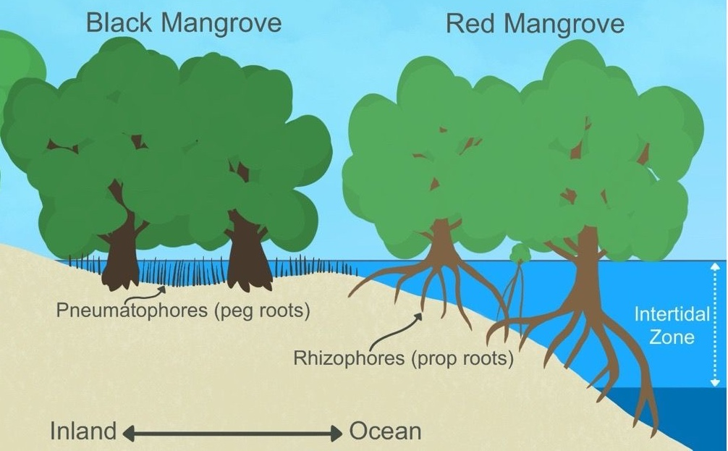
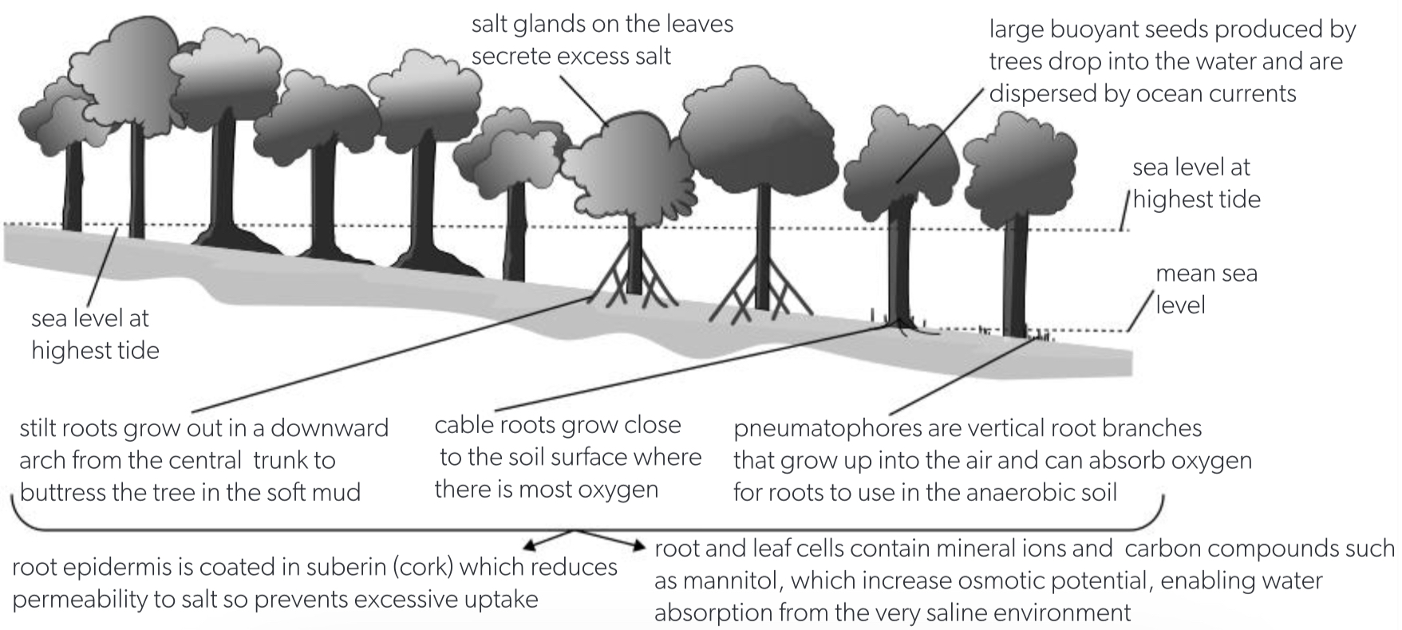
Species have adaptations to their abiotic environment (all the nonliving factors and processes in an ecosystem)
→ These determine their range of tolerance. Some adaptations allow species to tolerate extreme conditions, such as:
Red Mangrove (Rhizophora mangle)
Black Mangrove (Avicennia germinans)
Mangrove swamps are habitats in saltwater tidal zones. These are challenging areas to grow:
waterlogged anaerobic soils → low oxygen for roots
high salt concentrations (in mud and ocean) is hypertonic relative to root cells → draw water out of cells by osmosis
Salty water → lack of freshwater availability
Adaptations:
Salt glands
Root epidermis coated in suberin (cork)
Cable roots
Pneumatophores
Stilt/prop roots
Large buoyant seed-containing propagules
Accumulation of mineral ions in leaf and root cells

Slide 5
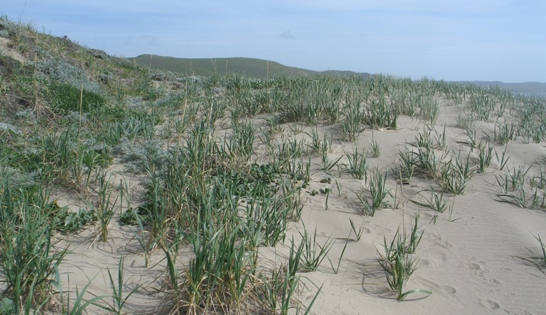
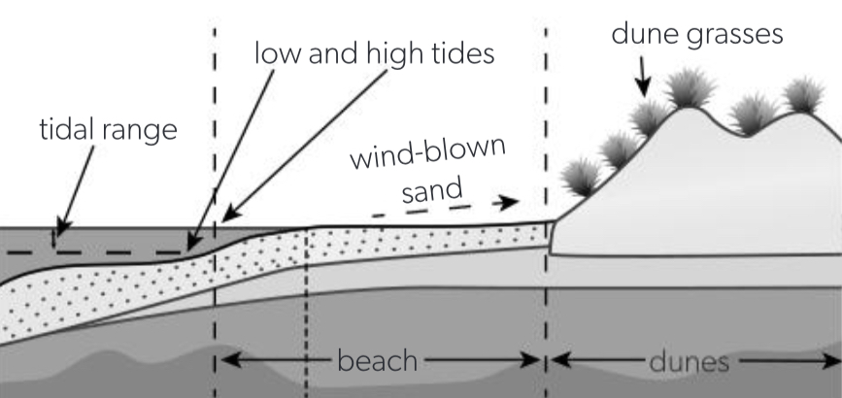
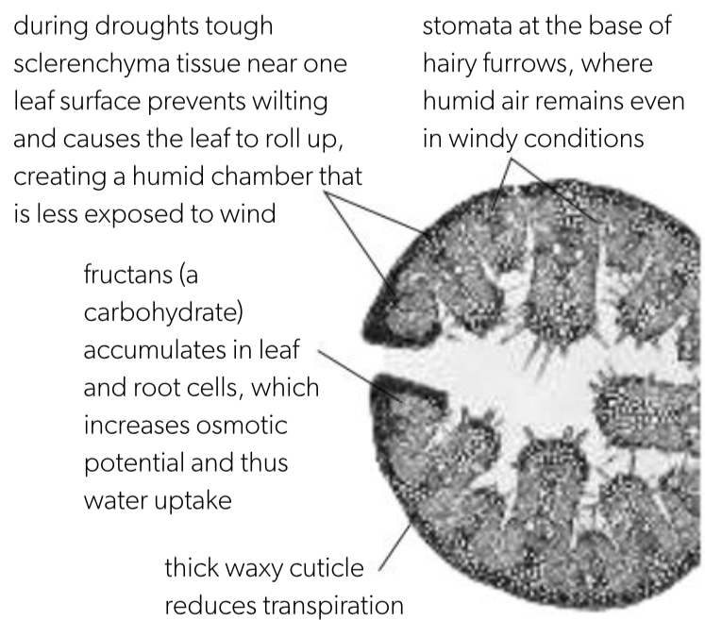
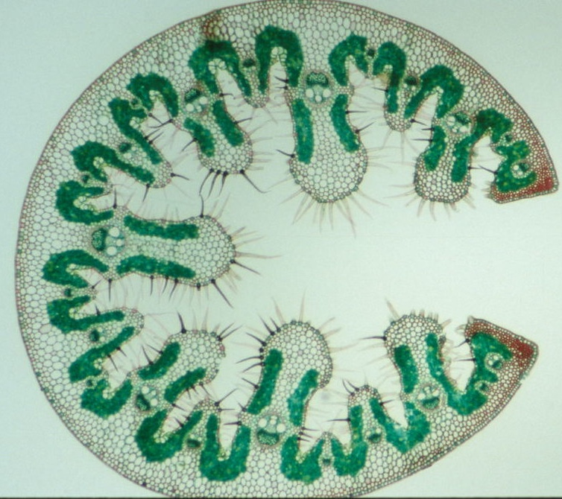
Species have adaptations to their abiotic environment (all the nonliving factors and processes in an ecosystem)
→ These determine their range of tolerance. Some adaptations allow species to tolerate extreme conditions, such as:
Lyme grass (Leymus mollis)
Marram grass (Ammophila)
Grass which grows along wind-blown sand dunes. These are challenging areas to grow:
Sand retains little water
Sand contains little nutrients/organic matter
High [salt] → draw water out of cells via osmosis
Dry air → high evaporative water loss
Adaptations:
Thick waxy cuticle on leaves
Stomata in indentations (furrows)
Rolled-up leaves
Tough sclerenchyma
Rhizomes (underground stems)
Hairs trap water vapour
Accumulation of fructans in root and leaves

Slide 6
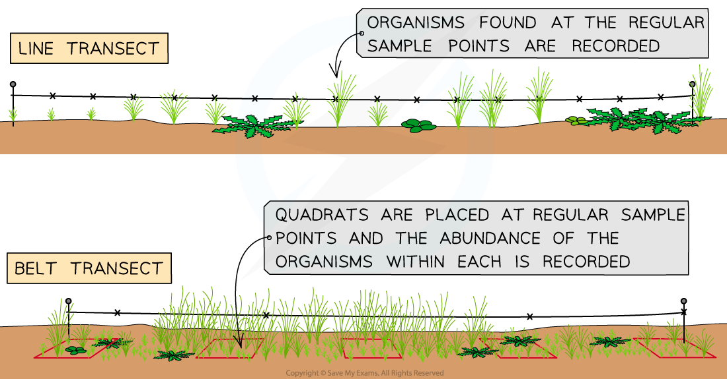
Can investigate the effect of a limiting abiotic factor on the distribution of a species using transect sampling
transect is used to measure the change in species abundance along an environmental gradient
gives an estimate of distribution at different levels of the abiotic factor in question
Sampling: taking measurements from a smaller representative of a larger one
Transects are lines laid out across a site that can be used to measure abundance and distribution across a habitat (natural or semi-natural) → a tape measure is laid out along the gradient of interest, and samples are taken along the line
Different types:
Continuous line transect: every species touching the tape measure is recorded
Interrupted line transect: Species touching the line at regular intervals (ex: every meter) are recorded
Continuous belt transect: Quadrats are placed end-to-end along the line
Interrupted belt transect: Quadrats are placed at regular intervals (ex: every meter) along the line

Slide 7
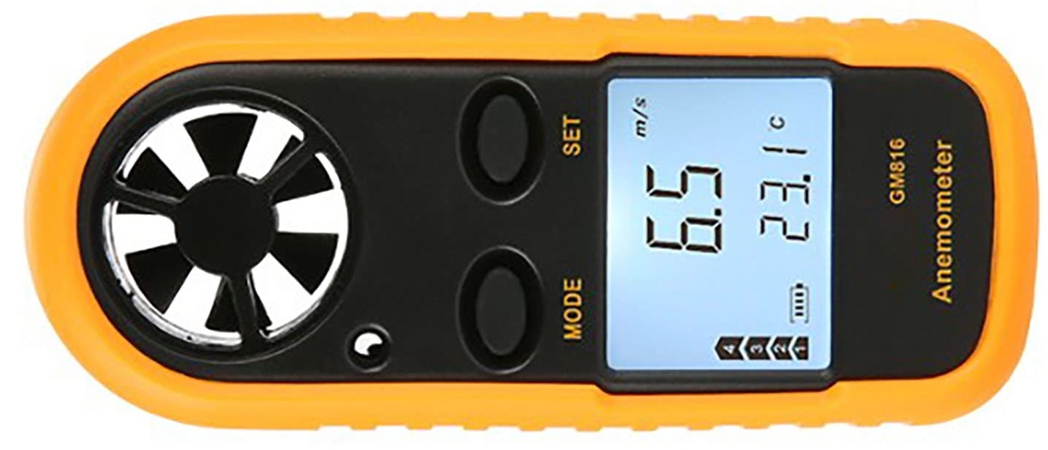
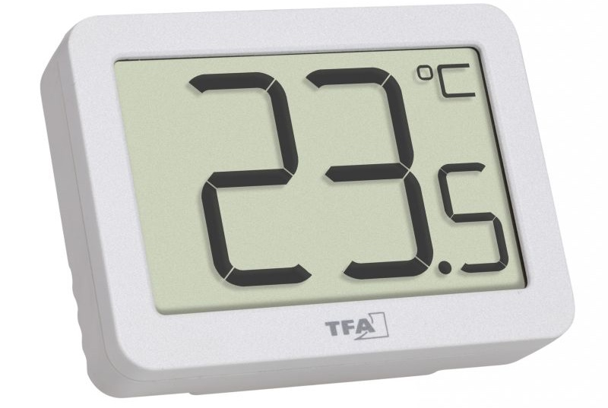
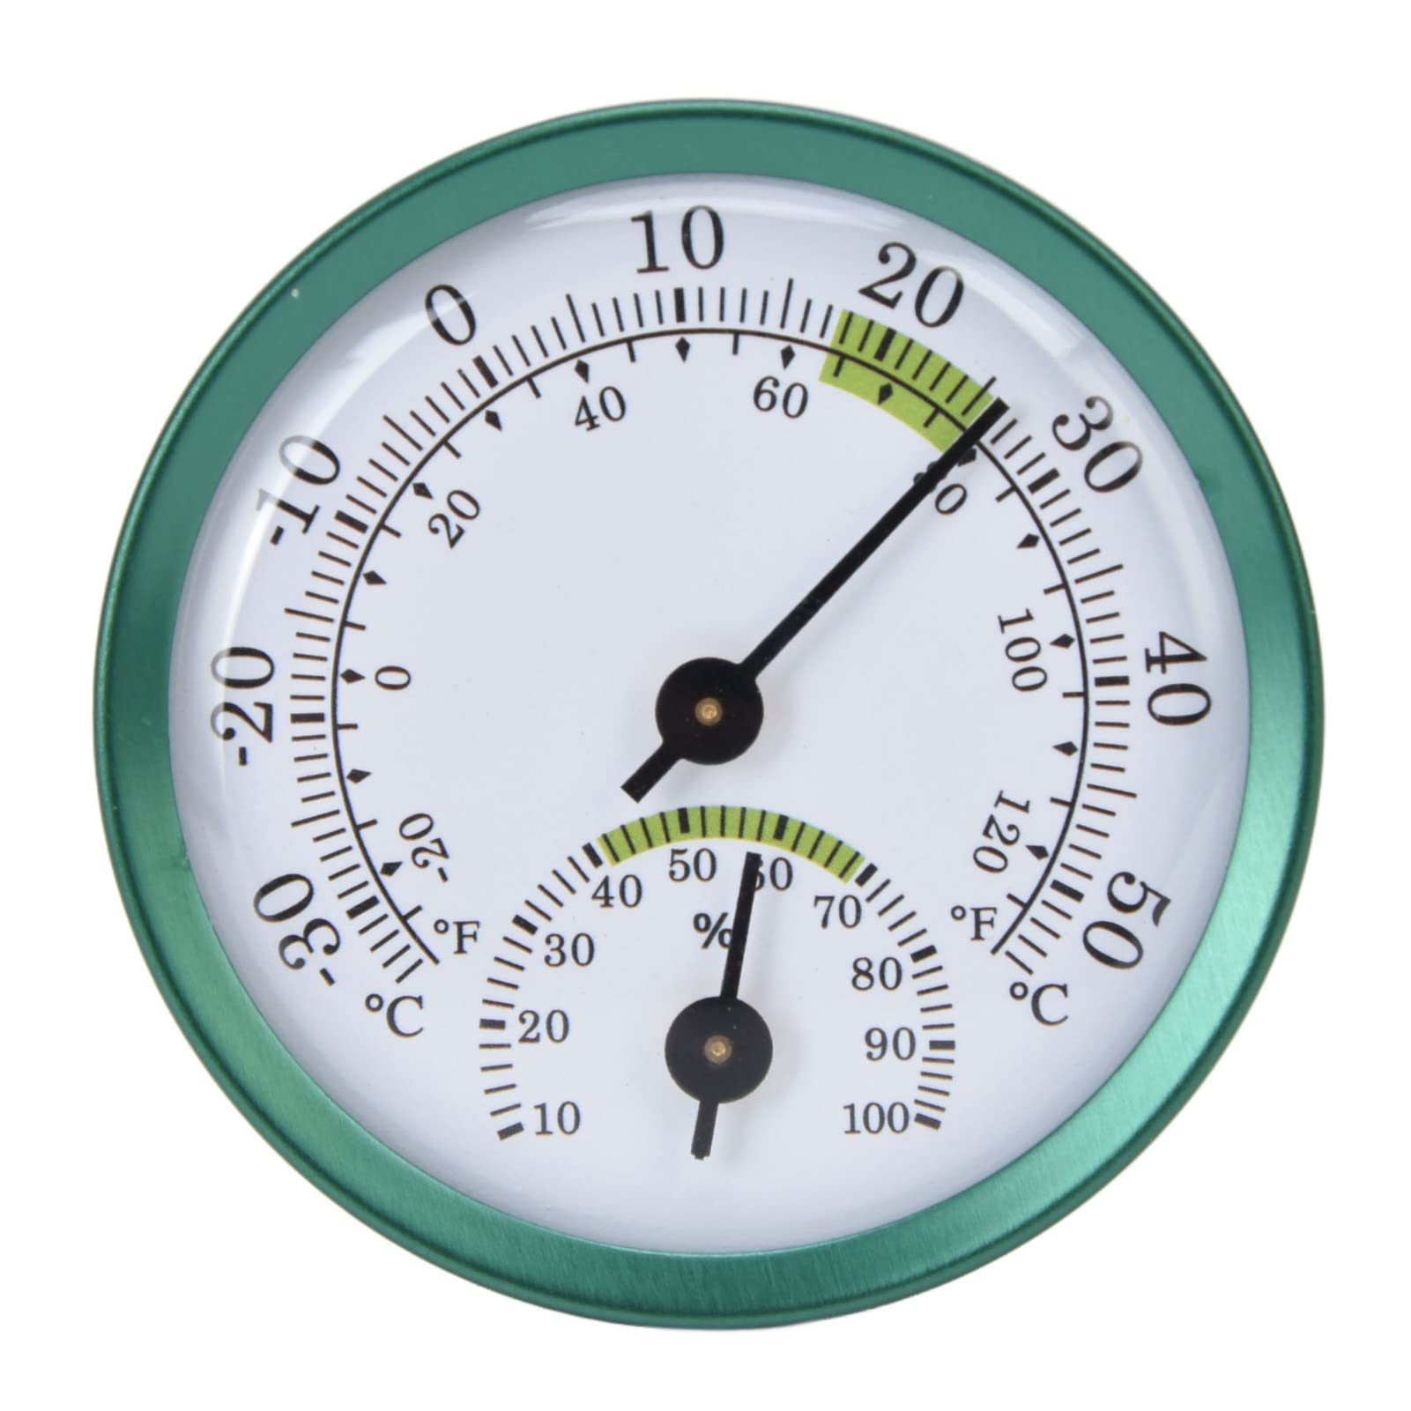
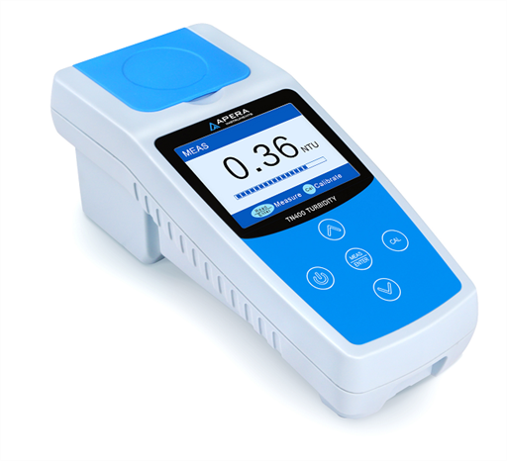
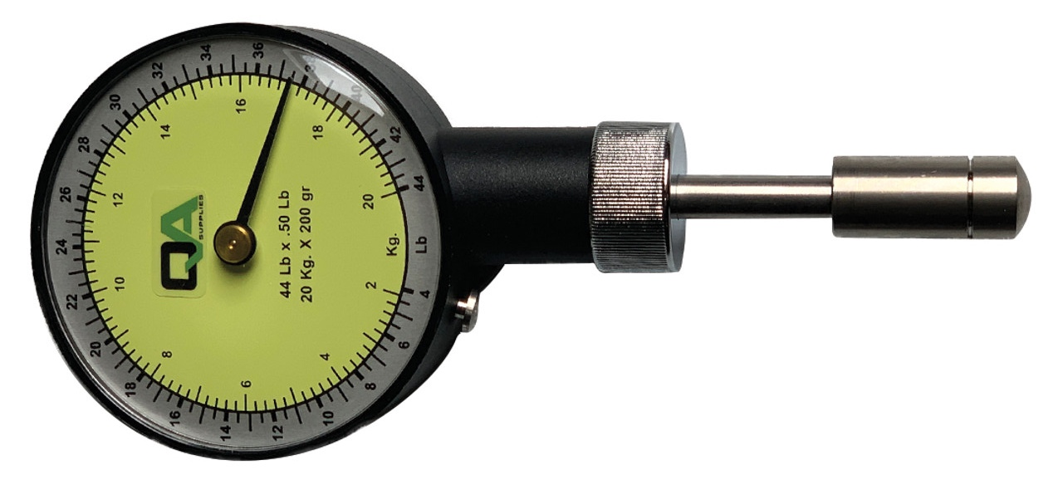
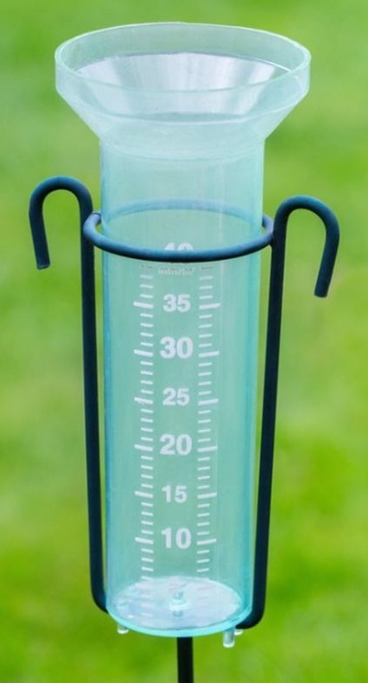
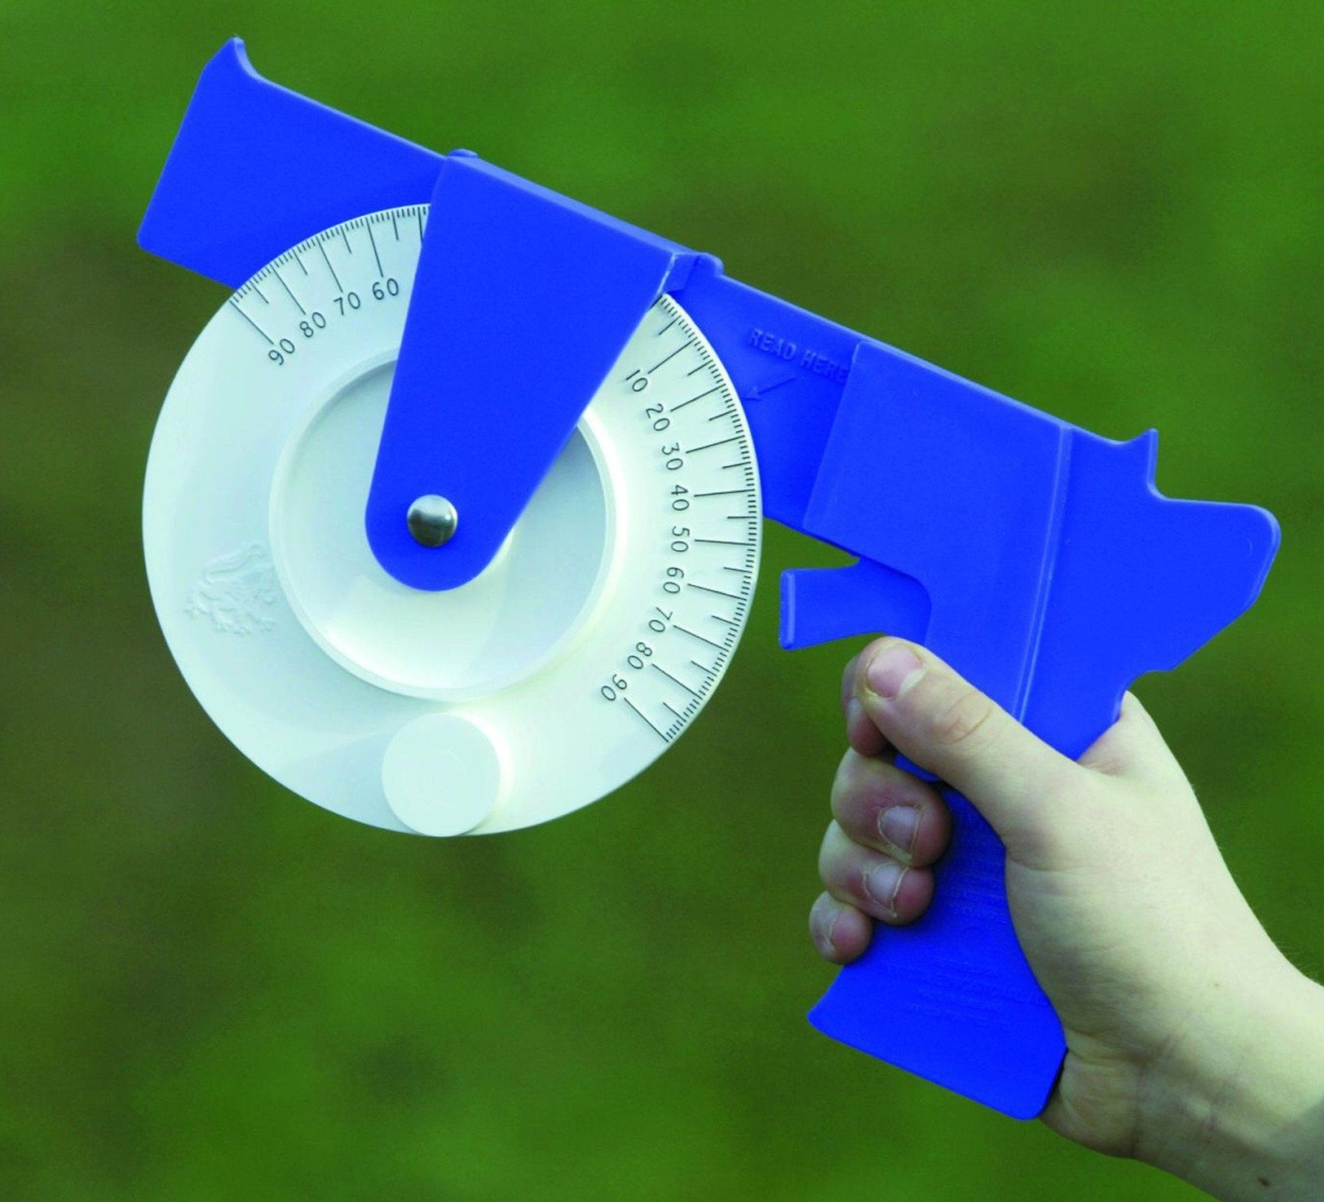
When investigating the impact of an abiotic factor on species distribution it is important to measure the relevant abiotic factor at each sample site along the transect. A variety of sensors and data loggers can be used:
Thermometer
anemometer
Turbidity meter
hydrometer
penetrometer
Soil temperature
/pH
/moisture probe
Dissolved oxygen meter
inclinometer
Rain gauge
photometer

Slide 8
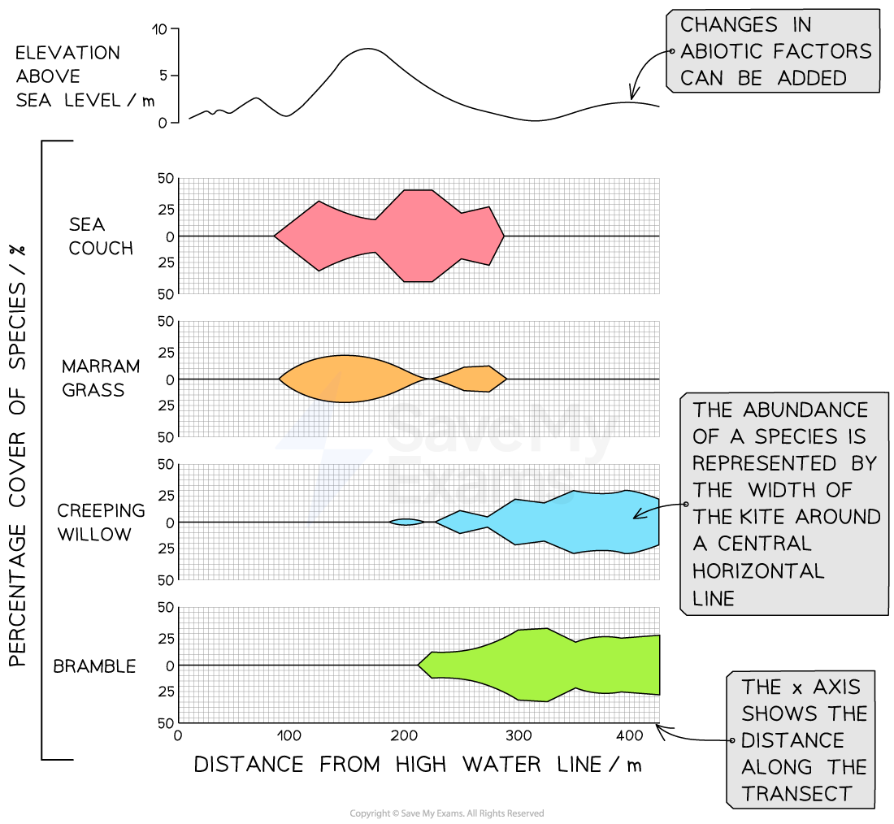
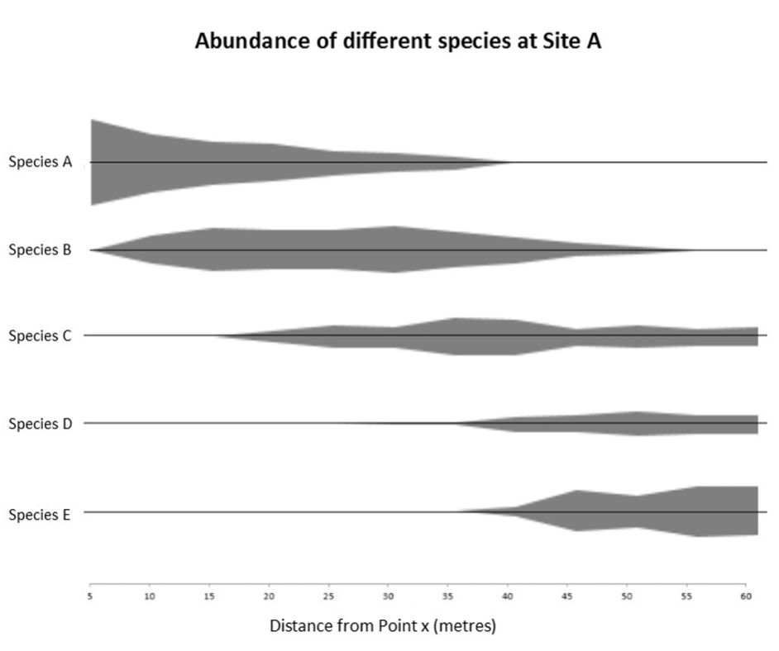
Results of an investigation into the distribution of organisms in response to an environmental gradient can be represented visually using a kite diagram which displays distribution and abundance

Slide 9
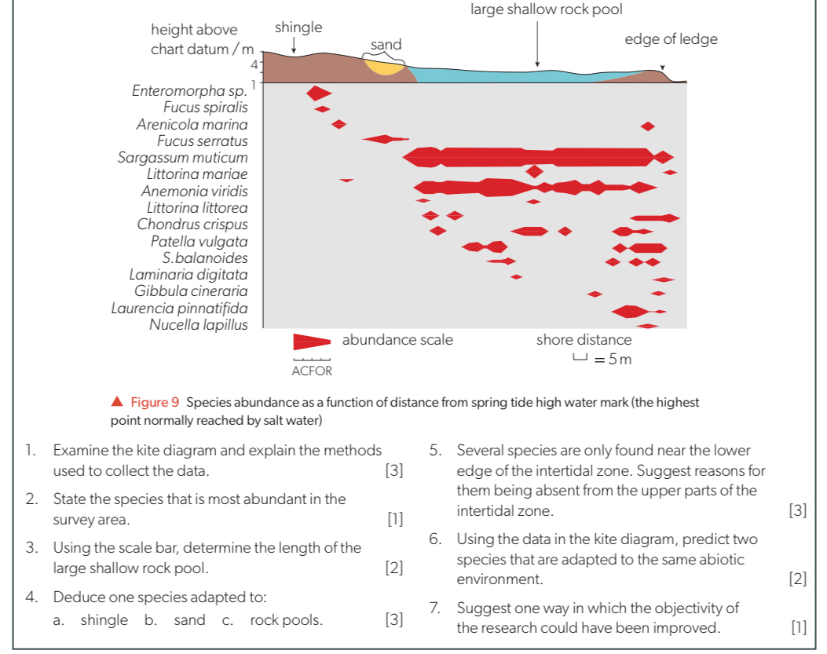

Slide 10
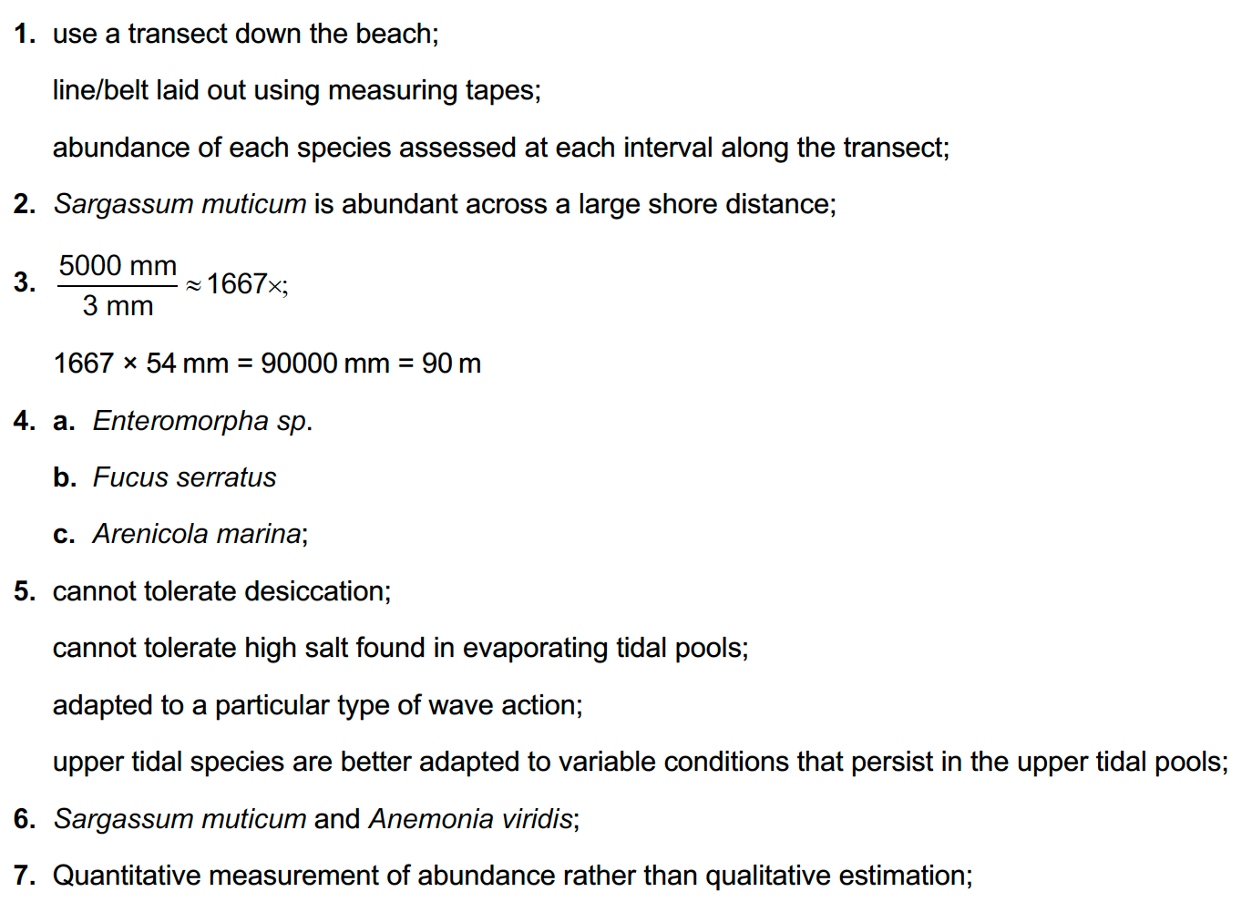
Answers

Slide 11
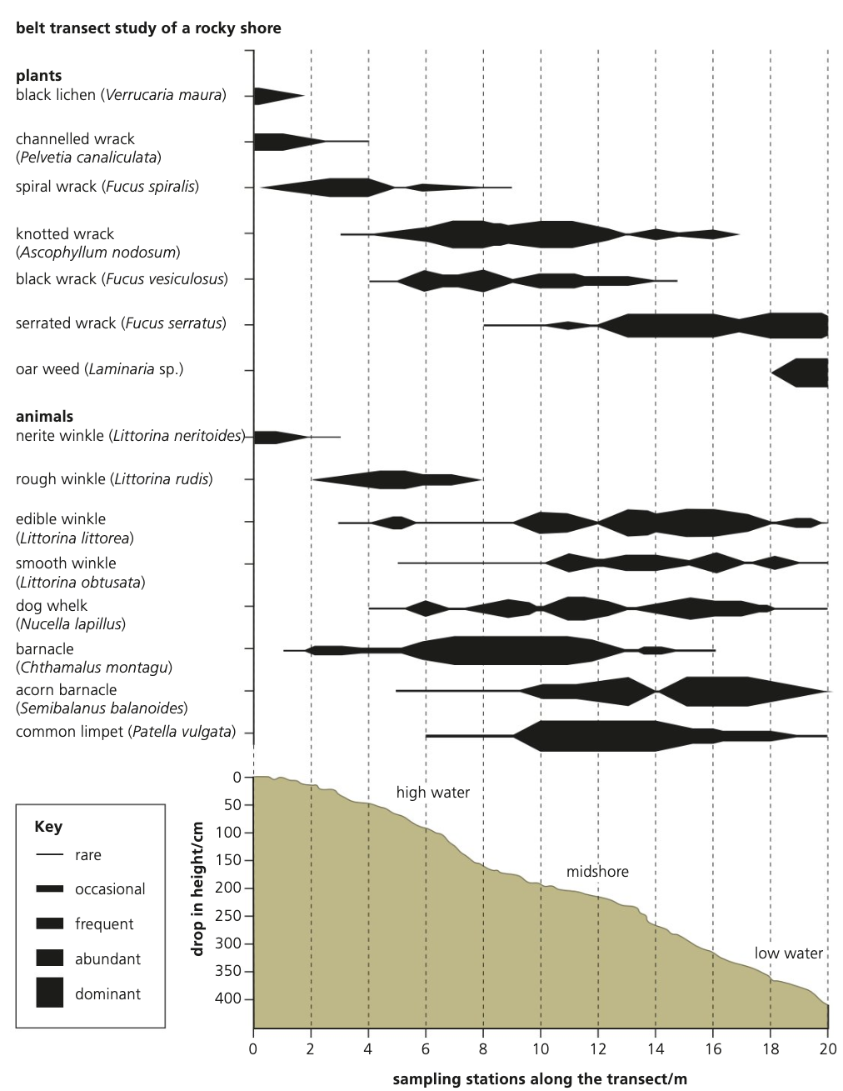
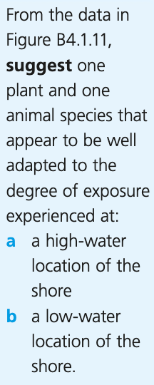
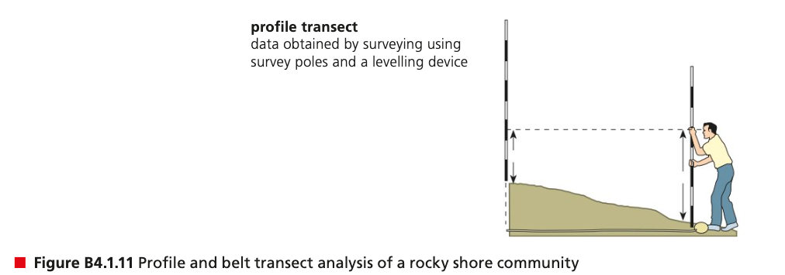

Slide 12
Answers

Slide 13
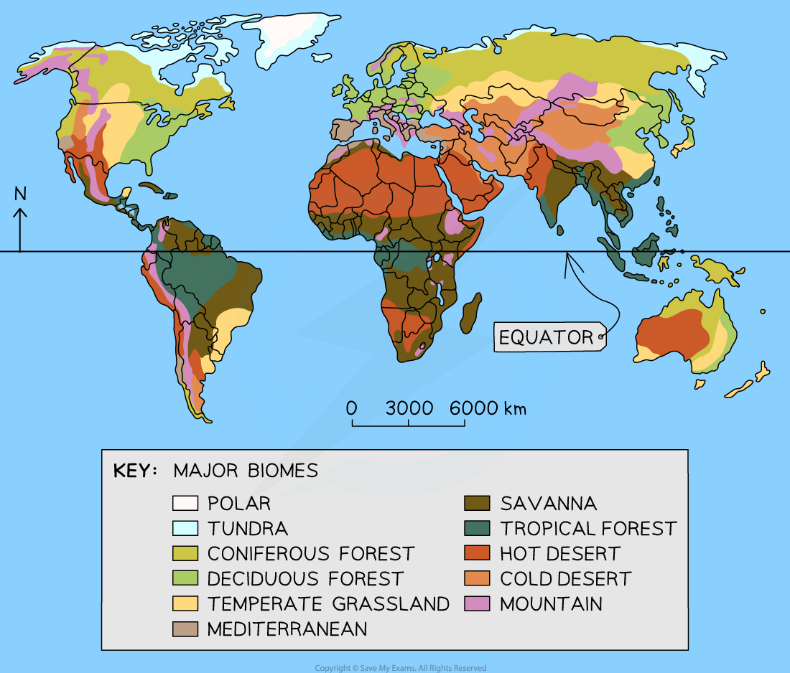
Biome: groups of ecosystems with similar communities due to similar abiotic conditions and convergent evolution
With any combination of abiotic factors, one particular type of biome is likely to develop
Ecosystems found in equivalent biomes in different parts of the world contain similar communities, even if the species are not exactly the same due to shared abiotic factors and resultant convergent evolution due to shared selection pressures
Terrestrial biomes typically named after the dominant vegetation type (ex: grassland)

Slide 14
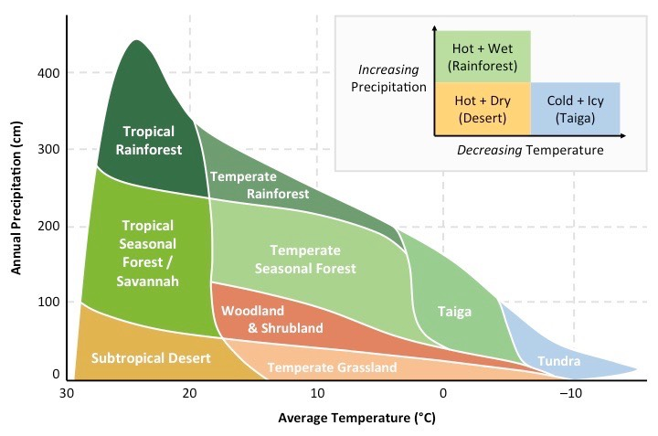
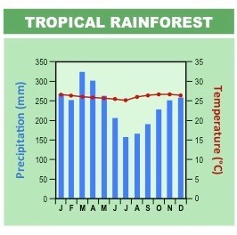
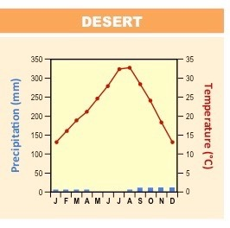
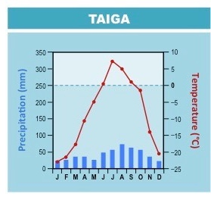
Environmental factors most influential for terrestrial biome distribution are temperature and rainfall (precipitation) patterns
Climograph: diagram which
shows the relative combination of temperature and precipitation in an area

Slide 15
Climate Conditions | Tropical Forest | Temperate Forest | Taiga (boreal forest) | Grassland | Tundra | Hot Desert
Temperature | HIGH (26-28°C) | Moderate/variable (-30 to 30°C) | Low (-40 to 20°C) | High/medium | Very low (-40 to 18°C) | Variable (very high in day, low at night)
Precipitation | HIGHEST >2500 mm/yr | high 500-1500mm/yr | moderate 200-500mm/yr | moderate 500-900mm/yr | low 150 – 250mm/yr | lowest <250mm/yr
Light Intensity | HIGH | medium | Medium/low | High/medium | Low but variable. (long periods of constant night or day) | high
Seasonal Variation | No seasons. Same yearround as at equator | 4 seasons: Warm summers Cold winters | Short summers Long winters | Variation: dry season or wet season | Very short summer, very cold winter | minimal
Other features | VERY HIGH biodiversity and NPP Nutrient poor soil | Vegetation dominated by decidous and evergreen trees. High biodiversity. High NPP. Nutrient-rich soil | Largest terrestrial biome by landmass. Vegetation dominated by conifers. Animals adapted to cold | Vegeration dominated by grass species with few trees. Animals mostly grazers | High winds. Permafrost. Low biodiversity. Low NPP Low-growing plants. Animals adapted to cold. Poor soil | Little vegetation. Plants and animals adapted to hot, dry conditions. Very low NPP
Notes:
NPP = Net primary productivity
Covered in C4.2

Slide 16
Living in hot deserts and tropical rainforests require specific adaptations for both animal and plant species.
Hot desert conditions:
Very dry (little precipitation)
Variable temperatures (very hot days, very cold nights)
High insolation
Tropical rainforest conditions:
Very wet (high precipitation)
Year-round high temperatures
Year-round high insolation
High levels of biodiversity and competition
Animal examples:
Fennec fox (Vulpes zerda)
Dromedary (Camelus dromedarius)
Granulated thick-tailed scorpion (Parabuthus granulatus)
Desert Kangaroo rat (Dipodomys deserti)
Animal examples:
Spider monkey (Ateles geoffroy)
Poison dart frogs (Dendrobates tinctorius azureus)
Orchid mantis (Hymenopus coronatus)
Plant examples:
Yellow meranti (Shorea faguetiana)
Kapok tree (Ceiba pentandra)
Carnivorous pitcher plants (Nepenthes rajah)
Plant examples:
Saguaro cactus (Carnegiea gigantea)

Slide 17
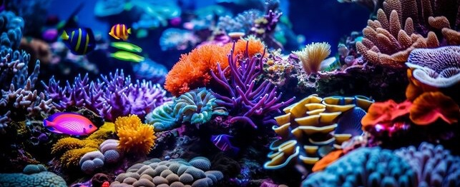
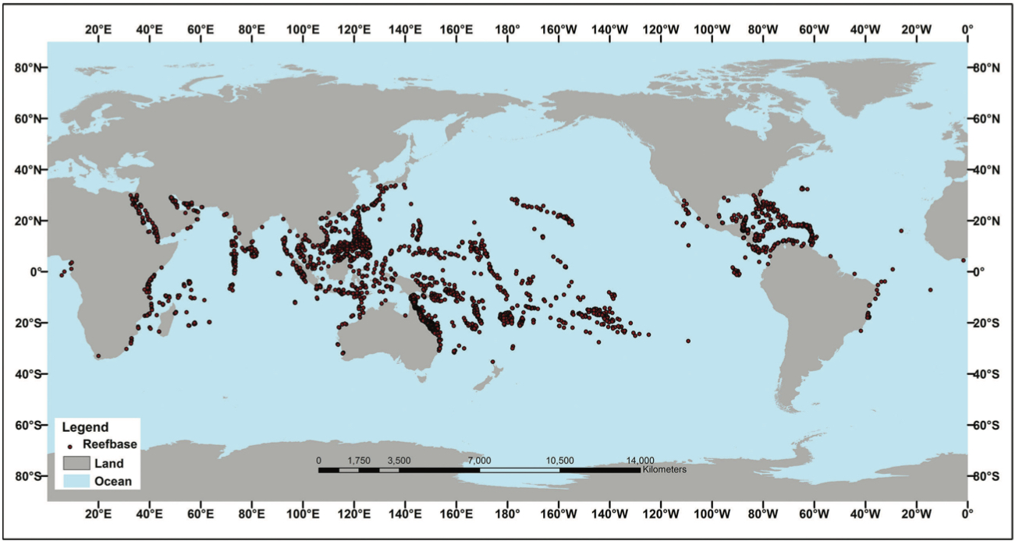
Corals → result of a symbiotic relationship between coral polyp and a zooxanthellae algae
polyp provides shelter and protection
algae carry out photosynthesis and produce carbon compounds such as carbohydrates
Some species of coral polyps secrete calcium carbonate (CaCO₃) which builds up in layers to form a hard outer exoskeleton
over time these deposits from thousands of individuals can form a coral reef
Reef-building corals have a narrow range of tolerance for a number of abiotic factors:
Abiotic factor | Conditions required | Explanation
Water depth | Shallow (<50m) | Shallow needed so light can penetrate for zooxanthellae photosynthesis
pH | >7.8 (8.0-8.4 optimum) | Lower pH results in lower CaCO₃ and CaCO₃ dissolution CO₂ from fossil fuels dissolve in oceans → lowering pH
Water salinity | 32 – 42 parts per thousand | Marine animals, require correct osmolarity. Freshwater runoff can alter salinity → osmotic stress
Water clarity | clear | Turbidity would prevent light penetration, limiting photosynthesis
Water temperature | 23 – 28°C | Ideal temperarures for polylps and zooxanthellae. Rising ocean temperatures cause corals to expel zooxanthellae → coral bleaching
Notes:
C4.1 → corals and zooxanthellae

