Slide 1
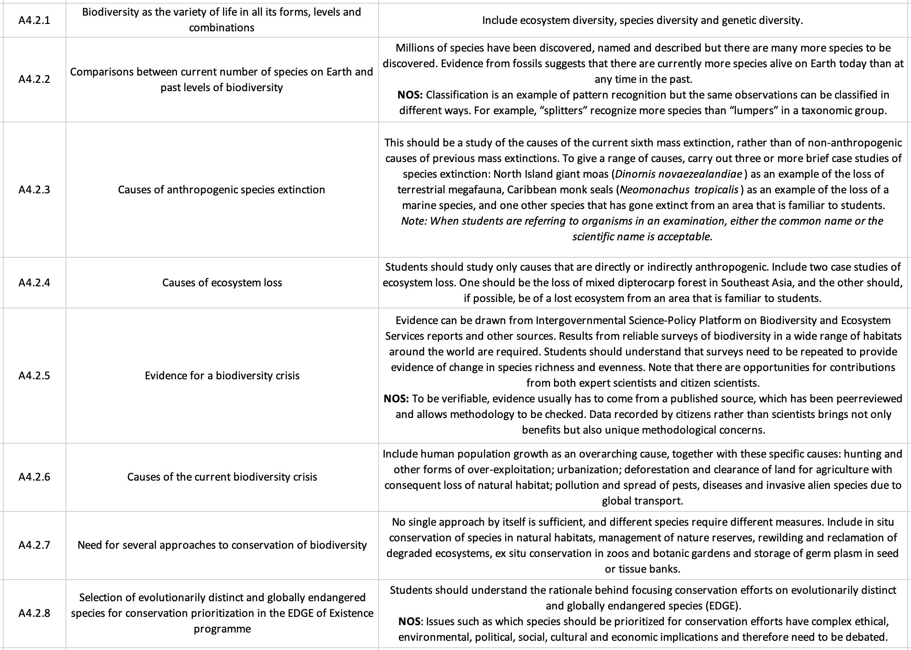
ipad notes will replace these at a later date
SL Learning Outcomes

Slide 2
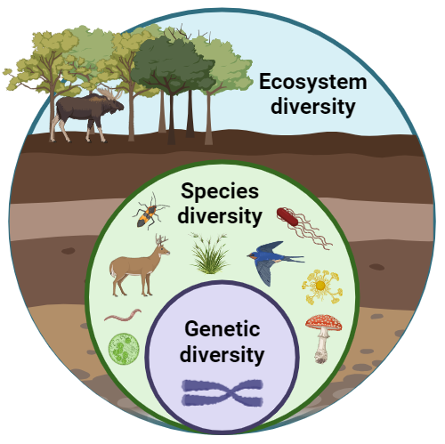
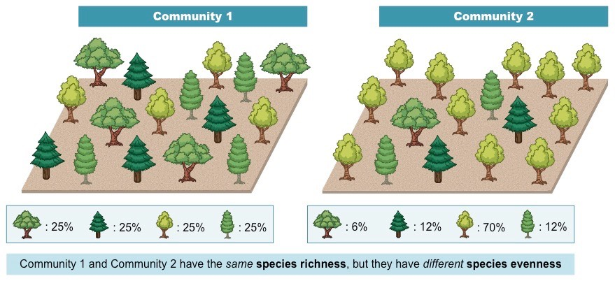
Biodiversity: variety of life in all of its forms, levels and combinations
The more diversity, the more stable, resistant and resilient to change
Biodiversity can be examined at different scales:
Ecosystem diversity: variety of ecosystems (species living together in communities interacting in their abiotic environment) within a region or across the Earth
  Most broad scale of biodiversity
  Impacted by the varied environments/habitats on Earth and the geographical ranges of species
  Ex: the more available habitats = more ecosystem diversity
Species diversity: number of different species (richness) and their relative abundance (evenness) within an ecological community
  A community with high species diversity has both high species richness and species evenness
Genetic diversity: variety in the gene pool (number of different genes and their alleles) within a species. This varies between geographically separated populations and within populations, i.e. between individuals

Slide 3
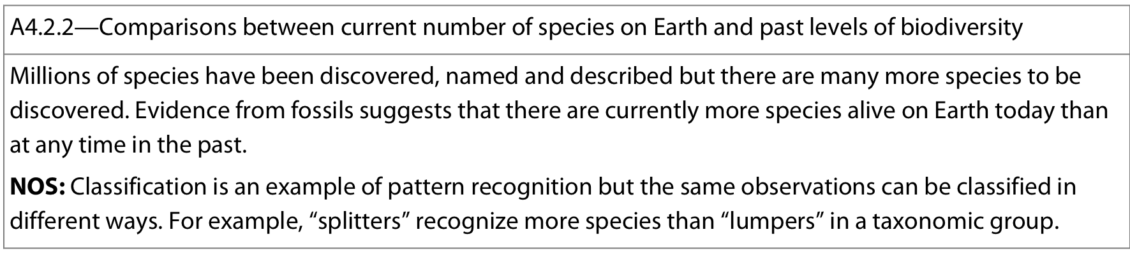

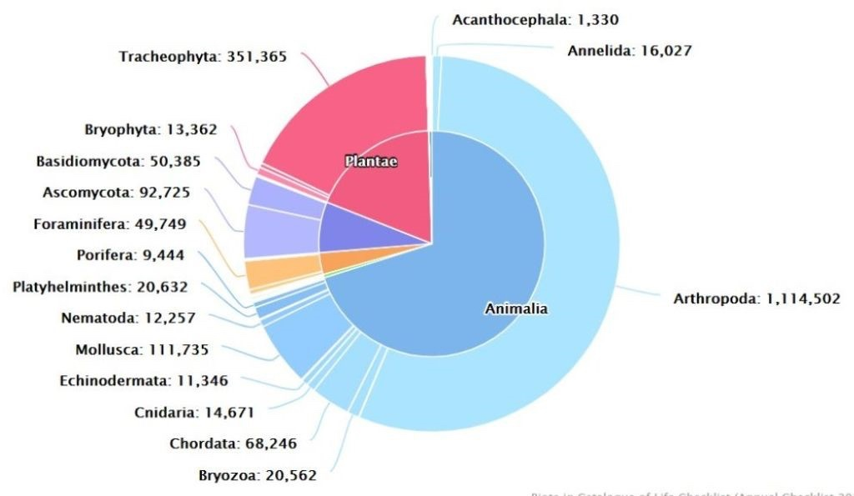
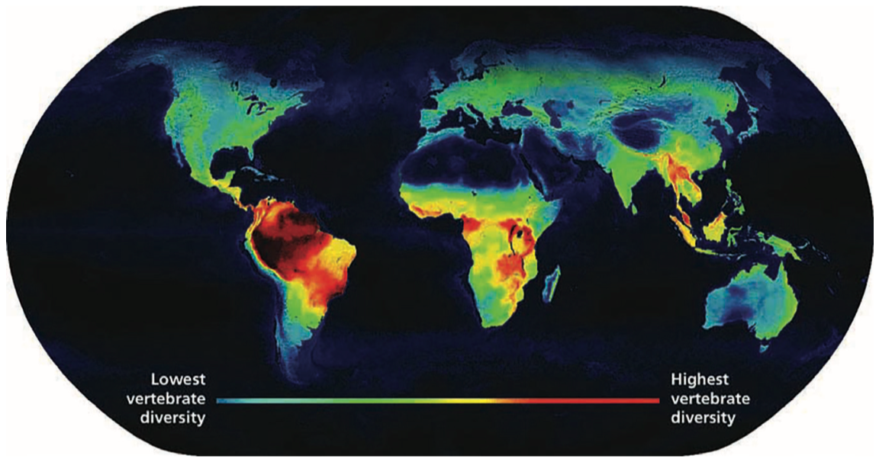
Biodiversity on Earth is very difficult to determine and estimates vary widely
The Catalogue of Life estimates 2.3M extant species on the planet recognized by taxonomists at present time
the TOTAL number is not currently known (estimate vary but most are around 10 million) thus there are many more species left to discover and classify
Estimates of number of prokaryotic species are extremely difficult to assess and are generally unknown
There is also a bias as to which organisms get discovered based on size, interest, funding, feasibility, extremely small differences between organisms etc.
Biodiversity is not even around the Earth where generally, the most biodiverse are closest to the equator with diversity dropping with proximity to poles

Slide 4
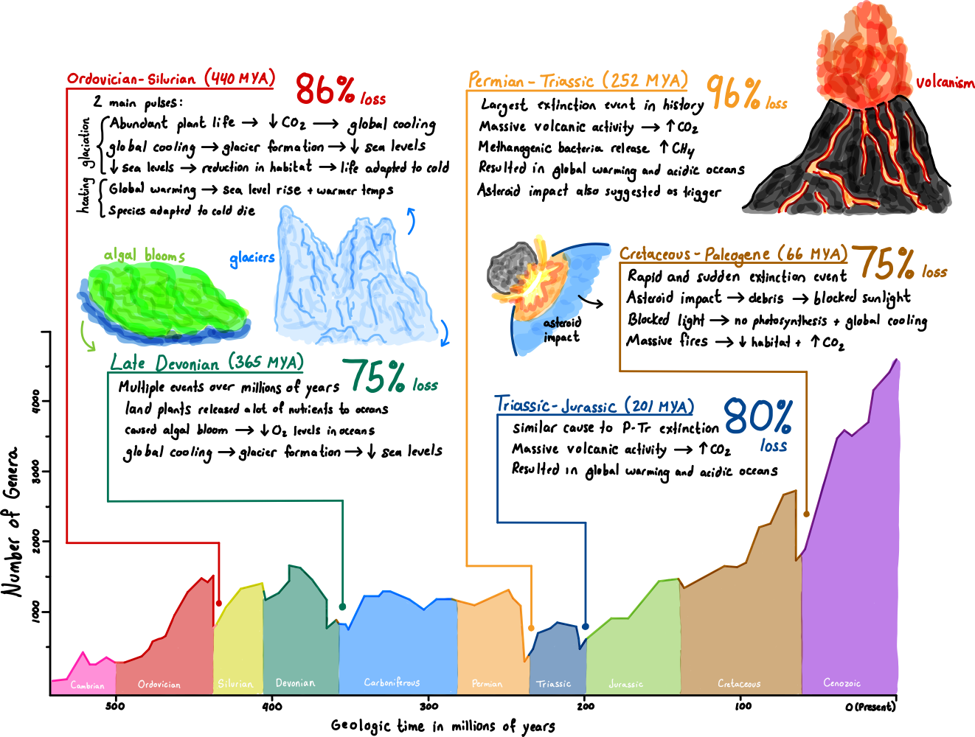
Mass extinctions:
when >75% pf the total number of species have gone extinct over a relatively short period of geologic time
There have been 5 mass extinction events in the Earth’s history
Causes of these events are still debated and largely relies on fossil evidence and rock composition

Slide 5
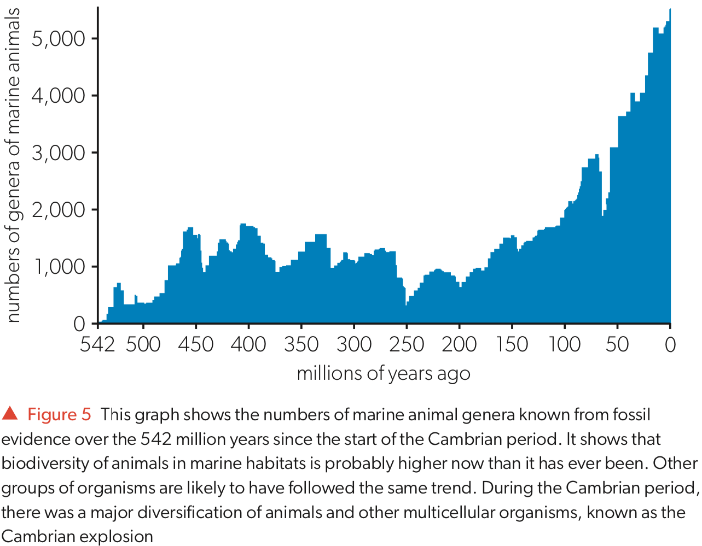
Evidence from fossils suggests that there are currently more species alive on Earth today than at any time in the past
The most recent mass extinction event was ~66 million years ago (end of Cretaceous period) when the Earth was hit by a large asteroid
Following a mass extinction event, biodiversity tends to rise due to evolution and adaptive radiation where new species fill vacant niches
Ex: extinction of non-avian dinosaurs led to adaptive radiation of mammals and birds to fill vacant niches left behind
As the last mass extinction event was 66MYA, biodiversity has been able to undergo a sustained increase → likely higher than ever in earth’s history
Notes:
Different types of fossil evidence:
Petrification: organic matter of the dead organism is replaced by mineral ions
Mould: organic matter decays but the space left becomes a mould, filled by mineral matter
Trac: impression of a form, such as a leaf or footprint, made in layers that harden
Perservation: intact whole organism is perserved for example, in amber (resin exuded from a conifer, then solidified) or in acidic peat

Slide 6
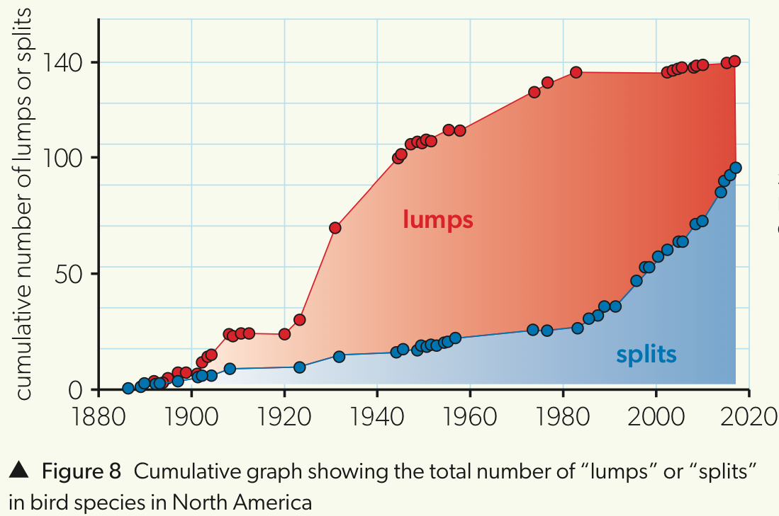

NOS: The accuracy of the estimated number of species on Earth is dependent on the process of classification, thus the same observations can be classified in different ways
It can be said that taxonomists are either:
"Lumpers” focus on similarities more than differences, and are more likely to classify species together
  →If species are incorrectly classified together then estimates will be too small
“Splitters” focus on differences, and are more likely to classify species separately
  →If species are incorrectly separated then estimates will be too large
Potential factors to consider in these trends:
1935, paper proposing the biological species concept
1980s saw massive improvements on DNA technology

Slide 7
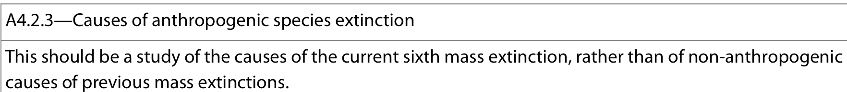
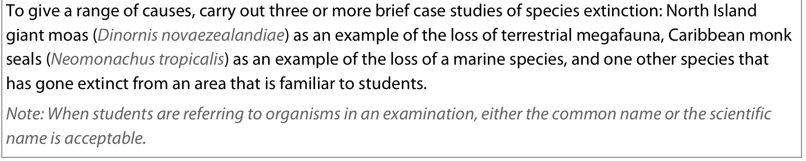
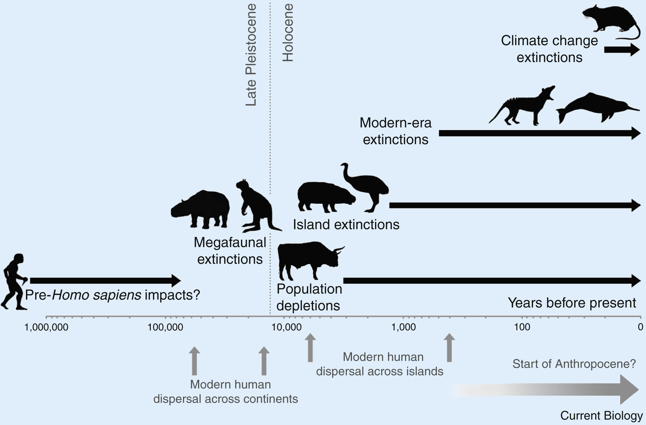

We are currently in a 6th mass extinction event – Holocene extinction aka Anthropocene Extinction
Unlike the previous 5, this ongoing event is biologically-driven - human activity
Current extinction rates are estimated at 100 to 1,000 times higher than natural background extinction rates and are accelerating
Examined through 3 major case studies:
The North Island giant moa (Dinornis novaezealandiae)
Caribbean monk seals (Neomonachus tropicalis)
One other species of your choice that has gone extinct due to human activity. Some well known examples:
  Baiji (Lipotes vexillifer)
  Passenger pigeon (Ectopistes migratorius)
  Falklands wolf (Dusicyon australis)
  Tasmanian tiger (Thylacinus cynocephalus)

Slide 8
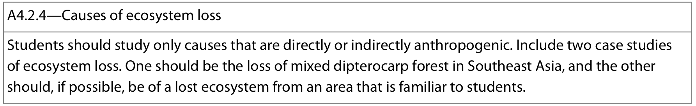




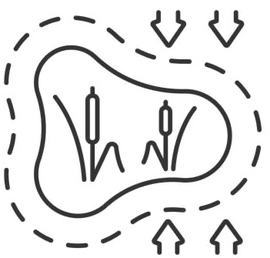



Humans are causing significant loses to ecosystems. Major causes:
Agriculture
Overexploitation of natural resources
Water management (damsn, irrigation)
leaching
Urbanization
Mining and smelting
Draining of wetlands
Climate change
Examined through 2 major case studies:
Loss of mixed dipterocarp (Dipterocarpacea) forest in Southeast Asia
Loss of ecosystem of your choice due to human activity. Some well known examples:
  Great Barrier Reef, Australia
  Northern Great Plains, North America
  Mangrove forests, various locations
  Aral Sea (between Kazakhstan and Uzbekistan)

Slide 9
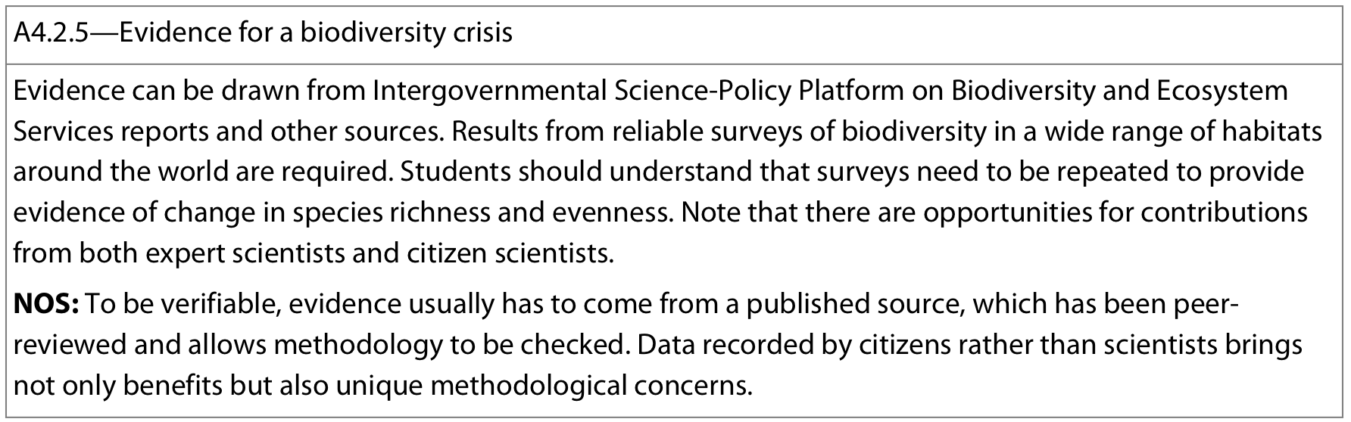
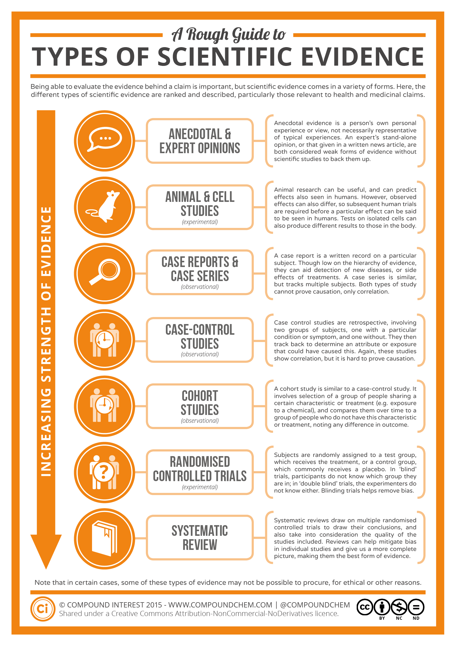
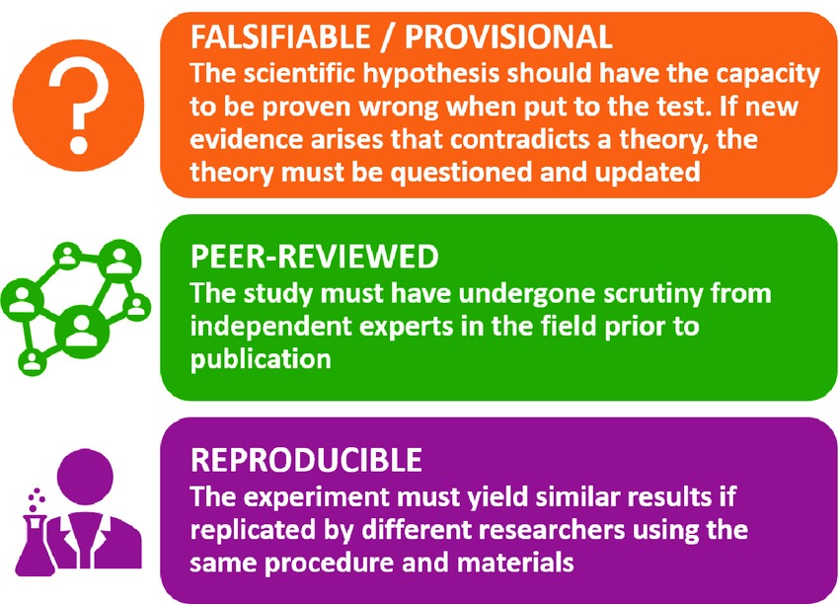
NOS: What makes scientific evidence verifiable and reliable?
From a published, peer-reviewed source
Large data sample
No conflict of interest/bias by investigators
Clear how data was obtained
Collecting data on global biodiversity is very difficult and time-intensive and qualified scientists alone may not be enough to gain an accurate picture on a national or global scale
→ organizations can ask the public to help with data collection 'citizen scientists’
→ Citizen scientists are often untrained, and may not always collect valid data as a result, so there will be a certain amount of trade-off between the quality and the quantity of the data
Good experimental design and high-quality data analysis can help to mitigate the effects of using citizen scientists.

Slide 10
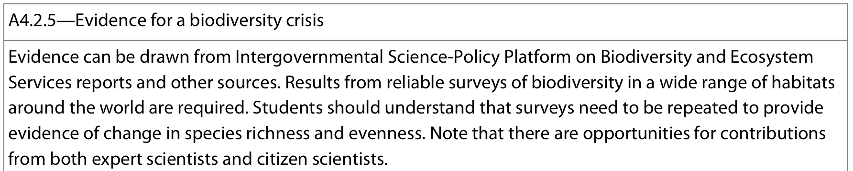
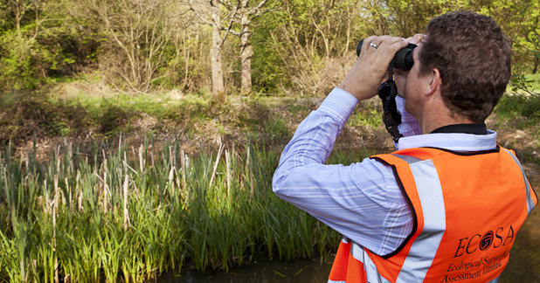

If there is indeed a “biodiversity crisis”, what is the evidence?
Ecological surveys are conducted in habitats to determine:
  Biodiversity
  Geographical range of species
  Genetic diversity of a species
  Ecosystem damage
When assessing the biodiversity of a particular region, two key measures are investigated:
Species richness: the number of different species present in an area (more species = greater richness)
Species evenness: the relative abundance of the different species in an area (similar abundance = more evenness)
→ Simpson’s reciprocal index quantifies biodiversity by taking into account richness and evenness
D = diversity index (higher = more diverse)
N = total number of organisms of ALL species found
n = number of individuals of a particular species

Slide 11
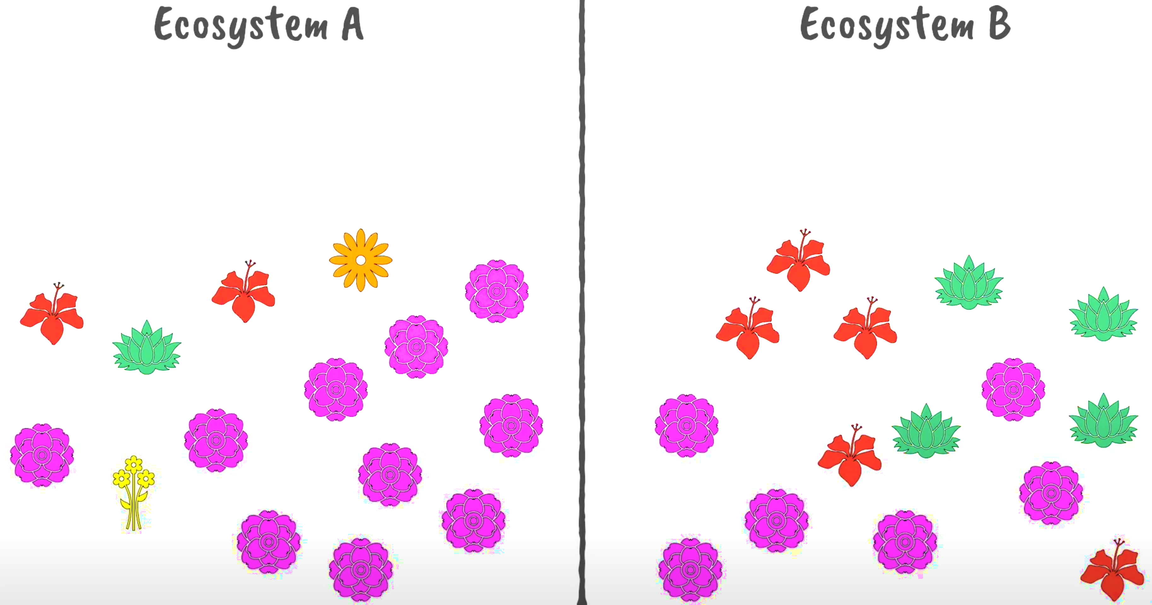
Example problem 1:
Which ecosystem has the higher biodiversity?

Slide 12
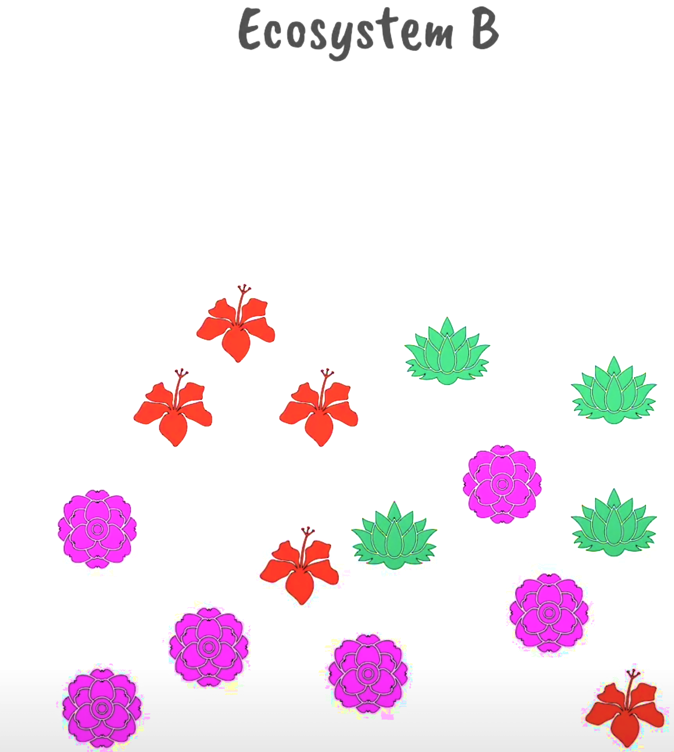
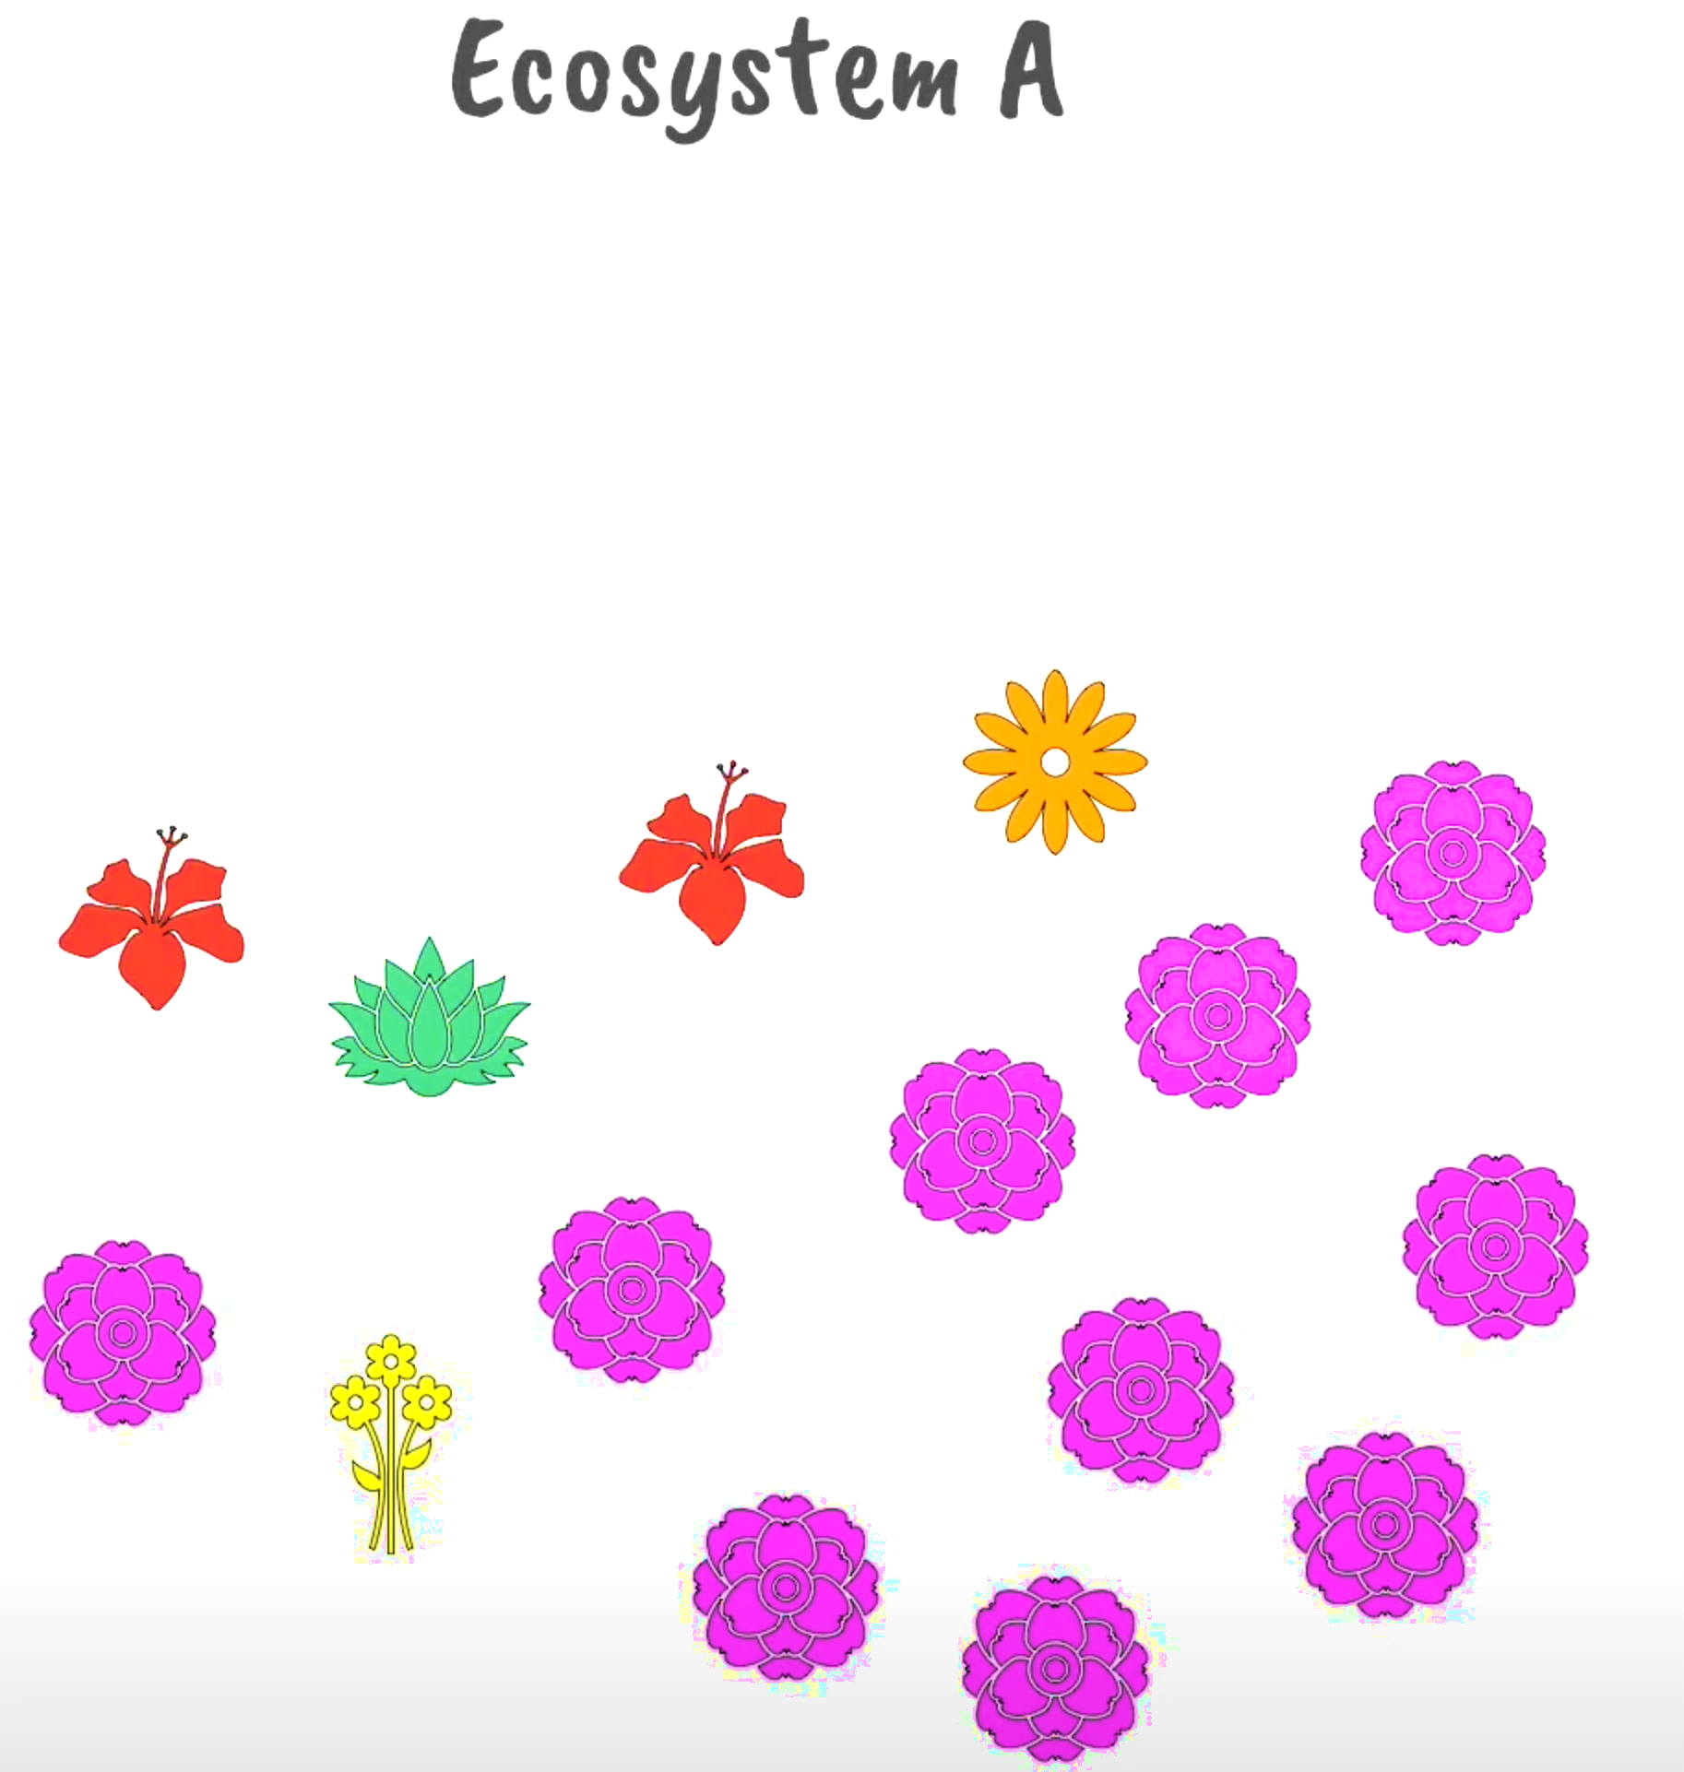
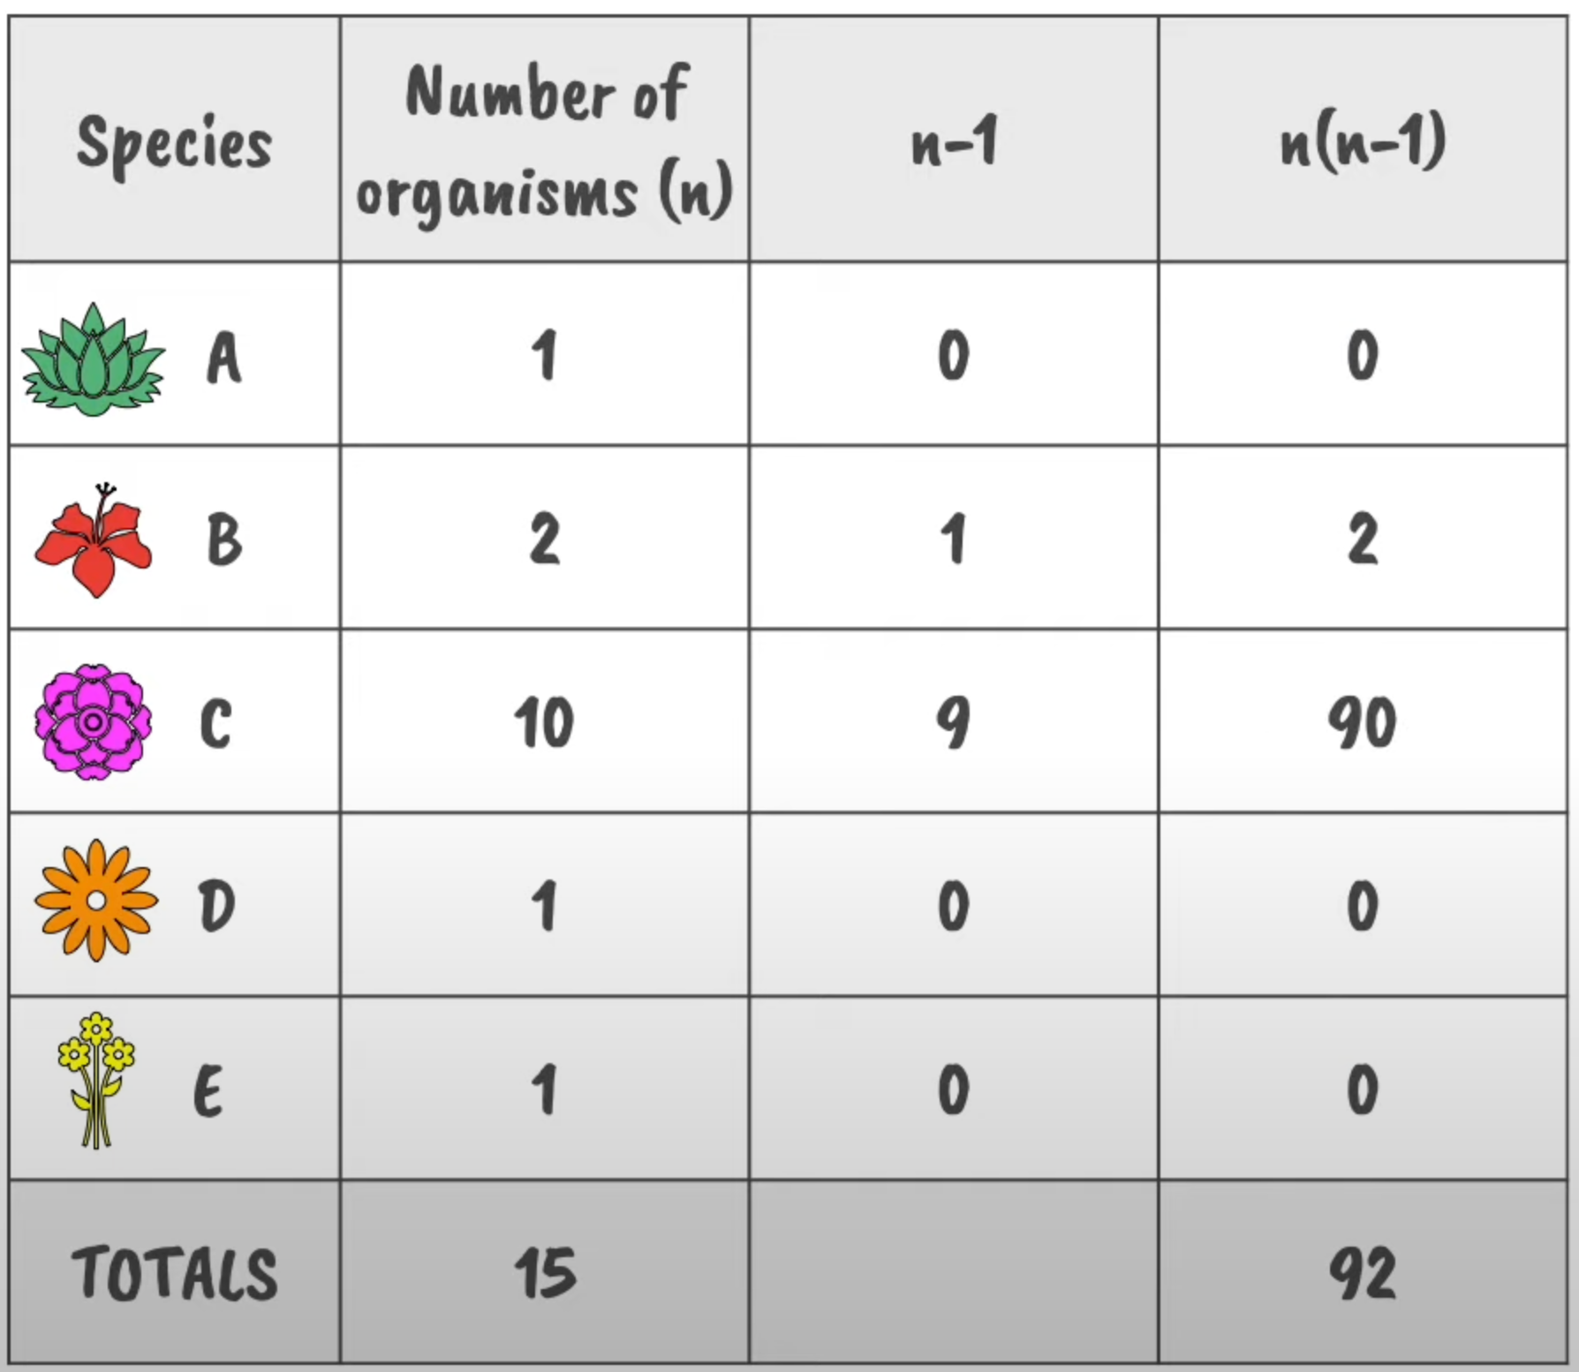
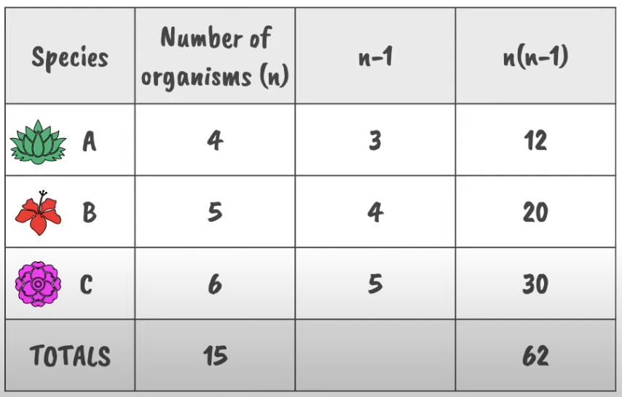
Example problem 1:
Which ecosystem has the higher biodiversity?
D = 15(15-1)
92
= 2.28
D = 15(15-1)
62
= 3.39

Slide 13

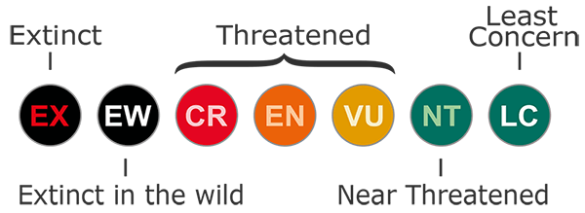
If there is indeed a “biodiversity crisis”, how is the evidence around the world collected and disseminated?
Intergovernmental Science-Policy Platform on Biodiversity and Ecosystem Services (IPBES)
intergovernmental organization established to improve communication between science and policy on issues of biodiversity and ecosystem services. (like the IPCC for climate change).
gather information, recommend policies, and communicate findings relating to global biodiversity and ecosystems in published reports
These reports are based on repeated surveys and may rely on contributions from both expert scientists and citizen scientists
International Union for Conservation of Nature (IUCN)
international organization working in the field of nature conservation and sustainable use of resources
IUCN red list is a list of the world's most threatened species, ranked in groups of increasing severity and risk of extinction (and thus most in need of conservation efforts)
The IUCN red list has been compiled by scientists and scientific organizations all around the world, and is used by many groups to inform conservation efforts

Slide 14
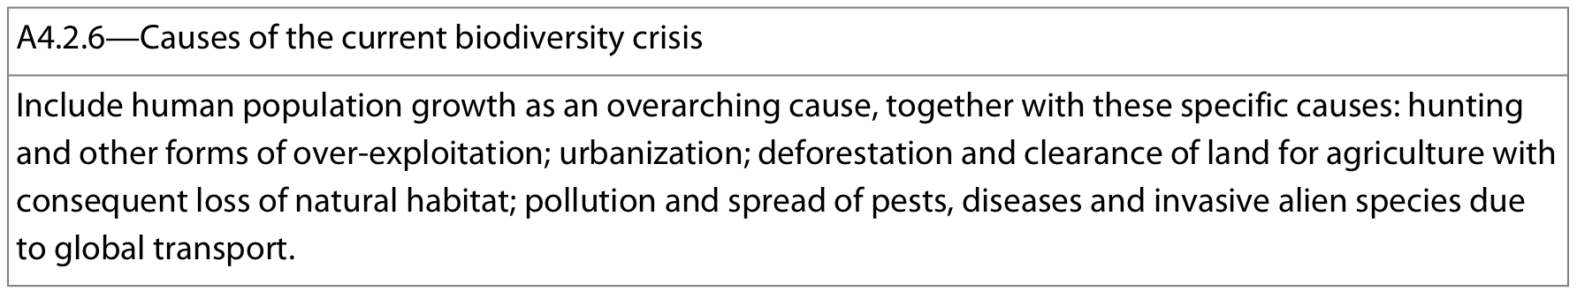
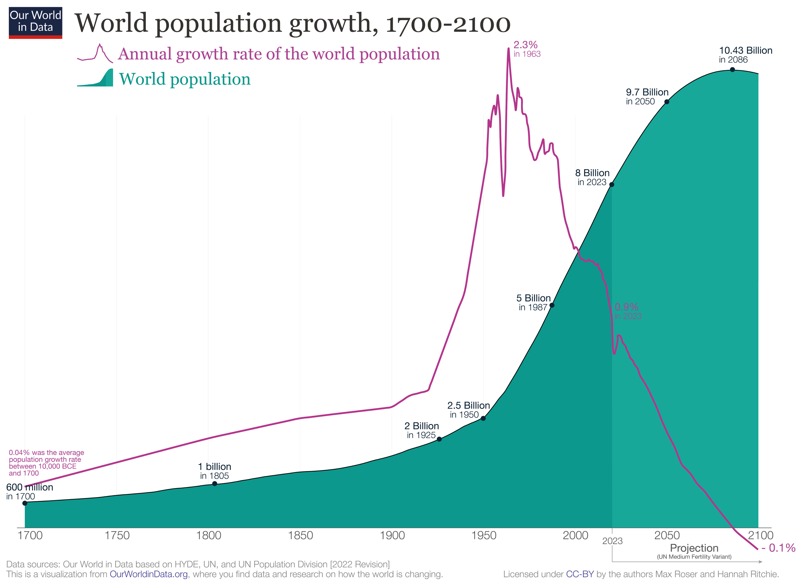
Human population growth is the overarching cause of the current biodiversity crisis
Between 1920 and 2020 the human population has more than quadrupled!
Even though birth rates are now decreasing, people are living longer so births are occurring at a higher rate than deaths and the population continues to grow
As the global population continues to increase demands for the following also increase
  Food
  Water
  Land
  resources
→ This drives many of the causes resulting in the biodiversity crisis

Slide 15

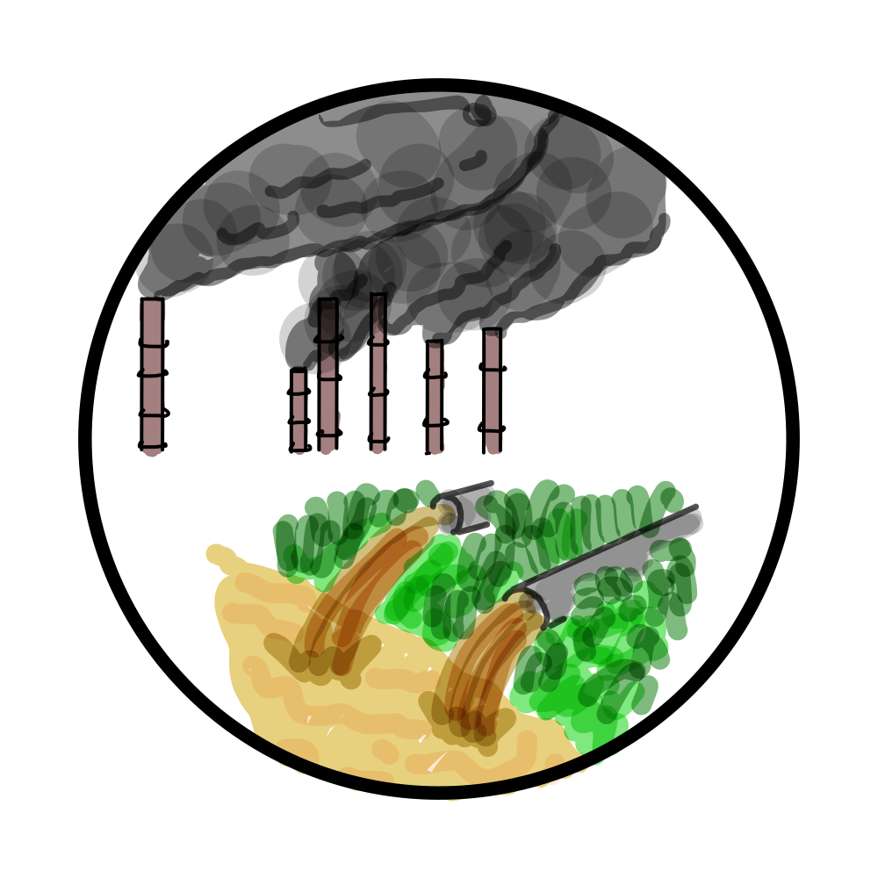
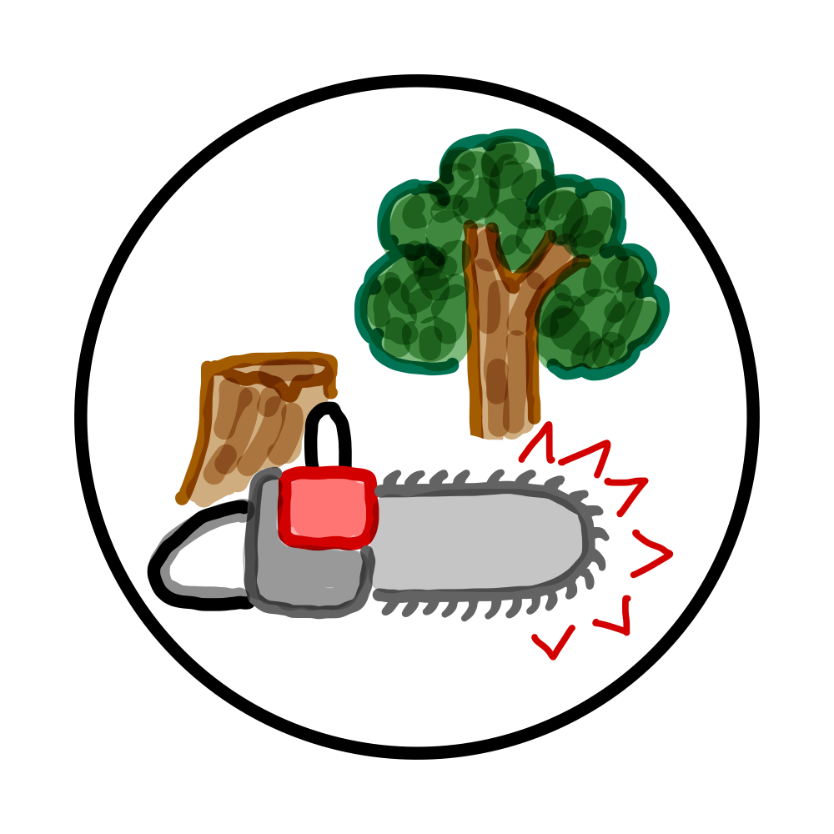
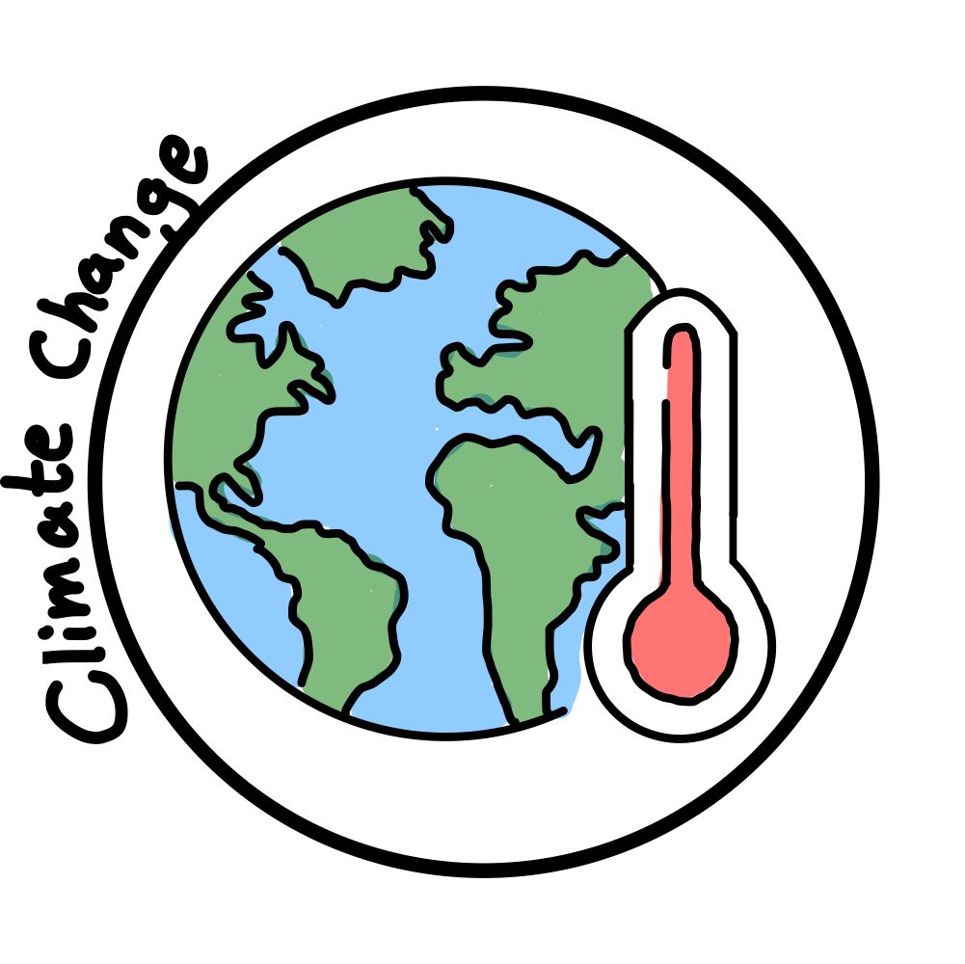

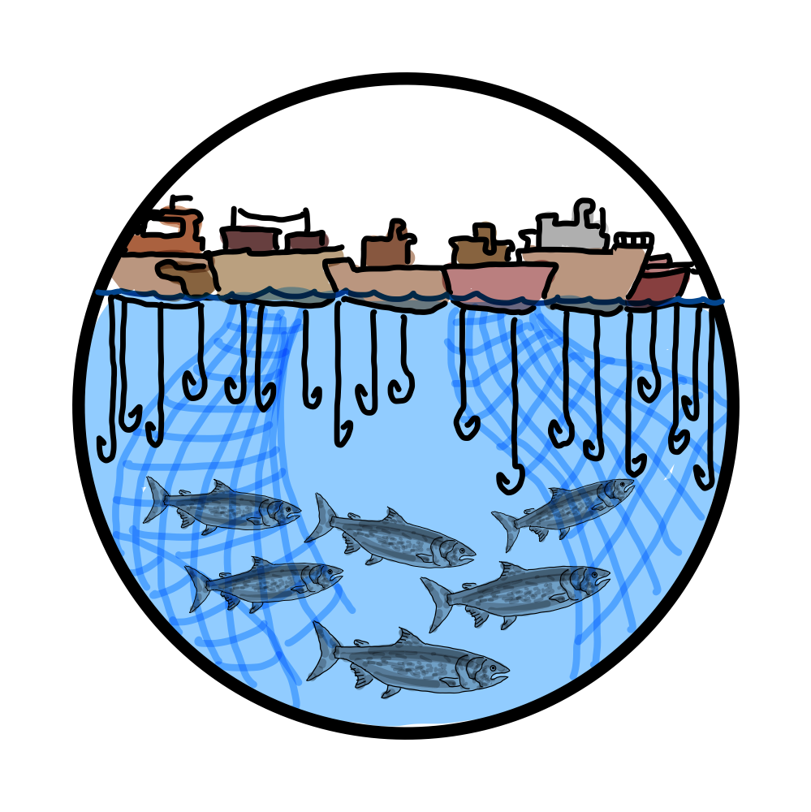

Human population growth is the overarching cause of the current biodiversity crisis exacerbating the following causes:
Spread of invasive species and pests
Pollution
Deforestation
Hunting
Overexploitation of resources
Urbanization

Slide 16
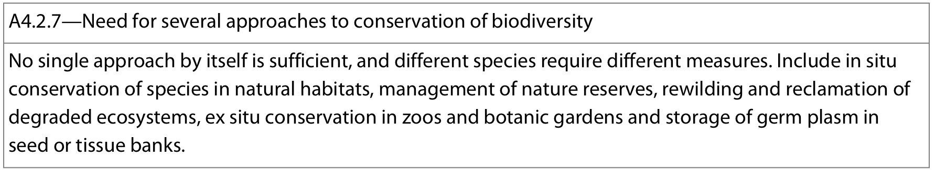
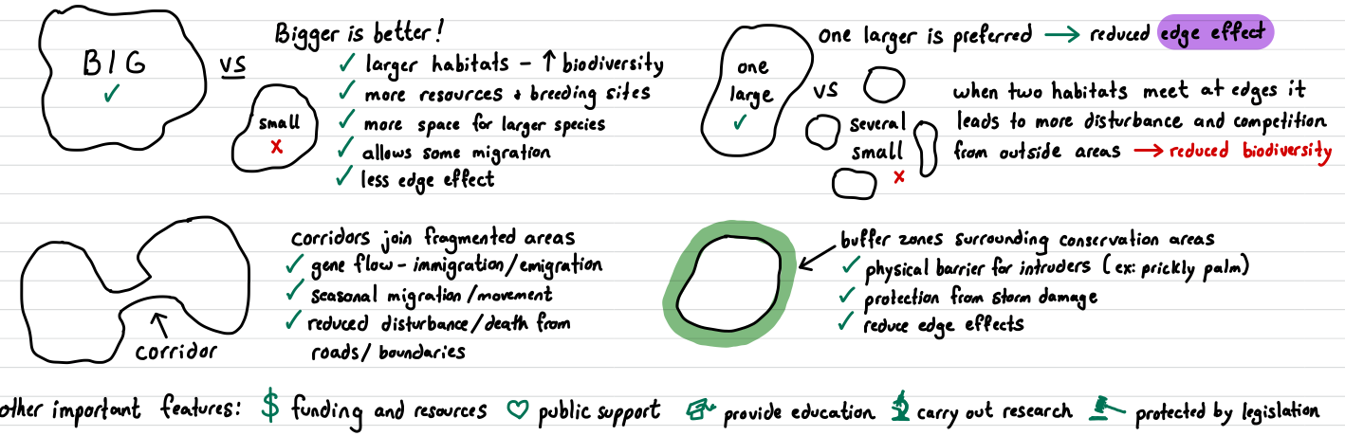
In situ conservation is the preservation of plant and animal species within their natural habitat (on-site)
Aims to preserve the greatest amount of natural habitat within an ecosystem (thus maintaining complex ecological relationships and interactions, maintaining biodiversity and equilibrium)
May require active management:
  Controlled grazing
  Controlled poaching
  Re-introduction of locally-extinct species
  Removal of invasive species
  Controlled access to visitors
  Legal action against human impacts
What makes a good protected area?

Slide 17
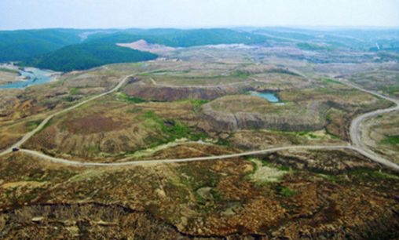
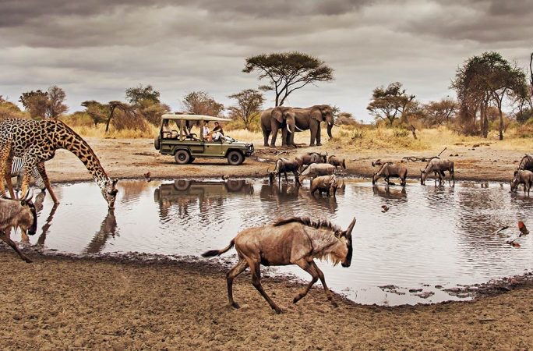
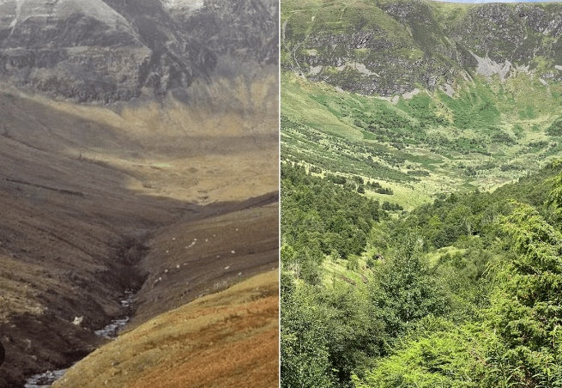
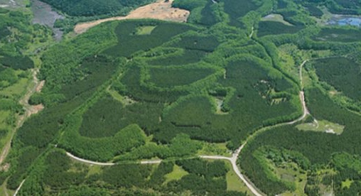
In situ conservation is the preservation of plant and animal species within their natural habitat (on-site)
National parks
Rewilding of degraded ecosystem
Reclamation of degraded ecosystem
Pros of protected areas | Cons of protected areas
Allows species to live in environment in which they are adapted | Requires sufficient funding
Can conserve whole ecosystems (holistic approach) | Difficult to establish due to political issues/economic interests
Maintains animals normal behaviour | Areas can become ‘islands’ which result in a loss of biodiversity
allows preservation of potentially unknown species | Requires constant monitoring and regulation
Provides an area for re-introduction programmes | Subject to outsides outforces difficult to control

Slide 18
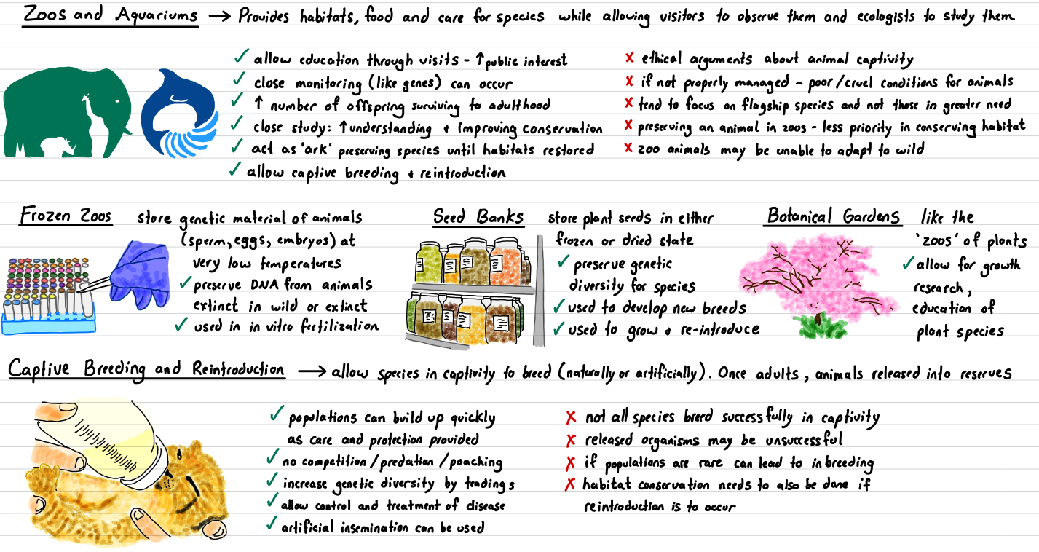
Ex situ conservation is the preservation of plant and animal species outside their natural habitats (off-site)
Focuses on vulnerable species. Often used as a backup for in situ or when species cannot safety remain in natural habitats
Notes:
Germ plasm: genetic resources such as seeds, tissues, and DNA sequences that are maintained for the purpose of animal and plant breeding, conservation efforts, agriculture, and other research use

Slide 19
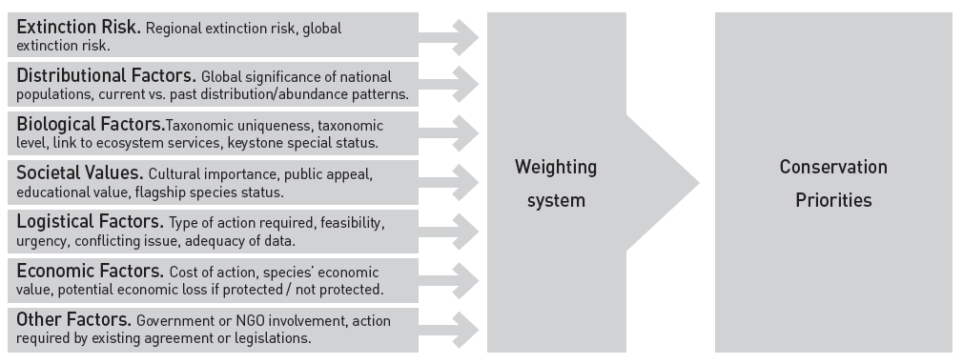

Slide 20
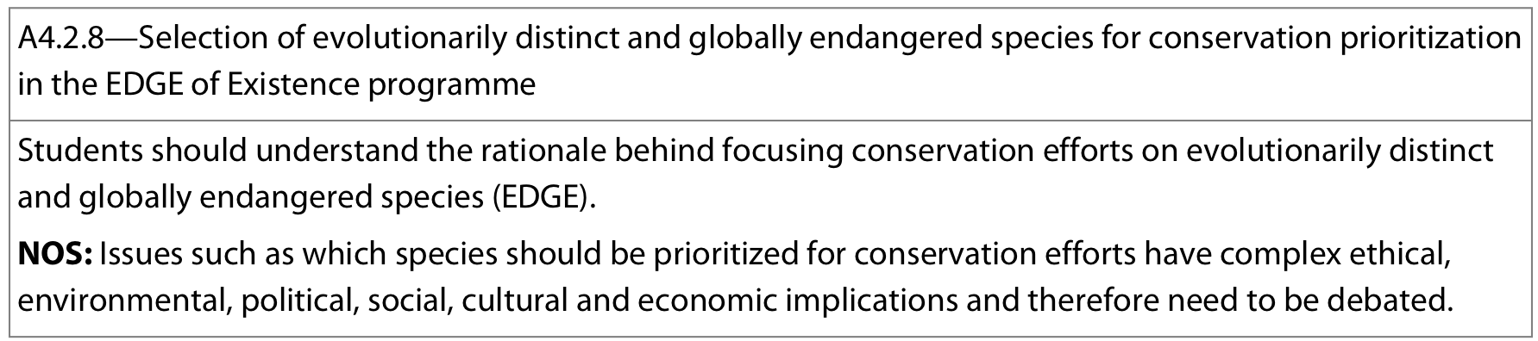

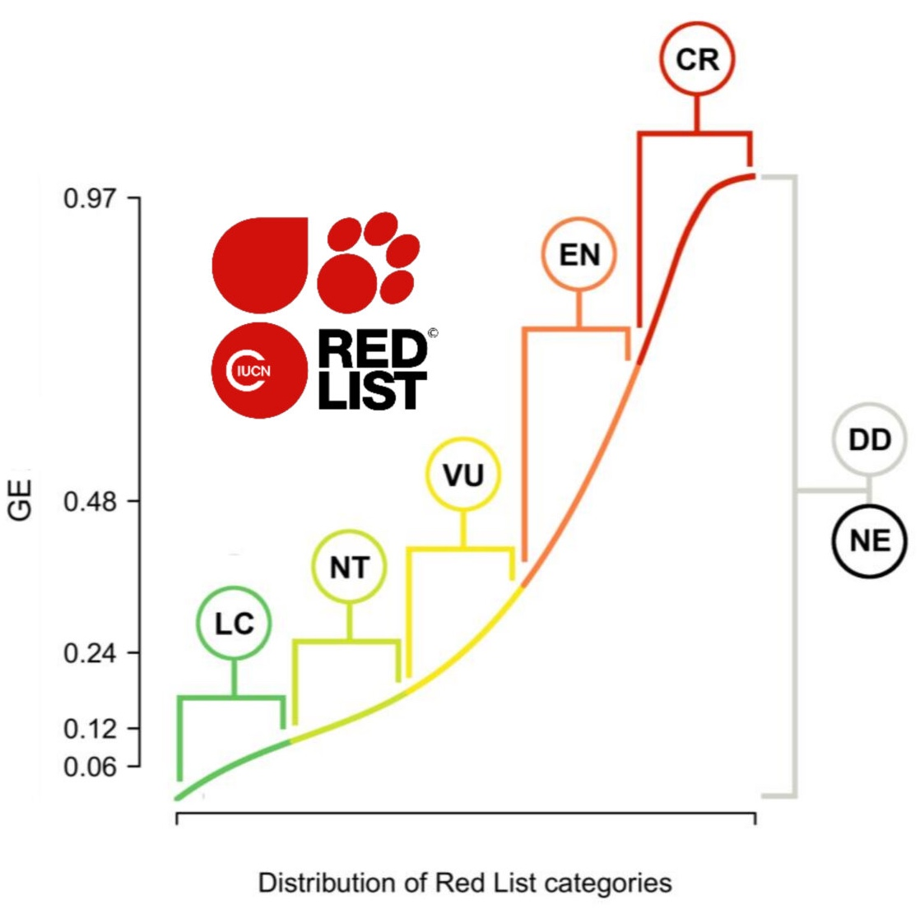
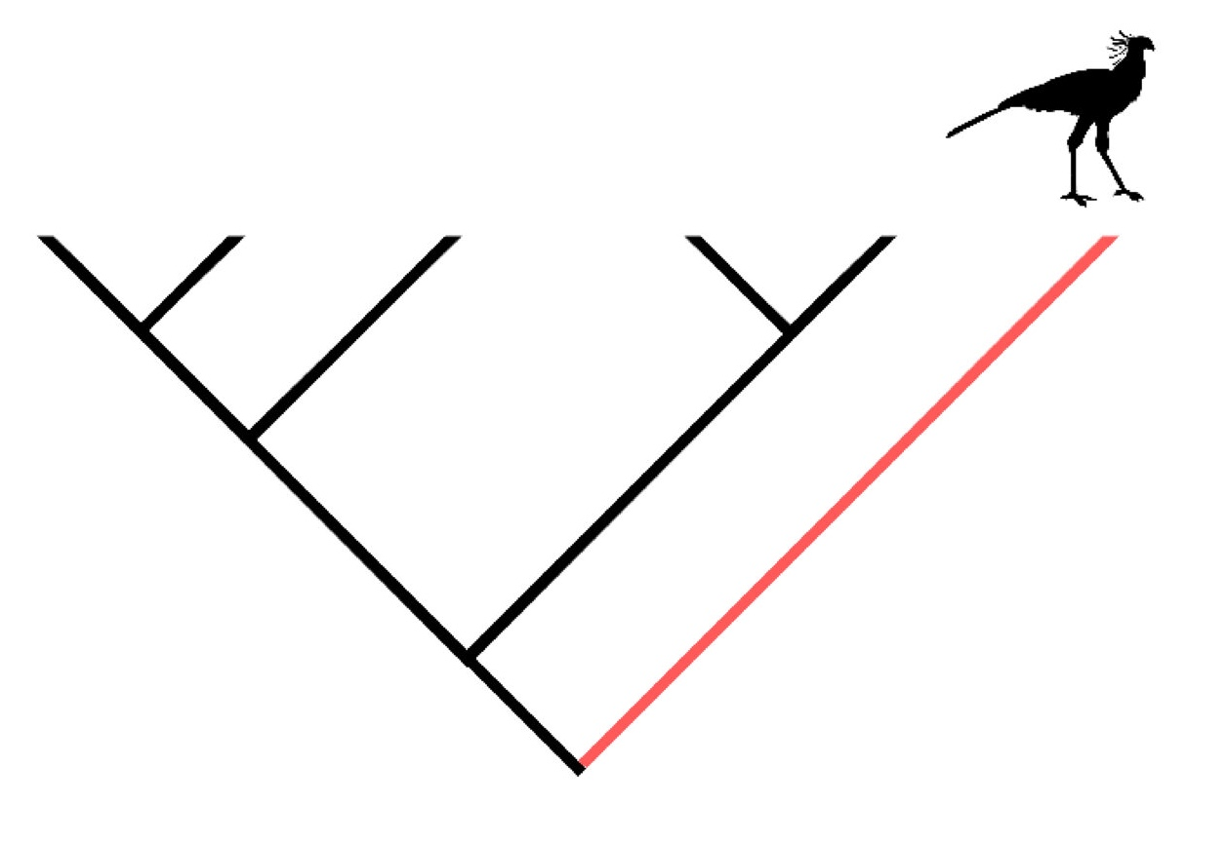
With so many species in danger, which species should be prioritized
→ EDGE species: custodians of evolutionary history; threatened species that, should they be conserved, are expected to secure long branches of the Tree of Life into the future. EDGE species are identified using two criteria:
Evolutionary Distinct:
does the species have few or no close relatives, it is is a member of a very small clade?
measures the amount of evolutionary history a species is expected to represent into the future
Globally Endangered:
is the species likely to become extinct because all remaining populations are threatened?
represented the extinction risk of a species

Slide 21
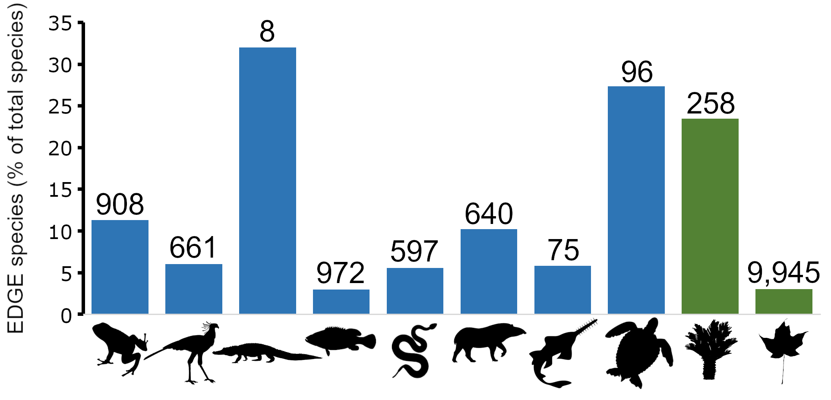

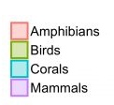
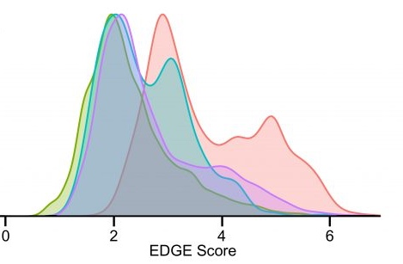
The proportion of total species in each taxonomic group that are EDGE Species. The numbers atop each bar represent the number of EDGE Species for each group. Groups (left to right): amphibians, birds, crocodylians, ray-finned fish, lepidosaurs (snakes, lizards and the tuatara), mammals, sharks and rays, testudines (turtles and tortoises), gymnosperms (conifers and cycads), angiosperms (flowering plants).

