Slide 1
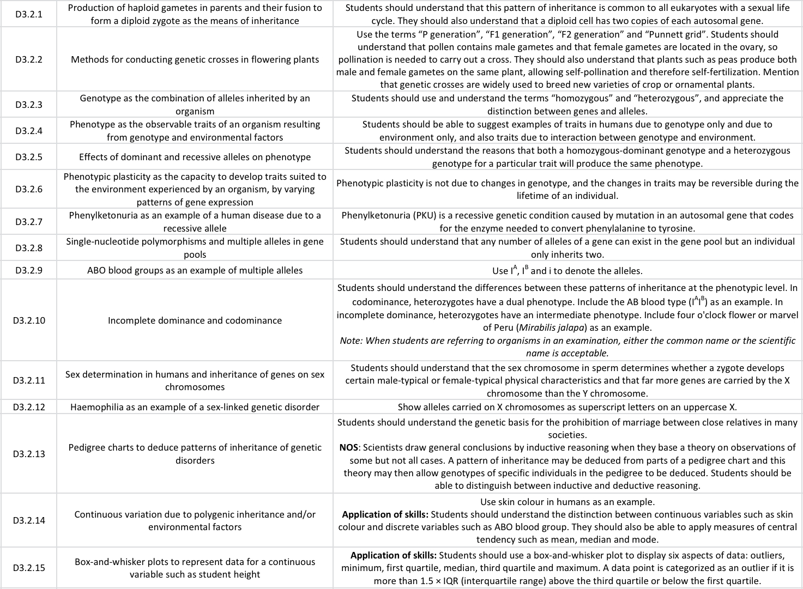
ipad notes will replace these at a later date
SL Learning Outcomes

Slide 2
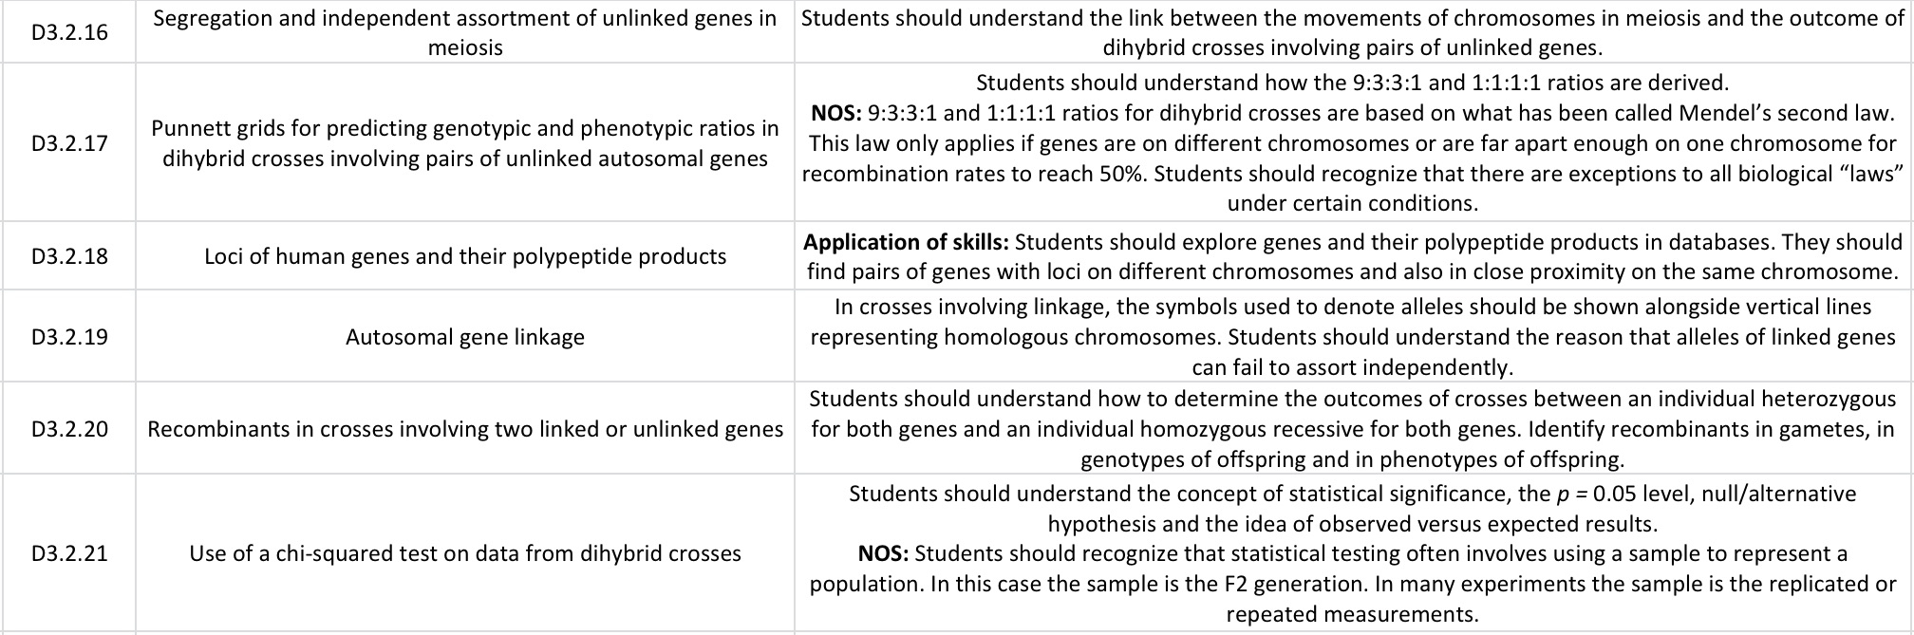
AHL Learning Outcomes

Slide 3
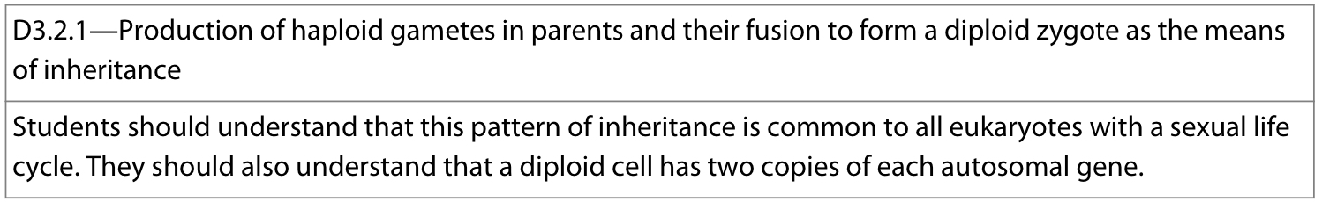
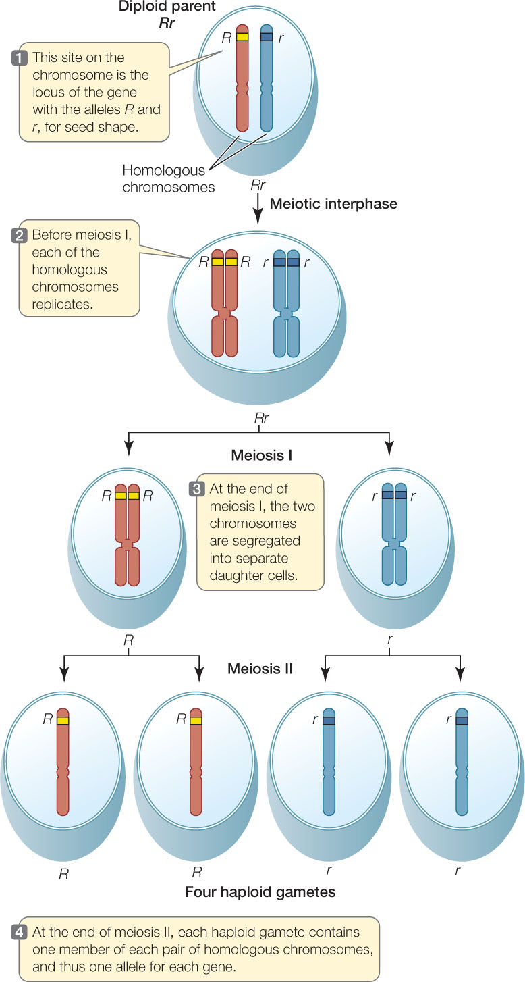
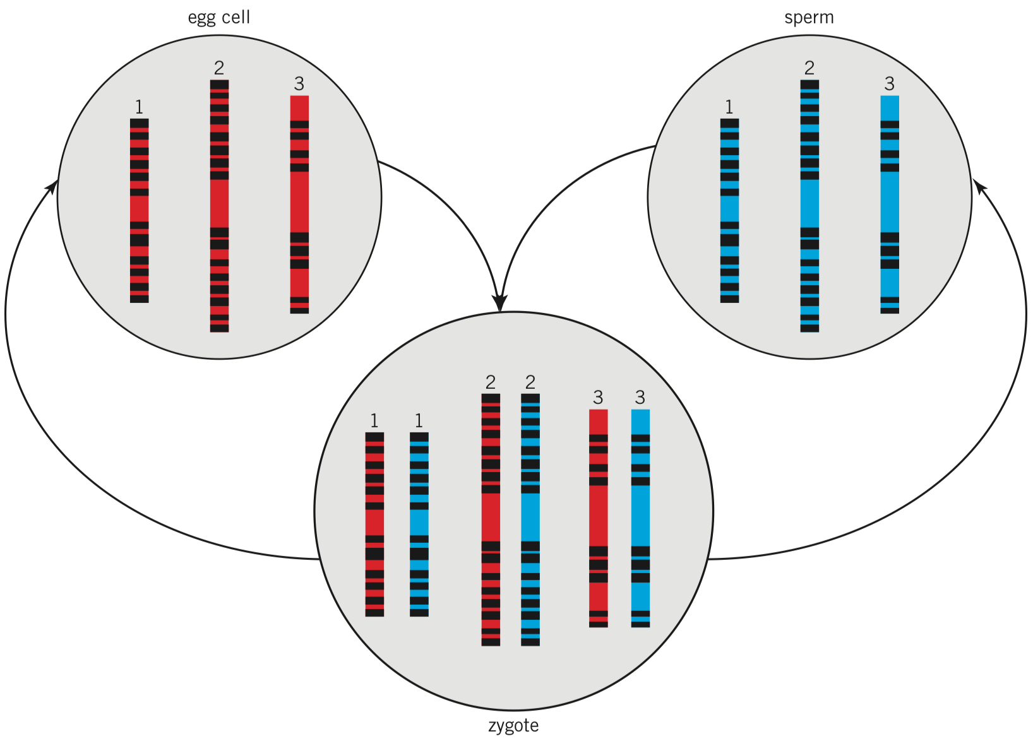
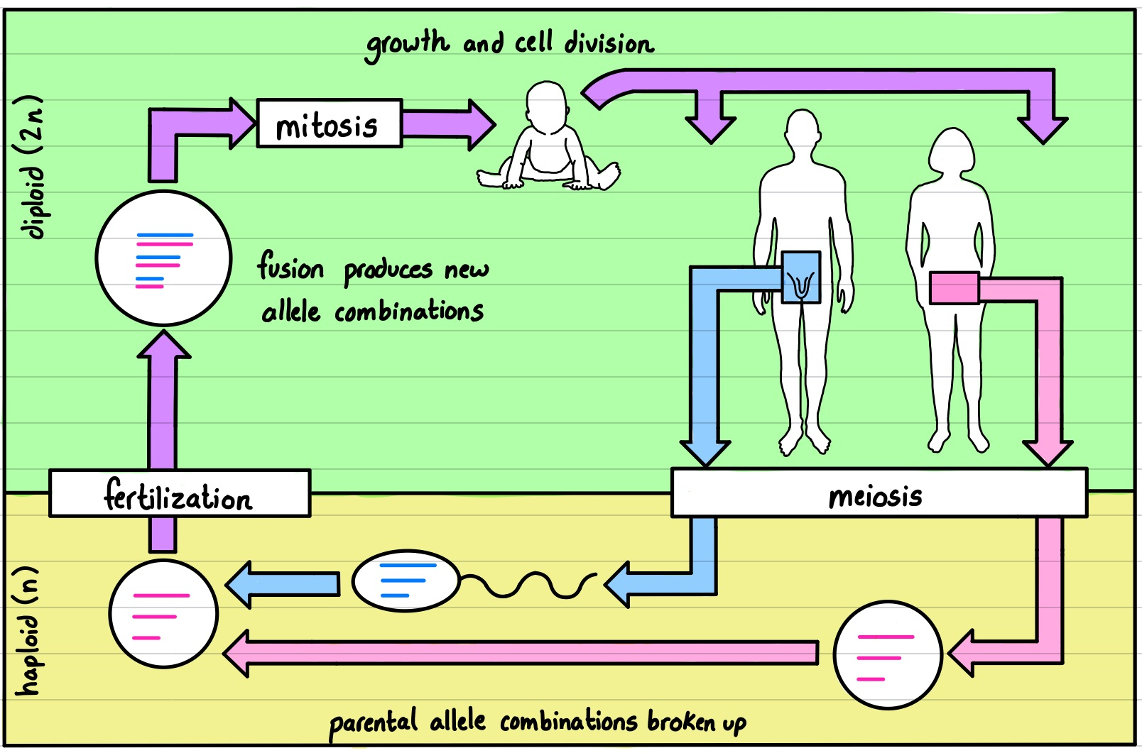
Meiosis produces haploid gamete:
nucleus contains one of each chromosome (n)
each gene has one copy (allele) located on a chromosome
Fertilization produces diploid zygote:
nucleus contains two of each chromosome (2n)
each autosomal gene has two copies (2 alleles, one on each homologous chromosome)
Eukaryotic sexual life cycle
Notes:
Alleles = versions of the same gene

Slide 4
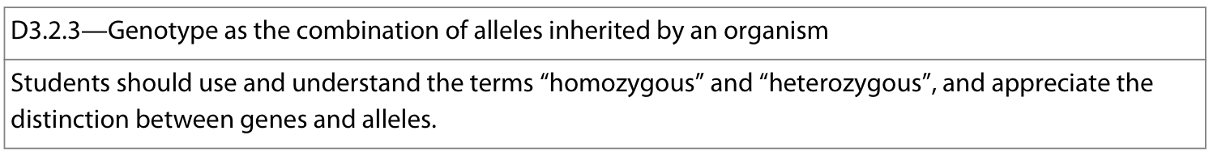
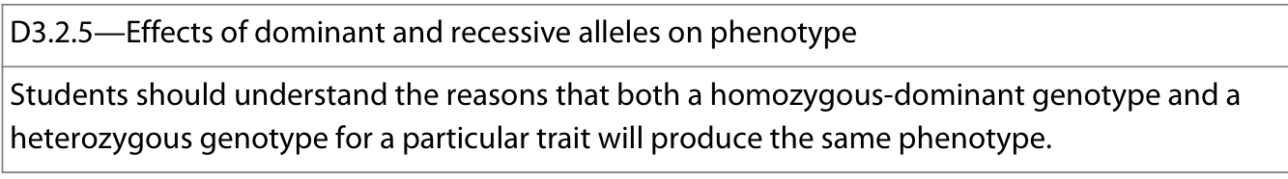
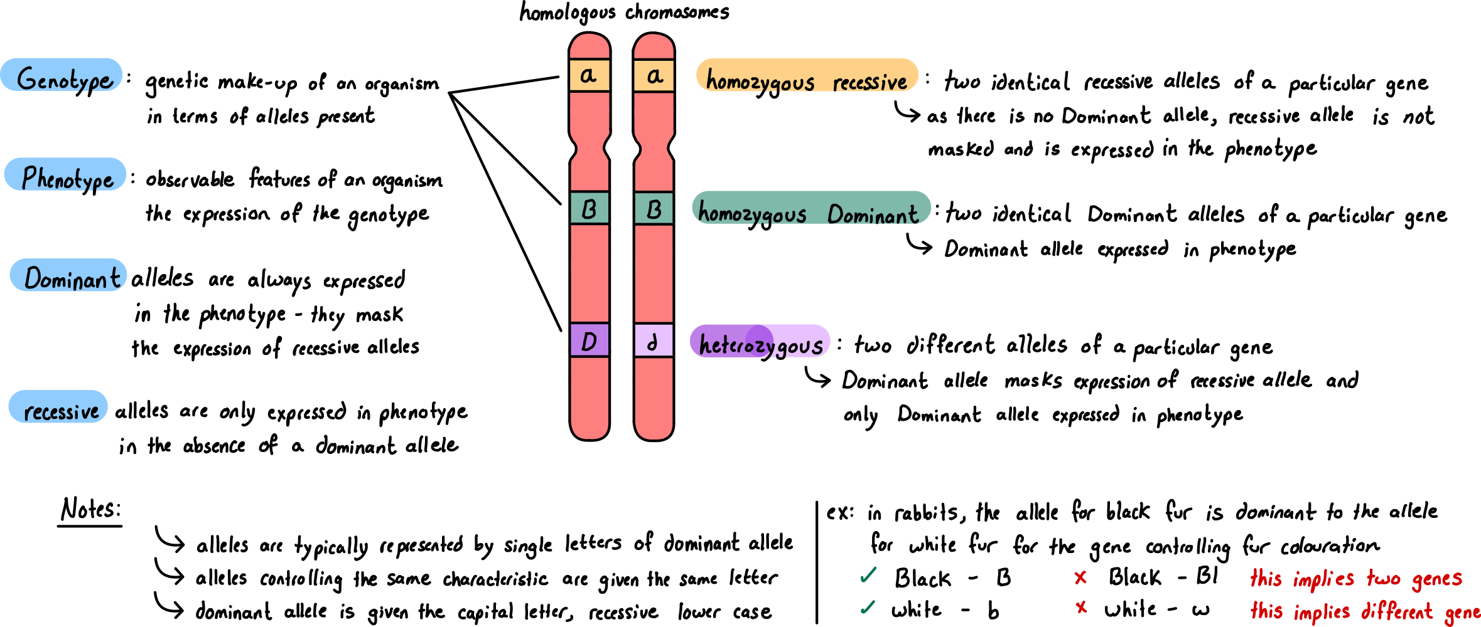
Notes:
Useful website of genetic terms: https://sg.idtdna.com/pages/education/decoded/article/genotyping-terms-to-know

Slide 5
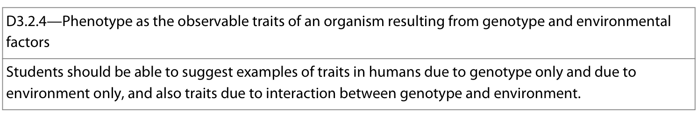

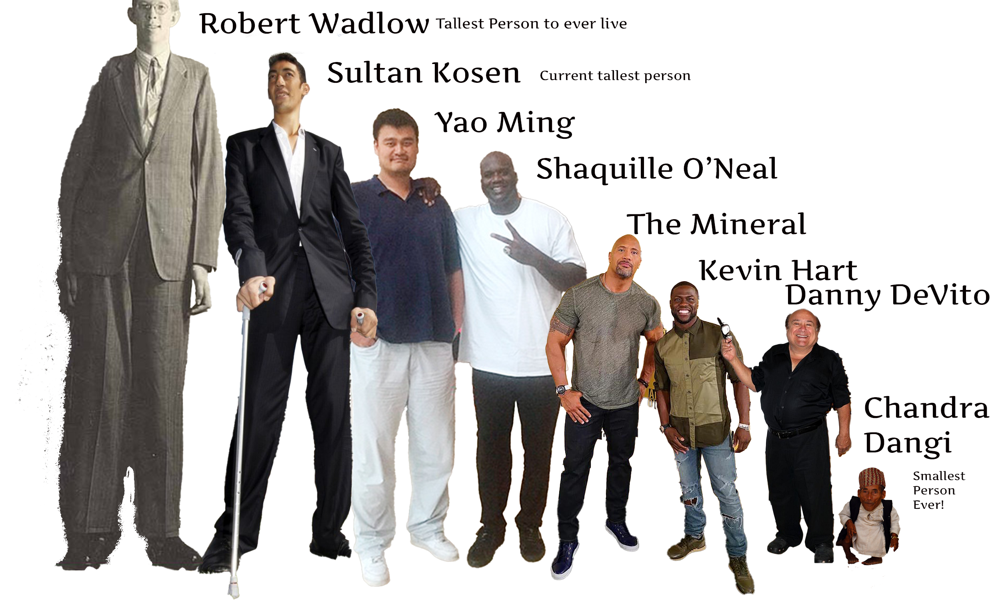
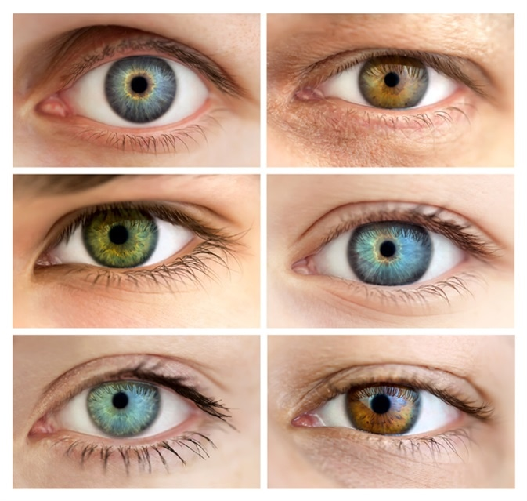
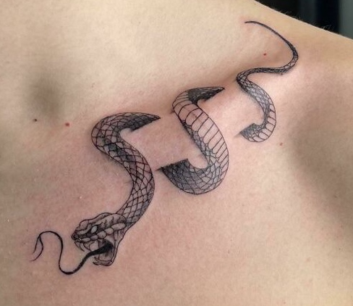
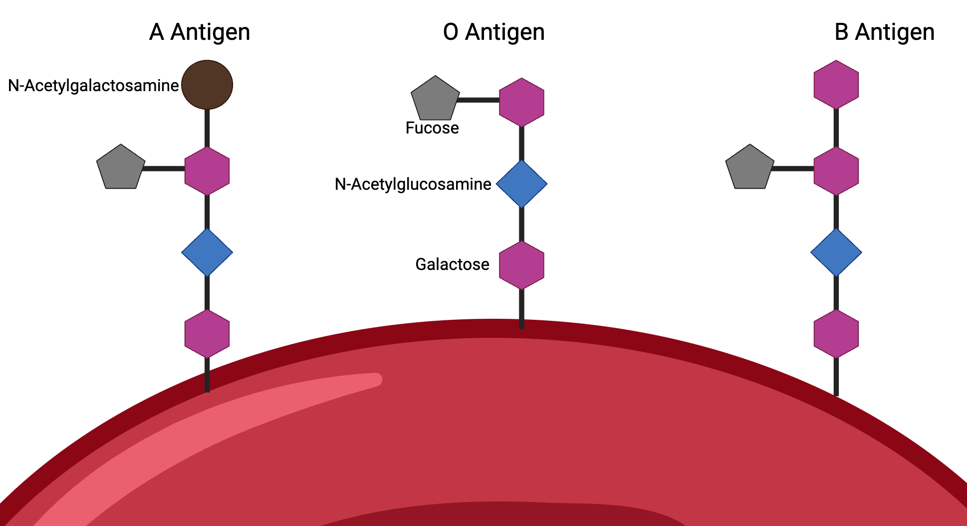
Phenotype: observable traits (characteristics) of an organism
Most phenotypic traits are due to the interaction between genotype of an organism and the environment in which it exists but there are exceptions.
Traits caused by genotype ONLY
ABO blood groups
Eye color
Genetic diseases:
  Huntington’s disease
  Haemophilia
  Cystic fibrosis
  Color blindness
Ability to smell β-Ionone
Traits caused by genotype + environment
Skin color
Height in humans
Autism
Diabetes
Cancer
Traits caused by environment ONLY
Learned behavior:
  Languages spoken
  Skills acquired
  Knowledge learned
Acquired physical characteristics:
  Scars due to wounds
  Tattoos and piercings
  Larger muscles from exercise
Characteristics from infection:
  River blindness (onchocerciasis)
Notes:
Observable = trait is visible or detectable with tests (not necessarily by visual inspection)

Slide 6
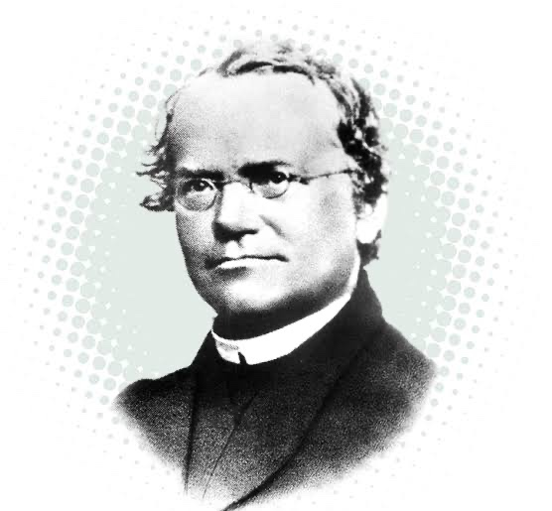
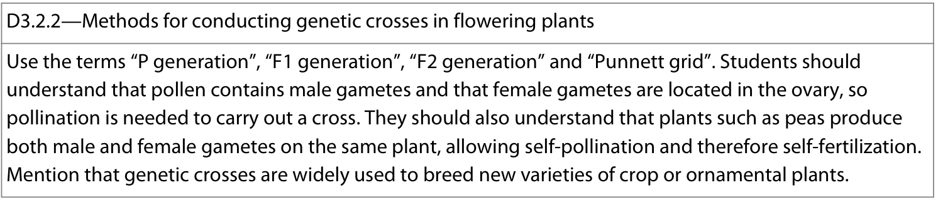
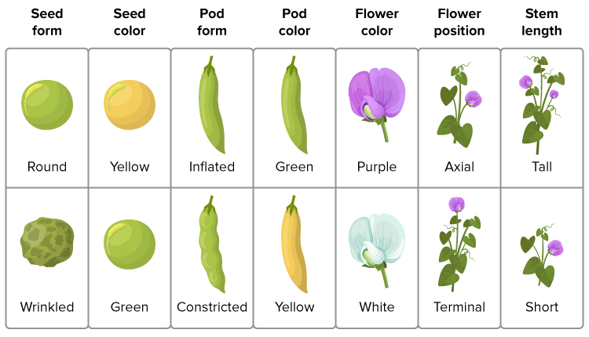
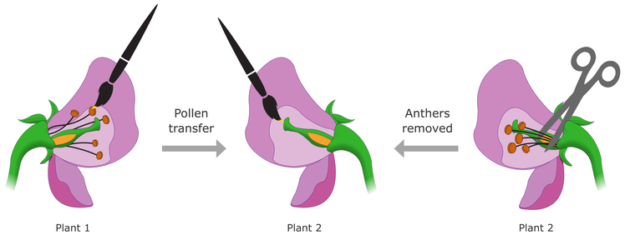
Gregor Mendel (1822 –1884) was a monk and teacher with interests in plant breeding. The monastery he attended had a botanical garden where he began a series of experiments to find out how traits are passed from generation to generation.
At the time, it was thought that parents’ traits were blended in their progeny.
He studied pea plants (Pisum sativum) which are hermaphroditic (producing both male and female gametes) as a model organism
Pea plants vary in several visible traits where for each there are two distinct phenotypes (ex: green seed vs yellow seed)
He performed controlled cross pollination:
  Anther removed from plant 2 (to prevent self-pollination and fertilization)
  Pollen from plant 1 is manually transferred to stigma of plant 2

Slide 7
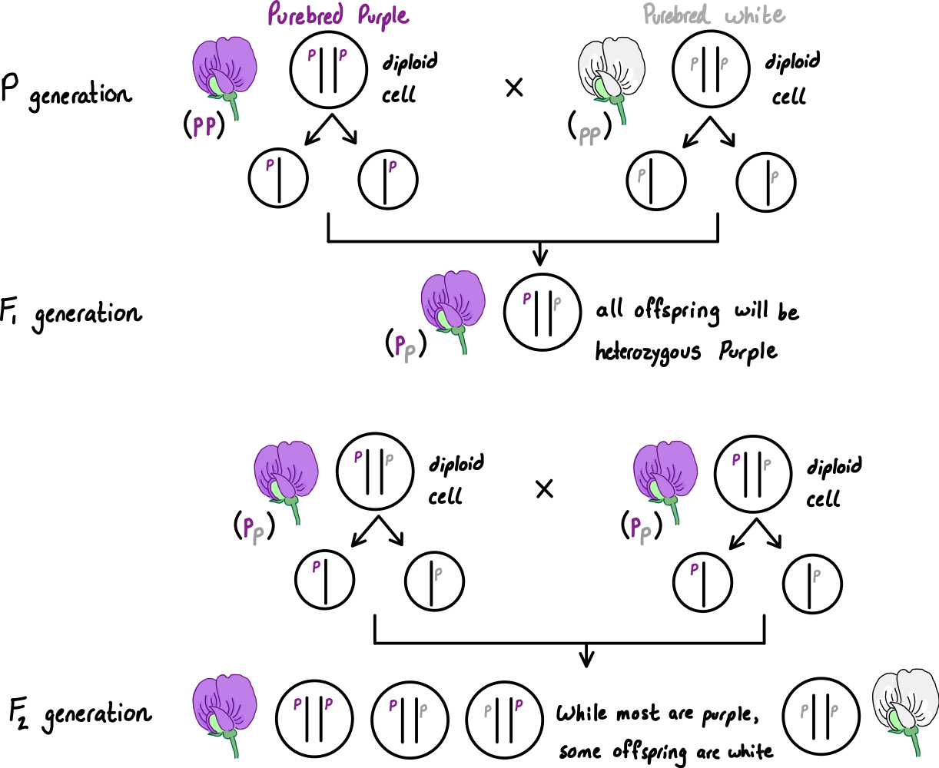
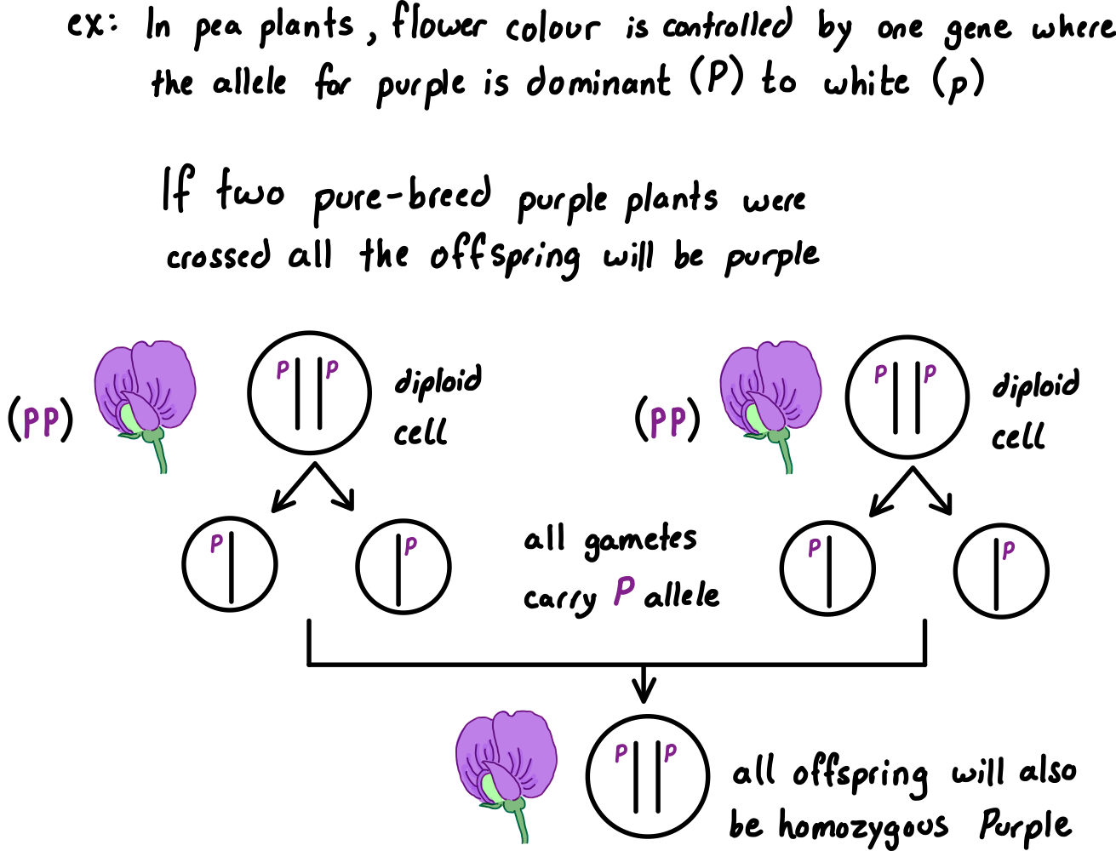
Pure breeds: individuals that are homozygous for a gene as they will always pass down the same allele to their offspring, thus the offspring will always express the same phenotype as their parents
Notes:
P = parent generation
F1 = first filial (offspring) generation
F2 = second filial (offspring) generation

Slide 8
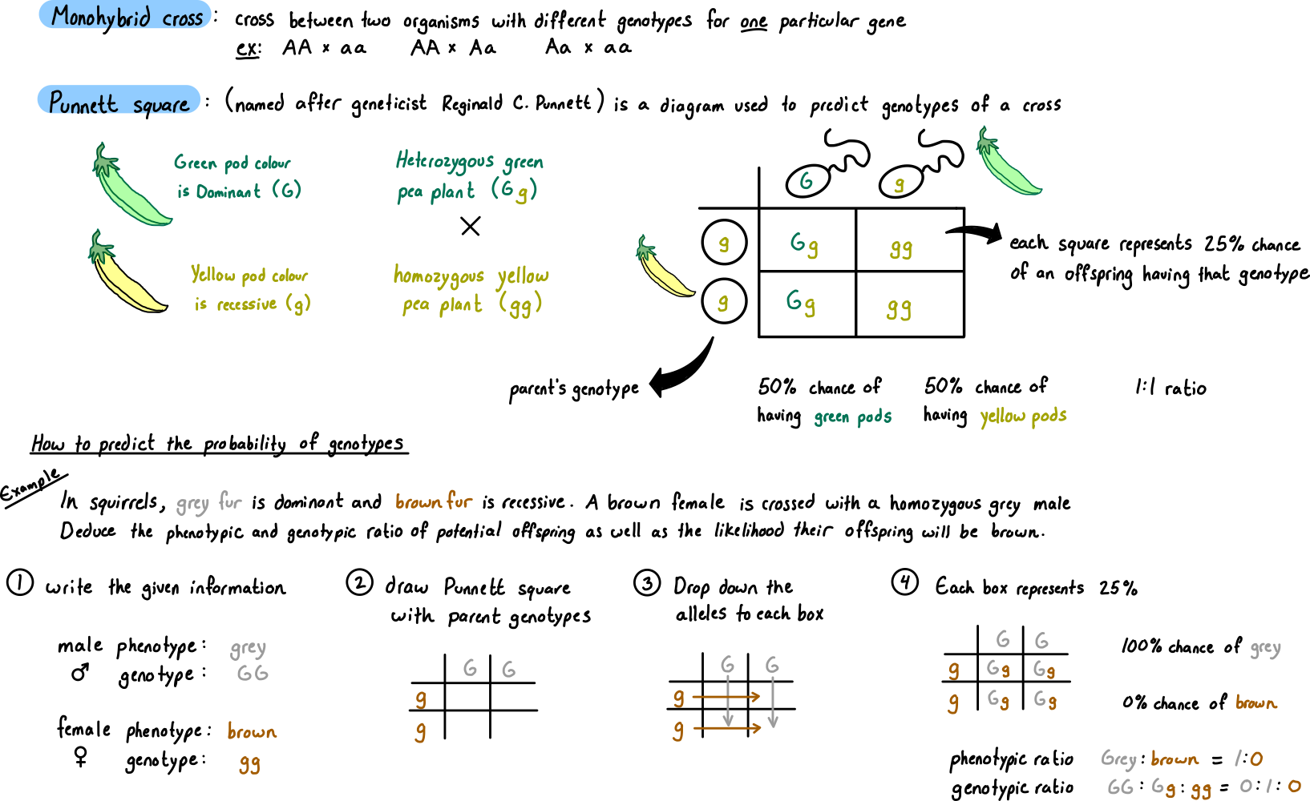

Slide 9
Practice problems – monohybrid crosses of single-factor complete dominance inheritance
For each, determine the phenotypic and genotypic ratio of offspring
1. Hornless (H) in cattle is dominant over horned (h). A horned bull is mated with a homozygous hornless cow
2. Brown eyes is dominant to blue eyes. A brown-eyed man whose mother had blue eyes has children with a blue-eyed woman.
3. In guinea pigs, short hair is dominant over long. Two heterozygotes mated.
4. In tomatoes, red fruit is dominant over yellow fruit. A heterozygous red fruit is crossed with a yellow fruit.

Slide 10
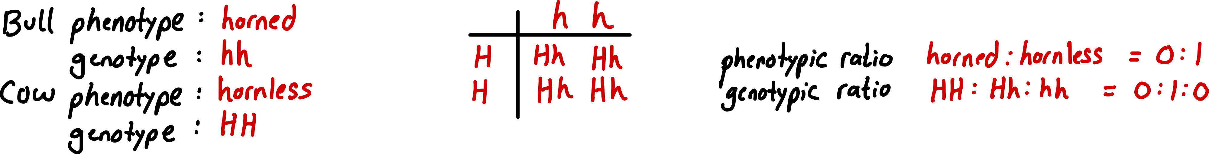
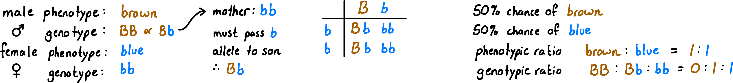
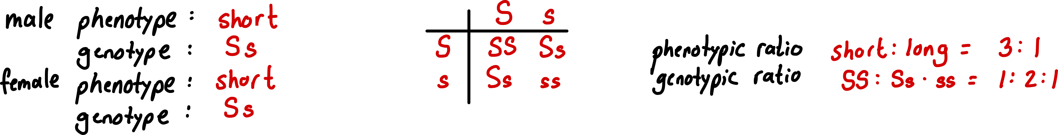
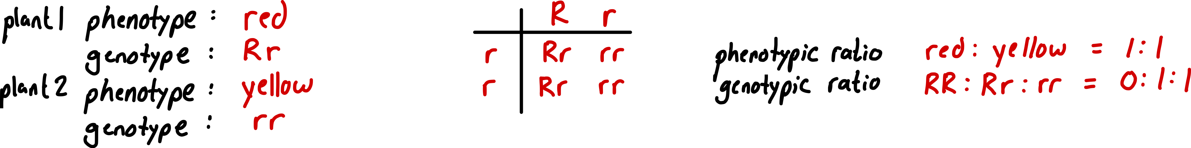
Practice problems – monohybrid crosses of single-factor complete dominance inheritance
For each, determine the phenotypic and genotypic ratio of offspring
Answers
1. Hornless (H) in cattle is dominant over horned (h). A horned bull is mated with a homozygous hornless cow
2. Brown eyes is dominant to blue eyes. A brown-eyed man whose mother had blue eyes has children with a blue-eyed woman.
3. In guinea pigs, short hair is dominant over long. Two heterozygotes mated.
4. In tomatoes, red fruit is dominant over yellow fruit. A heterozygous red fruit is crossed with a yellow fruit.

Slide 11
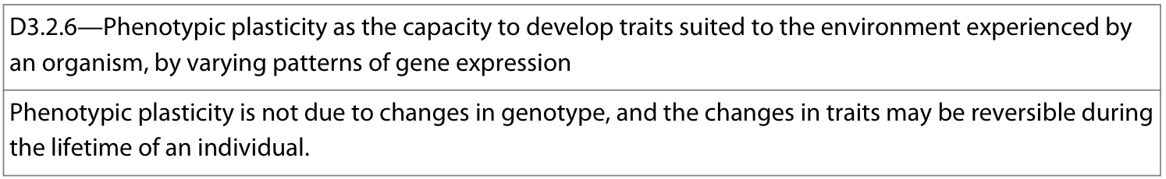
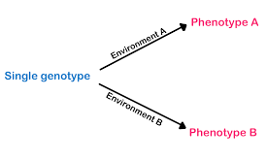
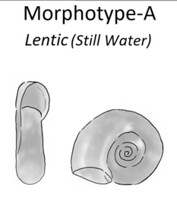
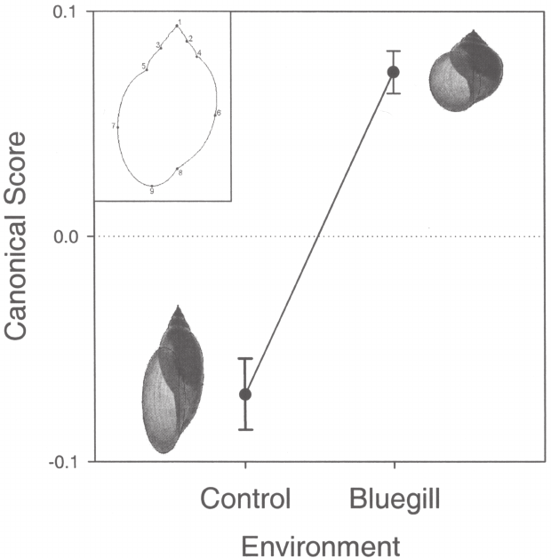
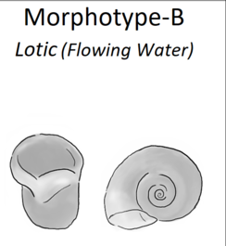
Phenotypic plasticity: capacity to develop traits suited to the environment by an organism
Accomplished by varying patterns of gene expression, i.e. turning genes “on” or “off”
As only gene expression is changing and not the genetic sequence (i.e. genotype) this may be reversible during the lifetime of the individual
Very useful in an environment which is variable, allowing the organism to alter its phenotype as a response
Ex: Snail shell morphology in various environmental conditions
The shape of snail shells is controlled by genes
Environmental cues such can alter this gene expression to alter the shape of the shell
  Chemical cues from the presence of a predator (bluegill sunfish) alters gene expression and causes the shell to be less conical and more rotund, thus more difficult to crush by the predator
  In still water, shells are large, narrow, flat allowing it to better trap of air and regulate its buoyancy. In flowing water, shell is small, broad, round which cannot trap air and allows for less drag in flowing water

Slide 12
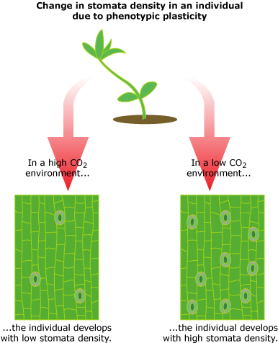
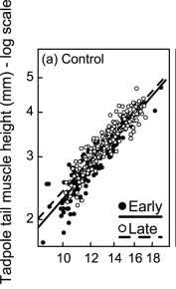
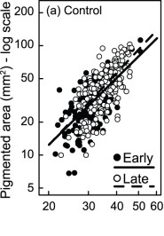
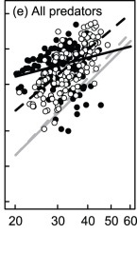

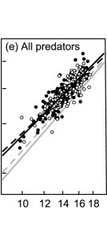
Phenotypic plasticity: capacity to develop traits suited to the environment by an organism
Ex: Leaf morphology in varying environmental conditions
Stomata are used for gas exchange and transpiration of water. Plants grown in different environmental conditions can alter gene expression when creating new leaves, altering the stomatal density
  In environments with low CO₂, stomatal density increases to maximize the amount of gas exchange
  In environments with high CO₂, stomatal density is reduced to conserve water while still sufficient CO₂
Ex: red-eyed treefrog (Agalychnis callidryas) tadpole morphology
Presence of predators alters the timing of egg hatching and tadpole morphology
  eggs respond to vibrations of predators (e.g., snakes or wasps) when being attacked and escape by hatching up to 30% early
  tadpoles developed deeper tail muscles and fins and darker pigmentation in response to fish predators in order to better camouflage and swim

Slide 13
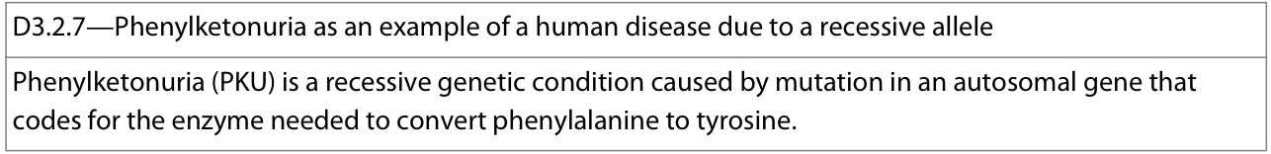
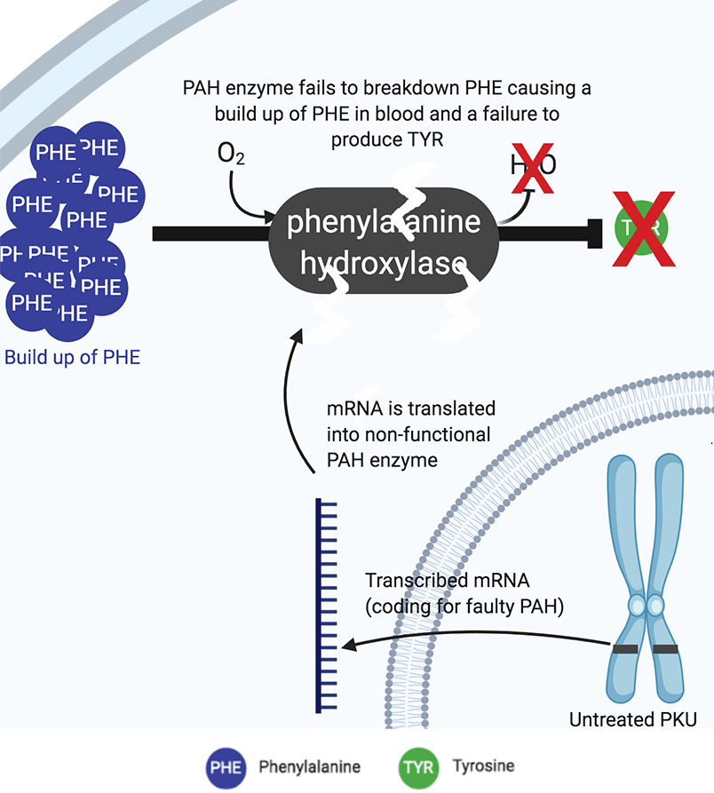
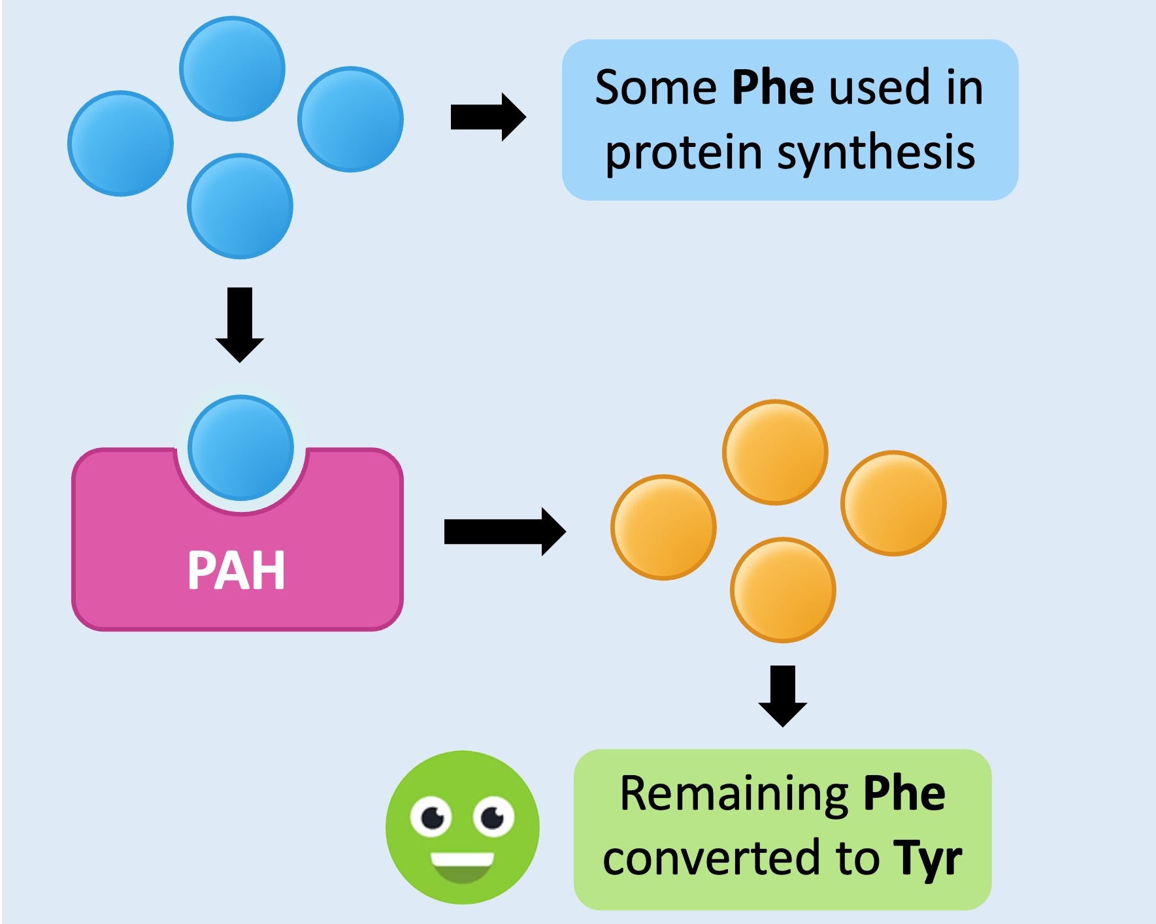
PAH gene on chromosome 12 codes for the enzyme phenylalanine hydroxylase (PAH) which converts the essential amino acid phenylalanine into tyrosine
Tyrosine is then used to make neurotransmitters such as dopamine, epinephrine, norepinephrine
Phenylketonuria (PKU)
Autosomal recessive genetic condition
Mutation in the autosomal PAH gene on chromosome 12 results in an inefficient or non-functional PAH, resulting in a toxic buildup of Phenylalanine and a lack of tyrosine
Symptoms:
  Severe intellectual disability
  Psychiatric disorders
  Seizures
Treatment:
  Diet low in phenylalanine
  Reduce/eliminate high protein foods

Slide 14
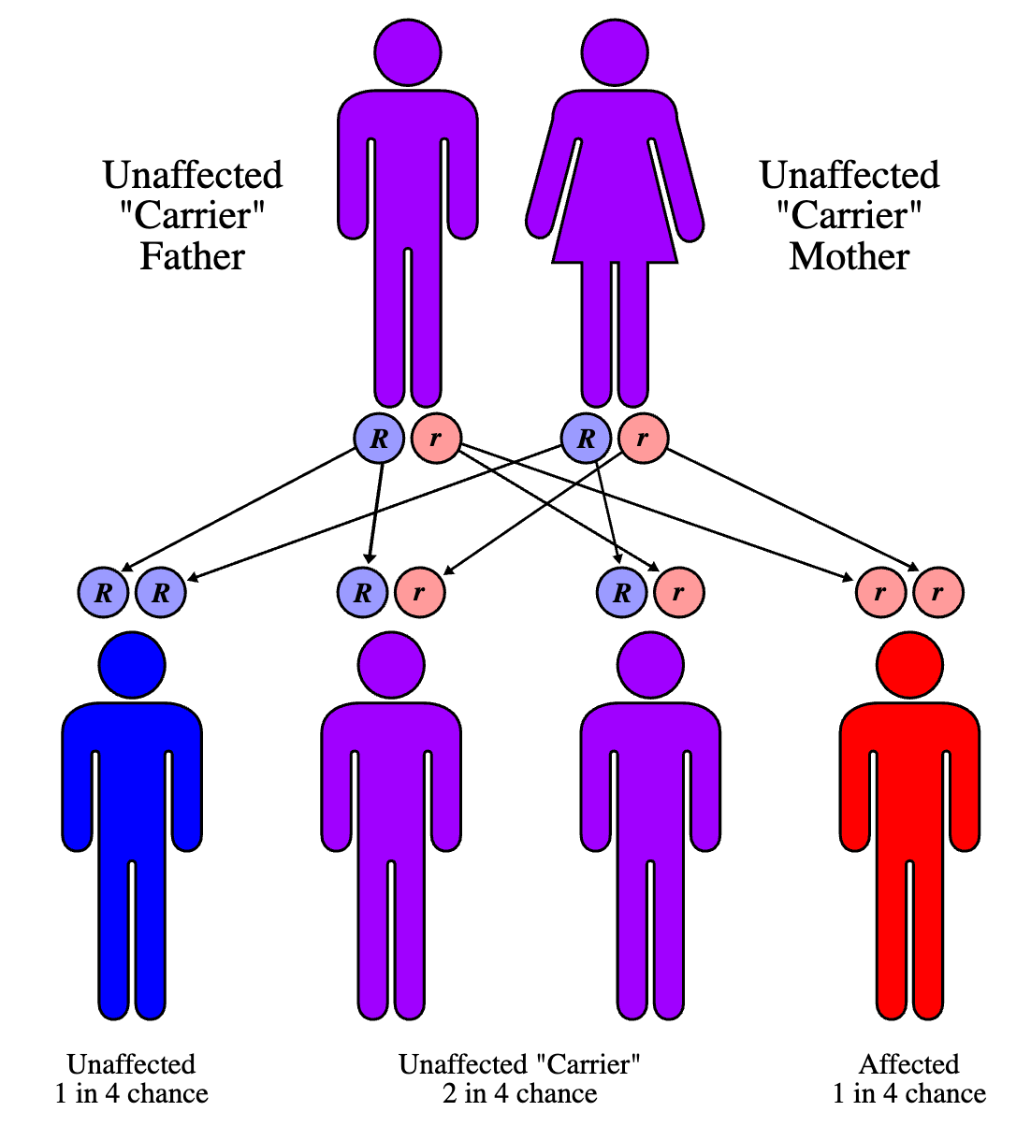
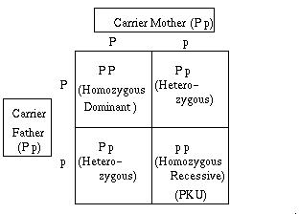
As a recessive disorder, two mutated alleles are required (absence of the normal dominant allele) to have PKU
A heterozygous individual, with one mutated allele is a carrier as they ”carry” the PKU allele (allowing them to potentially pass it to their offspring) even though they don’t express it

Slide 15
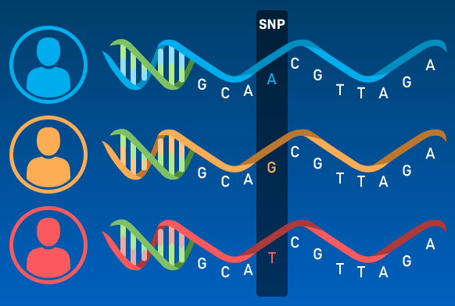
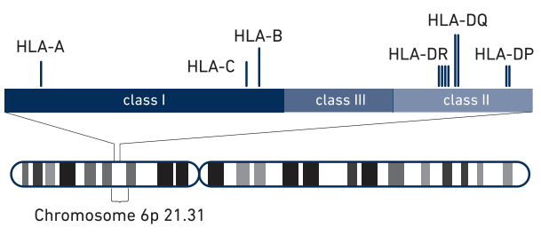
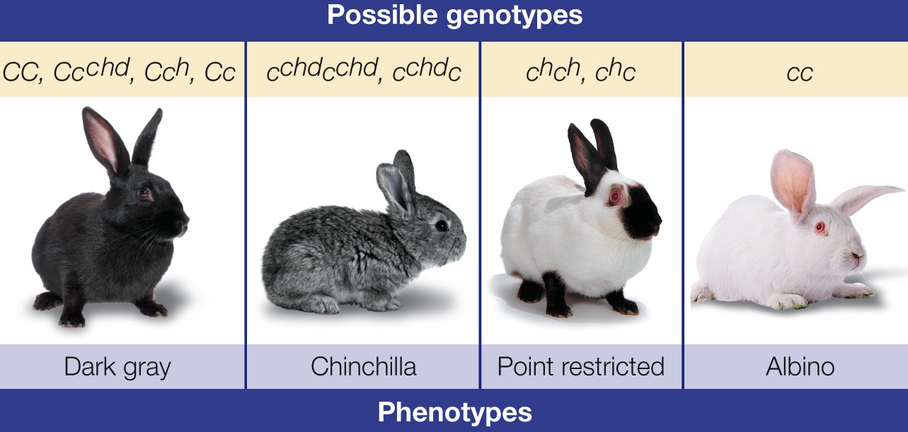
Gene pool: all the genes and their different alleles present in a population
Recall: alleles are variations of a specific gene. Most alleles only vary from each other one or a few base pairs
Single-nucleotide polymorphisms (SNPs): variation at a single base in a DNA sequence present in more than 1% of the population
a single nucleotide substitution can create phenotypic variation thus, most genes possess more than just a single dominant and recessive variant
even though individuals only inherit two alleles per gene (one from each parent), there are typically multiple alleles for any given gene within the gene pool
Ex: HLA (Human Leukocyte Antigen)
a complex of genes on chromosome 6 in humans that encode cell-surface proteins responsible for regulation of the immune system (MHC proteins)
HLA genes are highly polymorphic and have MANY different allele variants, allowing fine-tuning of the adaptive immune system
There are so many alleles that a complex naming system is needed
Ex: gene for fur coat colour in rabbits have 4 alleles with display a hierarchy of dominance C > C^{chd} > C^{h} > c
Notes:
D4.1 – gene pools discussed here as well
D1.3 – SNPs discussed

Slide 16
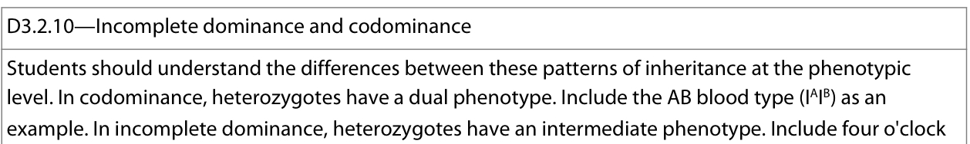
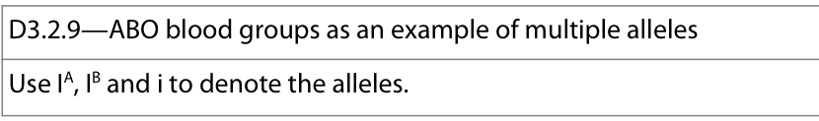
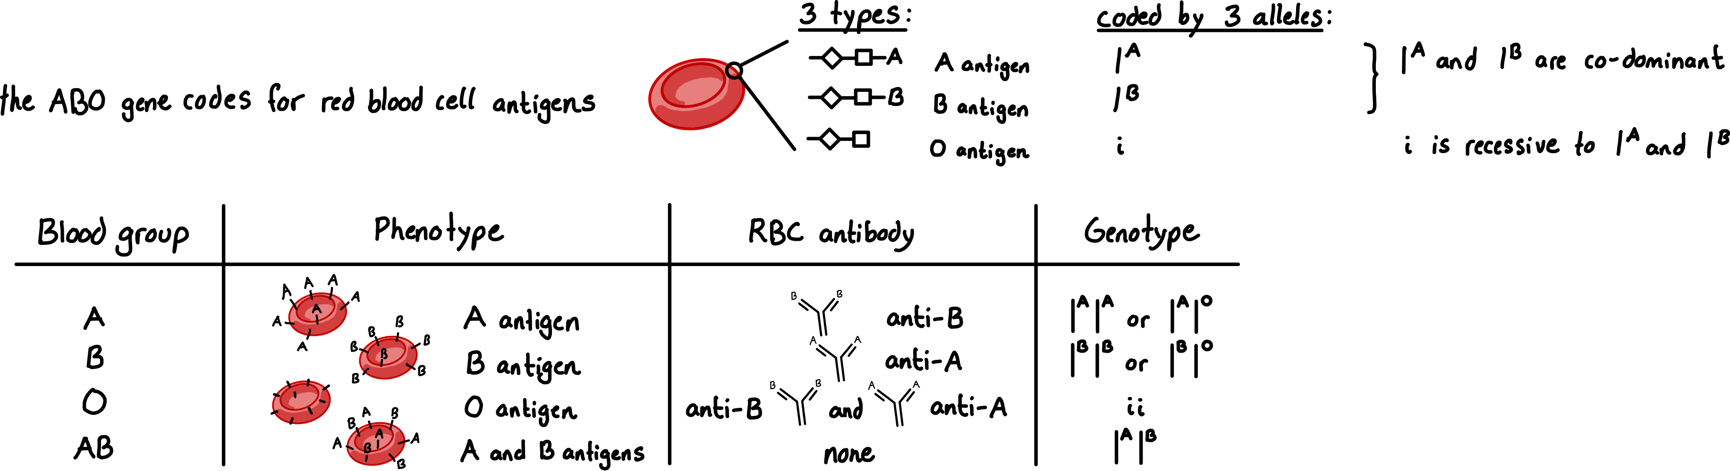
ABO blood group system in humans is an example of multiple alleles.
Four different phenotypes: A , B, AB, O
One gene determines the ABO blood group of a person
Gene has three alleles of the gene: I^{A}, I^{B}, i
I^{A} and I^{B} alleles show co-dominance: both are expressed in a heterozygous I^{A} I^{B} genotype (neither masks expression of the other) and both are dominant over the i allele

Slide 17
Practice problems – crosses of co-dominant alleles
1. A man is blood group AB and his wife is heterozygous B. Deduce genotypic and phenotypic ratio of potential offspring.
2. Alice has blood group A and her husband has blood group B. Their first child, Amanda, has blood group O. Their second child, has blood group AB. Deduce genotype of both Alice and her husband.
3. Man has blood group O has children with an AB woman. Deduce genotypic and phenotypic ratio of potential offspring.
4. In chickens, black feather C^{B} is co-dominant to white C^{W}. A white rooster is mated with a white/black hen. Deduce genotypic and phenotypic ratio of potential offspring.

Slide 18
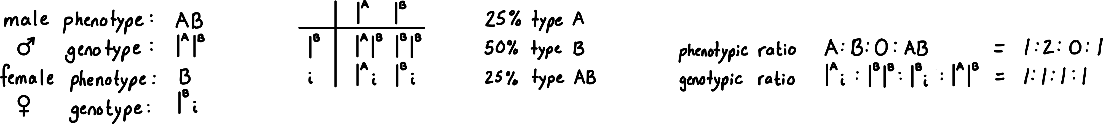
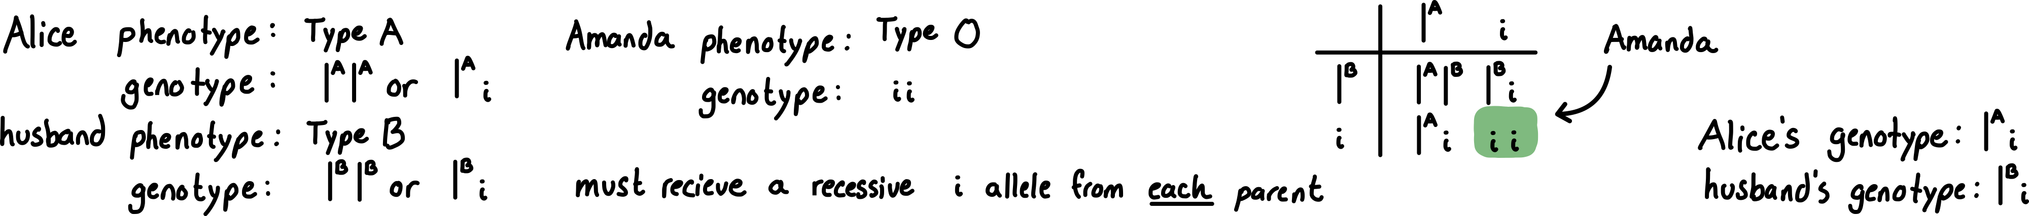
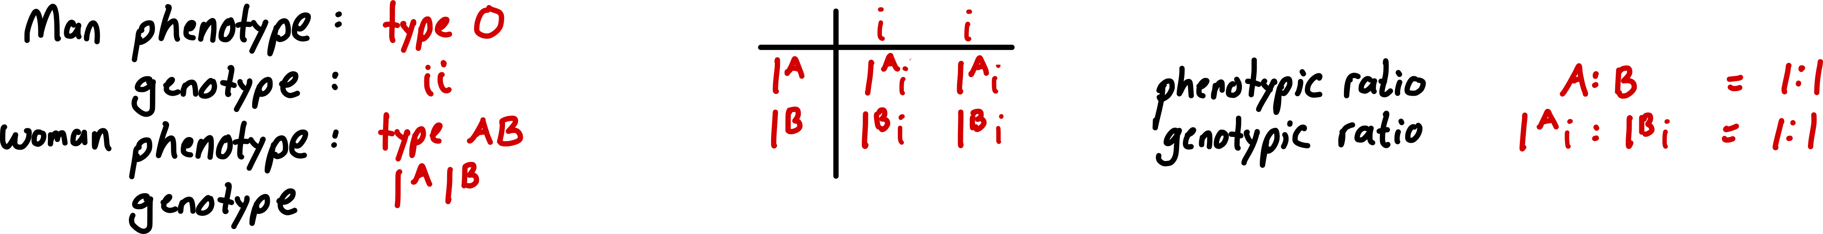
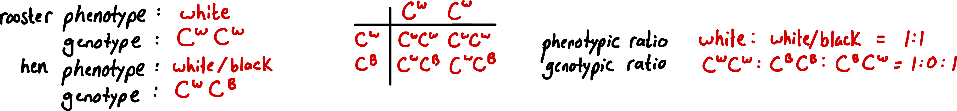
Practice problems – crosses of co-dominant alleles
Answers
1. A man is blood group AB and his wife is heterozygous B. Deduce genotypic and phenotypic ratio of potential offspring.
2. Alice has blood group A and her husband has blood group B. Their first child, Amanda, has blood group O. Their second child, has blood group AB. Deduce genotype of both Alice and her husband.
3. Man has blood group O has children with a AB woman. Deduce genotypic and phenotypic ratio of potential offspring.
4. In chickens, black feather C^{B} is co-dominant to white C^{W}. A white rooster is mated with a white/black hen. Deduce genotypic and phenotypic ratio of potential offspring.

Slide 19





Incomplete dominance: heterozygous genotypes express an intermediate phenotype of the two homozygous phenotypes
Ex: flower colour phenotype in Mirabilis jalapa aka, four o’clock plant or marvel of Peru
The flowers usually open from late afternoon or at dusk (between 4 and 8 o'clock), giving rise to its name
Flower colour is controlled by 1 gene with 2 alleles (C_{R} –red pigmentation C_{W} – no pigmentation, i.e. white)
Homozygous genotypes code for red and white petals respectively but heterozygous genotype results in a blend: pink
Genotype: C_{R}C_{R}
Phenotype: red petals
Genotype: C_{R}C_{W}
Phenotype: pink petals
Genotype: C_{W}C_{W}
Phenotype: white petals
Notes:
Note: there is no accepted convention for how to show these alleles, just be consistent and clear

Slide 20
Practice problems – incomplete dominant alleles
1. A red and pink four o’clock are crossed. Deduce the genotypic and phenotypic ratio of the potential offspring.
2. Two unknown four o’clock flowers were crossed, producing red and white flowers in the F1 generation. Deduce the genotypes of the P generation, and justify your answer.
3. Explain the difference between co-dominance and incomplete dominance

Slide 21



Practice problems – incomplete dominant alleles
Answers
1. A red and pink four o’clock are crossed. Deduce the genotypic and phenotypic ratio of the potential offspring.
2. Two unknown four o’clock flowers were crossed, producing red and white flowers in the F1 generation. Deduce the genotypes of the P generation, and justify your answer.
3. Explain the difference between co-dominance and incomplete dominance

Slide 22



Human chromosomes can be classified as autosomes and sex chromosomes
Autosome:
non-sex chromosomes (chromosomes 1-22)
Both typical males and females have a homologous pairs of autosomes
Genes located on autosomes are termed autosomal
Sex chromosomes:
carry genes that determine the sex of an individual (ex: SRY gene found on Y chromosome signals male-typical gonad development in foetus)
Typical females have a homologous pair of X chromosomes
Typical males have a non-homologous pair, one X chromosome and one Y chromosome
As females contain two X chromosomes, each ovum will always contain 1 X sex chromosome but a sperm may contain either a Y or X chromosome
Therefore, the sex of the child will be ultimately determined by which chromosome is carried by the sperm
Notes:
Note there are MANY exceptions to this system, hence the term “male-typical” and “female-typical”
Sex is not binary: https://www.youtube.com/watch?v=kT0HJkr1jj4

Slide 23



There are FAR more genes carried on the X chromosome than the Y chromosome
Thus any genes found only on the X chromosome, typical males will only have a single allele whereas typical females will have 2 alleles

Slide 24





Slide 25
Practice problems – crosses of sex-linked inheritance
1. A colour-blind woman and a man with normal vision have children. Deduce genotypic and phenotypic ratio of potential offspring.
2. Clouded leopards live in the Tropical rainforest of South-east Asia. The normal spots (brown) are dominant and black spots are recessive. The trait is sex-linked. A male with black spots was crossed with a female with normal spots. She has four cubs: two males and two females. For each sex. One cub had normal spots and the other cub had black spots. Deduce the genotype of the mother.

Slide 26


Practice problems – crosses of sex-linked inheritance
Answers
1. A colour-blind woman and a man with normal vision have children. Deduce genotypic and phenotypic ratio of potential offspring.
2. Clouded leopards live in the Tropical rainforest of South-east Asia. The normal spots (brown) are dominant and black spots are recessive. The trait is sex-linked. A male with black spots was crossed with a female with normal spots. She has four cubs: two males and two females. For each sex. One cub had normal spots and the other cub had black spots. Deduce the genotype of the mother.

Slide 27
Practice problems – crosses of sex-linked inheritance
3. A woman who has normal clotting factors (whose father had haemophilia) is married to a man with normal clotting factors. Deduce the phenotypic and genotypic ratio of their potential offspring.
4. A haemophiliac man and a woman who is a carrier for haemophilia are planning on having children. Deduce the phenotypic and genotypic ratio of their potential offspring.

Slide 28


Practice problems – crosses of sex-linked inheritance
Answers
3. A woman who has normal clotting factors (whose father had haemophilia) is married to a man with normal clotting factors. Deduce the phenotypic and genotypic ratio of their potential offspring.
4. A haemophiliac man and a woman who is a carrier for haemophilia are planning on having children. Deduce the phenotypic and genotypic ratio of their potential offspring.

Slide 29



Slide 30




Deductive reasoning:
Use general theories to form hypotheses and explain particular cases to draw conclusions
“top-down” approach going from general to specific
Ex: All dogs have ears; poodles are dogs, therefore, poodles have ears
Inductive reasoning:
Use observations to construct an explanation (theory) that can be applied to other cases
“bottom-up” approach going from specific to general
Ex: Every swam I observe is white, therefore, all swans are white.
Notes:
Deductive reasoning guarantees the conclusion only if the premises are true. The logic itself is airtight → if A is true and B is true, then C necessarily follows. But if a premise is wrong, the conclusion collapses even though the reasoning structure is valid.
Ex: "All dogs have ears → poodles are dogs → therefore poodles have ears." That works because both premises happen to be true. But if someone reasoned "All birds can fly → penguins are birds → therefore penguins can fly," the logic is structurally identical and valid, but the conclusion is wrong because the first premise is false.
Inductive reasoning has a fundamentally different vulnerability: even if every single observation is true, the conclusion can still be wrong because you're generalising beyond your data. Every observed swan genuinely was white - those observations weren't wrong. The conclusion was wrong because the next observation (black swans in Australia) broke the pattern.
deduction risks false premises, induction risks incomplete evidence.

Slide 31



Practice problems – pedigrees

Slide 32






Practice problems – pedigrees
Answers

Slide 33



Practice problems – pedigrees
a) Deduce if the condition is recessive or dominant? Justify your answer
b) Deduce if the condition is autosomal or sex-linked. Justify your answer
I

Slide 34

Practice problems – pedigrees
Answers
a) Deduce if the condition is recessive or dominant? Justify your answer
Dominant – A and B are both affected but have produced unaffected children (D & F). Therefore, A and B must have been carrying recessive healthy alleles (heterozygous). If condition was recessive, all children would be affected
b) Deduce if the condition is autosomal or sex-linked. Justify your answer
Autosomal – Male C can only pass on one X chromosome. If it were carried on X, daughter H would be affected by the dominant allele
I

Slide 35


Practice problems – pedigrees
a) Deduce if the condition is recessive or dominant. Justify your answer
b) Deduce if the condition is autosomal or sex-linked. Justify your answer
a) Deduce if the condition is recessive or dominant. Justify your answer
b) Deduce if the condition is autosomal or sex-linked. Justify your answer

Slide 36

Practice problems – pedigrees
Answers
a) Deduce if the condition is recessive or dominant. Justify your answer
Two children are albino but the aprents are not → suggests that albinism is caused by the recessive allele (a) and the normal pigmentation by the dominant allele (A)
b) Deduce if the condition is autosomal or sex-linked. Justify your answer
Both daughters and sons with albinism. If it was x-linked recessive, daughters could not be homozygous recessive (XªXª) as they must inherit dominant allele from father (X^{A}).
Therefore condition is autosomal and parents’ genotype is Aa
a) Deduce if the condition is recessive or dominant. Justify your answer
Two affected parents have unaffected child. If condition was recessive this would not be possible as parents must pass recessive allele. Therefore condition is dominant.
b) Deduce if the condition is autosomal or sex-linked. Justify your answer.
Generation I parents produced all affected daughters and unaffected sons. If X-linked dominant, daughters of the father in generation I must inherit his X chromosome, carrying dominant allele. Data suggests X-linkage but sample size is small.

Slide 37


Despite there being over 4000 identified genetic disorders, the prevalence of them in population is small – most being very rare.
Due to many genetic disorders being caused by rare recessive alleles
Therefore, in order to be affected by an autosomal recessive disorder, an individual needs to inherit 2 rare recessive alleles, one from each parent
This becomes far more prevalent in children of a marriage between close relatives
Inbreeding depression: reduction in the overall fitness of offspring resulting from increased homozygosity due to mating between closely related individuals largely due to increased likelihood of expressing recessive deleterious alleles
As such, marriage between close relatives is prohibited in many societies to prevent inbreeding depression and reduce the prevalence of rare recessive genetic disorders

Slide 38


Variation can be broadly categorized into two types:
aka “discrete”
Mendel’s pea plant traits

Slide 39



Example of continuous variation – skin colour in humans
Skin colour is caused by both genes and the environment:
  Polygenic: many genes responsible. Each gene has an allele that codes for melanin and another that does not. The more of the melanin allele, the darker the skin colour (additive effect)
  Environment: UV radiation causes increased production of melanin to prevent damage (as melanin absorbs UV)
UV radiation on the skin can cause damage, melanin blocks this. However, UV is also needed for vitamin D production → leading to an evolutionary tradeoff:
  At the equator there is high UV intensity → darker skin favourable:
  More melanin blocks damage from UV
  High light exposure still allows for vitamin D production
  At the poles there is low UV intensity → paler skin favourable:
  less melanin blocks less UV, allowing for vitamin D production

Slide 40


Central tendency: statistical measure that identifies a single value as representative of an entire distribution. It aims to provide an accurate description of the entire data / most typical/representative of the collected data.
Mean (average)
sum of all datapoints / number of datapoints in data set
most common measure of central tendency and can be used with both continuous and discontinuous data sets
Median (50% percentile)
The middle value of a data set arranged in order of increasing value
Useful statistic if dataset is skewed (does not follow normal distribution) and if there are outliers present
Mode
The most common value in the dataset
Useful statistic if dataset is nominal or categorical and mean/median cannot be calculated
Use TI-84 calculator

Slide 41




Box-and-whisker plot: used to represent continuously variable data (such as human height).
They display the following in a dataset:
  Maximum: largest value
  Minimum: smallest value
  First quartile (Q₁): 25th percentile
  Median (Q₂): 50th percentile
  Third quartile (Q₃): 75th percentile
  Lower Outlier: less than Q₁ – 1.5(IQR)
  Upper Outlier: more than Q₃ + 1.5(IQR)
  Interquartile range (IQR) = Q₃ - Q₁
OUTLIER
Step 1 – Enter data
1. press
2. Under “EDIT” select 1:Edit…
Use TI-84 calculator
3. Enter data in L₁
Step 2 – Calculate
1. press
2. Under “CALC” select 1:1 – Var Stats
3. Select Calculate

Slide 42
Practice problems – box-and-whisker
Plot the following dataset using a box-and-whisker
1. dataset: 3,3,7,7,7,8,8,10,11,12,15,21
2. dataset: 1,1,2,2,3,4,5,6,7,7,8,9,9,9

Slide 43


Practice problems – box-and-whisker
Plot the following dataset using a box-and-whisker
Answers
1. dataset: 3,3,7,7,7,8,8,10,11,12,15,21
2. dataset: 1,1,2,2,3,4,5,6,7,7,8,9,9,9

Slide 44


Practice problems – box-and-whisker
Answer

Slide 45






Segregation in genetics refers to the separation of chromosomes (and the genes they carry) in Meiosis
Law of Segregation: each gamete made by an organism will get just one of the two gene copies (1 allele) present in a parent organism, and that the alleles are randomly allocated to the gametes
  → Due to random orientation of bivalents during Meiosis I
Law of Independent Assortment: the alleles of two (or more) different genes get sorted into gametes independently of one another. I.e. the allele a gamete receives for one gene does not influence the allele received for another gene

Slide 46




Law of independent assortment only applied to unlinked genes
Unlinked genes: genes located on different chromosomes
If genes are unlinked, the movement of one chromosome (and thus genes located on it) do not impact the movement and segregation of another chromosome (and its genes) during Meiosis thus the alleles segregate randomly, independent of each other
Linked genes: genes located on the same chromosome
If genes are linked, the movement of a chromosome impacts the segregation of more than 1 gene (as they are located on the same chromosome), thus the alleles segregate together and not independent of each other

Slide 47


Dihybrid cross: cross between two individuals with two observed traits that are controlled by two distinct genes.

Slide 49


Slide 50


Slide 51


Slide 52


Slide 53


Slide 54


Slide 55


Slide 56






There are over 21,000 genes in the human genome that code for MANY different polypeptide products
Genes and their polypeptide products can be explored for tens of thousands of different genomes using online databases:
National Center of
Biotechnology Information
Ensembl genome database project
Online Mendelian Inheritance in Man
Using databases you can find:
Gene name
Gene location (locus) on chromosome
Gene base sequence
Gene alternatives (alleles)
Gene transcripts
Protein amino acid sequence
3D Protein models
and MUCH MORE!
Example: AMY1 (amylase alpha 1C)

Slide 57

Gene locus (plural loci) is written using specific nomenclature:
shorter arm of a chromosome → p-arm,
longer arm → q-arm.
Example: 3p22.1, where:
  3 = chromosome 3
  p = p-arm
  22 = region 2, band 2 (read as "two, two”)
  1 = sub-band 1
Thus, the entire locus of the example above would be read as "three P two two point one".
The cytogenetic bands are areas of the chromosome either rich in actively-transcribed DNA (euchromatin) or packaged DNA (heterochromatin). They appear differently upon staining (for example, euchromatin appears white and heterochromatin appears black on staining). They are counted from the centromere out toward the telomeres

Slide 58


Linked genes: pairs or groups of genes which are inherited together, carried on the same chromosome (close to one another)
Genes can be linked on the X chromosome but in most cases, on an autosome → autosomal gene linkage
As alleles of linked genes are located on the same chromosome, they can fail to sort independently and move as a single unit (linkage group)
Vertical lines represent homologous chromosomes and are used to represent linked genes

Slide 59


Linked genes will be inherited together (no independent assortment) and hence don’t follow the normal inheritance patterns for a dihybrid cross
Instead, the phenotypic ratios will be more closely aligned to a monohybrid cross as the two genes are inherited together

Slide 60



The generation of new combinations of alleles is recombination, which occurs in Prophase I of Meiosis
Recombinants refer to the combinations of alleles not found in the parents (for either linked or unlinked genes)
Recombinants can either be identified within gametes or in the genotypes and phenotypes of offspring
The closer together the genes are on the chromosome, the more likely they will be inherited together
The more genes are on a chromosome, the more likely cross-over will occur and recombination can occur

Slide 61


Slide 62
Practice Question 1
The alleles for round seed (R) and yellow seed (Y) are dominant over the alleles for wrinkled seed (r) and green seed (y).
Pure-breeding round yellow plants were crossed with pure-breeding wrinkled green plants. The offspring of the F₁ generation were back-crossed to the wrinkled-green parental strain.
Deduce the phenotypic ratio of the F₂ generation
Identify recombinant genotypes in the F₂ generation

Slide 63

Practice Question 1
The alleles for round seed (R) and yellow seed (Y) are dominant over the alleles for wrinkled seed (r) and green seed (y).
Pure-breeding round yellow plants were crossed with pure-breeding wrinkled green plants. The offspring of the F₁ generation were back-crossed to the wrinkled-green parental strain.
Deduce the phenotypic ratio of the F₂ generation
Identify recombinant genotypes in the F₂ generation

Slide 64
Practice Question 2
In sweet peas the genes for flower color and pollen grains are carried on the same chromosome. Plants which are heterozygous at both loci are test-crossed. A small number of purple;short and white;long individuals have appeared in the offspring.
Explain what happened.

Slide 65

Practice Question 2
In sweet peas the genes for flower color and pollen grains are carried on the same chromosome. Plants which are heterozygous at both loci are test-crossed. A small number of purple;short and white;long individuals have appeared in the offspring.
Explain what happened.

Slide 66

Practice Question 3
In a species of flower, the color and height of a flower are linked genes. The color red (R) is dominant to white (r) and Tall (T) is dominant to short (t) For the test cross below,
identify the phenotypes of the parents
identify the genotypes and phenotypes of the offspring which are recombinants

Slide 67


Practice Question 3
In a species of flower, the color and height of a flower are linked genes. The color red (R) is dominant to white (r) and Tall (T) is dominant to short (t) For the test cross below,
identify the phenotypes of the parents
identify the genotypes and phenotypes of the offspring which are recombinants

Slide 68

Chi squared “goodness of fit” test (χ²): assesses if there is a statistically significant difference between observed values and predicted values
In genetics, it can be used to assess whether a pair of genes are linked based on the phenotypic ratios from crosses and whether they agree with the predicted Mendelian 9:3:3:1 or 1:1:1:1 ratios or not
This is a type of hypothesis testing whether a tested statistic will be calculated in order to either reject or fail to reject the null hypothesis
Null hypothesis (H₀): there is no significant difference between the observed and expected frequencies, i.e. the genes are likely unlinked
Alternative hypothesis (H_{A}): there is a significant difference between the observed and expected frequencies, i.e. the genes are likely linked
This conclusion is given at a certain p-value (alpha), in science this is p ≤ 0.05
p value: Probability of obtaining the observed effect, or larger in the dataset if the null hypothesis is correct
It indicates the stength of the sampled evidence against the null hypothesis.
Ex: p = 0.02 means 2% likelihood of obtaining similar (or more extreme) results where the null hypothesis is true

Slide 69
Worked example

Slide 70

Worked example

Slide 71

Worked example

Slide 72

Worked example

Slide 73


Practice Question 1

Slide 74




Slide 75

Practice Question 2

Slide 76






