Slide 1
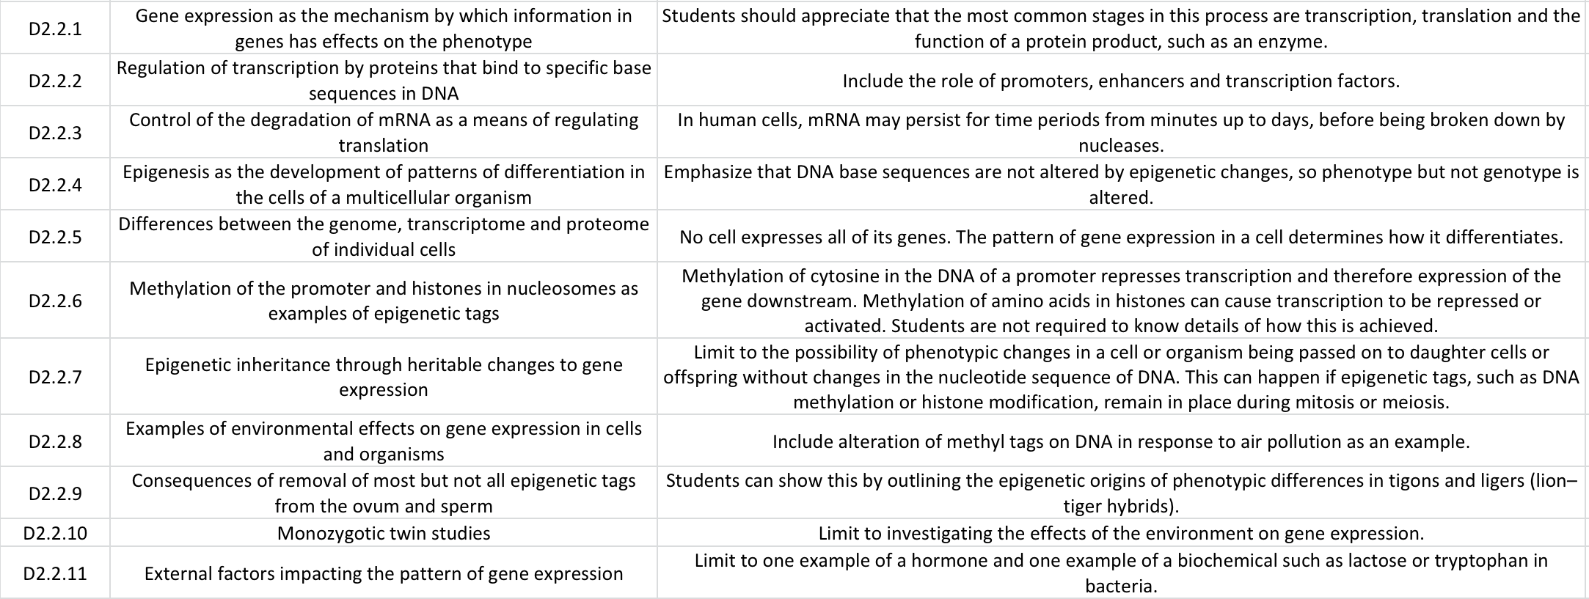
AHL Learning Outcomes
ipad notes will replace these at a later date

Slide 2

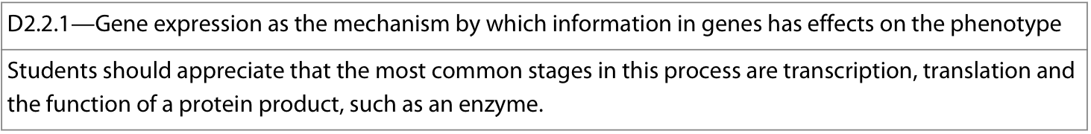
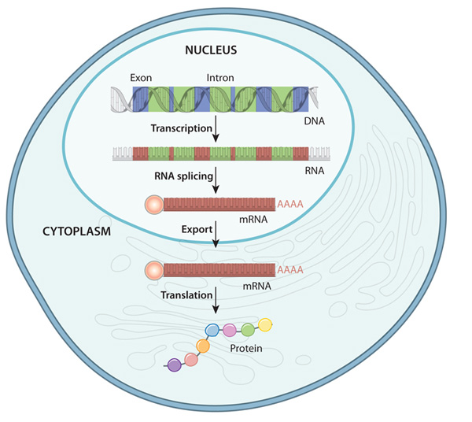
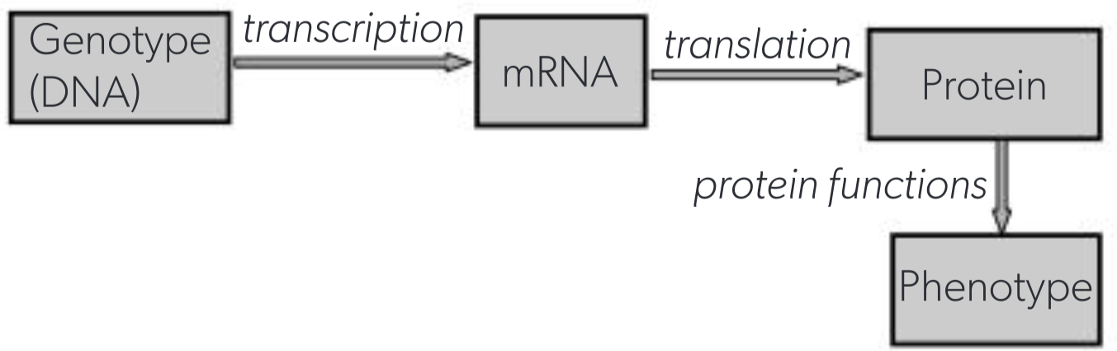
Gene expression : process by which information encoded in a gene is used to create a functional product (protein)
the mechanism by which genetic instructions (genotype) give rise to observable characteristics (phenotype)
the main stages in this process (and determination of the phenotype) are:
Transcription: DNA gene transcript → complementary mRNA transcript
  The rate of gene transcription can be altered and regulated by:
    Binding of epigenetic tags to parts of the DNA
    Proteins and non-coding sequences (promoters, enhancers, transcription factors)
    changes in the environment
    signaling chemicals (such as hormones)
Translation: mRNA transcript → polypeptide
  Can be controlled via rate of mRNA degradation
Protein function → specific function within organism/cell (ex: enzymatic action, structural component)
Notes:
D1.2 → more detail on transcription and translation

Slide 3
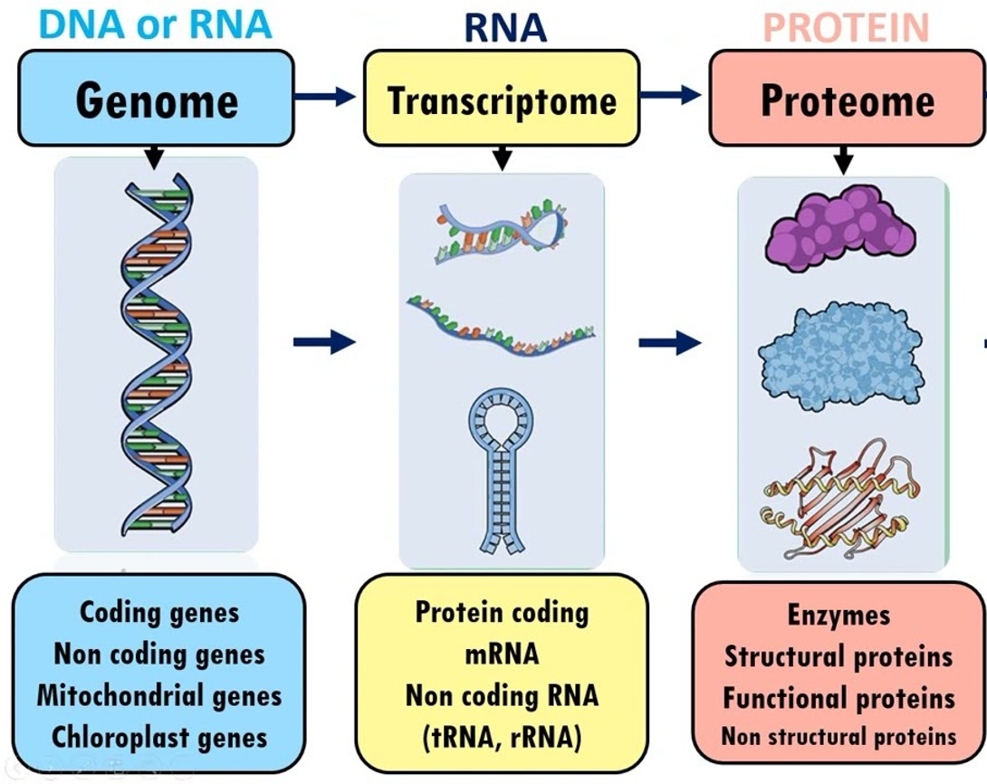
Genome: the whole of the genetic information (typically DNA) of a cell
Includes both coding and non-coding sequences
Includes DNA in nucleus and organelles (mitochondrion and chloroplast)
All cells in a multicellular organism share the same genome
As cells specialize, they only express some genes and not others
Transcriptome: entire set of RNA transcripts present in a cell
Includes mRNA, tRNA, rRNA
No cell transcribes all of its genes simultaneously, and many genes are never transcribed in a given cell type, so its transcriptome does not contain an RNA copy of each gene
Transcriptome varies over time within any cell and between cells of a multicellular organism
Proteome: entire set of proteins produced by a cell
Based on the transcriptome but the quantities of each protein in a cell are not directly proportional to the quantity of corresponding mRNA due to regulation
Pattern of gene expression within a cell determines its transcriptome, proteome and how it differentiates
The pattern of gene expression is a cell determines how it differentiates

Slide 4
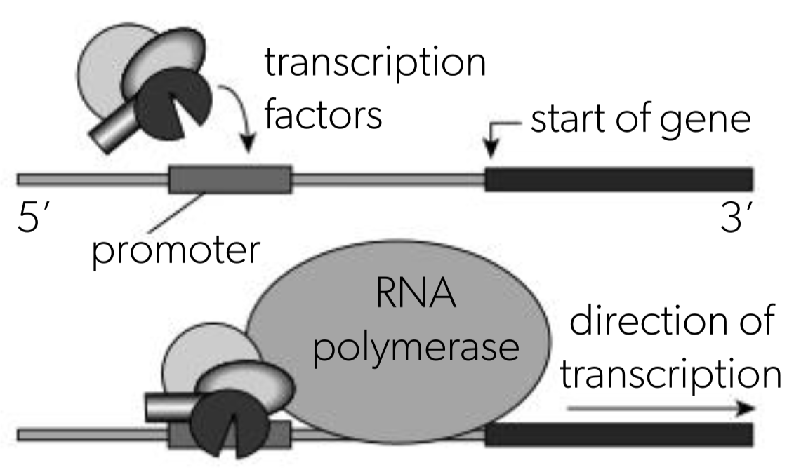
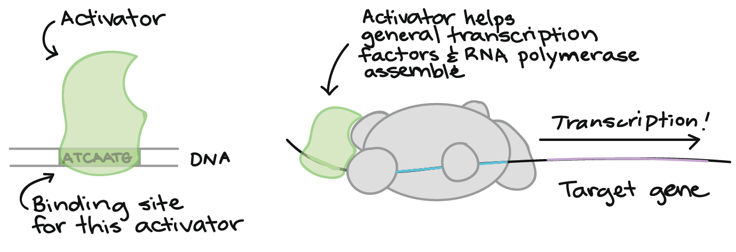
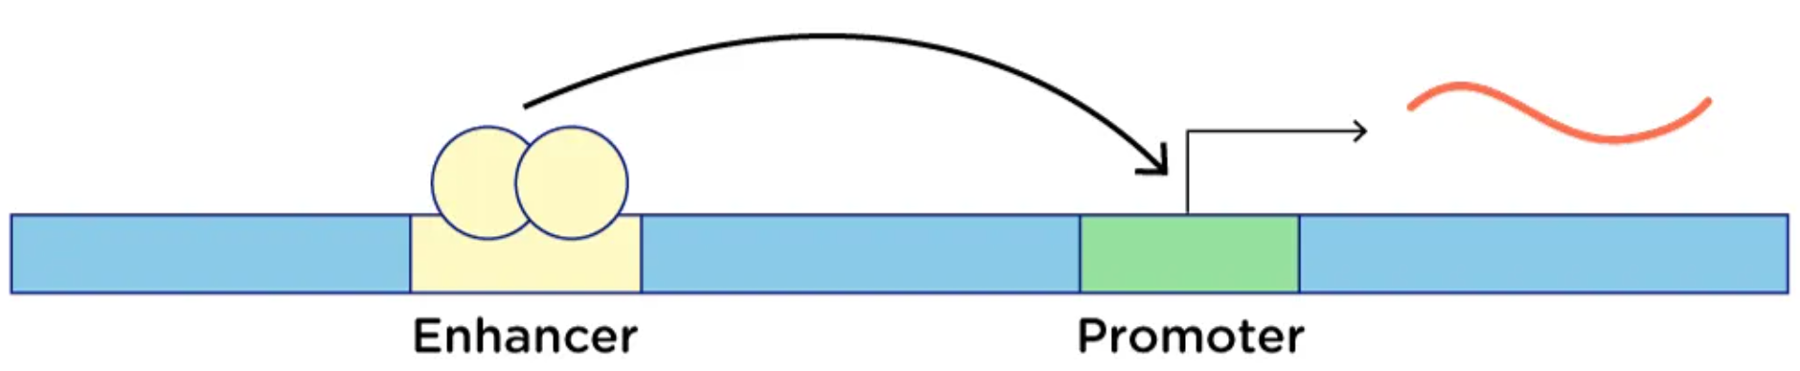
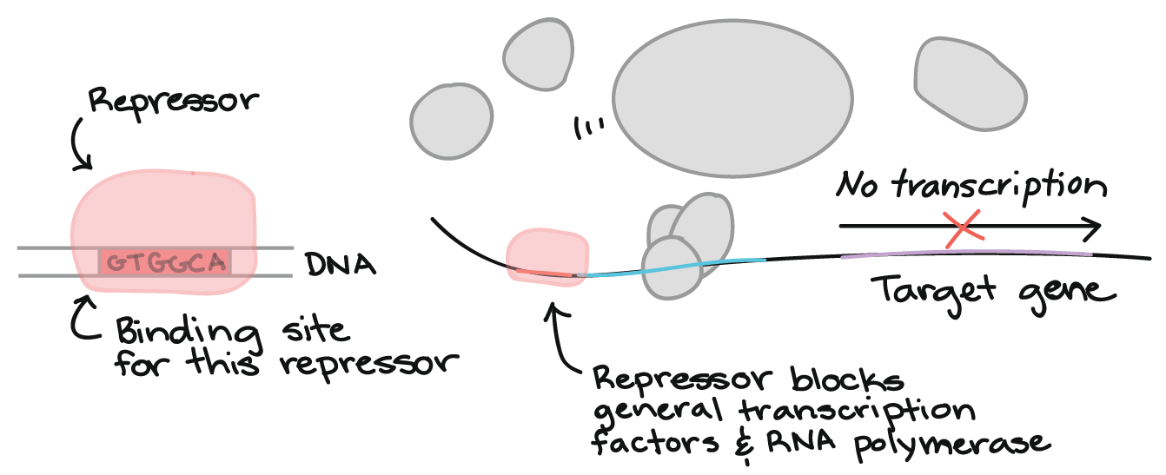

Gene expression can be regulated at the transcription stage via specific non-coding DNA sequences and proteins (transcription factors)
Promoters: non-coding DNA sequence upstream (in 5’ direction) of a gene
  In eukaryotes, proteins (transcription factors) bind onto promoter region
  RNA polymerase binds onto transcription factors and begins transcription of the gene (5’ → 3’ direction)
Enhancers: non-coding regulatory DNA sequence upstream or downstream of a gene (potentially thousands of bp away from the gene) which promotes gene transcription when bound to an activator protein, increasing the rate of gene expression
Silencers: non-coding regulatory DNA which represses gene transcription when bound to a repressor protein, decreasing the rate of gene expression
Notes:
*These are discussed in D1.2 HL

Slide 5
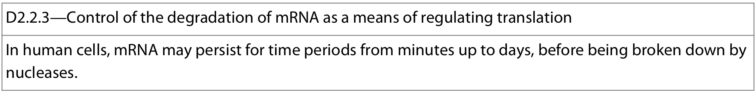
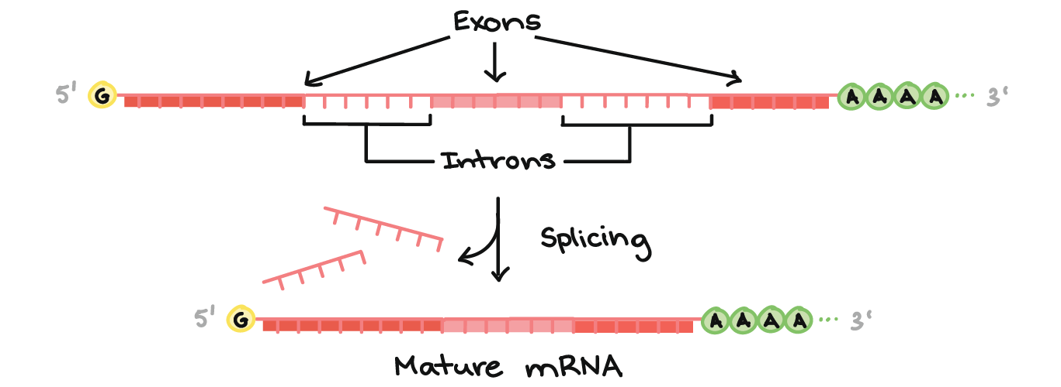
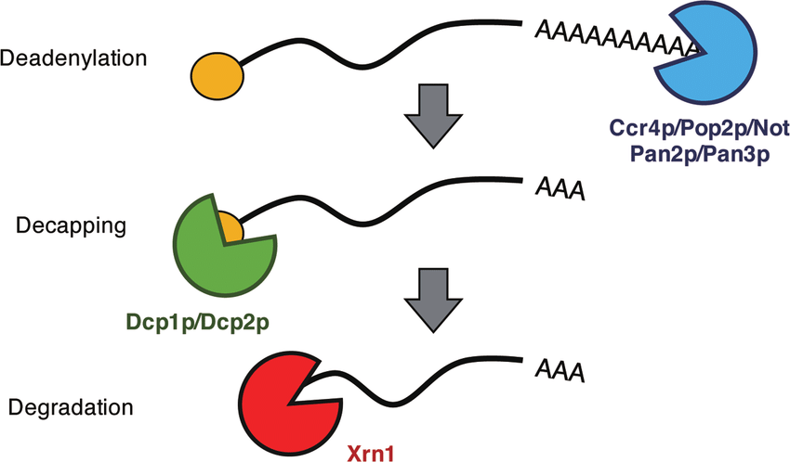

Gene expression can be regulated at the translation stage by regulating the rate at which mRNA transcripts are degraded
Recall (D1.2): in eukaryotes, post-transcriptional modification involves:
  Splicing (removing introns and joining exons)
  Addition of a 3’ poly-A tail
  Addition of a 5’ methylated guanosine cap
Mature mRNA is degraded through poly-A tail removal, de-capping, and finally hydrolysis of mRNA transcript by nuclease enzymes, allowing the nucleotides to be recycled and re-used
The length of the poly-A tail, hormones, chemical signals, and regulatory sequences can alter the rate of mRNA degradation, allowing regulation of protein translation
The rate the mRNA is degraded determines how long a transcript persists, and therefore the total amount of polypeptide produced:
  Slower rate of degradation → mRNA persists longer → more translation of mRNA → more protein made over time
  Faster rate of degradation → mRNA persists shorter → less translation of mRNA → less protein made over time
The rate of this degradation is very variable:
  Ex: 30 nucleotides removed/min → mRNA persists for ~5 minutes
  Ex: 1-2 nucleotides removed/hr → mRNA persists for a ~week
(nuclease)
Notes:
interesting article on mRNA degredation being encoded: https://sci-hub.se/10.1016/j.tig.2011.10.005

Slide 6
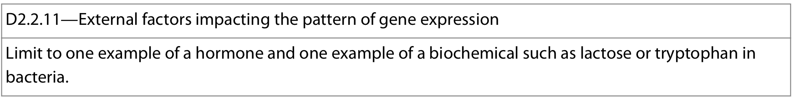
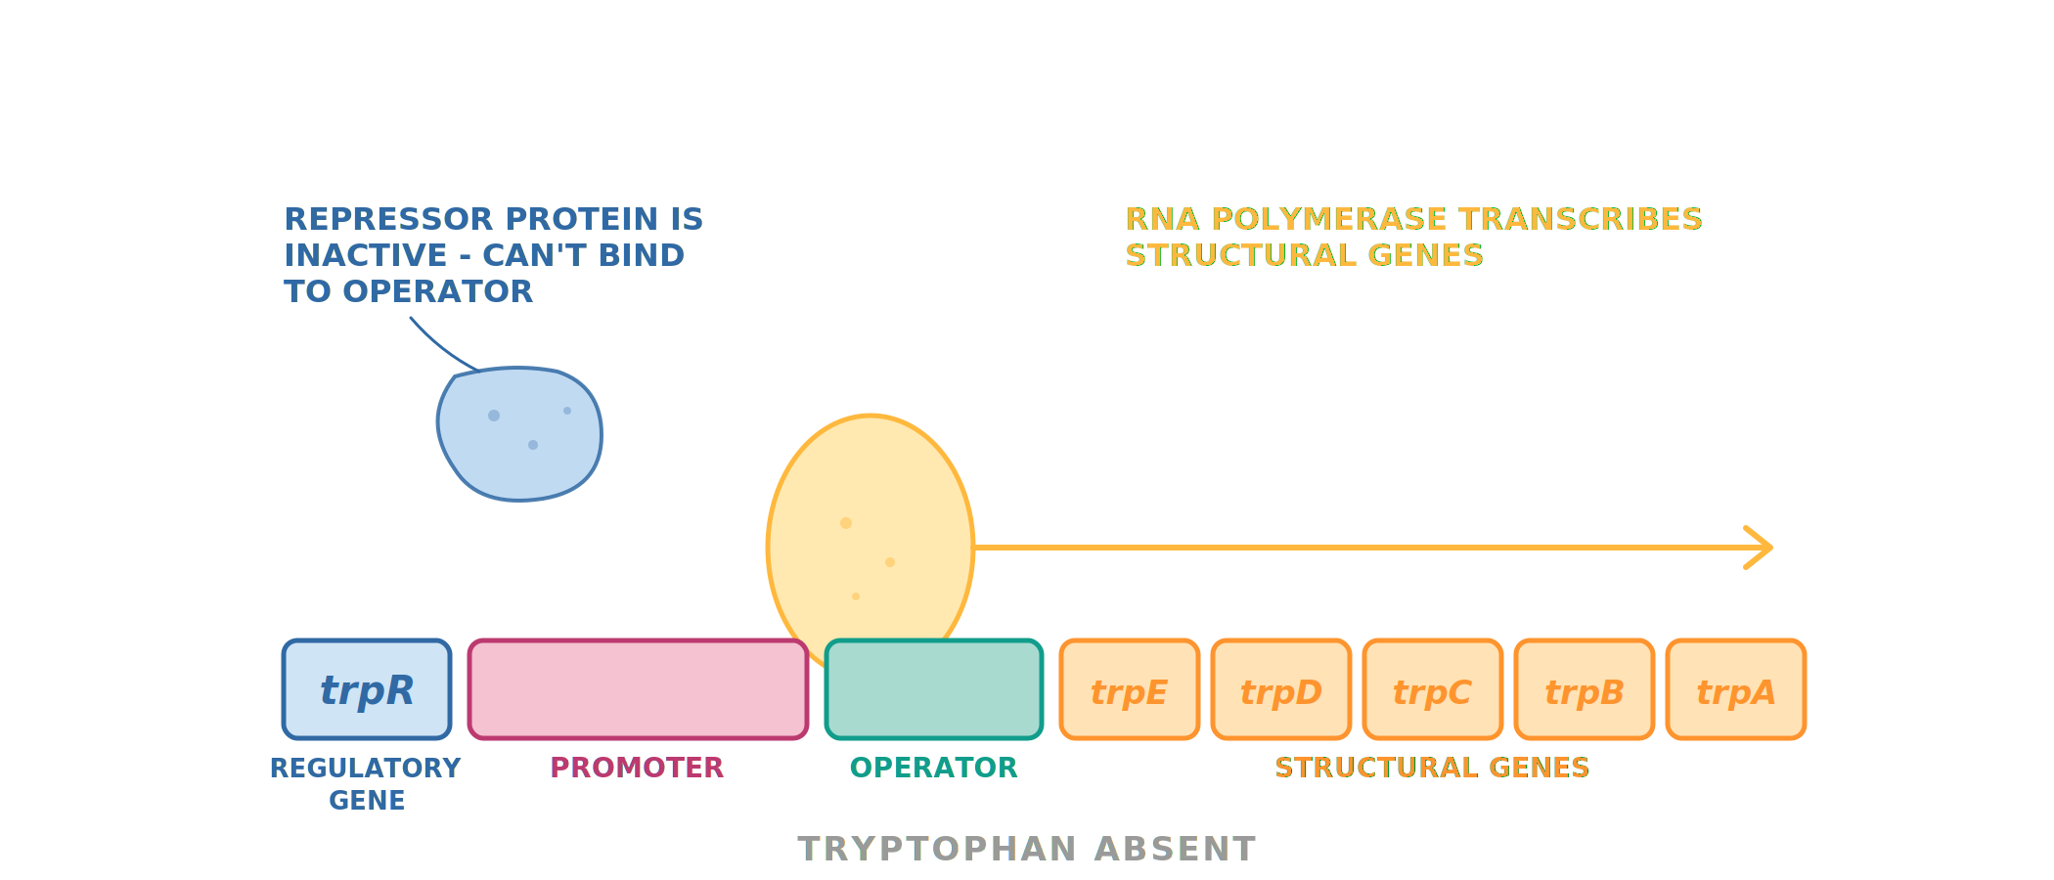
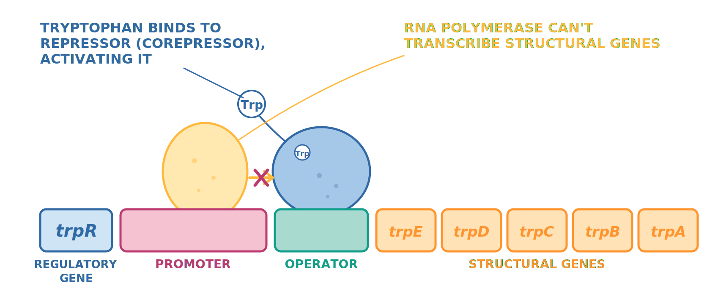
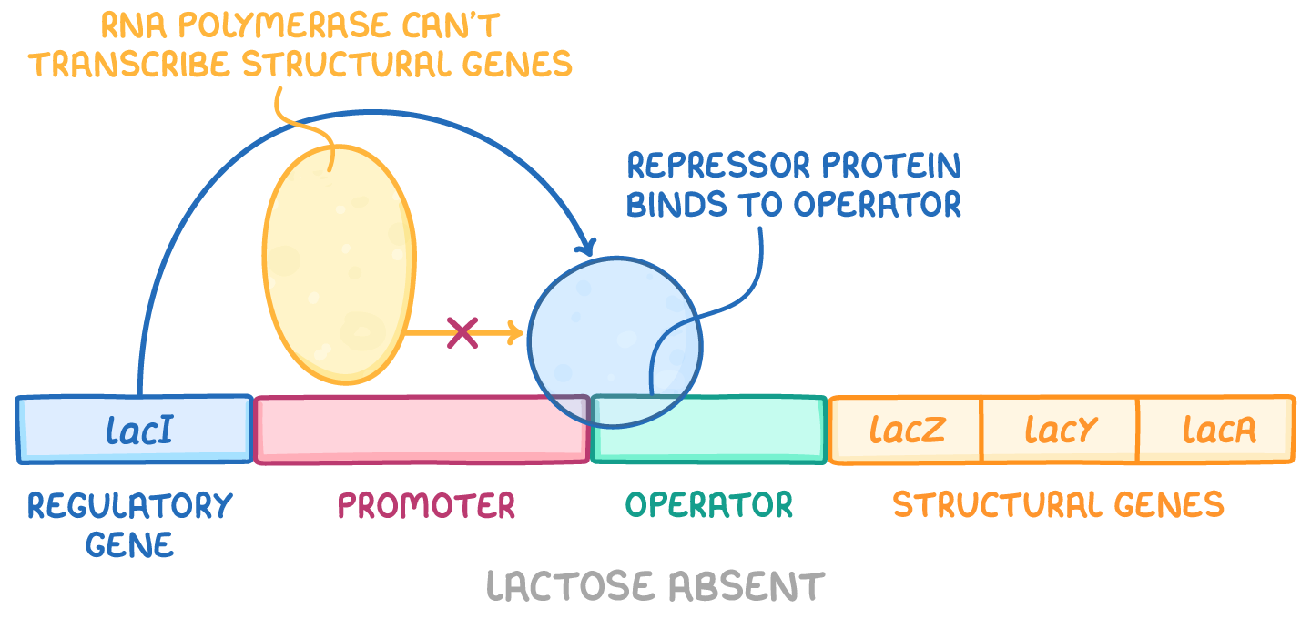
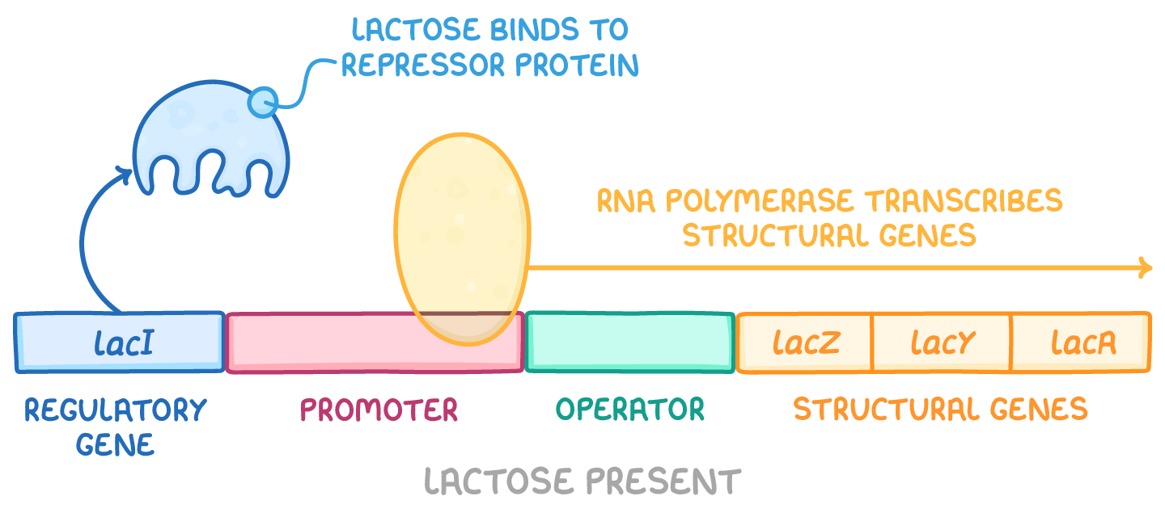
Gene expression can be regulated and impacted by external factors:
Effect of biochemical concentration: tryptophan biosynthesis in E. coli bacteria
The trp operon is a group of genes that controls the biosynthesis of tryptophan, allowing bacterium to produce its own tryptophan when it is unavailable from the environment. The genes are controlled by the same promoter region and are transcribed together.
The trp operon used to conserve energy by producing tryptophan-synthesising enzymes only when tryptophan is absent and needed
When tryptophan is absent
→ Operon is derepressed
When tryptophan is present
→Operon is repressed
repressor protein is inactive and cannot bind to operator
RNA polymerase binds to the promoter
RNA polymerase transcribes the structural genes
The enzymes for tryptophan biosynthesis are produced
Tryptophan concentrations will build over time
Tryptophan (corepressor) binds to the inactive repressor protein
repressor protein changes shape and binds to the operator
RNA polymerase is blocked from binding to the promoter
RNA polymerase can't transcribe the structural genes, so enzymes for tryptophan biosynthesis aren't produced
Tryptophan concentrations will decrease over time
Notes:
Useful video: https://www.youtube.com/watch?v=38w9FKqxLf4

Slide 7
Gene expression can be regulated and impacted by external factors:
Effect of biochemical concentration: lactose catabolism in E. coli bacteria
The lac operon is a group of genes that control the catabolism of lactose, allowing the bacterium to use lactose as an energy source when glucose is scarce. The genes are controlled by the same promoter region and are transcribed together.
The lac operon is used to conserve energy by producing lactose-metabolizing enzymes only when lactose is present and needed
When lactose is absent
→ Operon is repressed
When lactose is present
→Operon is derepressed
Lactose binds to the repressor protein
repressor protein changes shape and is released from operator
RNA polymerase binds to the promoter and begins transcription
RNA polymerase transcribes the structural genes, leading to the production of enzymes necessary for lactose metabolism
Lactose concentrations will decrease over time
repressor protein bound to the operator
RNA polymerase is blocked from binding to promoter
RNA polymerase can't transcribe the structural genes
The enzymes for lactose metabolism aren't produced
Lactose concentrations will build over time
Notes:
the term “operator” is prokaryotic whereas “silencers” is eukaryotic
Useful video: https://www.youtube.com/watch?v=Eekp-ZPObIg

Slide 8
Comparing the lac and trp operons
Both operons share the same architecture (regulatory gene, promoter, operator, structural genes transcribed together) and both use a repressor protein. They differ in how the trigger molecule interacts with the repressor — and therefore in the conditions under which transcription occurs.
Feature | lac operon | trp operon
Type of regulation | Inducible — operon is OFF by default, switched ON in response to a signal | Repressible — operon is ON by default, switched OFF in response to a signal
Metabolic role | Catabolic — enzymes break down lactose for energy | Anabolic — enzymes synthesise tryptophan
Trigger molecule | Lactose (the substrate to be broken down) | Tryptophan (the end-product of the pathway)
Role of the trigger | Inducer — inactivates the repressor | Corepressor — activates the repressor
Default state of repressor | Active — binds the operator, blocking transcription | Inactive — cannot bind the operator on its own
Operon when trigger absent | OFF | ON
Operon when trigger present | ON | OFF
Regulatory / structural genes | Regulatory gene: lacI Structural genes: lacZ, lacY, lacA | Regulatory gene: trpR Structural genes: trpE, trpD, trpC, trpB, trpA
Biological logic | Make the digestive enzymes only when lactose is available to be broken down — save energy when there's no substrate | Make the synthesis enzymes only when tryptophan is unavailable — save energy when there's already enough end-product

Slide 9
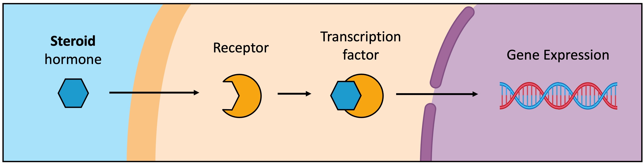
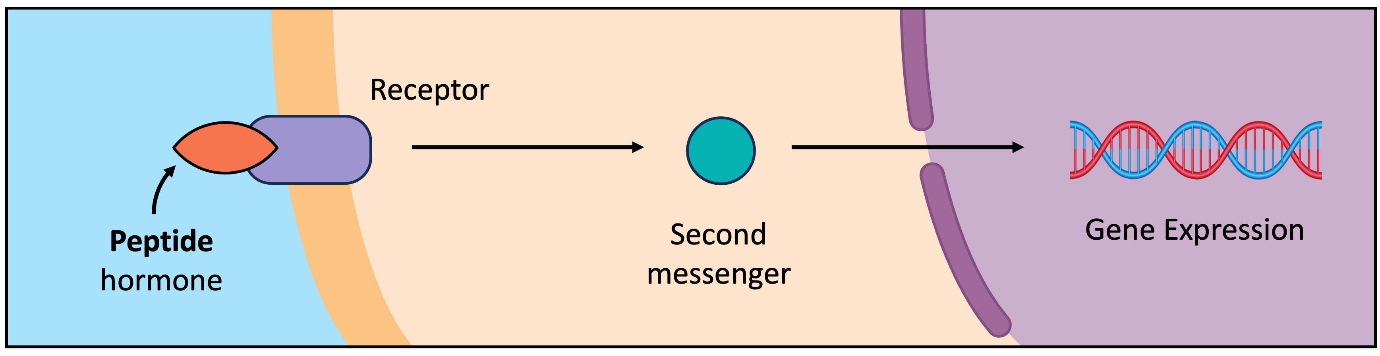
Gene expression can be regulated and impacted by external factors:
Steroid hormones are lipophilic/hydrophobic and can freely cross the plasma membrane to induce changes in gene expression
Bind to receptors in either the cytoplasm or nucleus of the target cell, to form an active receptor-hormone complex
Activated complex will move into the nucleus and bind directly to DNA, acting as a transcription factor for gene expression
C2.1.13
Oestradiol
Progesterone
Peptide hormones induce changes in gene expression, but cannot do so directly as they cannot cross the plasma membrane (as they are lipophobic/hydrophilic)
Thus, they bind to transmembrane receptors on the plasma membrane which activate intracellular second messengers
Via this process of signal transduction, the second messengers can initiate changes to the pattern of gene expression
C2.1.11
Insulin

Slide 10
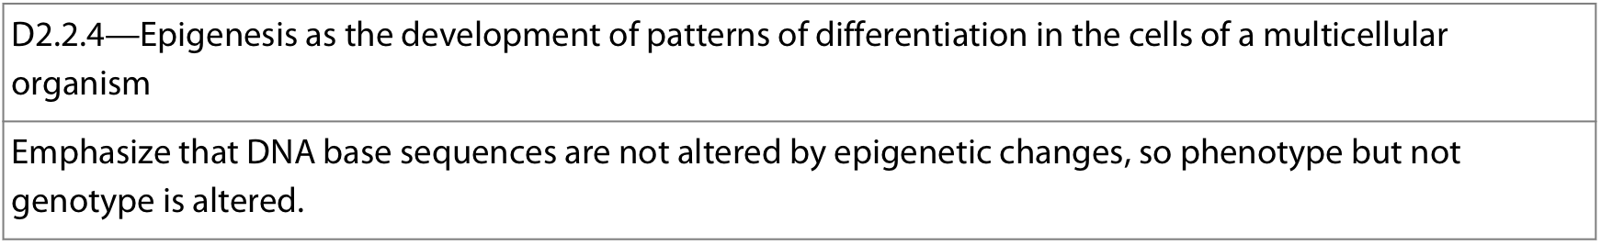
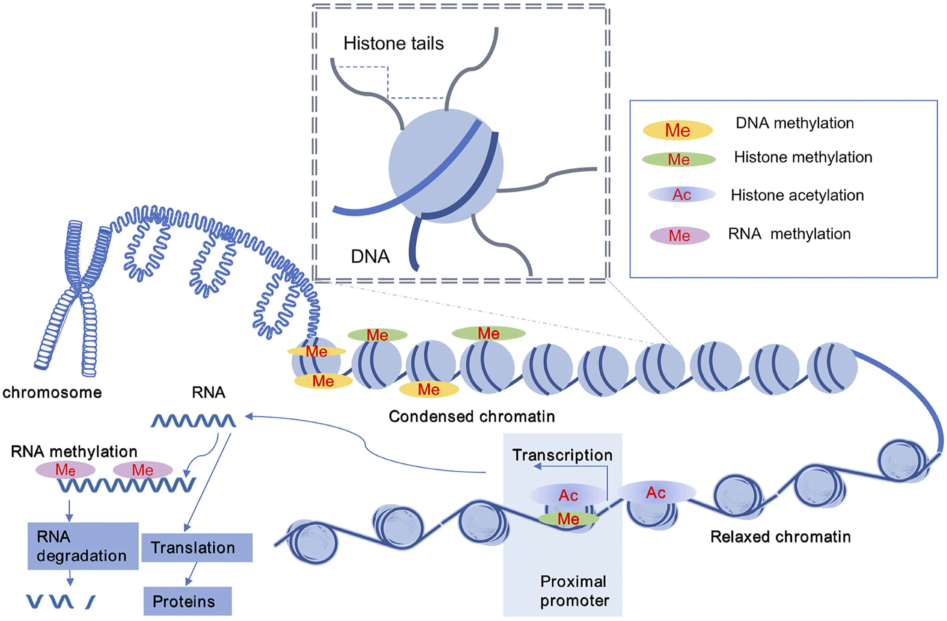
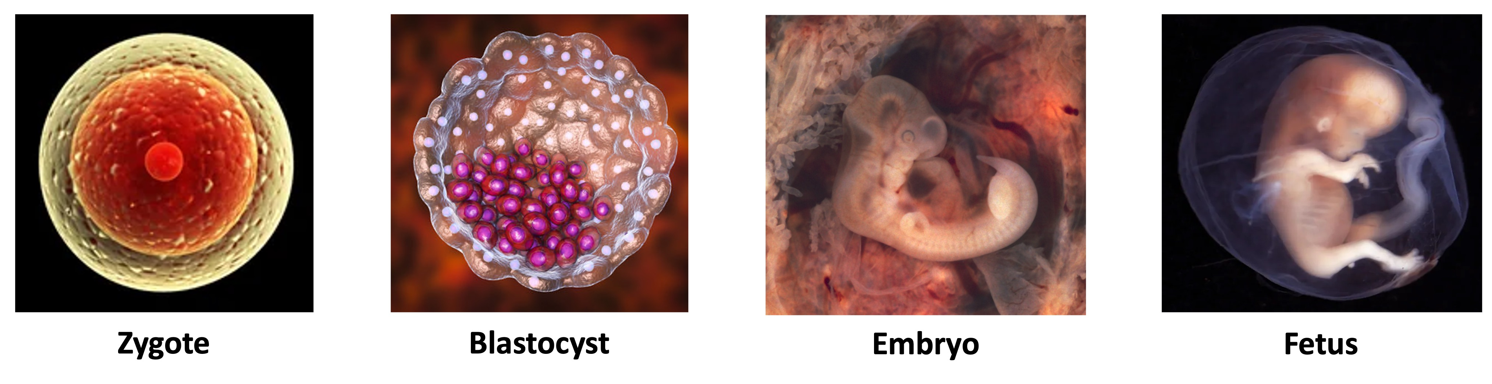
Epigenetics: the study of heritable changes in gene expression that do not involve change to the DNA base sequence
Unlike genetic changes (mutations), epigenetic modifications do not alter the DNA sequence and are potentially reversible
Epigenesis: development of patterns of differentiation in the cells of a multicellular organism
Epigenetic changes involves the addition and removal of epigenetic tags, altering gene expression
Expression of different genes in different cells of a multicellular organism will lead to different transcriptome and proteome → causing different patterns of development
Results in cells having different characteristics even though their base sequences are identical (i.e. the phenotype is altered but not the genotype)
differential gene expression allows an undifferentiated egg cell to differentiate into a complex multicellular organism
Notes:
Etymology: ‘epi’ = above ; ‘genetic’ = genes

Slide 11
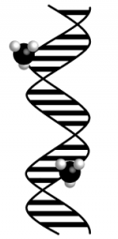
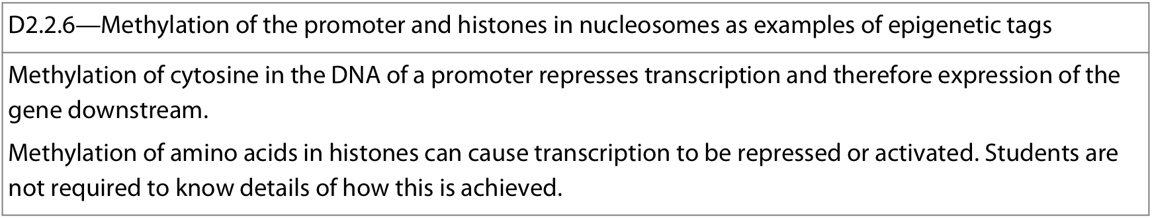
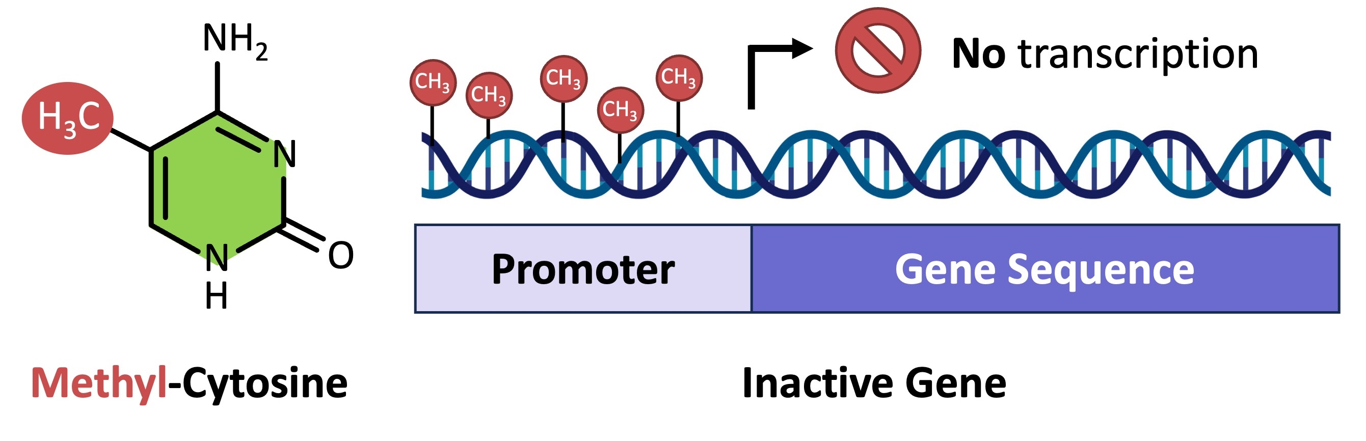
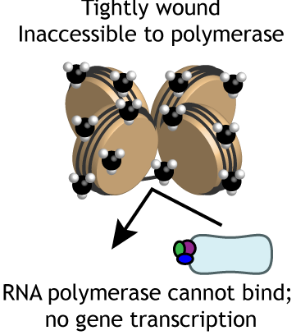
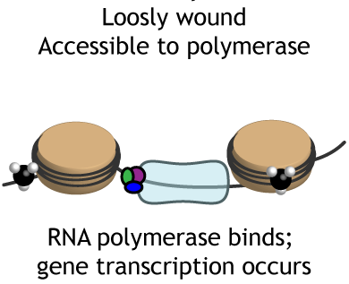
Methylation: When a methyl (-CH₃) group is added/substituted into a molecule, altering its function
Methyl groups act as epigenetic tags and regulate gene expression by either switching genes “on” or “off”
DNA methylation: incorporation of a methyl group to a DNA base in order to change the activity of a DNA segment without changing the base sequence
Methyl groups are added to the promoter region before a gene
Typically, cytosine bases are methylated
DNA methylation impairs the binding of the transcription factors, preventing RNA polymerase from binding
represses transcription of a gene and ∴ reduces gene expression
Histone methylation: incorporation of a methyl group to the amino acids of histone protein ‘tails’ of a nucleosome
Methylation of histone amino acids can cause DNA to coil tightly around the histone → makes it more difficult for RNA polymerase to access the DNA and bind → represses transcription of a gene ∴ reduces gene expression
Methylation of histone amino acids can cause DNA to coil more loosely around the histone → makes it easier for RNA polymerase to access the DNA and bind → activates transcription ∴ increases gene expression
Notes:
Nucleosome structure discussed in A1.2
DNA methylation patterns are heritable through mitosis (when a cell divides), methylation patterns on the parent DNA are copied onto the daughter DNA

Slide 12
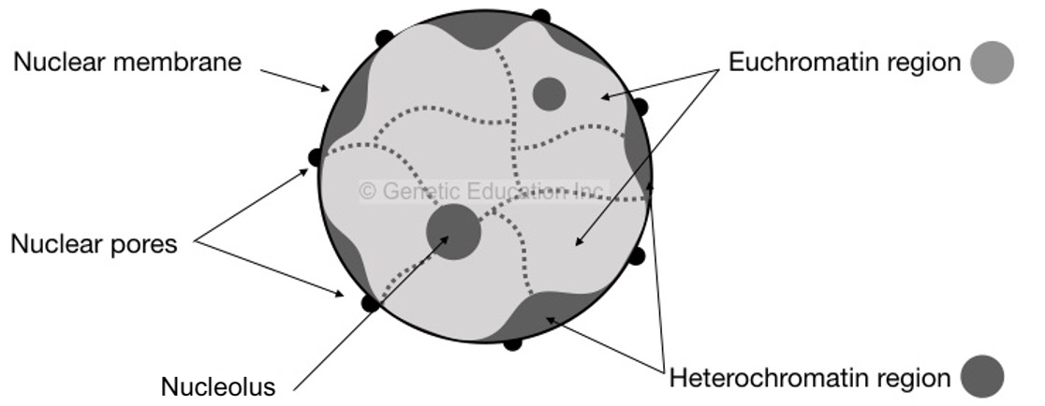
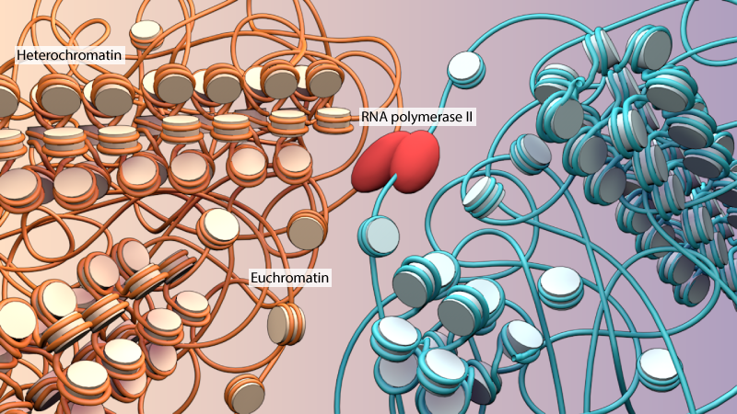


Individual nucleosomes are linked together to form chromatin
→ Histone modifications determine whether a region exists as heterochromatin or euchromatin
When DNA is supercoiled (tightly packed) and not accessible for transcription, it exists as condensed heterochromatin
When the DNA is loosely packed and therefore accessible to the transcription machinery, it exists as euchromatin
Different cell types will have varying segments of DNA packaged as heterochromatin and euchromatin depending on which genes are active within the cell
Some segments of DNA may be permanently supercoiled, while other segments may change over the life cycle of the cell
Notes:
Nucleosome structure discussed in A1.2

Slide 13
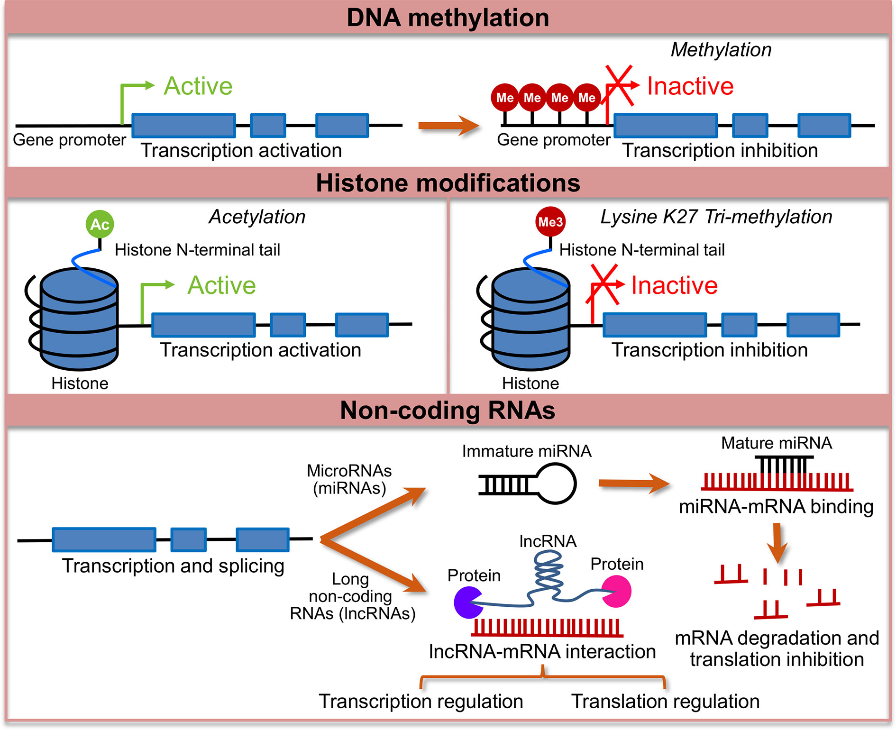
Extra!
Notes:
A summary of how gene expression can be altered

Slide 14
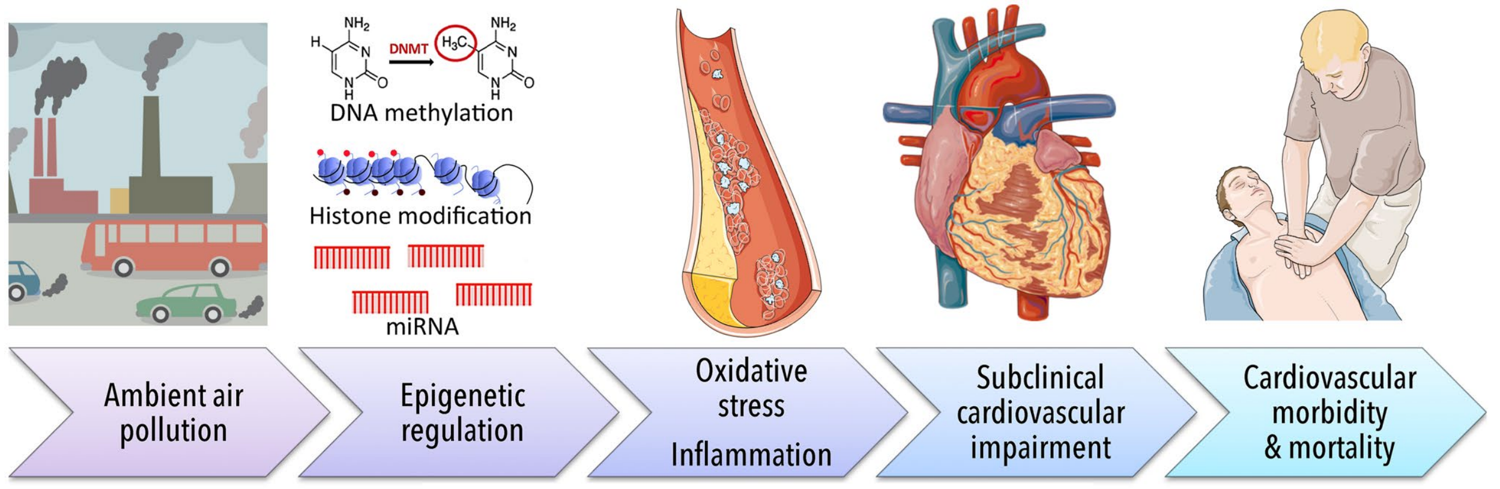
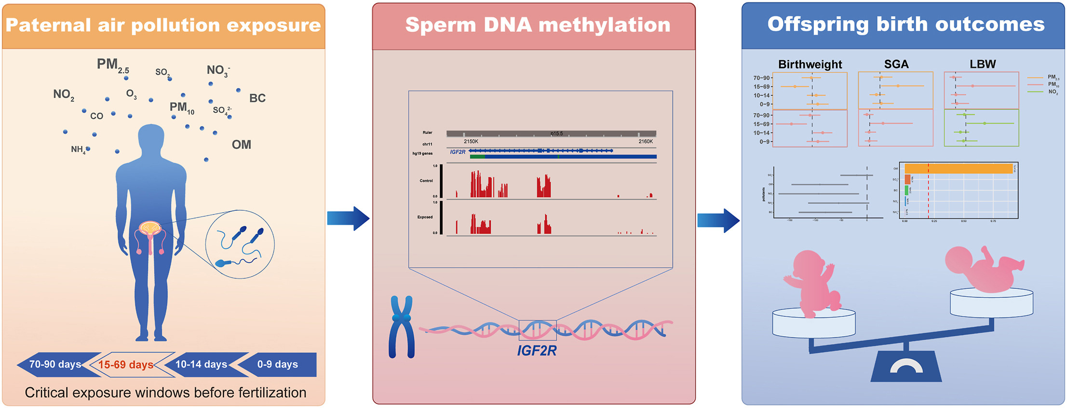
The environment can alter gene expression by altering methyl tags in the epigenome
Environmental factors may regulate DNA methylation by altering the activity of the enzyme DNMT (DNA methyltransferase)
Exposure to air pollution (ex: particulate matter, nitrogen oxides - NOₓ , ozone, polycyclic aromatic hydrocarbons - PAH) can alter the epigenome by altering DNMT activity, thus leading to altered methylation patterns and changes in gene expression:
  In general, air pollution linked to a decrease in methylation across the genome, but some areas show increases
  Air pollution linked to changes in methylation of immunoregulatory genes:
    Increasing inflammation and altering immune profile
    Can result in development of cardiopulmonary complications – such as high blood pressure and several negative respiratory conditions (ex: asthma)
  Note: a change in normal gene expression is a common cause for various forms of cancer
  Air pollution exposure by men shown to alter methylation patterns in sperm, resulting in lower birth weights in their offspring
Notes:
Paper on air pollution and methylation: https://www.researchgate.net/publication/341982781_From_air_pollution_to_cardiovascular_diseases_the_emerging_role_of_epigenetics
Paper on air pollution exposure in children and methylation: https://pmc.ncbi.nlm.nih.gov/articles/PMC7893154/

Slide 15
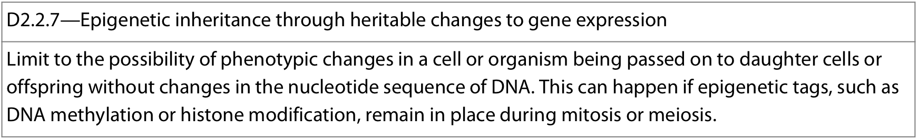
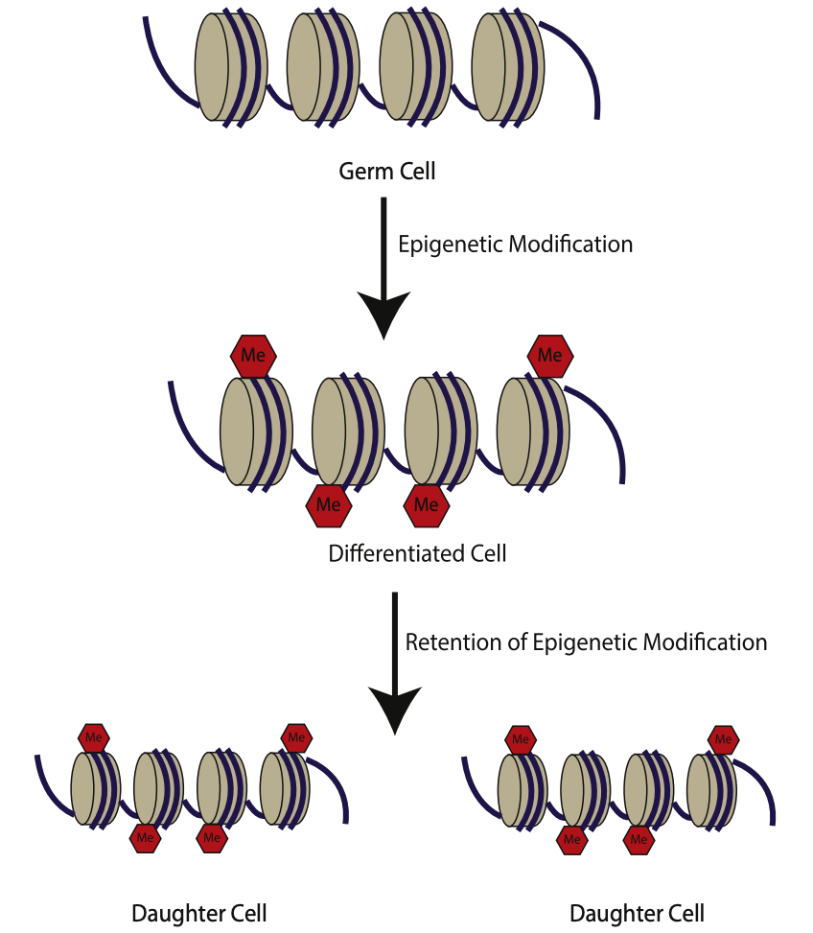
Epigenetic tags (ex: DNA and/or histone methylation) alter gene expression ∴ influence/alter phenotypes
Each cell in a multicellular organism has a specific pattern of epigenetic tags, giving it a specific transcriptome and proteome needed for carrying out its functions
These epigenetic tags are not fixed and can be altered by their environment
Pluripotent (undifferentiated) cell
Epigenetic tags can be passed onto daughter cells:
Early in development, pluripotent cells of the early embryo lack most epigenetic tags. As they differentiate, they acquire tags characteristic of their cell type
When the differentiated cell divides via mitosis, the daughter cells can retain the epigenetic profile of the parental cells and thus maintain the same differentiated cell identity and phenotypic changes without altering the DNA base sequence
This allows new daughter cells to be differentiated for the same functions and changes made to respond to the environment can be conserved

Slide 16
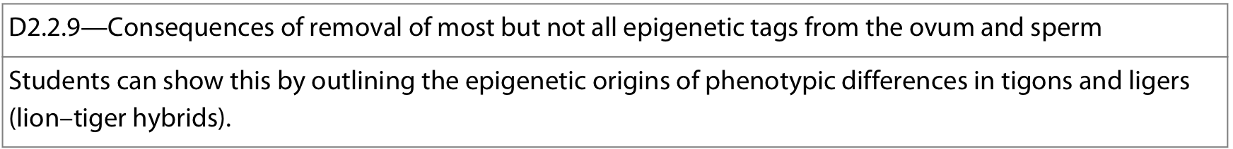
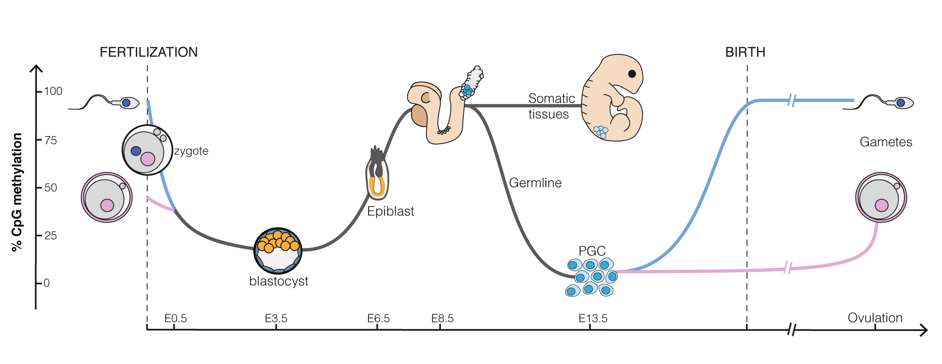
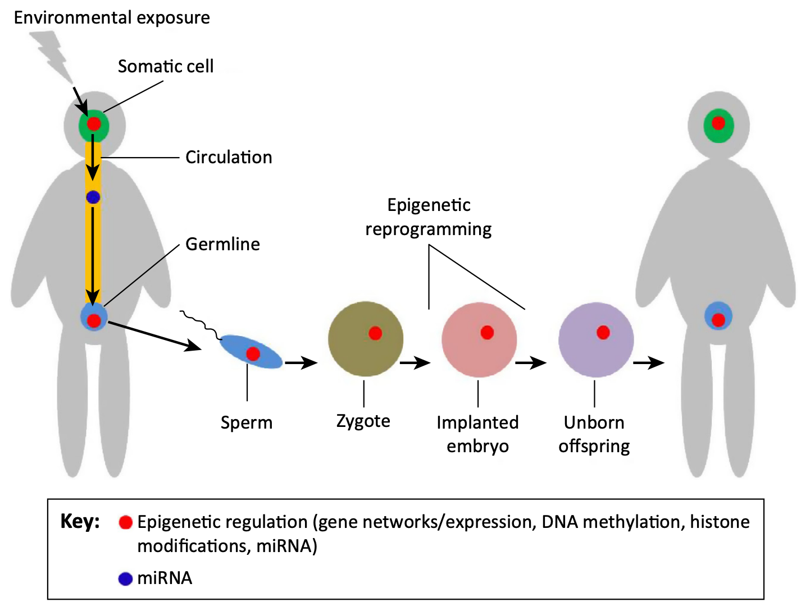
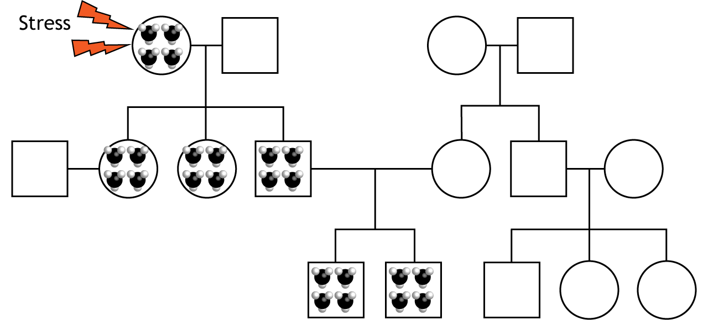
Reprogramming: removal of most pre-existing epigenetic tags occurs in two waves – during gamete formation and again in the zygote shortly after fertilization → returns zygote to genetic 'blank slate’ to ensure that the early embryo can differentiate and form every cell type
A small proportion of genes do not undergo reprogramming during gamete production (meiosis) and remain epigenetically silenced in the egg or sperm
Transgenerational epigenetic inheritance is the passing of epigenetic tags from parent to offspring
Genes that retain their epigenetic tags are called imprinted genes and allow for phenotypic changes in an organism to be potentially passed on to offspring,
allows the possibility that the environment encountered by one generation could have an impact on the gene expression in the next
Notes:
Useful paper on epigentic inheritance: https://sci-hub.se/https://www.sciencedirect.com/science/article/abs/pii/B9780127999586000081

Slide 17
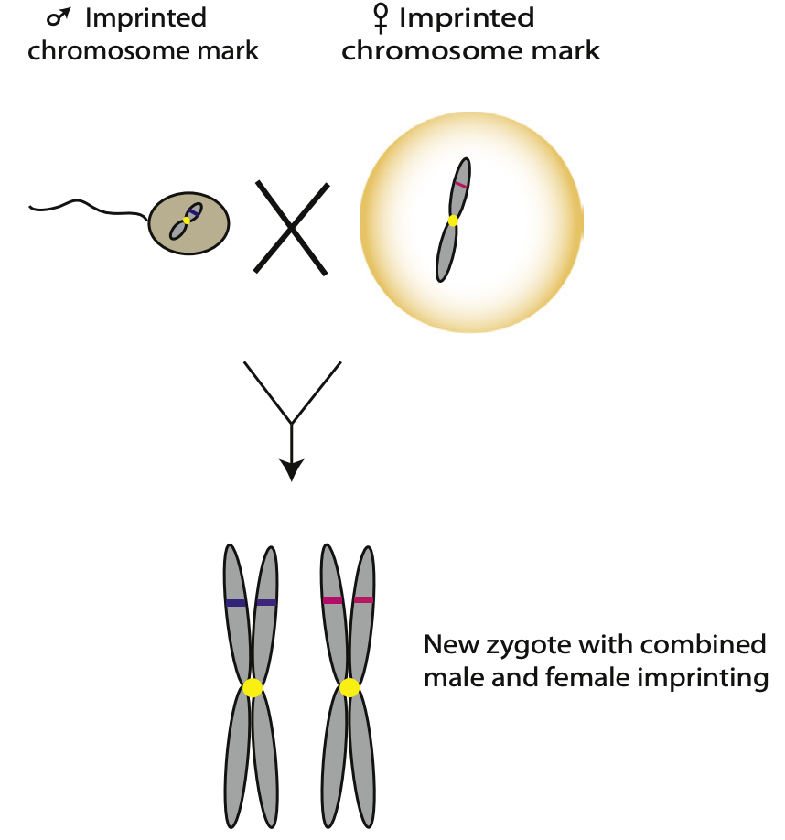
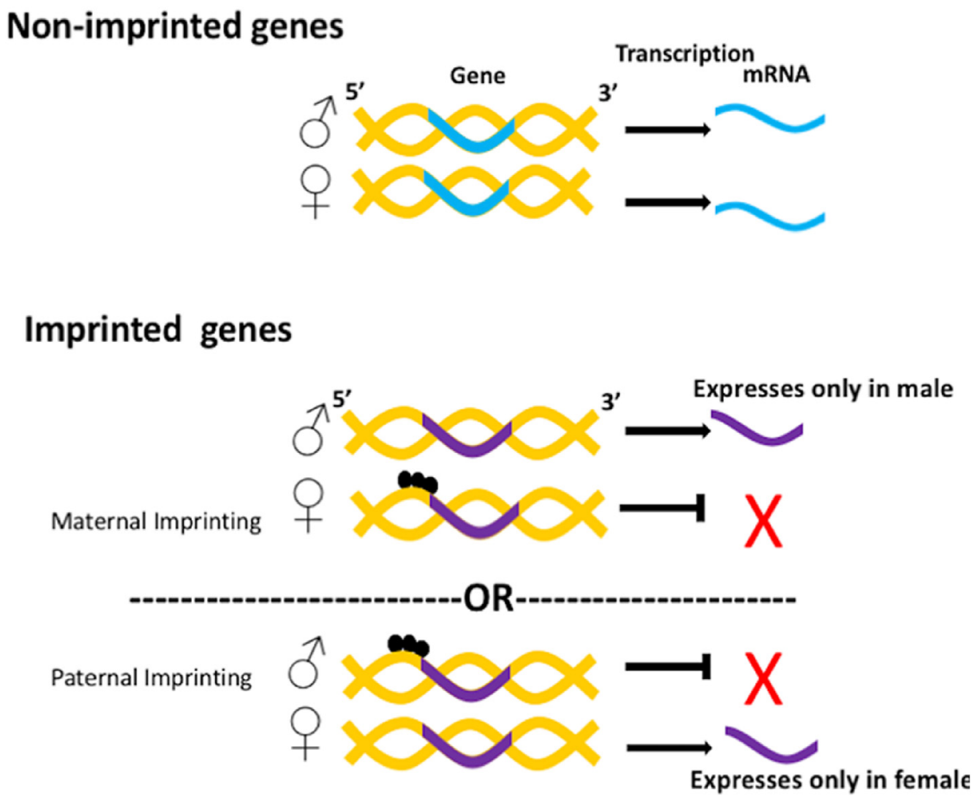
While ~99% of all epigenetic tags are removed during the production of ova and sperm, some persist
this means that some epigenetic tags which alter the expression of genes persist and are passed from parent to offspring → e.g. genomic imprinting: alleles are silenced depending on parent of origin
During gametogenesis (spermatogenesis and oogenesis), epigenetic tags are added to sperm and ova, thereby silencing some genes
For most genes, two copies (alleles) are inherited, one from each parent but with imprinted genes, only one working copy is inherited due to differential silencing from methylation during gametogenesis
  Maternal imprinting: maternal allele is silenced, paternal allele is normally expressed
  Paternal imprinting: maternal allele is normally expressed, paternal allele is silenced

Slide 18
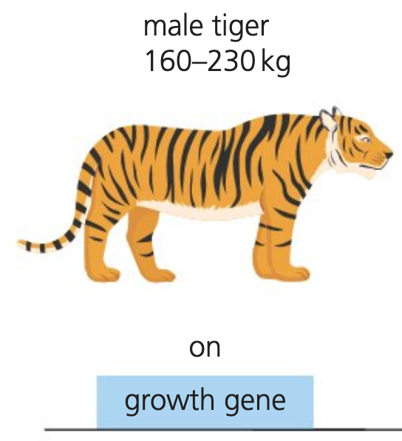
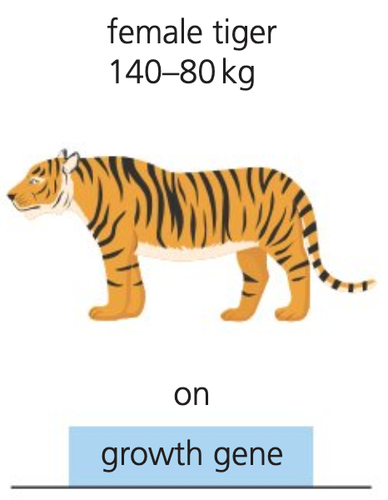
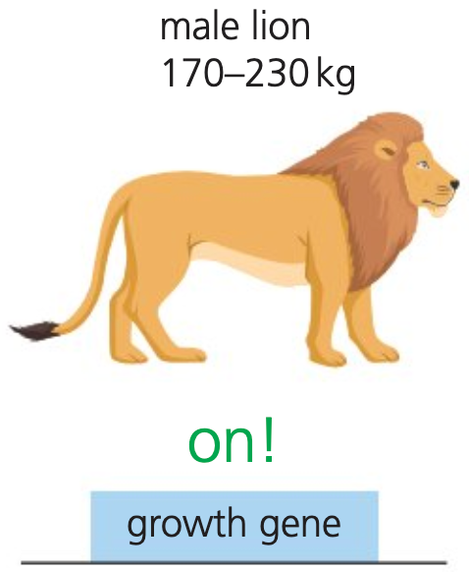
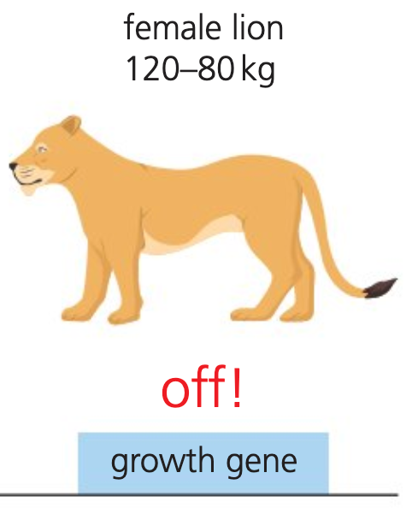




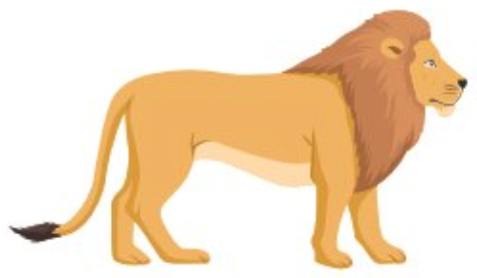


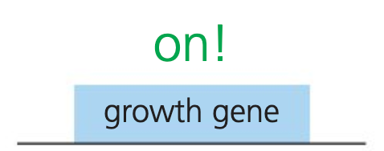
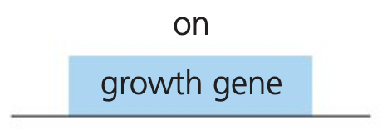


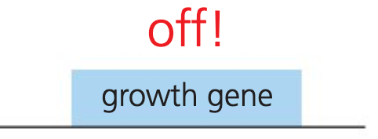

No imprinting in Tigers with respect to growth and size
Imprinting in Lions with respect to growth and size
x
x
Lions live in prides where a single lioness may mate with multiple males and have a litter with cubs from multiple fathers
male lion incentivized to have the largest offspring (so his cubs can outcompete the other littermates) and hence will produce sperm containing imprinted genes that promote growth
lioness incentivized to have smaller offspring (in order to achieve a successful pregnancy that prioritizes all cubs equally) and will produce eggs containing imprinted genes that restrict growth
The imprints cancel each other out and cubs are similar size to their parents
Tigers are solitary animals, and a tigress will only produce a litter with cubs from a single male tiger
Therefore, reproductive goals of the male tiger and female tigress are the same and there is no need for imprinted genes to develop in this species
Neither gene is imprinted, and offspring grow in similar size to their parents
Notes:
“incentivized” reflects evolutionary selection, not conscious behaviour

Slide 19
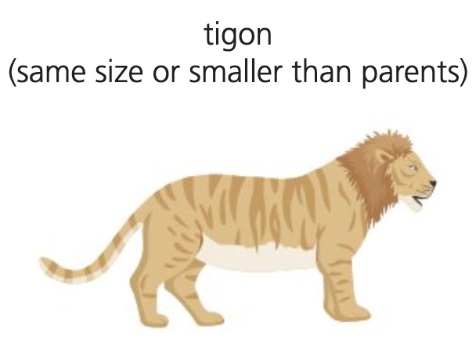
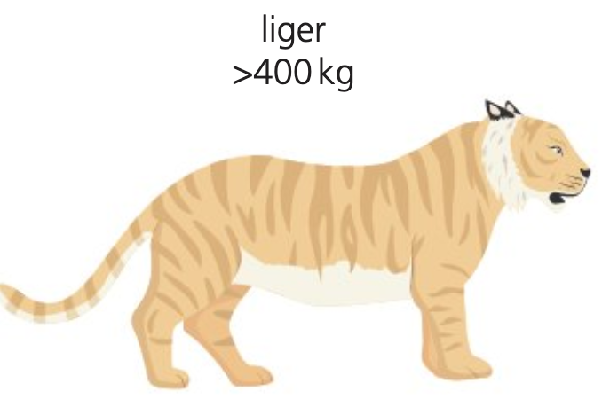
Male lion + Female tiger → Liger
Male tiger + Female lion → tigon
x
x
Lion sperm (imprinted to promote growth) is combined with a tiger egg (no growth-related imprinting)
results in a VERY LARGE offspring, larger than both parents
Tiger sperm (without growth-related imprinting) is combined with a lion egg (imprinted to suppress growth)
results in a medium-small offspring, normal size or smaller size compared to either parent

Slide 20


Monozygotic (MZ) twins (aka identical twins) are formed by the splitting of an early-stage embryo to form two natural genetic clones
While the twins are born identical, they will develop different phenotypes due to exposure to different environments and thus acquiring a different epigenome
As both twins share the same genome and genetic profile, any changes in their phenotypes will be due to the environment
In MZ twin studies, differentially methylated regions (DMR) are identified between the twins in order to explain potential differences they have in phenotypes (and disease prevalence) and therefore the effects of the environment on gene expression and phenotype as their genotype is controlled
Ex: DNA methylation patterns were compared between MZ twin pairs aged 3 and pairs aged 50. The results demonstrate a significant difference in methylation patterns as MZ twins aged

Slide 21


Slide 22

Answers:

